Slide 1


Slide 2

Unit
8
SHOPPING
LESSON 6: SKILLS 2
1

Slide 3
LESSON 1: GETTING STARTED
WARM-UP
Warm up
Listening
PRESENTATION
Task 1: Work in pairs. Discuss and tick (v) the things related online shopping.
Task 2: Listen to a talk about online shopping and fill in each blank with a suitable word.
Task 3: Listen to a talk about online shopping and fill in each blank with a suitable word.
PRACTICE
Writing
Task 4: Work in pairs. Choose a type of shopping from the list. Discuss and take notes of its advantages and disadvantages.
Task 5: Write a paragraph (80-100 words) about the advantages or disadvantages of a type of shopping. Use the ideas in 4.
PRODUCTION
CONSOLIDATION
Wrap-up
Homework

Slide 4

CHATTING
WARM-UP
Have you ever shopped online?
What do you need to shop online?

Slide 5


PRESENTATION
VOCABULARY
access (n)
/ˈækses/
Quyền truy cập vào

Slide 6
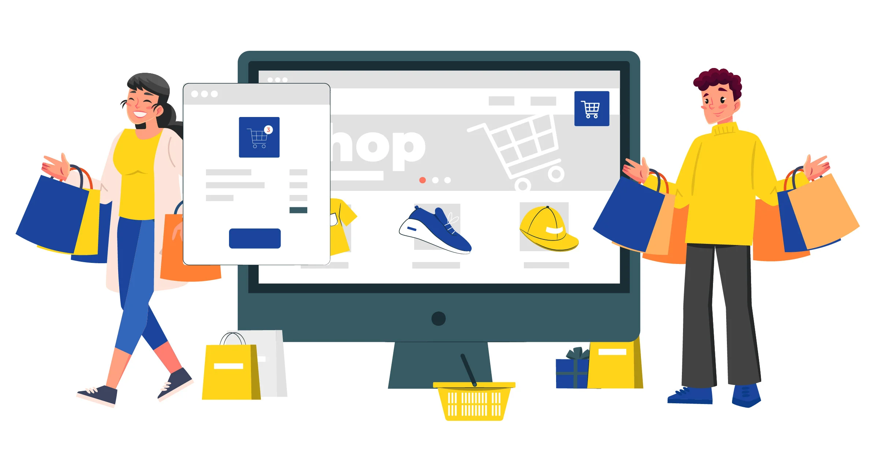
PRESENTATION
VOCABULARY
purchase (v)
/ˈpɜːtʃəs/
Mua sắm

Slide 7
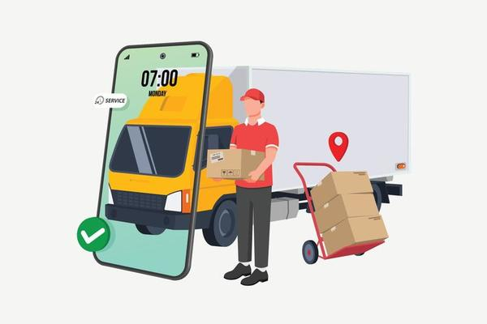
PRESENTATION
VOCABULARY
shipping (n)
/ˈʃɪpɪŋ/
Việc chuyển hàng,
giao hàng

Slide 8

PRESENTATION
VOCABULARY
overshopping (v)
/ˈəʊvə(r) ˈʃɒpɪŋ/
Mua sắm quá đà

Slide 9


PRESENTATION
I. LISTENING
1
Work in pairs. Discuss and tick the things related to online shopping.
1. internet access
2. travelling
a smartphone/ laptop
a smartphone/laptop

Slide 10
PRACTICE
I. LISTENING
2
Listen to a talk about online shopping and fill in each blank with a suitable word.
service
You can buy a product or ___________ online.
When shopping online, you visit a _________ website.
Online shopping helps you save time and ___________.
If you return a product, you still must pay for the ___________.
Shopping online can make you become a ___________.
seller’s
money
shipping
shopaholic

Slide 11

PRACTICE
I. LISTENING
3
Listen again and choose the correct answer A, B, or C.
1. When you shop online, you can pay______ ways.
A. one B. two C. three
2. The talk does NOT describe online shopping as_______.
convenient B. ease C. interesting
3. The talk is mainly about _______ of online shopping.
A. always B. sometimes C. rarely

Slide 12
PRODUCTION
II. WRITING
4
Work in pairs. Choose a type of shopping from the list. Discuss and take notes of its advantages and disadvantages.
1. Shopping online
2. Shopping at a supermarket
3. Shopping at an open-air market

Slide 13

PRODUCTION
II. WRITING
5
Write a paragraph (80-100 words) about the advantages or disadvantages of a type of shopping. Use the ideas in 4.
You can use the suggestions below:
Shopping…….. is interesting/ convenient/ safe/ ………
Firstly, ……
Secondly, …..
Writing

Slide 14
PRODUCTION
II. WRITING
5
Write a paragraph (80-100 words) about the advantages or disadvantages of a type of shopping. Use the ideas in 4.
Sample writing:
I often go shopping at the open-air market near my house. However, there are some things I don’t like about it. First, it is outdoor. On rainy or hot days, it is uncomfortable to shop. Secondly, the sellers usually ask for a higher price than the value of the goods and you have to bargain. It’s not easy if you don’t know the actual price of an item. Another disadvantage is hygiene. Fresh products like vegetables are often not very clean.

Slide 15

CONSOLIDATION
1
Wrap-up
What have we learnt in this lesson?
Online shopping
Advantages or disadvantages of a kind of shopping.

Slide 16

CONSOLIDATION
2
Homework
Learn the new words by heart.
Rewrite the paragraph about the advantages or disadvantages of a type of shopping.
Do Exercise ………..page ……Unit 8/Workbook

Slide 17

Website: hoclieu.vn
Fanpage: facebook.com/sachmem.vn/

