Slide 1
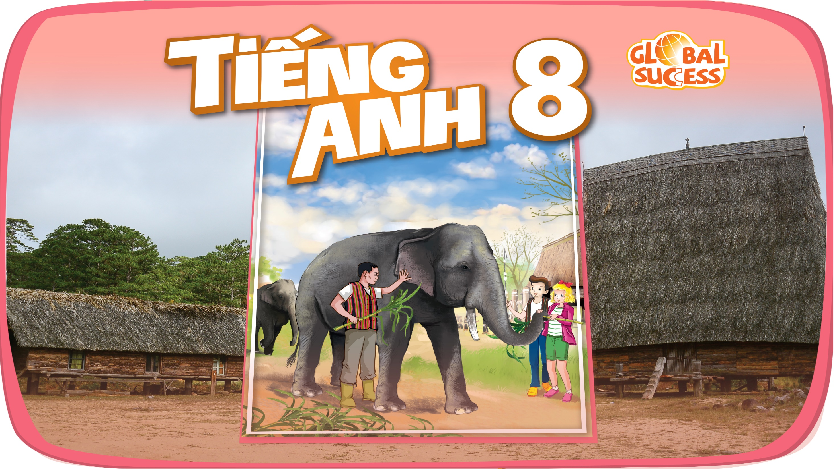

Slide 2

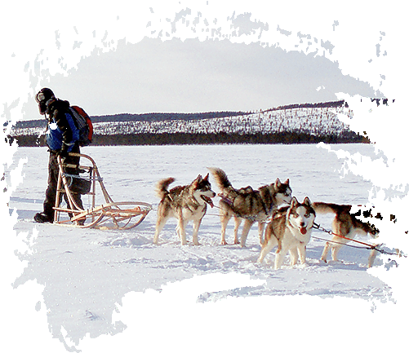
Unit
6
LIFESTYLES
LESSON 5: SKILLS 1
1

Slide 3
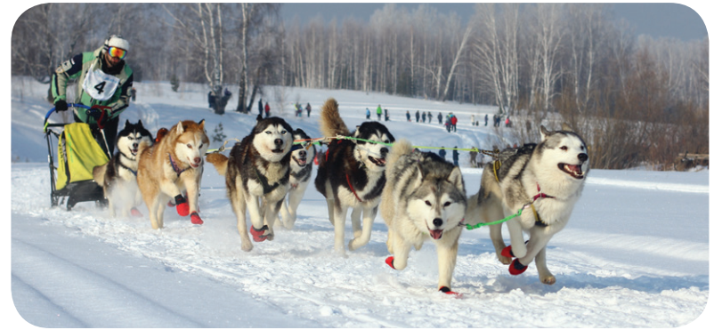
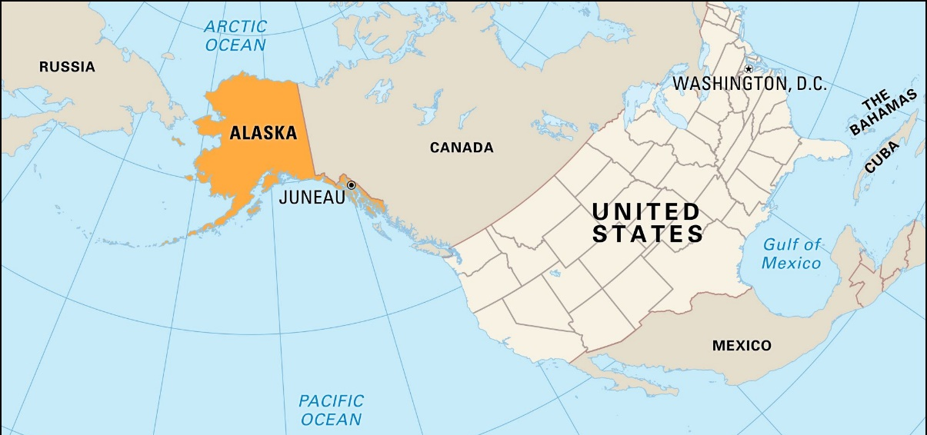
WARM-UP
1
Work in groups. Look at the picture, and discuss what you know about Alaska.
Location?
Climate?
Native people?
Language?
Cuisine?
Culture?

Slide 4
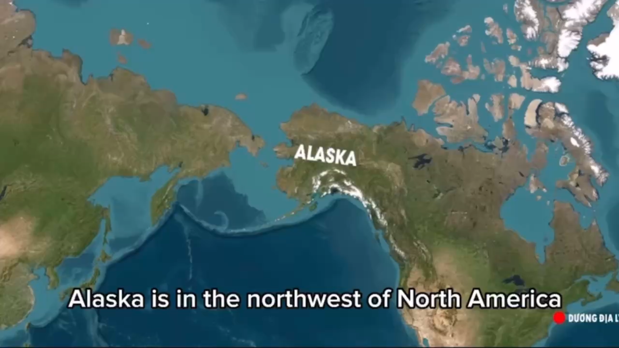

Slide 5
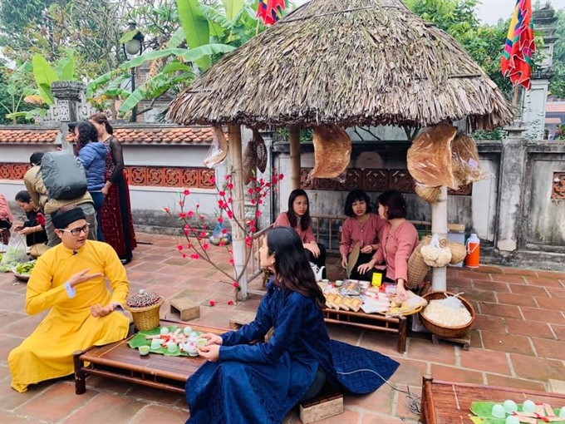

READING
maintain (v)
﻿/meɪnˈteɪn/
duy trì, gìn giữ

Slide 6
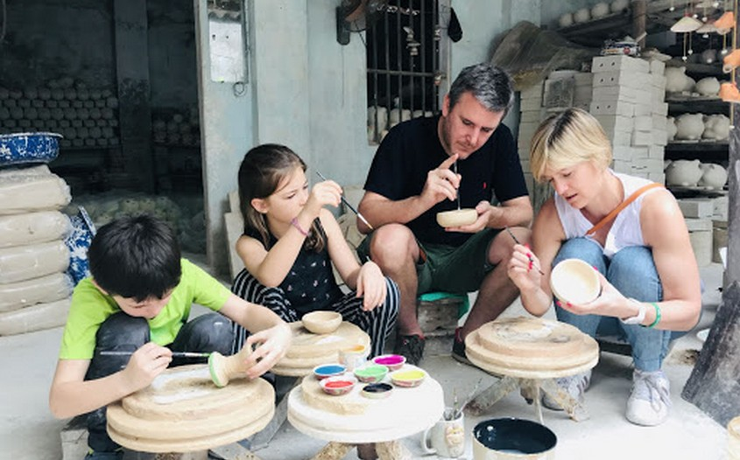
READING
experience (v)
﻿/ɪkˈspɪəriəns/
trải nghiệm

Slide 7
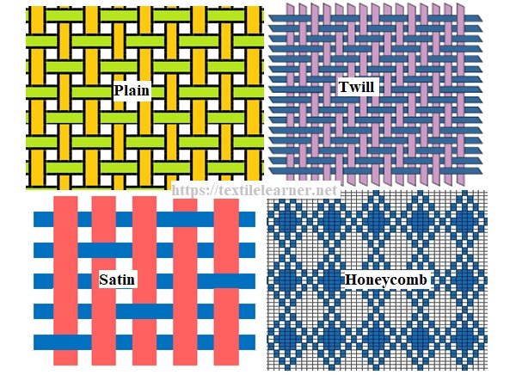
READING
style (n)
﻿/﻿staɪl/
phong cách

Slide 8
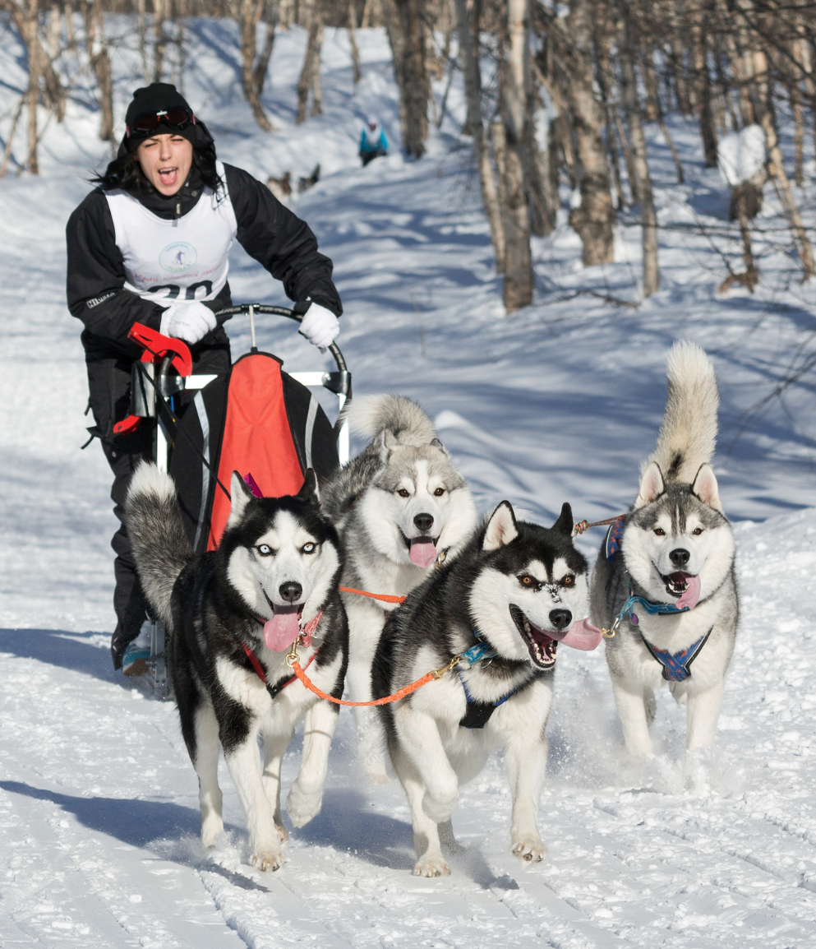
READING
musher (n)
﻿/﻿﻿ˈmʌʃə/
người điều khiển
xe trượt tuyết chó kéo

Slide 9
READING
New words | Pronunciation | Meaning
1. maintain (v) | ﻿/meɪnˈteɪn/ | ﻿duy trì, gìn giữ
2. experience (v) | ﻿/ɪkˈspɪəriəns/ | ﻿trải nghiệm
3. style (n) | /﻿staɪl/ | phong cách
4. musher (n) | ﻿/ˈmʌʃə/ | ﻿người điều khiển xe trượt tuyết chó kéo

Slide 10
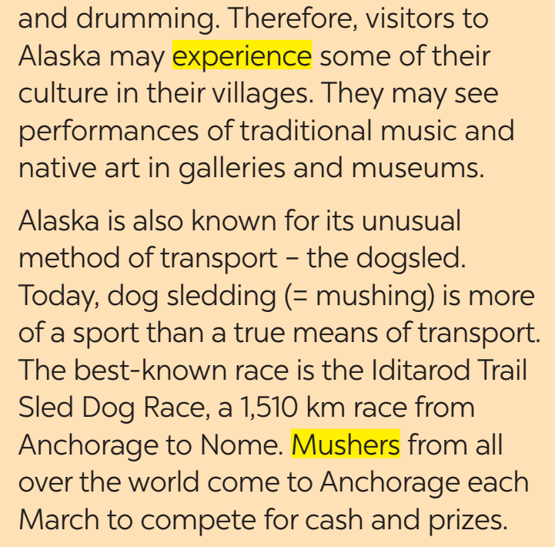
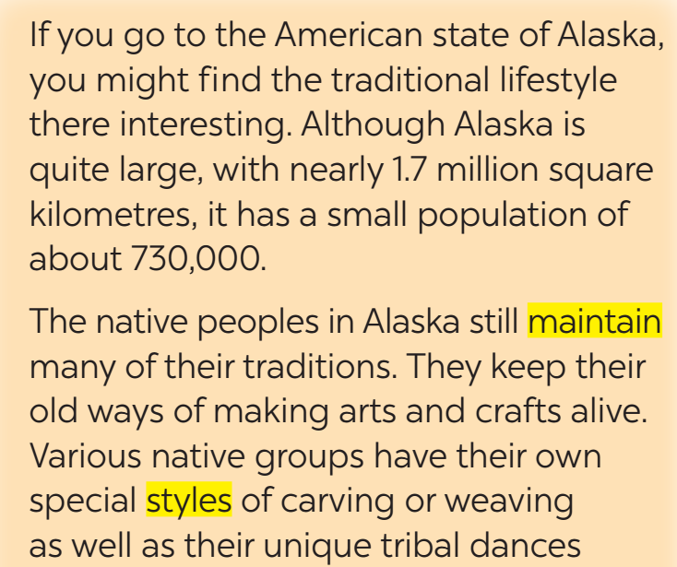
READING
2
Match the highlighted words in the text with their meanings.

Slide 11
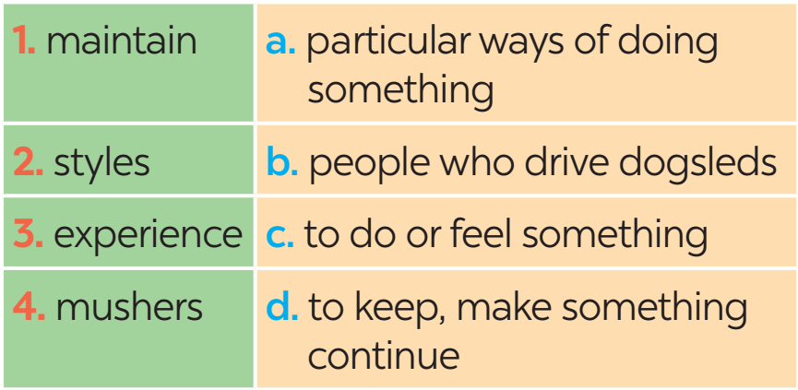
READING
2
Match the highlighted words in the text with their meanings.

Slide 12
Mr Nam, grandfather, a 70-year-old farmer
I was one of the few children in my village who was still at school at the age of 15. Every dgay, I got up early and walked to school. Learning then depended mostly on our teachers and textbooks. We had no library or lab. The nearest bookshop was six kilometres away. I learned simply by taking notes during class, memorisingthem, and doing the homework. Life then was simple. We rarely travelled outside our village, so we didn’t know much about the world around us.
READING
3
Read the passages and choose the correct answer A, B, C, or D.
1. Alaska is a very large state with an area of about , ______.
A. 730,000 square kilometres
B. 1.7 thousand square kilometres
C. 1,510 square kilometres
D. 1.7 million square kilometres
2. What do native peoples in Alaska still keep today?
A. Modern lifestyles only
B. Their old traditions
C. New technology
D. Foreign cultures

Slide 13
Mr Nam, grandfather, a 70-year-old farmer
I was one of the few children in my village who was still at school at the age of 15. Every dgay, I got up early and walked to school. Learning then depended mostly on our teachers and textbooks. We had no library or lab. The nearest bookshop was six kilometres away. I learned simply by taking notes during class, memorisingthem, and doing the homework. Life then was simple. We rarely travelled outside our village, so we didn’t know much about the world around us.
READING
3
Read the passages and choose the correct answer A, B, C, or D.
3. Visitors to Alaska can experience native culture by _______.
A. shopping in big cities
B. watching TV programmes
C. seeing traditional music and art
D. joining dog races
4. Where can visitors see native art in Alaska?
A. In galleries and museums
B. Only at home
C. Only in schools
D. On the Internet

Slide 14
Mr Nam, grandfather, a 70-year-old farmer
I was one of the few children in my village who was still at school at the age of 15. Every dgay, I got up early and walked to school. Learning then depended mostly on our teachers and textbooks. We had no library or lab. The nearest bookshop was six kilometres away. I learned simply by taking notes during class, memorisingthem, and doing the homework. Life then was simple. We rarely travelled outside our village, so we didn’t know much about the world around us.
READING
3
Read the passages and choose the correct answer A, B, C, or D.
5. Mushers from all over the world come to Anchorage in March to _______.
A. learn about native culture
B. travel with their families
C. compete for prizes
D. watch traditional dances

Slide 15

PRACTICE
4
Read the conversation again and tick T (True) or F (False).
Sentences | T | F
1. Alaska is a very large state.
2. Alaska has a very big population.
3. Native people in Alaska still keep many of their traditions.
4. Visitors can see traditional music and art in Alaska.
5. Dog sledding is only used as a means of transport today.
Alaska has a small population.
Dog sledding is more of sport than a means of transport today.

Slide 16
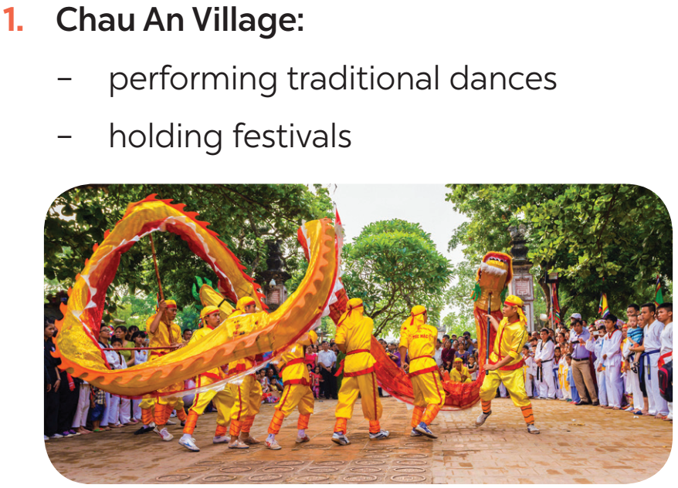
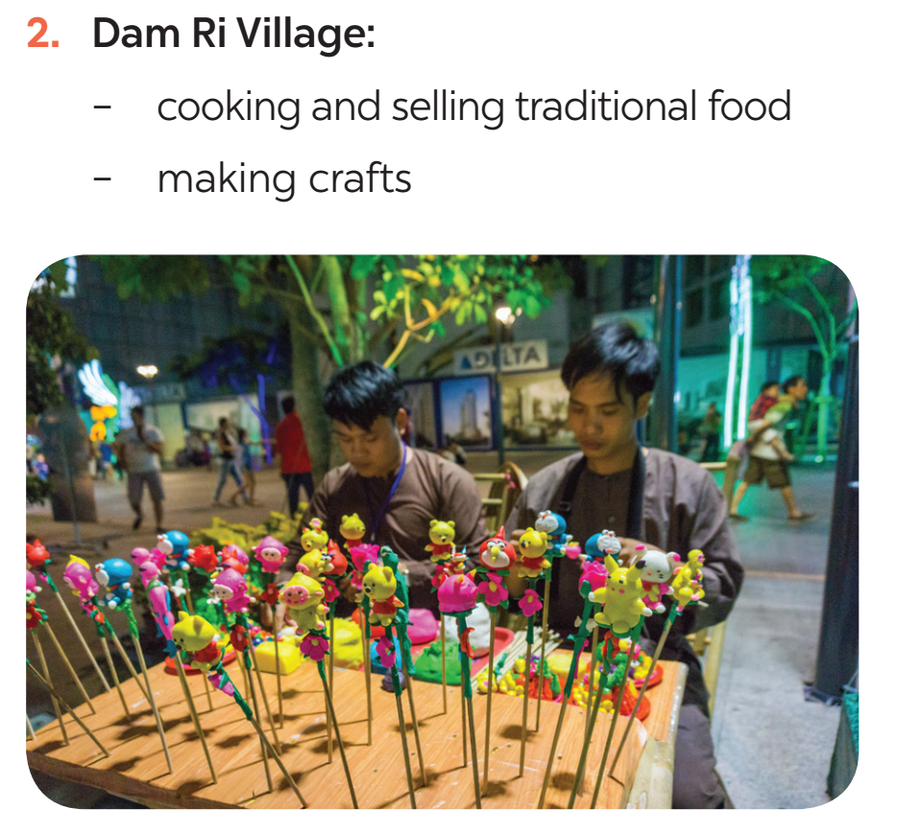
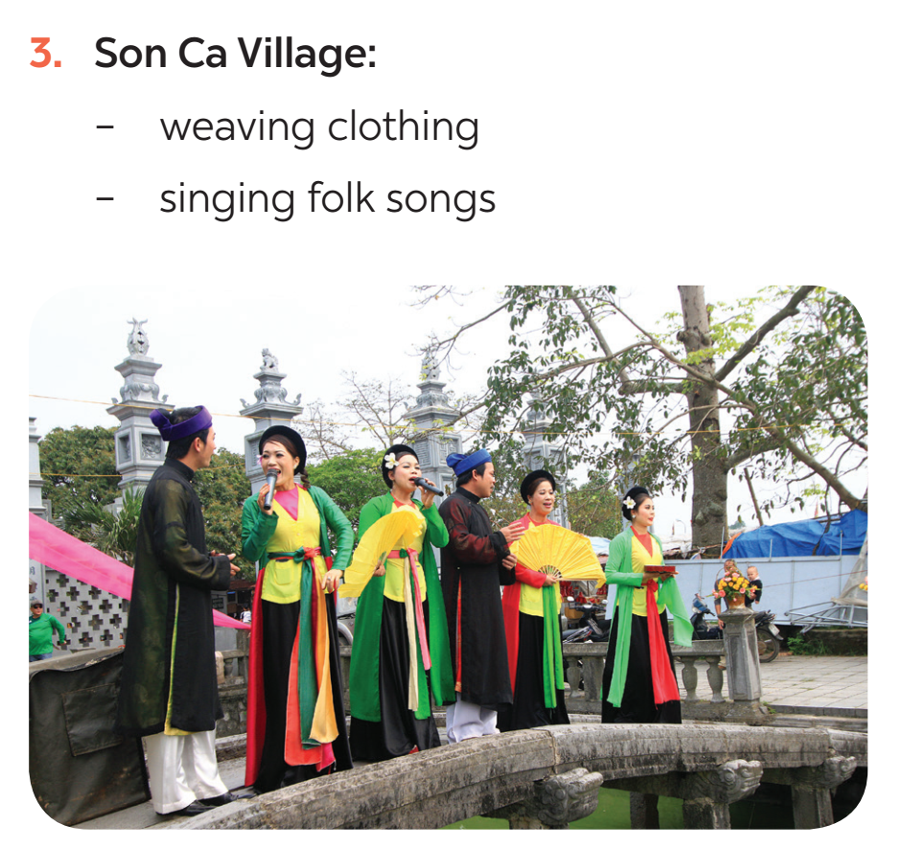
SPEAKING
4
Work in pairs. Look at the pictures and use the cues to talk about what people in some places do to maintain their traditional lifestyle.

Slide 17

SPEAKING
5
Work in pairs. Ask and answer about how people in your area maintain their traditional lifestyle. You can use the ideas in 4 and the reading text in 1.
Example:
I live in Bat Trang, which is a pottery village not far from Ha Noi centre. To maintain the traditional lifestyle, local people will make pottery and paint on the ceramic statues. Then they will sell those pottery products to tourists.

Slide 18

CONSOLIDATION
1
Wrap-up
What have we learnt in this lesson?
Read about Alaska
Talk about ﻿how people in their area maintain traditional lifestyles

Slide 19

CONSOLIDATION
2
Homework
Students’ workbook.

Slide 20

Website: hoclieu.vn
Fanpage: facebook.com/www.tienganhglobalsuccess.vn/

