Slide 1



Slide 2
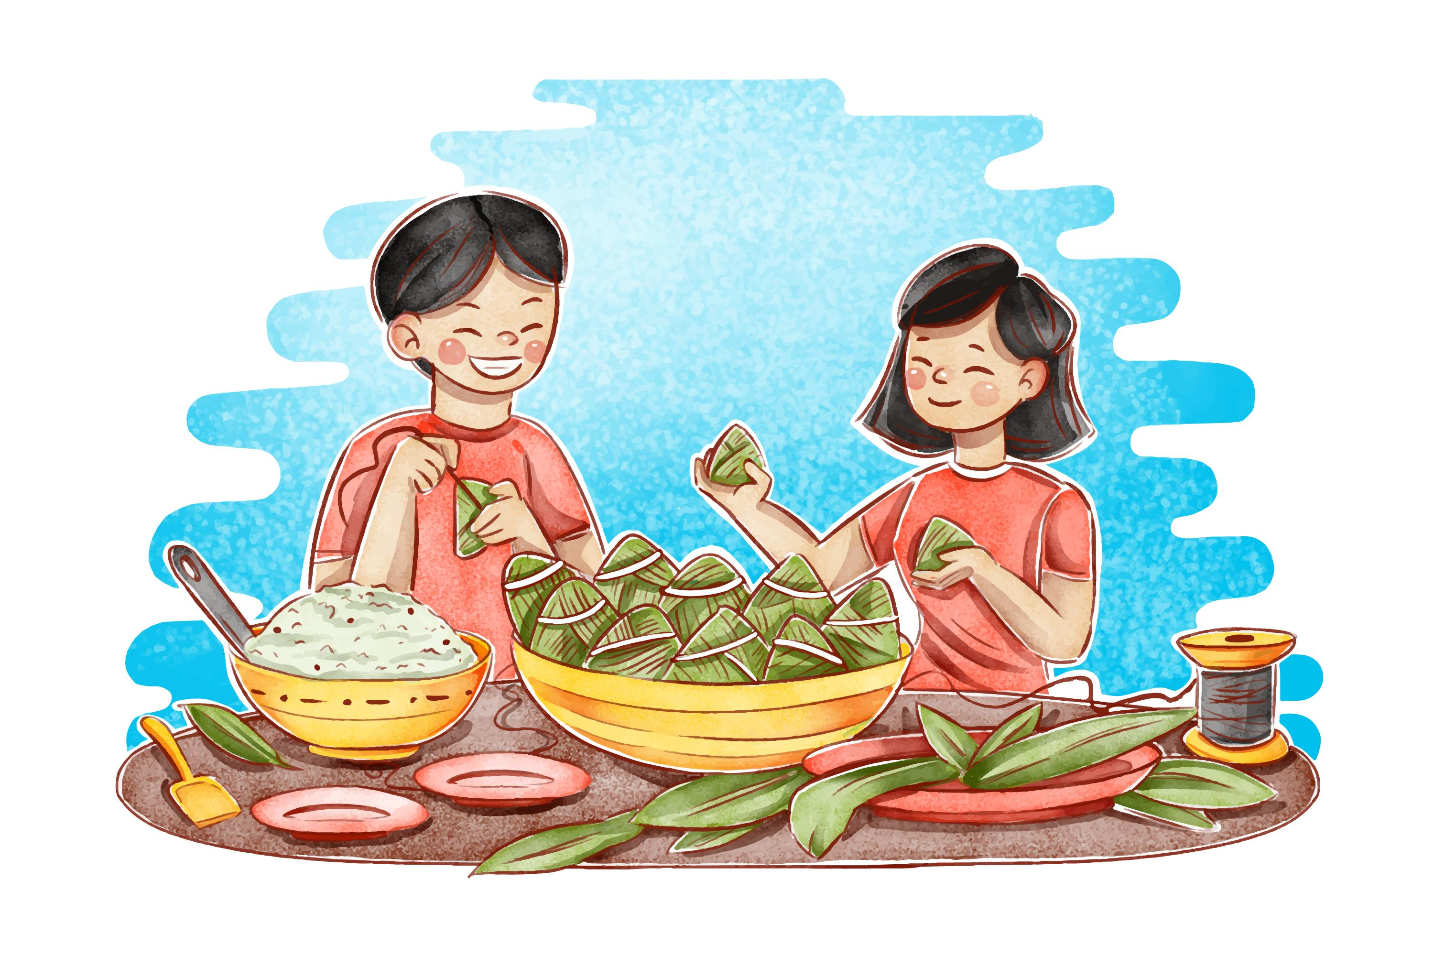


Unit
6
VIETNAMESE LIFESTYLE:
THEN AND NOW
LESSON 7: LOOKING BACK & PROJECT

Slide 3
VOCABULARY
1
Choose the correct answer A, B, C, or D to complete each sentence.
1. I love animals and I’m determined to ______ my dream of becoming a vet.
A. have
B. pursue
C. do
D. depend on
2. ______ people tend to put the needs of their families ahead of their own.
A. Independent
B. Democratic
C. Kind
D. Family-oriented

Slide 4
VOCABULARY
1
Choose the correct answer A, B, C, or D to complete each sentence.
3. Rapid changes in society and lifestyle have made the ______ in many families wider.
A. generation gap
B. family relation
C. family values
D. experiences
4. She has found ______ sources of information about life in Viet Nam a century ago.
A. extended
B. alive
C. various
D. long

Slide 5
VOCABULARY
1
Choose the correct answer A, B, C, or D to complete each sentence.
5. Like adults, children sometimes want some ______.
A. opportunity B. relations C. values D. privacy

Slide 6
VOCABULARY
2
Complete the sentences with the correct forms of the words in brackets.
1. My parents taught me not to listen to other people’s _______ conversations. (privacy)
private
2. It’s amazing that the boy can __________ all the information in such a short time. (memory)
memorise
3. Living away from home to attend college has made me more ____________. (independence)
independent

Slide 7
VOCABULARY
2
Complete the sentences with the correct forms of the words in brackets.
4. In a modern society, we learn to value a person’s _________. (free)
freedom
5. In a ____________ classroom, every student has the right to speak as well as the responsibility to listen to others. (democracy)
democratic

Slide 8
GRAMMAR
3
Circle the correct words or phrases to complete the following sentences.
1. Do you mind turning / to turn the volume down? I’m studying.
2.We decided spending / to spend this whole week learning to cook traditional foods
3. If you want seeing / to see the differences between the past and the present of a city, visit its museum.
4. He stayed in his room to avoid meeting / to meet his parents’ guests.
5. My brother promised taking / to take me to the exhibition of traditional farming tools.

Slide 9
GRAMMAR
4
4
Make complete sentences from the clues. Make any changes and add more words if necessary.
3. even / grandmother / enjoy / use / Facebook / communicate / her friends.
1. we / plan / visit / historical places / Cao Bang.
We plan / are planning to visit some historical places in Cao Bang.
4. last year / I / learn / make cakes / watch / cooking videos / Internet.
2. we / hope / have / bus station / near / village / soon.
We hope to have a bus station near our village soon.

Slide 10
GRAMMAR
4
Make complete sentences from the clues. Make any changes and add more words if necessary.
3. even / grandmother / enjoy / use / Facebook / communicate / her friends.
Even my grandmother enjoys using Facebook to communicate with her friends.
4. last year / I / learn / make cakes / watch / cooking videos / Internet.
5. this morning / I / suggest / do a survey / northern women’s traditional costumes.
Last year, I learned to make cakes by watching cooking videos on the Internet.

Slide 11
GRAMMAR
4
Make complete sentences from the clues. Make any changes and add more words if necessary.
5. this morning / I / suggest / do a survey / northern women’s traditional costumes.
This morning, I suggested doing a survey on northern women’s traditional costumes

Slide 12

CONSOLIDATION
1
Wrap-up
What have we learnt in this lesson?
Review the vocabulary and grammar of Unit 6;
Apply what they have learnt (vocabulary and grammar) into practice through a project.

Slide 13

CONSOLIDATION
2
Homework
- Prepare for the next lesson.

Slide 14
Website: hoclieu.vn
Fanpage: facebook.com/tienganhglobalsuccess.vn/

