Slide 1

WELCOME TO OUR CLASS!
Presented by: …..

Slide 2
REVIEW 3
Lesson 2: Skills

Slide 3

Reading

Slide 4


1. Read the following passage and choose the correct answer A, B, C, or D to each question.

Slide 5
1. Read the following passage and choose the correct answer A, B, C, or D to each question.
1. What skill can you improve when you read in English?
A. Social. B. Speaking.
C. Writing. D. Listening.
2. The phrase ‘figure out’ in the passage probably means ______.
A. understand B. try out
C. look up D. use
Notes:
1. C 2. A 3. B 4. D 5. D

Slide 6
1. Read the following passage and choose the correct answer A, B, C, or D to each question.
3. You can guess the meaning of a new word from the ______.
A. phrase B. context C. grammar D. notebook
4. The word ‘which’ in the passage refers to ______.
A. dictionary B. copy C. meanings D. words
5. The writer’s advice for English readers is to ______.
A. buy a dictionary C. show how to use words
B. find new words D. keep a vocabulary list
Notes:
1. C 2. A 3. B 4. D 5. D

Slide 7

Speaking

Slide 8
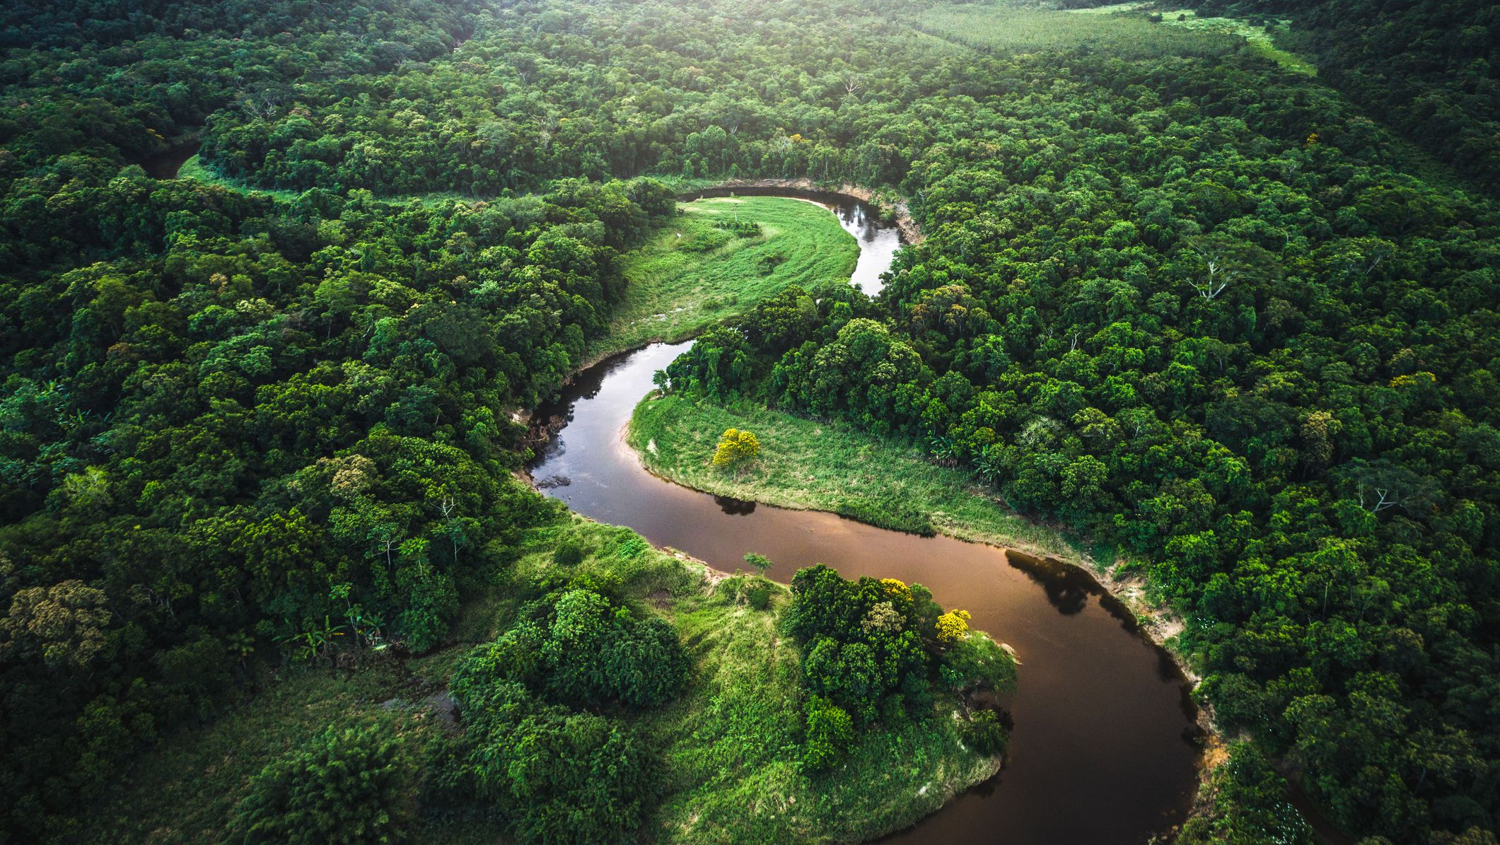
The Amazon Rainforest
Where is it?

Slide 9
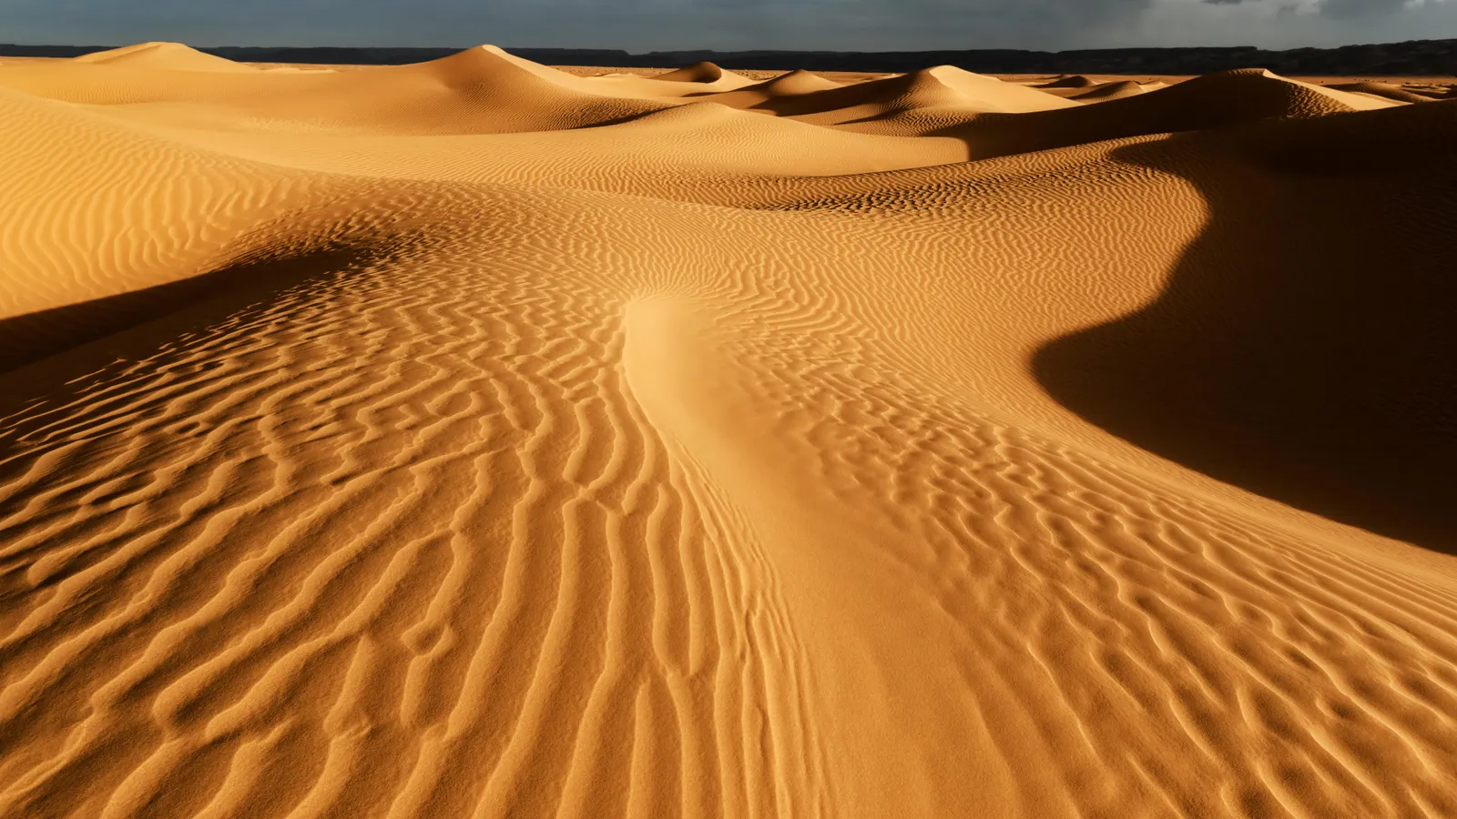
Where is it?
The Sahara Desert

Slide 10
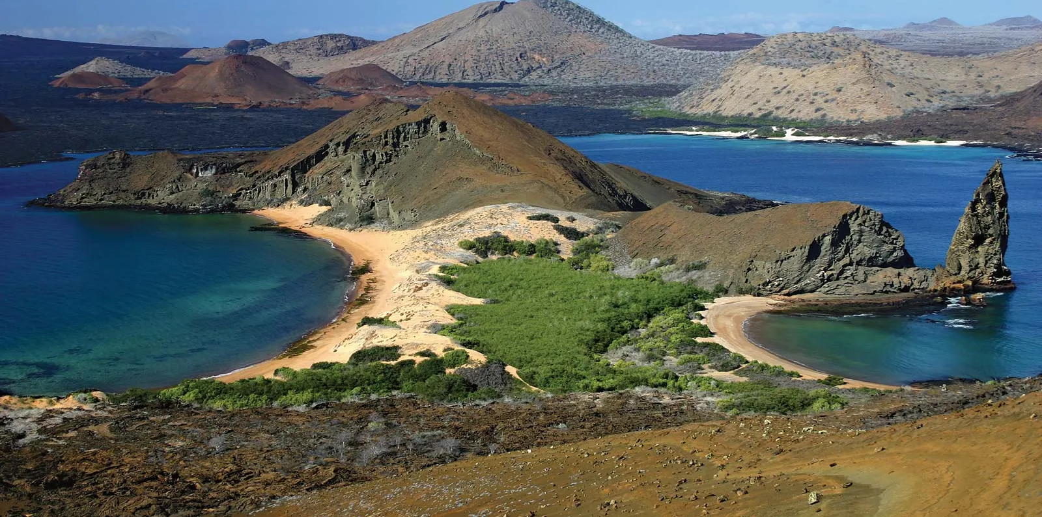
The Galápagos Islands

Slide 11
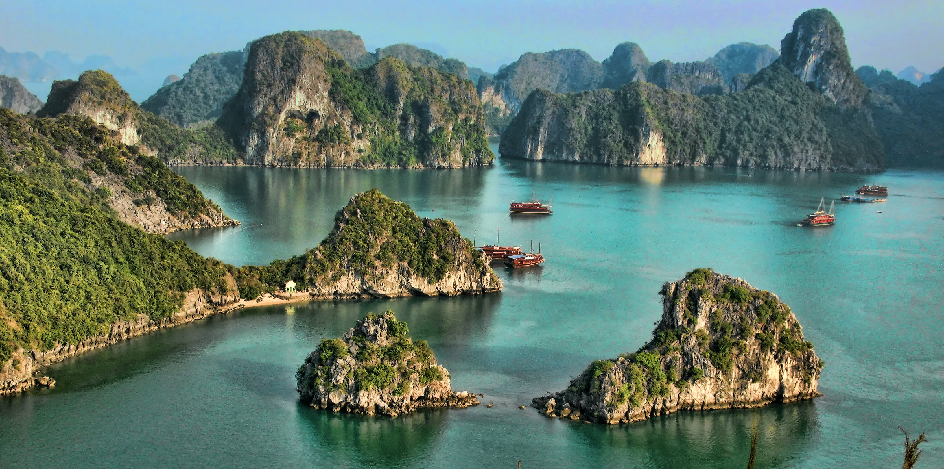
Ha Long Bay

Slide 12
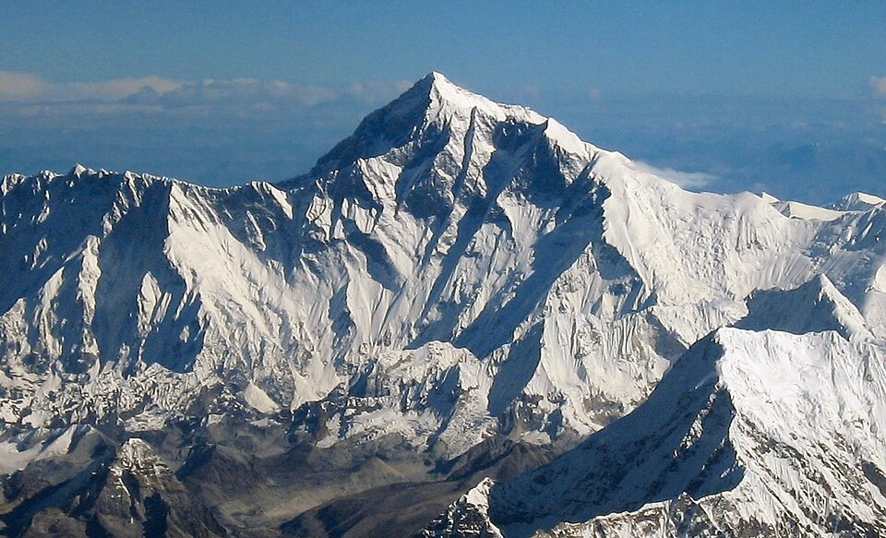
Mount Everest

Slide 13
2. Work in pairs. Look at the list of the natural wonders below. Rank them from 1 (most interesting) to 5 (least interesting), based on how interesting the places are for you.
The Amazon Rainforest
The Sahara Desert
The Galápagos Islands
Ha Long Bay
Mount Everest
What place would you like to visit most, and why?

Slide 14
Example:
The place I would like to visit most is Mount Everest. Because I want to go on an adventure of climbing and standing on top of Everest. Furthermore, it has breathtaking views of snow-capped peaks, and vast glaciers, creating a magnificent landscape that captivates the soul. Visiting Everest also offers an awe-inspiring sense of adventure and a chance to explore the beauty of the natural world.

Slide 15
Listening

Slide 16

3. Listen to the passage and fill in each blank with no more than TWO words.
1. There are __________ for travellers to the Galápagos Islands.
2. Travellers can’t bring any food or live __________ to the islands.
3. Travellers mustn’t litter on the islands or ___________ into the ocean.
4. Visitors shouldn’t buy souvenirs made from animals or ___________ from the islands.
5. Visitors can help _________ this natural wonder of the world.
Notes:
1. some tips 2. material 3. throw rubbish
4. plants 5. preserve

Slide 17
3. Listen to the passage and fill in each blank with no more than TWO words.
some tips
1. There are __________ for travellers to the Galápagos Islands.
Below are some tips for travellers to follow to reduce their impact on the islands.
Notes:
1. some tips 2. material 3. throw rubbish
4. plants 5. preserve

Slide 18
3. Listen to the passage and fill in each blank with no more than TWO words.
2. Travellers can’t bring any food or live __________ to the islands.
material
Do not bring any food or live material to the islands or from one island to the other.
Notes:
1. some tips 2. material 3. throw rubbish
4. plants 5. preserve

Slide 19
3. Listen to the passage and fill in each blank with no more than TWO words.
3. Travellers mustn’t litter on the islands or ______________ into the ocean.
throw rubbish
- Do not litter on the islands or throw rubbish into the ocean.
Notes:
1. some tips 2. material 3. throw rubbish
4. plants 5. preserve

Slide 20
3. Listen to the passage and fill in each blank with no more than TWO words.
4. Visitors shouldn’t buy souvenirs made from animals or ___________ from the islands.
plants
- Do not buy souvenirs made from animals or plants from the islands.
Notes:
1. some tips 2. material 3. throw rubbish
4. plants 5. preserve

Slide 21
3. Listen to the passage and fill in each blank with no more than TWO words.
preserve
5. Visitors can help _________ this natural wonder of the world.
By doing these, visitors can help protect the unique species of the islands and help preserve this natural wonder of the world.
Notes:
1. some tips 2. material 3. throw rubbish
4. plants 5. preserve

Slide 22
Look at the answers again
some tips
1. There are _____________ for travellers to the Galápagos Islands.
2. Travellers can’t bring any food or live _____________ to the islands.
3. Travellers mustn’t litter on the islands or _____________ into the ocean.
4. Visitors shouldn’t buy souvenirs made from animals or _____________ from the islands.
5. Visitors can help _____________ this natural wonder of the world.
material
throw rubbish
plants
preserve
Notes:
1. some tips 2. material 3. throw rubbish
4. plants 5. preserve

Slide 23
Writing

Slide 24
4. Make sentences using the words and phrases given.
1. village / nearly inaccessible / by cars / rainy days / .
________________________________
2. what countries / people / speak English /first language/?
________________________________
3. should learn / speak English / fluently / a native speaker /
________________________________
The village is nearly inaccessible by cars on rainy days.
In what countries do people speak English as a first language?
You should learn to speak English fluently with a native speaker.
Notes:
1. The village is nearly inaccessible by cars on rainy days.
2. In what countries do people speak English as a first language?
3. You should learn to speak English fluently with a native speaker.
4. We will stay at the hotel which my friend has recommended to us. /
We stayed at the hotel which my friend recommended to us.
5. Many foreign tourists like Viet Nam because the accommodation and food are affordable.

Slide 25
4. Make sentences using the words and phrases given.
4. We / stay / hotel / which / my friend / recommend / us / .
________________________________
5. Many / foreign tourist / like Viet Nam / because / accommodation and food / affordable / .
________________________________
We will stay at the hotel which my friend has recommended to us. / We stayed at the hotel which my friend recommended to us.
Many foreign tourists like Viet Nam because the accommodation and food are affordable.
Notes:
1. The village is nearly inaccessible by cars on rainy days.
2. In what countries do people speak English as a first language?
3. You should learn to speak English fluently with a native speaker.
4. We will stay at the hotel which my friend has recommended to us. /
We stayed at the hotel which my friend recommended to us.
5. Many foreign tourists like Viet Nam because the accommodation and food are affordable.

Slide 26
WRAP-UP
What have we learnt in this lesson?
Read for specific information;
Revise and talk about the world’s natural wonders;
Listen for specific information;
Write correct sentences from words and phrases given.

Slide 27
HOMEWORK
Do the exercises in the workbook.
Prepare for the next lesson.

Slide 28

THANK YOU
See you next time!

