Slide 2
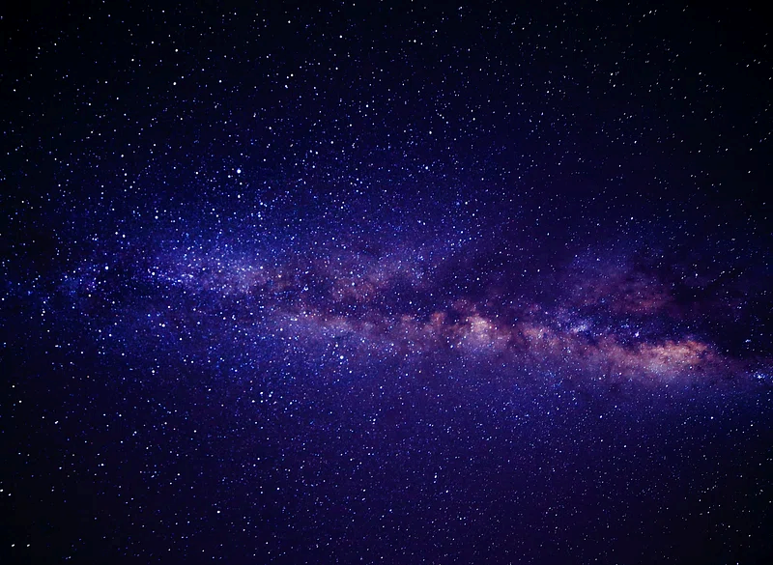
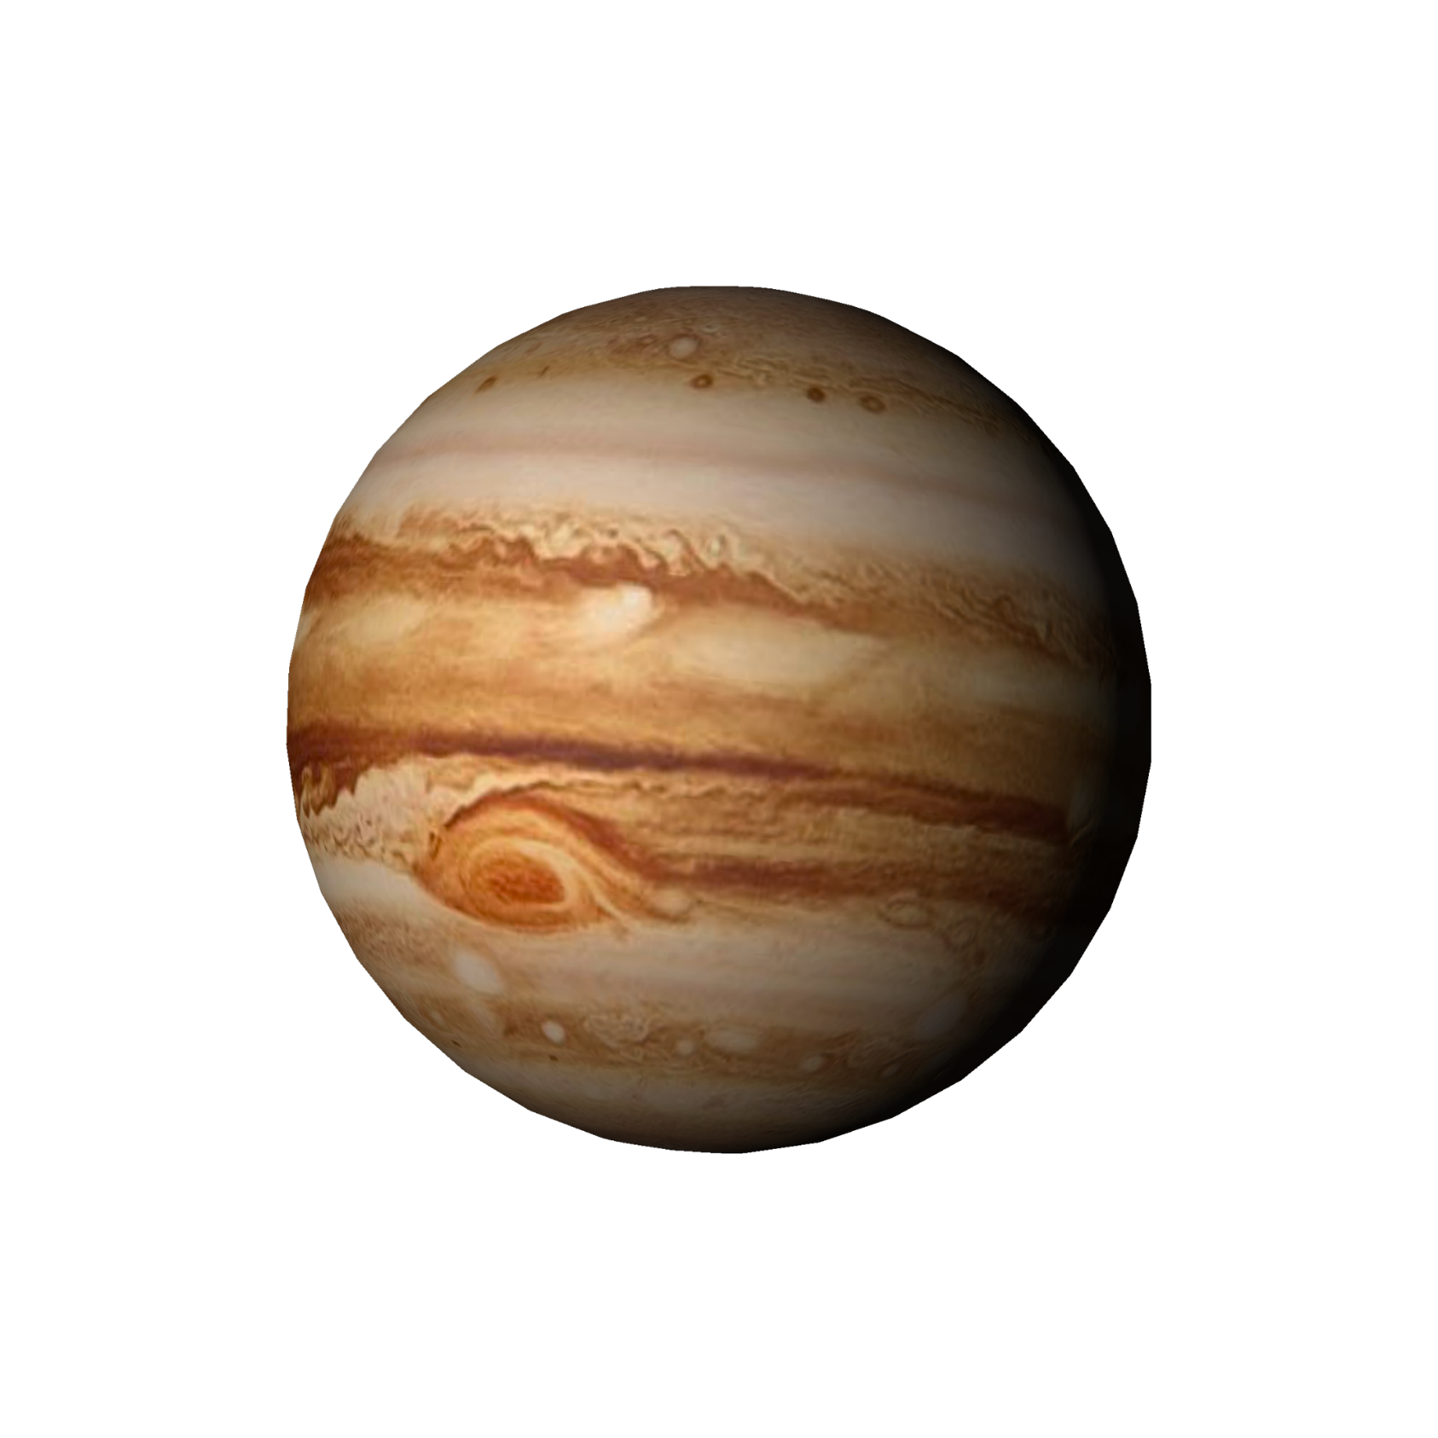






Unit
10
PLANET EARTH
LESSON 7: LOOKING BACK & PROJECT

Slide 3




Unit
10
PLANET EARTH
LESSON 7: LOOKING BACK & PROJECT

Slide 4

OBJECTIVES
By the end of the lesson, students will be able to:
Review the vocabulary and grammar of Unit 10
Apply what they have learnt (vocabulary and grammar) into practice through a project.

Slide 5

LESSON 7: LOOKING BACK & PROJECT
LESSON 1: GETTING STARTED
WARM-UP
Brainstorming
Task 1: Fill in the table with words and phrases about habitats.
Task 2: Complete the passage, using words/phrases in the box.
VOCABULARY
Task 3: Complete each sentence (1-5) with a non-defining relative clause (A-E)
Task 4: Combine the two sentences into one, using a non-defining relative clause.
GRAMMAR
PROJECT
Poster presentation
CONSOLIDATION
Wrap-up
Homework

Slide 6
WARM-UP
BRAINSTORMING
- Work in teams
Habitats | Actions to protect habitats
- There are slips of paper with words / phrases / short sentences to stick to either of the columns (habitats / actions to protect habitats).
- The group having more correct answers is the winner.

Slide 7
WARM-UP
BRAINSTORMING
Habitats | Actions to protect habitats

Slide 8
nature reserves habitat loss ecological balance
food chain climate change
VOCABULARY
1
Fill in the table with words and phrases about habitats.
- Work individually to write down the words / phrases in the columns.
Types of habitats | Things in a habitat
poles | flora and fauna
grassland, water bodies, landforms, forests, oceans, seas, rivers, lakes, ponds….
plants and animals, humans, air, light, heat, water…
Earth’s habitats are various and many are threatened. Each habitat includes living things, non-living things, and the surrounding environment. The relations of all living things and their environment in a habitat make up the habitat’s ecology. (1) ____________ or changes in population of plants and animals can cause changes to the natural (2) ___________ and the ecology. That means to maintain a(n) (3) ____________, we shouldn’t cause changes to the climate and the plants and animals of any habitat. In many countries, people have built (4) ____________ to keep endangered plants and animals safe. People should also avoid activities that may cause pollution and (5) ______.

Slide 9
VOCABULARY
2
Complete the sentences, using words/phrases from the box
nature reserves habitat loss ecological balance
food chain climate change
Earth’s habitats are various and many are threatened. Each habitat includes living things, non-living things, and the surrounding environment. The relations of all living things and their environment in a habitat make up the habitat’s ecology. (1) ____________ or changes in population of plants and animals can cause changes to the natural (2) ___________ and the ecology. That means to maintain a(n) (3) ____________, we shouldn’t cause changes to the climate and the plants and animals of any habitat. In many countries, people have built (4) ____________ to keep endangered plants and animals safe. People should also avoid activities that may cause pollution and (5) ______.
Climate change
food chain
ecological balance
natural reserves
habitat loss

Slide 10
LESSON 7: LOOKING BACK & PROJECT
LESSON 1: GETTING STARTED
WARM-UP
Brainstorming
A. who is considered the God of Thunder
B. which are large and extremely dry areas
C. whose work in geology is considered very important
D. which is the oldest national park in Viet Nam
E. which attract many tourists worldwide
Task 1: Fill in the table with words and phrases about habitats.
Task 2: Complete the passage, using words/phrases in the box.
VOCABULARY
Task 3: Complete each sentence (1-5) with a non-defining relative clause (A-E)
Task 4: Combine the two sentences into one, using a non-defining relative clause.
GRAMMAR
1. The Alps are a well-known mountain range, ______.
2. Deserts on Earth, ______, hardly get any rain.
3. People used to believe that Thor, ______, causes storms and lightning.
4. We spent time trekking, bird-watching, and kayaking in Cuc Phuong, ______.
5. James Hutton, ______, was one of the first scientists to study geology.

Slide 11
GRAMMAR
Complete each sentence (1-5) with a non-defining relative clause (A-E)
3
A. who is considered the God of Thunder
B. which are large and extremely dry areas
C. whose work in geology is considered very important
D. which is the oldest national park in Viet Nam
E. which attract many tourists worldwide
E
1. The Alps are a well-known mountain range, ______.
2. Deserts on Earth, ______, hardly get any rain.
3. People used to believe that Thor, ______, causes storms and lightning.
4. We spent time trekking, bird-watching, and kayaking in Cuc Phuong, ______.
5. James Hutton, ______, was one of the first scientists to study geology.
B
A
D
C

Slide 12
GRAMMAR
4
4
Combine the two sentences into one, using a non-defining relative clause.
1. Boreal forests cover vast areas in Canada, Alaska, and Russia. They are also called Taiga.
Boreal forests, which are also called Taiga, cover vast areas in Canada, Alaska, and Russia.
2. Polar bears are endangered animals. Their natural habitat is the Arctic.
Polar bears, whose natural habitat is the Artic, are endangered animals.

Slide 13
GRAMMAR
4
4
Combine the two sentences into one, using a non-defining relative clause.
3. Julie Arblaster focuses on studying climate change. She is an Australian
scientist.
Julie Arblaster, who is an Australian scientist, focuses on studying climate change.
4. Antarctica is Earth’s least populated continent. It is surrounded by the Southern Ocean.
Antarctica, which is surrounded by the Southern Ocean, is Earth’s least populated continent.

Slide 14
GRAMMAR
4
4
Combine the two sentences into one, using a non-defining relative clause.
5. The natural world is the world of living things. Living things include plants and animals scientist.
The natural world is the world of living things, which include plants and animals.

Slide 15
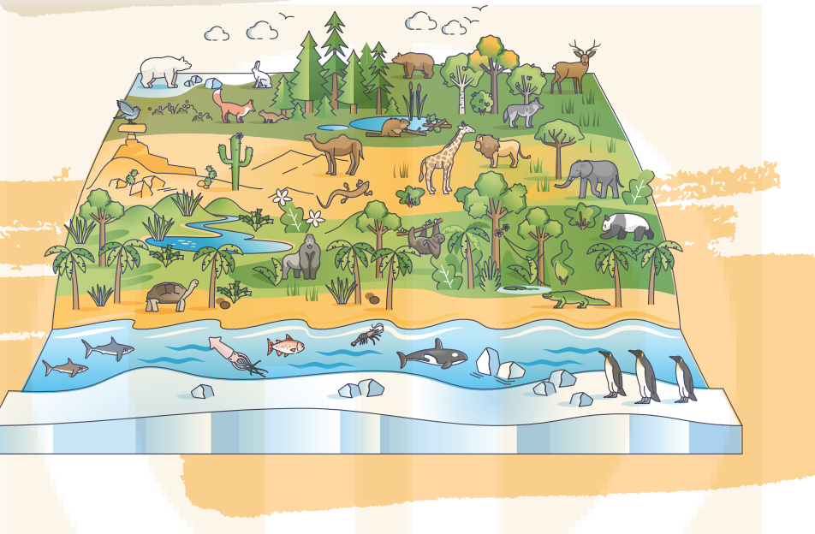
LESSON 7: LOOKING BACK & PROJECT
LESSON 1: GETTING STARTED
WARM-UP
Brainstorming
Task 1: Fill in the table with words and phrases about habitats.
Task 2: Complete the passage, using words/phrases in the box.
VOCABULARY
Task 3: Complete each sentence (1-5) with a non-defining relative clause (A-E)
Task 4: Combine the two sentences into one, using a non-defining relative clause.
GRAMMAR
PROJECT
Poster presentation

Slide 16
PROJECT
Our flora
and fauna

Slide 17
PROJECT
- Work in groups to choose an area to study about its flora and fauna.
- Consider your neighbourhood as it is more familiar to them.
-Gather pictures of the flora and fauna of the area.
-Can also draw or take pictures by yourselves.
-Create a poster with pictures and key words.

Slide 18
1/ Self-assessment
 | Tick where appropriate | Comments (in English or Vietnamese)
DELIVERY
I greeted the audience.
I spoke clearly and naturally.
I cooperated with my group members when delivering the talk.
I interacted with the audience.
I concluded my part of the talk appropriately.
DESIGN OF THE POSTER (if if is a poster presentation)
Our poster was clearly organised.
Our photos and drawings were suitable.
CONTENT: Our presentation includes the following information
Answer all suggested questions (in the project)
DELIVERY
I greeted the audience.
I spoke clearly and naturally.

Slide 19

1/ Peer-assessment
 | Tick where appropriate | Comments (in English or Vietnamese)
DELIVERY
The presenters greeted the audience.
The presenters spoke clearly and naturally.
The presenters cooperated when delivering their talk.
The presenters interacted with the audience.
The presenters concluded their talk appropriately.
DESIGN OF THE POSTER (if if is a poster presentation)
Their poster was clearly organised.
Their photos and drawings were suitable.
CONTENT: The presentation includes the following information about the hobby:
Answer all suggested questions
DELIVERY
The presenters greeted the audience.
The presenters spoke clearly and naturally.
PRESENTATION

Slide 20
PROJECT
PRESENTATION

Slide 21
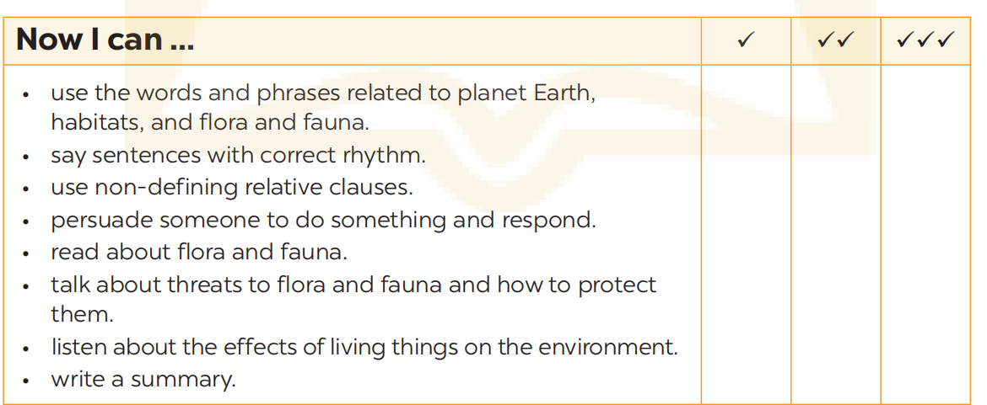
NOW I CAN...
Complete the self-assessment table.

Slide 22
LESSON 7: LOOKING BACK & PROJECT
LESSON 1: GETTING STARTED
WARM-UP
Brainstorming
Task 1: Put the words and phrases in the appropriate column.
Task 2: Complete the sentences, using words/phrases from the box.
VOCABULARY
Task 3: Combine each pair of sentences into one, using the given word in the brackets.
Task 4: Fill in each gap in the text with a conjunction from the box.
GRAMMAR
PROJECT
Poster presentation
CONSOLIDATION
Wrap-up
Homework

Slide 23

CONSOLIDATION
1
Wrap-up
What have we learnt in this lesson?
Review the vocabulary and grammar of Unit 10
Apply what they have learnt (vocabulary and grammar) into practice through a project.

Slide 24

CONSOLIDATION
2
Homework
- Prepare for the next lesson

Slide 25
Website: hoclieu.vn
Fanpage: facebook.com/www.tienganhglobalsuccess.vn/

