Slide 2

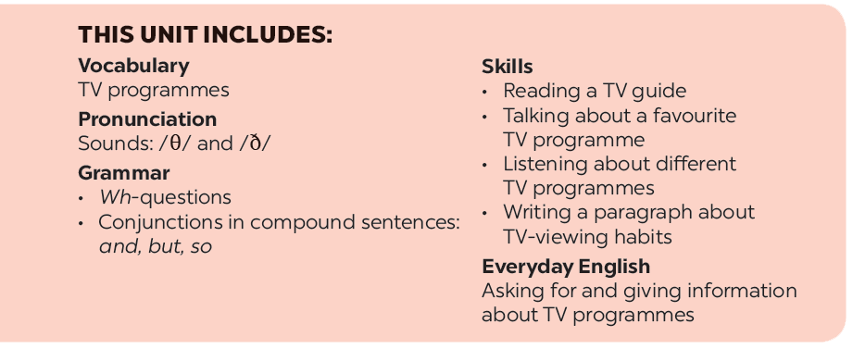

Slide 3







What’s on today?
Listen and read.
Find and write the adjectives in the conversation which describe the programmes and characters below.
Choose the correct answer A, B, or C.
Work in groups. Interview your partners about their favourite TV programmes and report to the class.
Read the conversation again and match 1-5 with a-e.

Slide 4



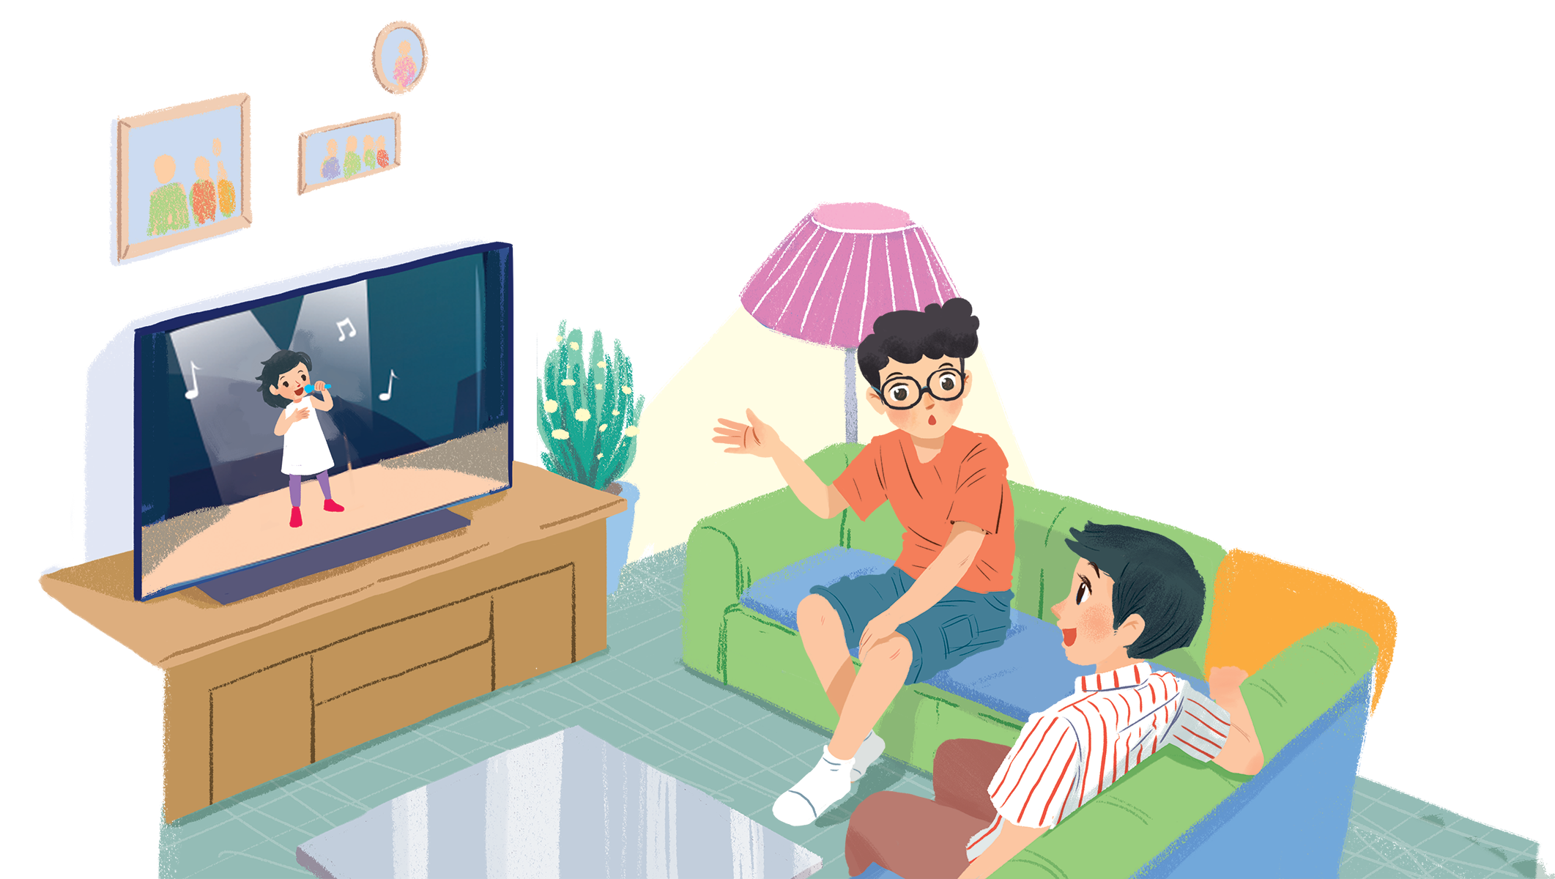
Listen and read.
What’s on today?

Slide 5
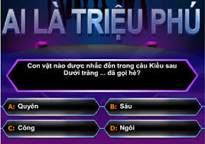
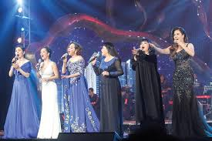
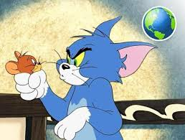
I. New words :
- TV programme ( n) : chương trình ti vi
- channel (n): kênh
- interesting (adj ): thú vị
- educational (adj ) : tính giáo dục

Slide 6
What’s on today?
Phong: What are you watching, Hung?
Hung: The Voice Kids.
Phong: That music talent show is very interesting.
Hung: It is. What programme do you often watch, Phong?
Phong: Films. I like animated films like The Lion King.
Hung: I love them, too. They’re wonderful.
Phong: I often watch them with my little brother, but he prefers cartoons.
Hung: Tom and Jerry?
Phong: Ha ... ha ... Yes, he loves Jerry the mouse.
Hung: Jerry’s a clever character. Do you know any English programmes for children?
Phong: Yes. I watch English in a Minute on VTV7.
This channel has many educational programmes.
Hung: Great. I’ll watch it, too.

Slide 7

Choose the correct answer A, B, or C.
1.
Phong and Hung are talking about _______.
A.
The Voice Kids programme
B.
English in a Minute programme
C.
different TV programmes
2.
Phong likes _______.
A.
animated films
B.
cartoons
C.
talent shows
3.
When you’re viewing a TV programme, you say: “I’m _______ TV.”
B.
C.
looking
A.
watching
seeing
4.
When a programme teachesyou something, it’s _______.
A. educational
B.
funny
C.
clever

Slide 8
Choose the correct answer A, B, or C.
1.
Phong and Hung are talking about _______.
A.
The Voice Kids programme
B.
English in a Minute programme
C.
different TV programmes
2.
Phong likes _______.
A.
animated films
B.
cartoons
C.
talent shows
3.
When you’re viewing a TV programme, you say: “I’m _______ TV.”
B.
C.
looking
A.
watching
seeing
4.
When a programme teachesyou something, it’s _______.
A.
educational
B.
funny
C.
clever

Slide 9

Read the conversation again and match 1-5 with a-e.
1. The Voice Kids
2. The Lion King
3. Tom and Jery
4. VTV7
5. English in a Minute
c. music talent show
a. animated film
a. animated film
b. channel
e. cartoon
c. music talent show
b. channel
d. educational programme
e. cartoon
d. educational programme

Slide 10
Read the conversation again and match 1-5 with a-e.
1. The Voice Kids
2. The Lion King
3. Tom and Jery
4. VTV7
5. English in a Minute
c. music talent show
a. animated film
a. animated film
b. channel
e. cartoon
c. music talent show
b. channel
d. educational programme
e. cartoon
d. educational programme

Slide 11

Find and write the adjectives in the conversation which describe the programmes and characters below.
1.
The Voice Kids
2.
animated films
3.
Jerry the mouse
4.
programmes on VTV7

Slide 12
Find and write the adjectives in the conversation which describe the programmes and characters below.
1.
The Voice Kids
interesting
2.
animated films
wonderful
3.
Jerry the mouse
clever
4.
programmes on VTV7
educational

Slide 13

Work in groups. Interview your partners about their favourite TV programmes and report to the class.
Example:
In our group, Mai likes sports programmes on TV. Binh likes ...

Slide 14







