Slide 1





Grade 6
Unit 7:
TELEVISION
Part 1: Getting started

Slide 2
Objectives
By the end of the lesson, students will be able to:
- use the lexical items related to the topic television
programmes for children;
- use the vocabulary and structures to talk about
famous children’s programmes.

Slide 3


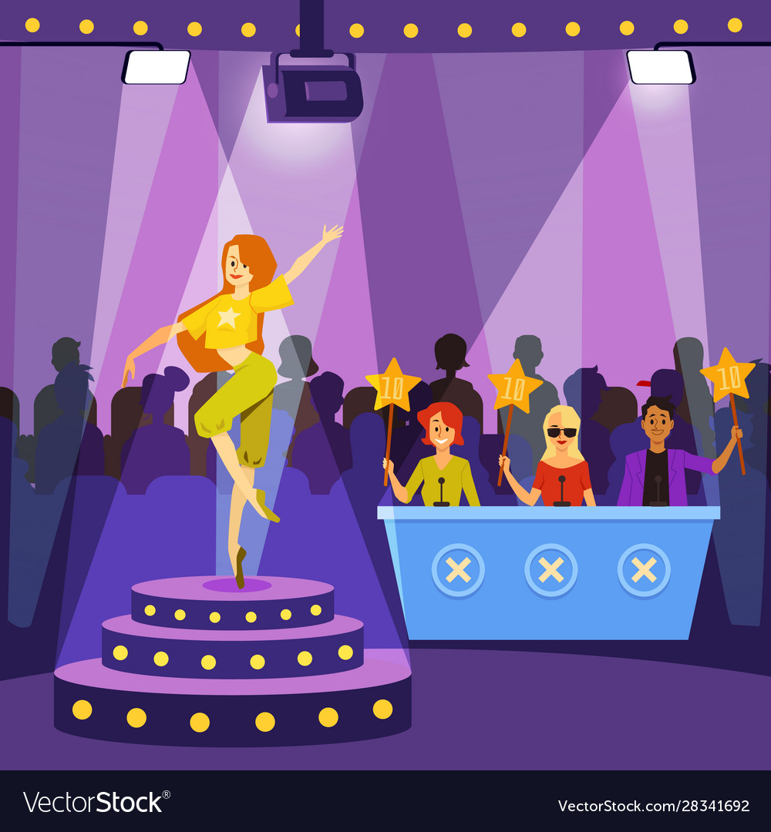

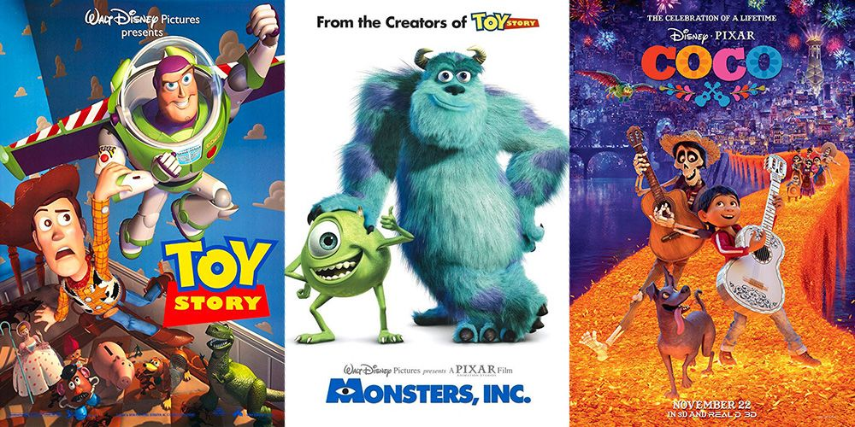

Vocabulary
1. programme (n) /ˈprəʊɡræm/
(something that people watch on TV)
2. animated (adj) /ˈænɪmeɪtɪd/
(made to look as if they are moving)
3. prefer (v) /prɪˈfɜːr/
(to like one thing or person better than another)
4. character (n) /ˈkærəktər/​
a person or an animal in a book, play or film
5. educational (adj) /ˌedʒuˈkeɪʃənl/
connected with education
6. talent (n) /ˈtælənt/
a natural ability to do something well
Chương tình truyền hình)
(phim) Hoạt hình
Thich hơn, quan tâm
Nhân vật
Có giáo dục, thuộc về giáo dục
Tài năng

Slide 4
Checking Vocabulary
1. programme (n) /ˈprəʊɡræm/
2. animated (adj) /ˈænɪmeɪtɪd/
3. prefer (v) /prɪˈfɜːr/
4. character (n) /ˈkærəktər/​
5. educational (adj) /ˌedʒuˈkeɪʃənl/
6. talent (n) /ˈtælənt/
Chương tình truyền hình)
(phim) Hoạt hình
Thich hơn, quan tâm
Nhân vật
Có giáo dục, thuộc về giáo dục
Tài năng

Slide 5

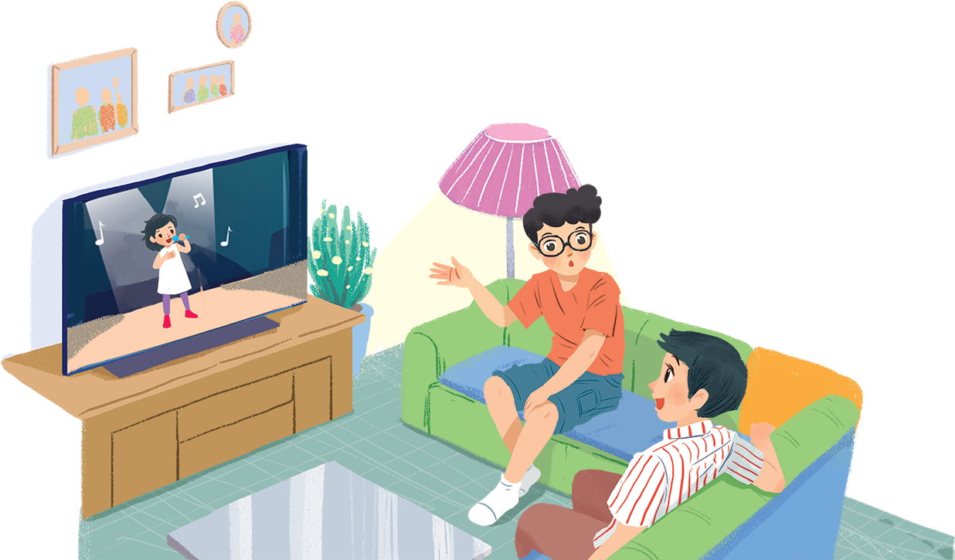

Before the reading
What do you see in the picture?
Which TV programs do you usually watch?

Slide 6


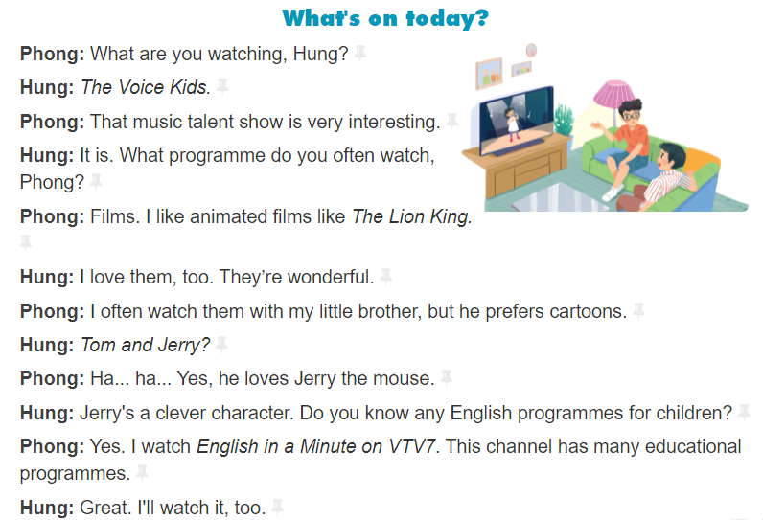

Slide 7
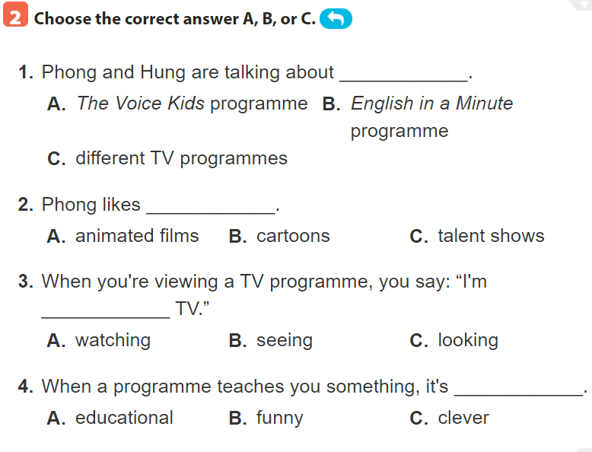
Hung: The Voice Kids.
Phong: Films. I watch English in a Minute on VTV7. This channel has many educational programmes.
Phong: Films. I like animated films like The Lion King.
Phong: I often watch them with my little brother, but he prefers cartoons. Hung: Tom and Jerry?
Phong: Yes. I watch English in a Minute on VTV7. This channel has many educational programmes.

Slide 8
1. The Voice Kids
a. Animated film
2. The Lion King
b. Channel
3. Tom and Jerry
c. Music talent show
4. VTV7
d. Educational programme
5. English in a Minute
e. cartoon

Slide 9
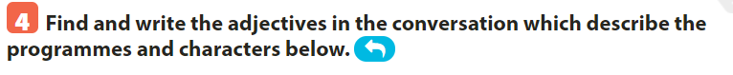
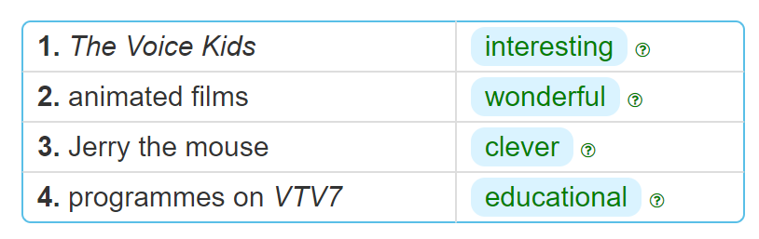
Phong: I often watch them with my little brother, but he prefers cartoons. Hung: Tom and Jerry?
Phong: Yes. I watch English in a Minute on VTV7. This channel has many educational programmes.
Phong: Films. I like animated films like The Lion King.
Hung: The Voice Kids. Phong: That music talent show is very interesting.

Slide 10

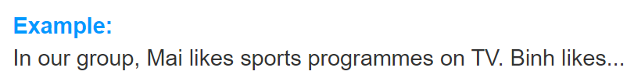
Binh likes animated films.
Hoa enjoys watching Tom and Jerry cartoon.
Hung is interested in The Voice Kids, a music talent show.
I really like English in a minute, an educational programme.

Slide 11
In conclusion
By the end of the lesson students will be able to:
- use the lexical items related to the topic television
programmes for children;
- use the vocabulary and structures to talk about
famous children’s programmes.
HOMEWORK:
Do exercises …….. on page . …
Prepare for “A closer look 1” part.

Slide 12


