Slide 1

UNIT 6: AROUND TOWN
Lesson 1.1
Page 40

Slide 2
Lesson Outline
Warm-up
Vocabulary
Structure
Practice
Consolidation
Wrap-up

Slide 3

WARM-UP

Slide 4

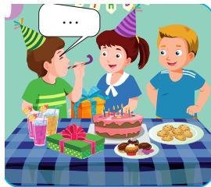


Click on the right word.
Happy New Year
Merry Christmas
Happy birthday

Slide 5
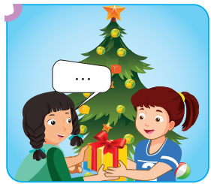
Click on the right word.
Happy New Year
Merry Christmas
Happy birthday

Slide 6
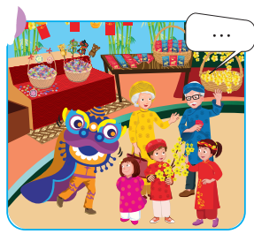
Click on the right word.
Happy New Year
Happy birthday
Merry Christmas

Slide 7

It’s time to learn …

Slide 8

New words
zoo,
beach,
park,
playground.

Slide 9



Click A to hear the sound

Slide 10

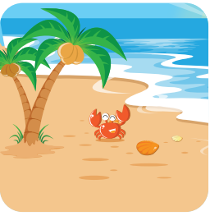
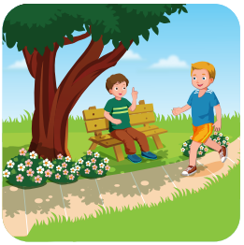





Click on the picture to hear the sound
/zuː/
sở thú
/biːtʃ/
bãi biển
/pɑːrk/
công viên
/ˈpleɪɡraʊnd/
sân chơi

Slide 11
/zuː/
sở thú

Slide 12
/biːtʃ/
bãi biển

Slide 13
/pɑːrk/
công viên

Slide 14
/ˈpleɪɡraʊnd/
sân chơi

Slide 15

Structures
I want to go to the (zoo).

Slide 16
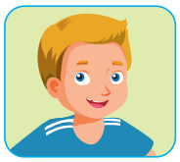
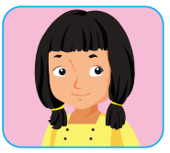
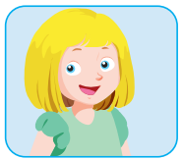

Where do you want to go?
I want to go to the playground.
I want to go to the zoo.
I want to go to the beach.
I want to go to the park.

Slide 17

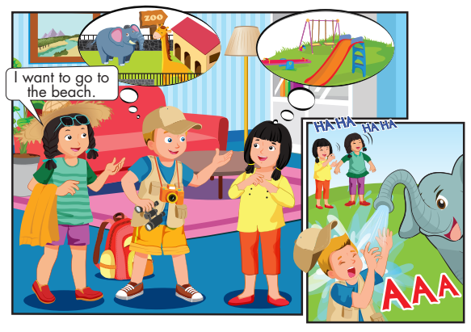
Click B to hear the sound

Slide 18


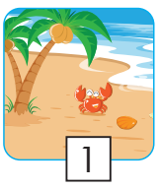

Click on the icon to hear the sound
2
3

Slide 19
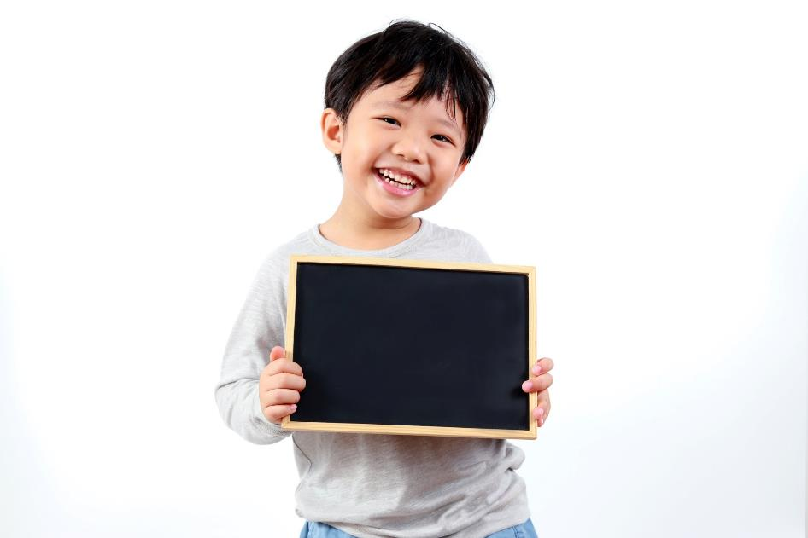
Practice

Slide 20


Click C to hear the sound
I want to go to the zoo.
I want to go to the park.
I want to go to the zoo.
I want to go to the park.
I want to go to the beach.
I want to go to the playground.
I want to go to the beach.
I want to go to the playground.

Slide 21
It’s time to play …

Slide 22

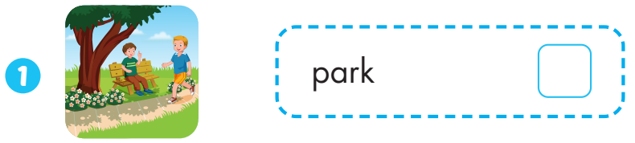


Slide 23
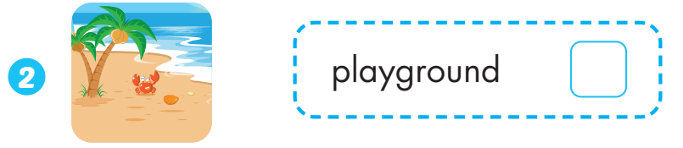


Slide 24
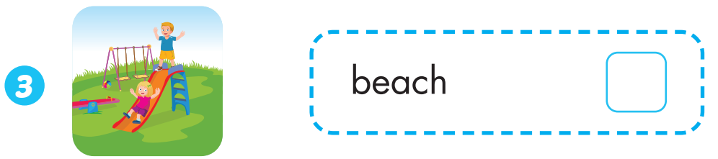

Slide 25
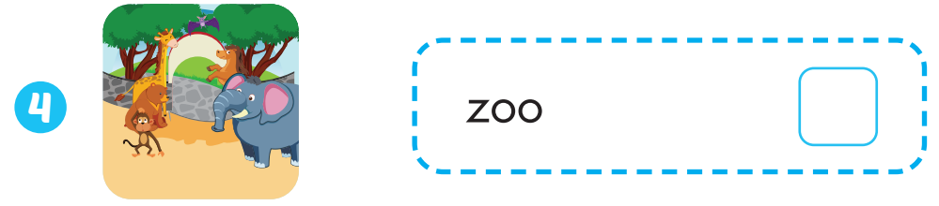

Slide 26

CONSOLIDATION

Slide 27

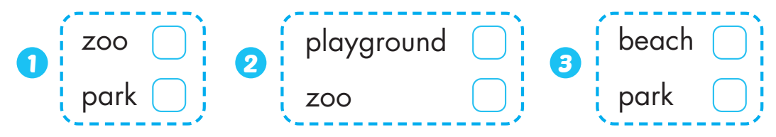

Slide 28

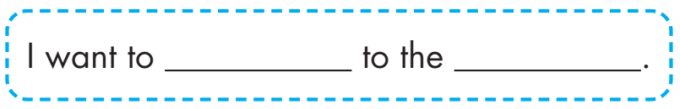
go
zoo

Slide 29
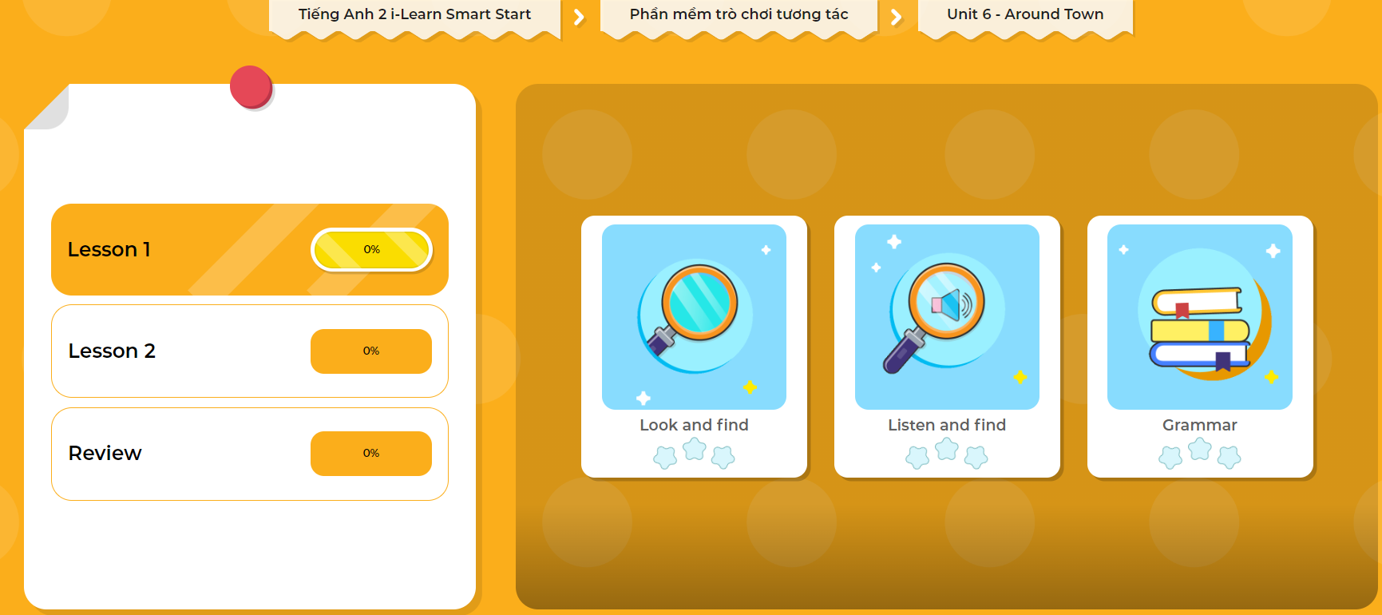
Extra Practice
DHA App
LET’S PLAY!
Click here to play the games

Slide 30

WRAP-UP

Slide 31
Today’s lesson
Vocabulary
zoo, beach, park, playground.
Structures/ Sentence patterns
I want to go to the (park).

Slide 32
Homework
Practice vocabulary and structure. Make sentences using them.
Practice the vocabulary and structure in Tiếng Anh 2 i-Learn Smart Start Notebook (page 42).
Do the exercises in Tiếng Anh 2 i-Learn Smart Start Workbook (page 38).
Play the consolidation games in Tiếng Anh 2 i-Learn Smart Start DHA App on www.eduhome.com.vn
Prepare the next lesson (page 41).

Slide 33
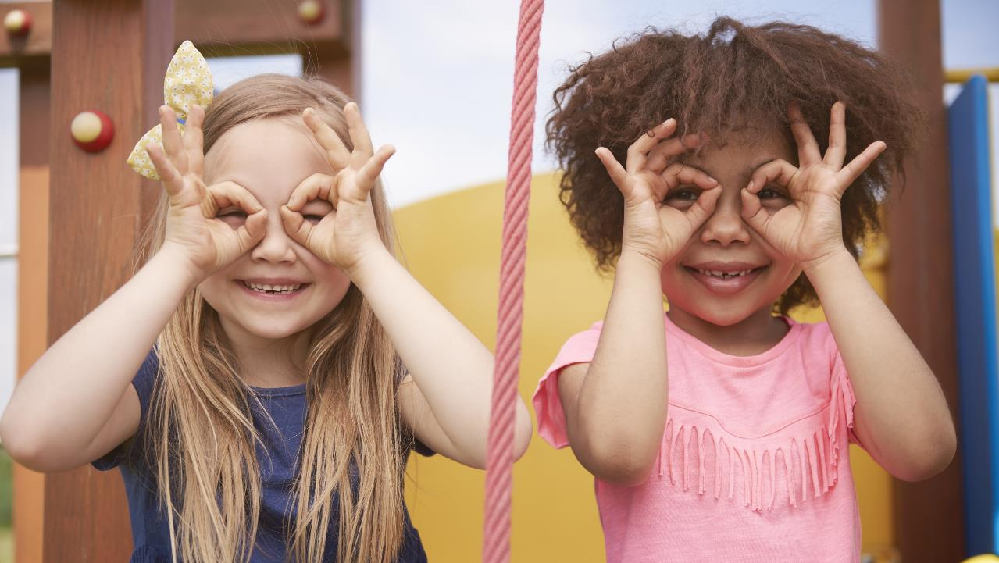
Enjoy your day!

