Slide 1

UNIT 6: AROUND TOWN
Lesson 1.2
Page 41

Slide 2
Lesson Outline
Warm-up
Practice
Speaking
Consolidation
Wrap-up

Slide 3
Objectives
By the end of this lesson, students will be able to say where they want to go.
Vocabulary:
Revise: zoo, beach, park, playground.
Sentence pattern:
“I want to go to the (park).” , “I want to go to the (beach).”

Slide 4

WARM-UP

Slide 5

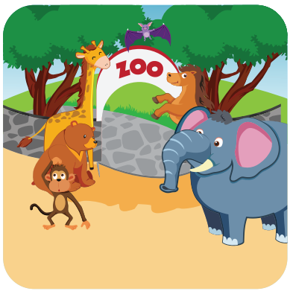


Click on the right word
park
beach
zoo

Slide 6
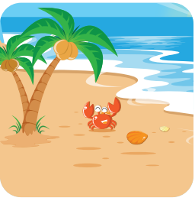
Click on the right word
zoo
beach
playground

Slide 7
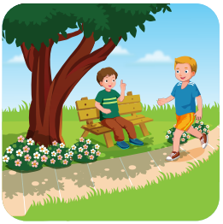
Click on the right word
park
zoo
beach

Slide 8

Click on the right word
zoo
playground
park

Slide 9

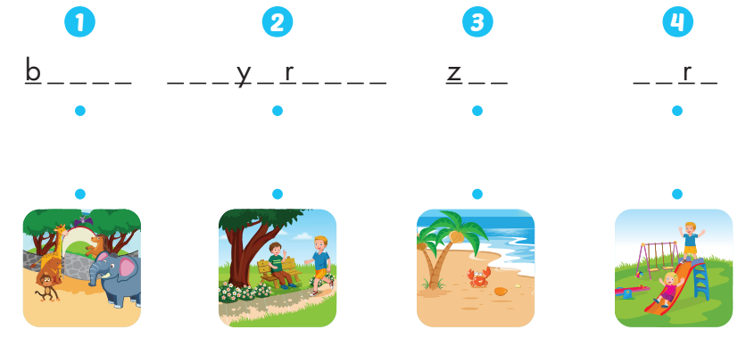
e a c h
p l a g o u n d
o o
p a k

Slide 10

It’s time to learn …

Slide 11

Speaking

Slide 12

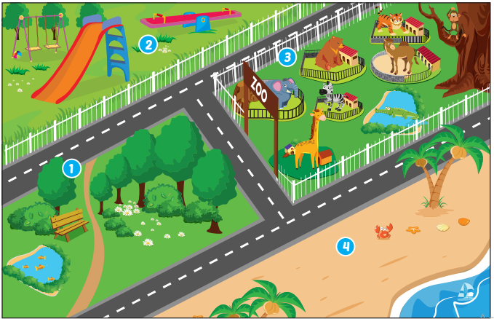

I want to go to the park.

Slide 13

I want to go to the playground.

Slide 14

I want to go to the zoo.

Slide 15

I want to go to the beach.

Slide 16

Practice

Slide 17

Structures
I want to go to the (park).
I want to go to the (beach).

Slide 18

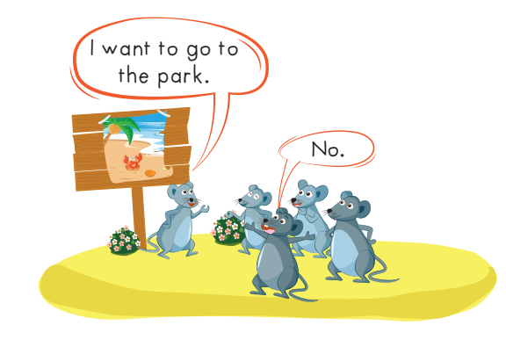

Slide 19
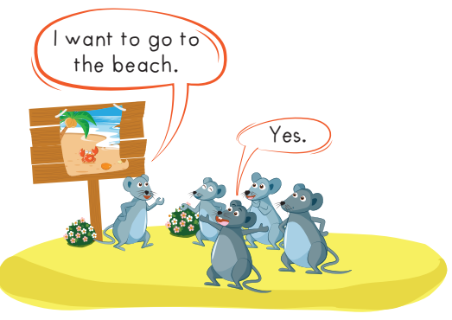
I want to go to the park.

Slide 20
I want to go to the playgound.

Slide 22
I want to go to the zoo.

Slide 23
I want to go to the playground.

Slide 24

CONSOLIDATION

Slide 25


beach

Slide 26
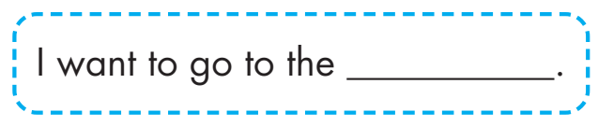
playground

Slide 27

want
park

Slide 28
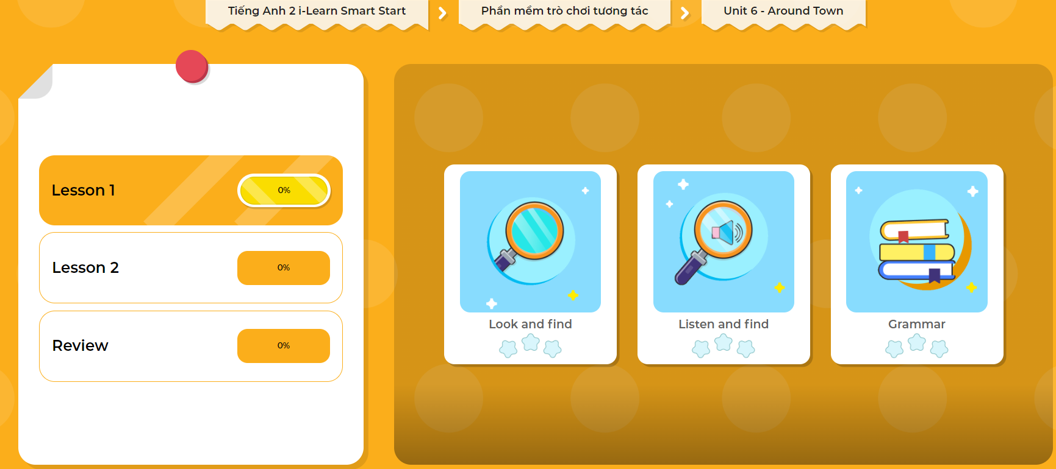
Extra Practice
DHA App
LET’S PLAY!
Click here to play the games

Slide 29

WRAP-UP

Slide 30
Today’s lesson
Vocabulary
Revise: zoo, beach, park, playground.
Structures/ Sentence patterns
I want to go to the (park).
I want to go to the (beach).

Slide 31
Homework
Practice vocabulary and structure. Make sentences using them.
Practice the vocabulary and structure in Tiếng Anh 2 i-Learn Smart Start Notebook (page 43).
Do the exercises in Tiếng Anh 2 i-Learn Smart Start Workbook (page 39).
Play the consolidation games in Tiếng Anh 2 i-Learn Smart Start DHA App on www.eduhome.com.vn
Prepare the next lesson (page 42).

Slide 32

Enjoy your day!

