Slide 1

UNIT 6: AROUND TOWN
Lesson 2.1
Page 42

Slide 2
Lesson Outline
Warm-up
Phonics
Practice
Consolidation
Wrap-up

Slide 3
Objectives
By the end of this lesson, students will review the /s/, /r/ sounds and practice these sounds.
Phonics: review /s/, /r/
Vocabulary: rabbit, sea, sun.
Skills:
Recognize the letters S/s, R/r and make the /s/, /r/ sounds.

Slide 4

WARM-UP

Slide 5

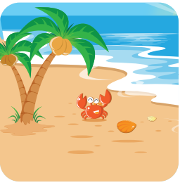

Where do you want to go?
I want to go to the beach.

Slide 6

Where do you want to go?
I want to go to the playground.

Slide 7
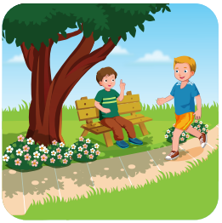
Where do you want to go?
I want to go to the park.

Slide 8
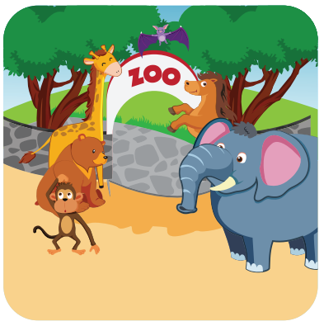
Where do you want to go?
I want to go to the zoo.

Slide 9

It’s time to learn …

Slide 10

Phonics
/s/, /r/

Slide 11




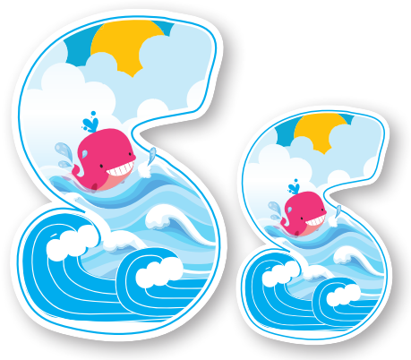


Slide 12

New words
rabbit, sea, sun.

Slide 13


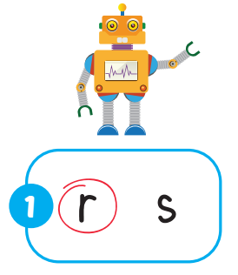

Slide 14
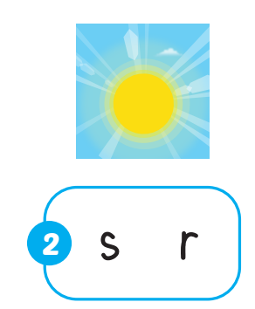
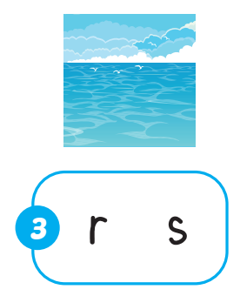


Slide 15

Practice

Slide 16

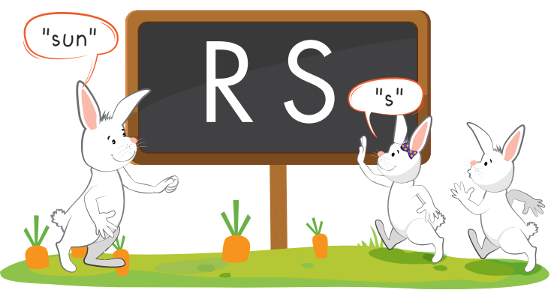

Slide 17
rabbit
“r”

Slide 18
sea
“s”

Slide 19

Further Practice

Slide 20


r
r

Slide 21

s
s

Slide 22

CONSOLIDATION

Slide 23

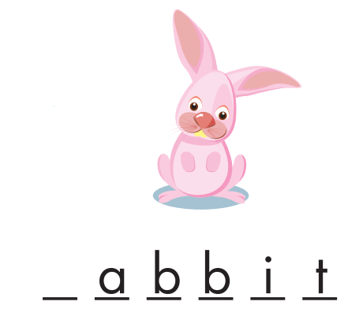
r

Slide 24

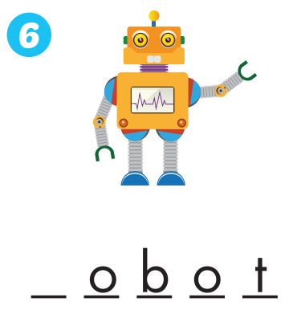
s
r

Slide 25
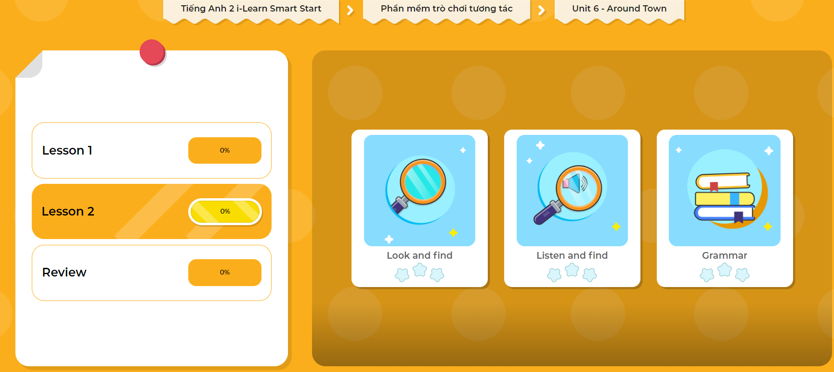
Extra Practice
DHA App
LET’S PLAY!
Click here to play the games

Slide 26

WRAP-UP

Slide 27
Today’s lesson
Vocabulary
rabbit, sea, sun
review /s/, /r/

Slide 28
Homework
Practice saying the sound.
Do the exercise in Tiếng Anh 2 i-Learn Smart Start Notebook (page 44).
Do the exercises in Tiếng Anh 2 i-Learn Smart Start Workbook (page 40).
Play the consolidation games in Tiếng Anh 2 i-Learn Smart Start DHA App on www.eduhome.com.vn
Prepare the next lesson (page 43).

Slide 29

Enjoy your day!

