Slide 1

UNIT 6: AROUND TOWN
Lesson 2.2
Page 43

Slide 2
Lesson Outline
Warm-up
Phonics
Practice
Consolidation
Wrap-up

Slide 3
Objectives
By the end of this lesson, students will review the /t/, /u/ sounds and practice them.
Phonics: review /t/, /u/ .
Vocabulary: review: umbrella, uncle, tiger, top.
Skills:
Recognize the letters T/t, U/u and make the /t/, /u/ sounds.

Slide 4

WARM-UP

Slide 5






s
r
Color the correct letters.
s
r
s
r

Slide 6
Color the correct letters.
s
s
r

Slide 7
Color the correct letters.
s
r
r

Slide 8
Color the correct letters.
s
s
r

Slide 9

It’s time to learn …

Slide 10

Phonics
/u/, /t/

Slide 11







Slide 12

New words
review: umbrella, uncle, tiger, top.

Slide 13

Practice

Slide 14


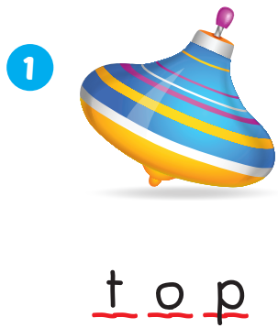
/tɒp/

Slide 15
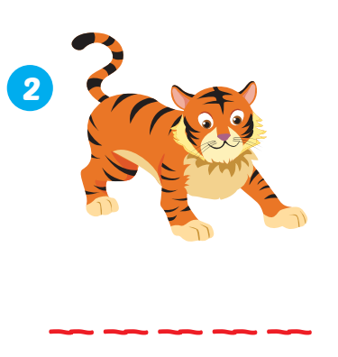
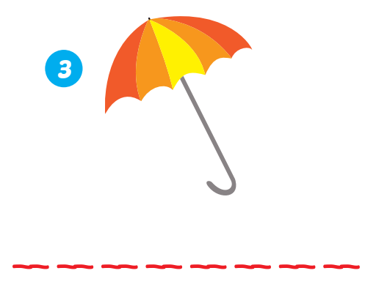
t i g e r
u m b r e l l a
/ˈtaɪ.ɡər/
/ʌmˈbrelə/

Slide 16

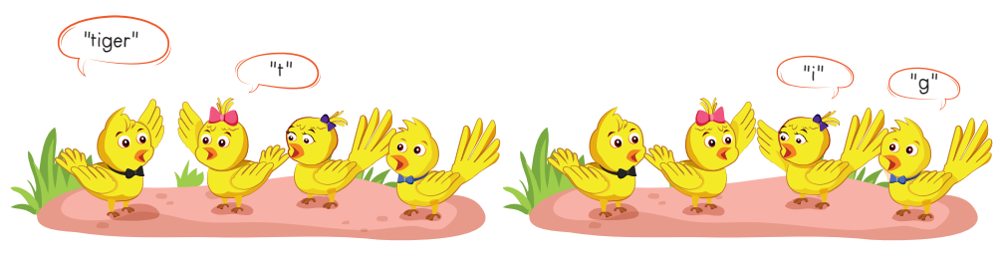
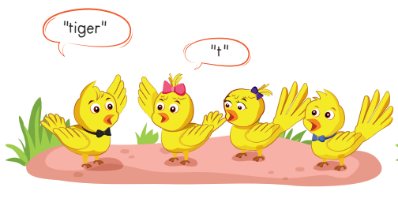
“e”
“r”

Slide 17
“uncle”
“u”
“n”
“c”
“l”
“e”

Slide 18
top
“t”
“o”
“p”

Slide 19
“u”
“m”
“b”
“r”
“e”
“l”
“l”
“a”

Slide 20

Further Practice

Slide 21

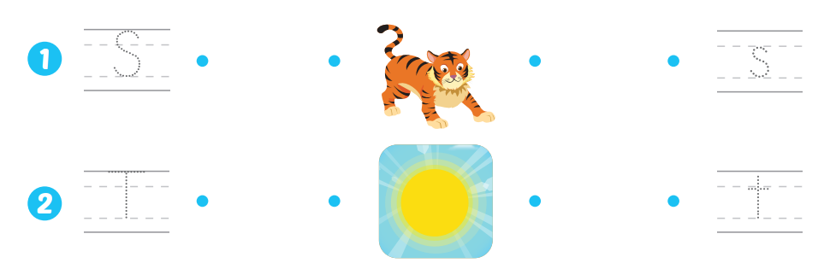
s
s
T
t

Slide 22

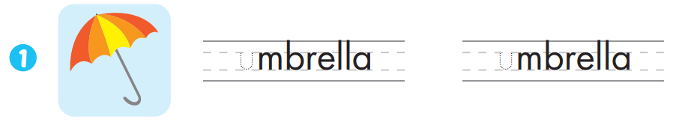
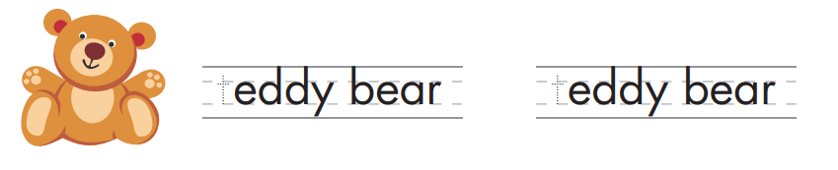

u
u
t
t

Slide 23

CONSOLIDATION

Slide 24

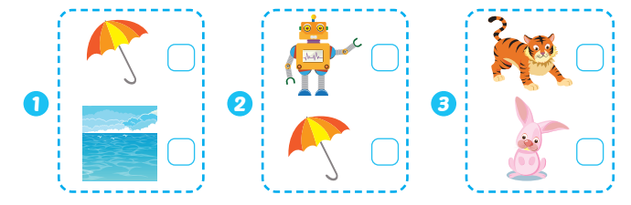


Slide 25

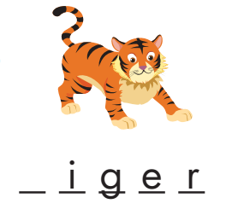

t
u

Slide 26
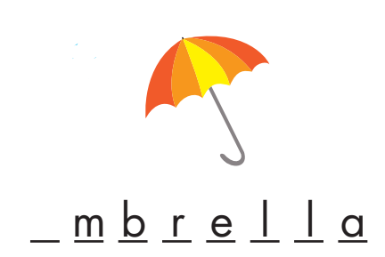
u

Slide 27
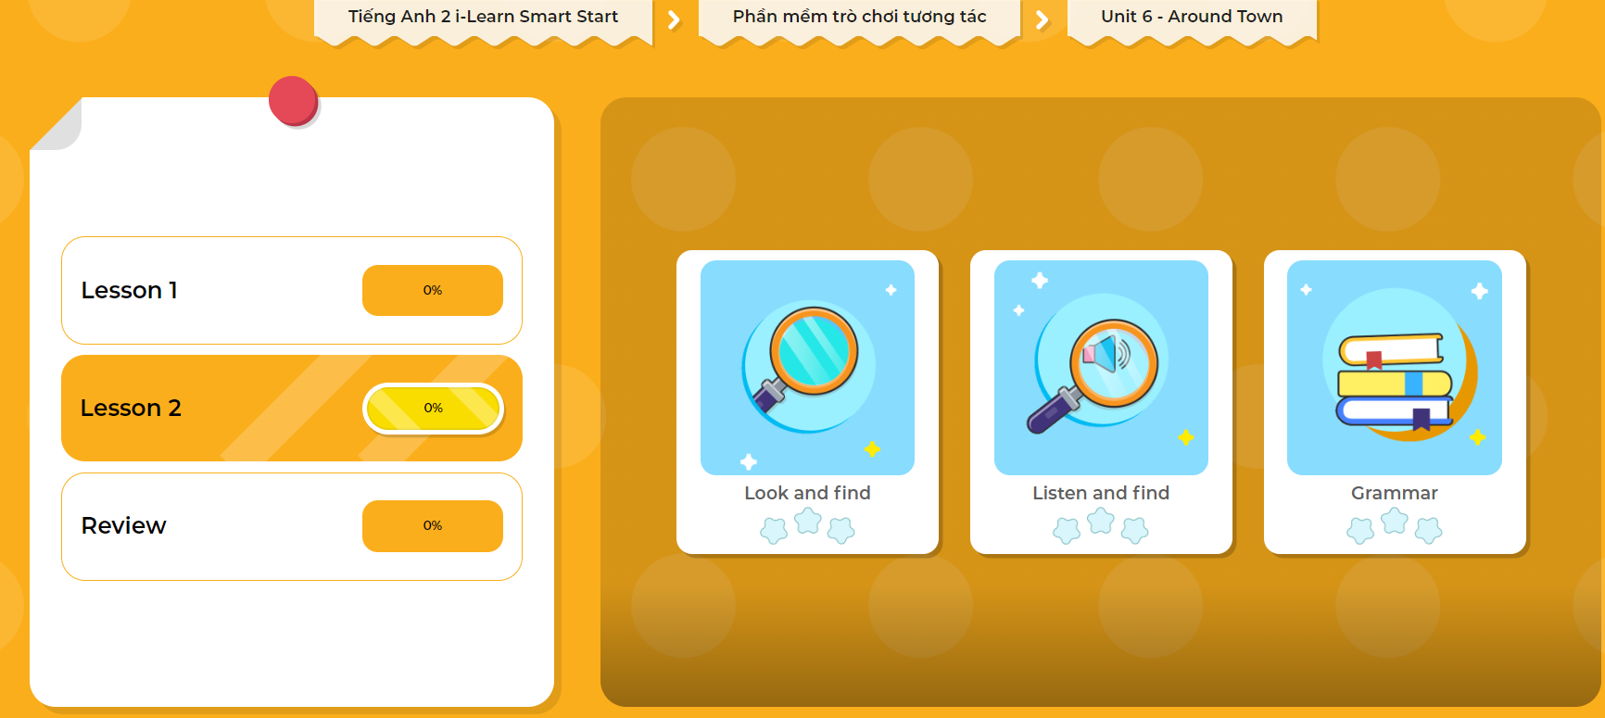
Extra Practice
DHA App
LET’S PLAY!
Click here to play the games

Slide 28

WRAP-UP

Slide 29
Today’s lesson
Vocabulary
review: umbrella, uncle, tiger, top.

Slide 30
Homework
Practice saying the target sound.
Do the exercise in Tiếng Anh 2 i-Learn Smart Start Notebook (page 45).
Do the exercises in Tiếng Anh 2 i-Learn Smart Start Workbook (page 41).
Play the consolidation games in Tiếng Anh 2 i-Learn Smart Start DHA App on www.eduhome.com.vn
Prepare the next lesson (page 44).

Slide 31
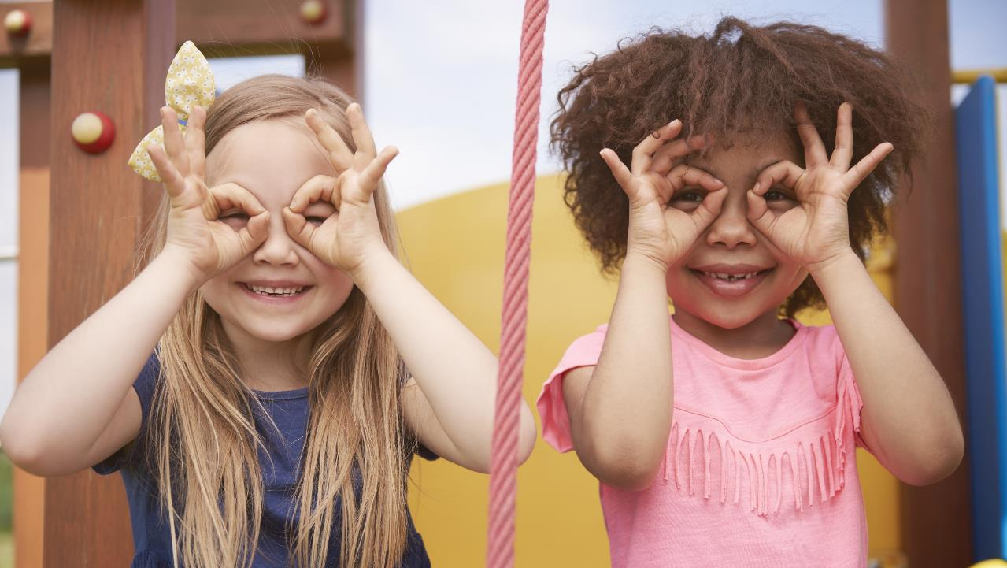
Enjoy your day!

