Slide 1

UNIT 6: AROUND TOWN
Review 5
Page 44

Slide 2
Lesson Outline
Warm-up
Practice
Consolidation
Wrap-up

Slide 3
Objectives
By the end of this lesson, students will review suggesting activities and say where they want to go.
Phonics: review the /t/, /u/, /r/, /s/ sounds.
Vocabulary: revision.
Sentence pattern: revision.

Slide 4

WARM-UP

Slide 5
Letter Quiz

Slide 6





Letter s

Slide 7


Letter r

Slide 8


Letter u

Slide 9

Letter t

Slide 10

Letter s
Letter r
Letter t
Letter u

Slide 11

It’s time to learn …

Slide 12



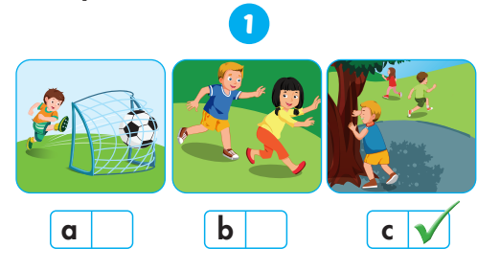

Slide 13
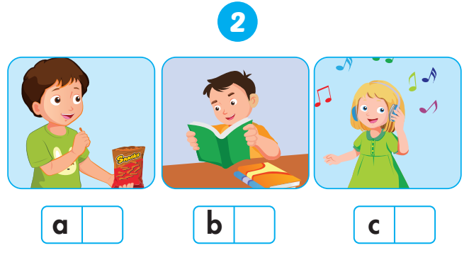


Slide 14
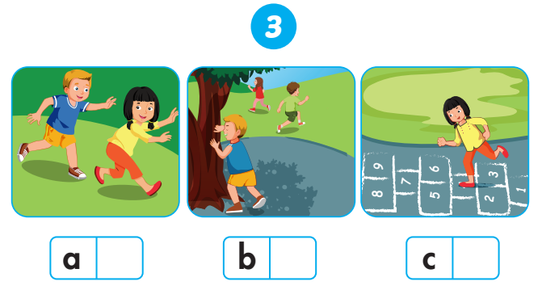

Slide 15
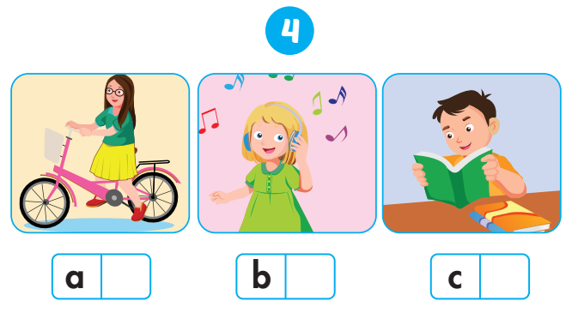

Slide 16

Practice

Slide 17

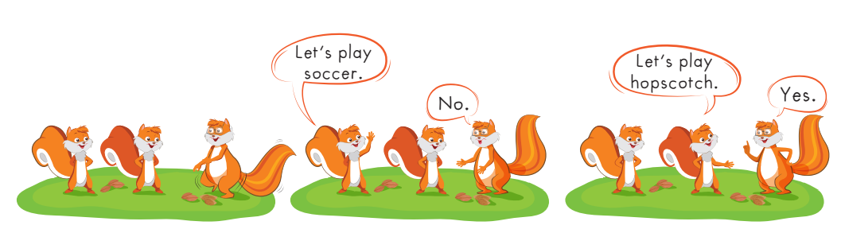

Slide 18

Further Practice

Slide 19

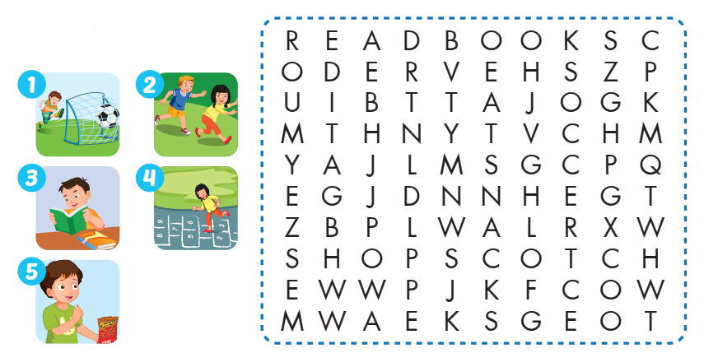


Slide 20







Slide 21

CONSOLIDATION

Slide 22


read

Slide 23
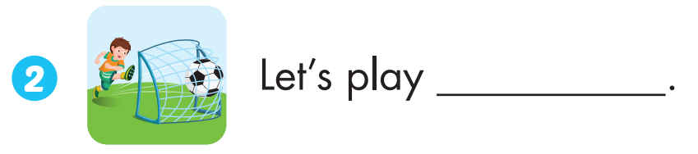
soccer

Slide 24

eat

Slide 25
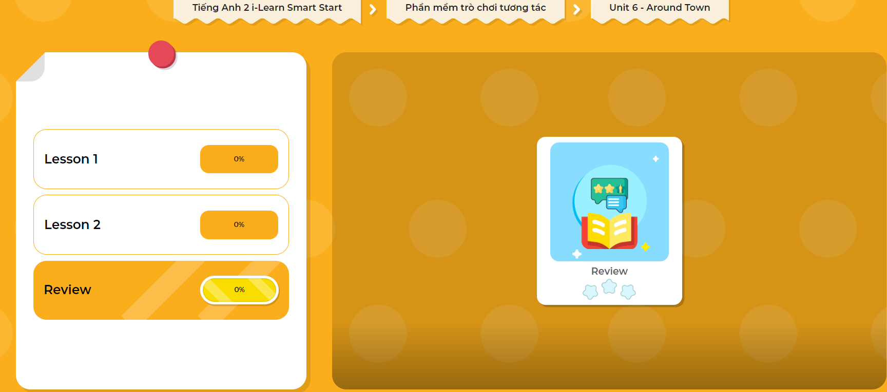
Extra Practice
DHA App
LET’S PLAY!
Click here to play the games

Slide 26

WRAP-UP

Slide 27
Today’s lesson
Vocabulary
Revise
Structures/ Sentence patterns
Revise

Slide 28
Homework
Practice vocabularies and structure. Make sentences using them.
Do the exercises in Tiếng Anh 2 i-Learn Smart Start Workbook (page 42).
Play the consolidation games in Tiếng Anh 2 i-Learn Smart Start DHA App on www.eduhome.com.vn
Prepare the next lesson (page 45)

Slide 29

Enjoy your day!

