Slide 1

Unit 7 : Clothes
Lesson 1.1: Vocabulary & Sentence Patterns
Page: 46

Slide 2
Lesson Outline
Warm-up
Vocabulary
Structure
Consolidation
Wrap-up

Slide 3
Objectives
By the end of this lesson, students will be able to identify clothes.
Vocabulary: T-shirt, dress, hat, shirt
Structure: Is this your (T-shirt)?
Yes, it is.
Is this your (dress)?
No, it isn’t.

Slide 4

WARM-UP

Slide 5

LET’S PLAY!
What’s missing?

Slide 6

It’s time to learn …

Slide 7

New words
T-shirt,
dress,
hat,
shirt.

Slide 8


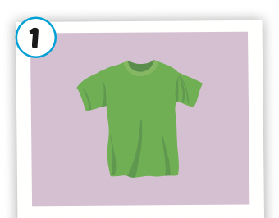
Click on the picture or the icon to hear the sound
T-shirt
/ˈtiː.ʃɝːrt/
áo thun

Slide 9
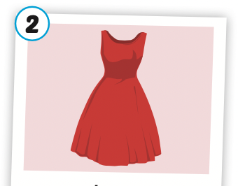
Click on the picture or the icon to hear the sound
dress
/dres/
áo đầm

Slide 10
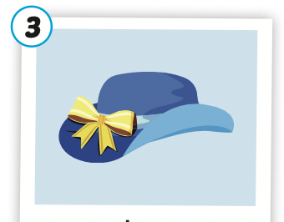
Click on the picture or the icon to hear the sound
hat
/hæt/
mũ, nón

Slide 11
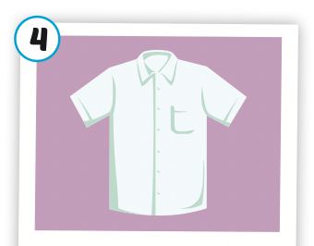
Click on the picture or the icon to hear the sound
shirt
/ʃɝːrt/
áo sơ mi

Slide 12
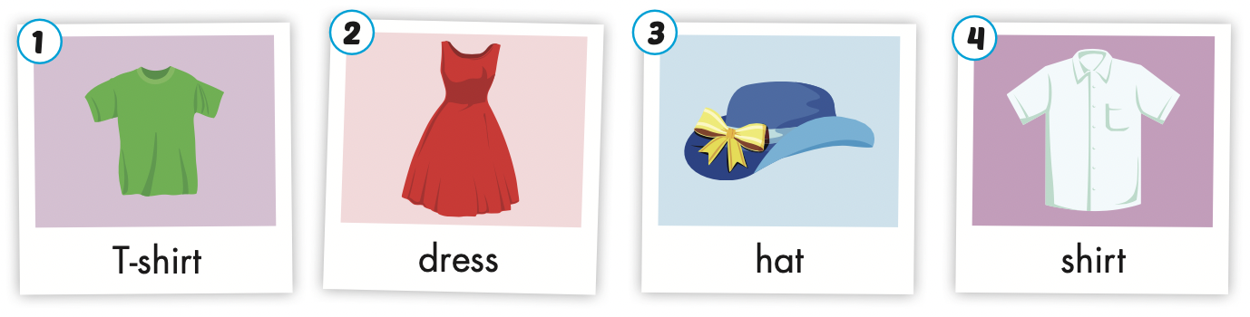

Slide 13
Let’s play!
Choose the pictures matching with the words.

Slide 14

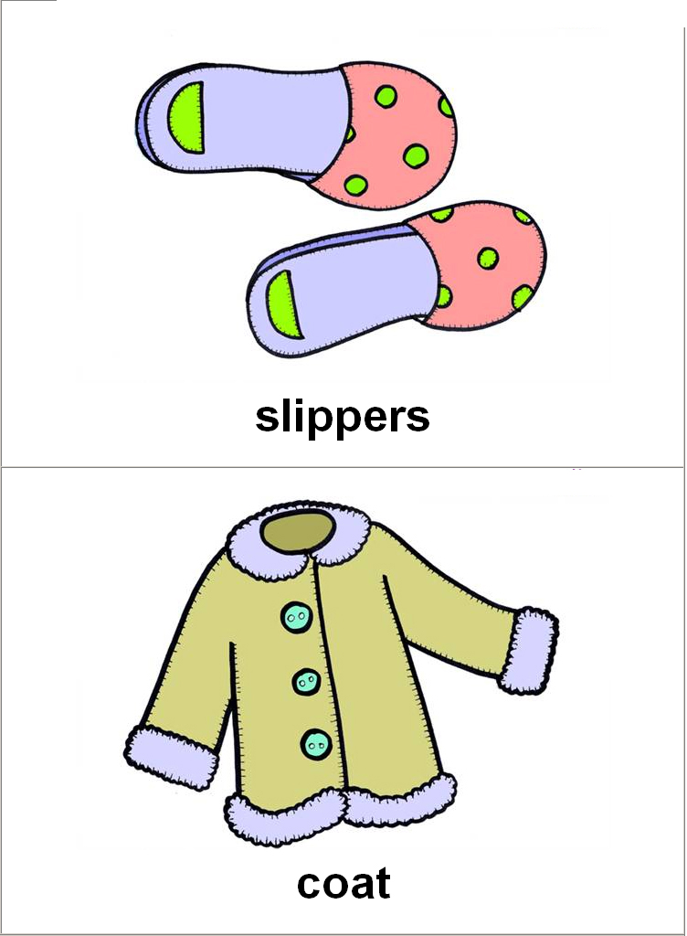
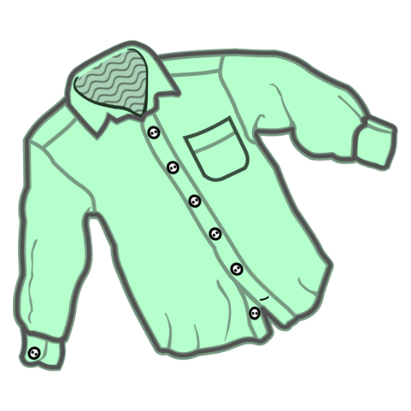

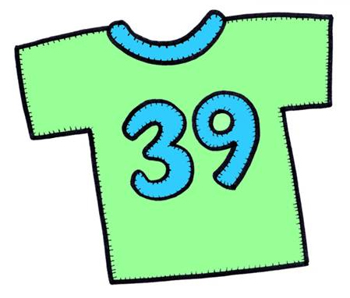
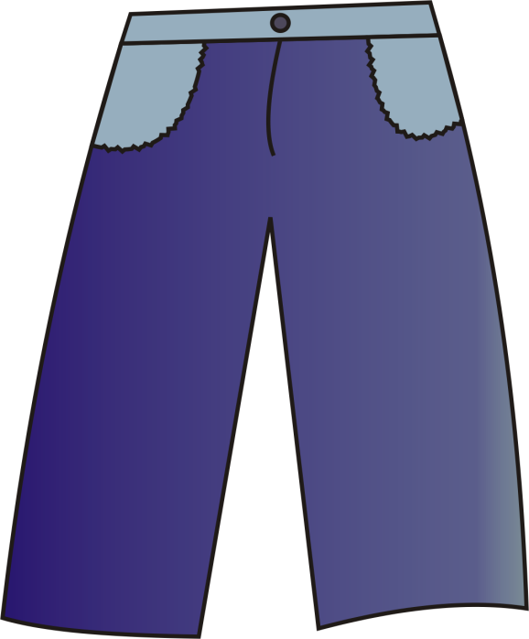

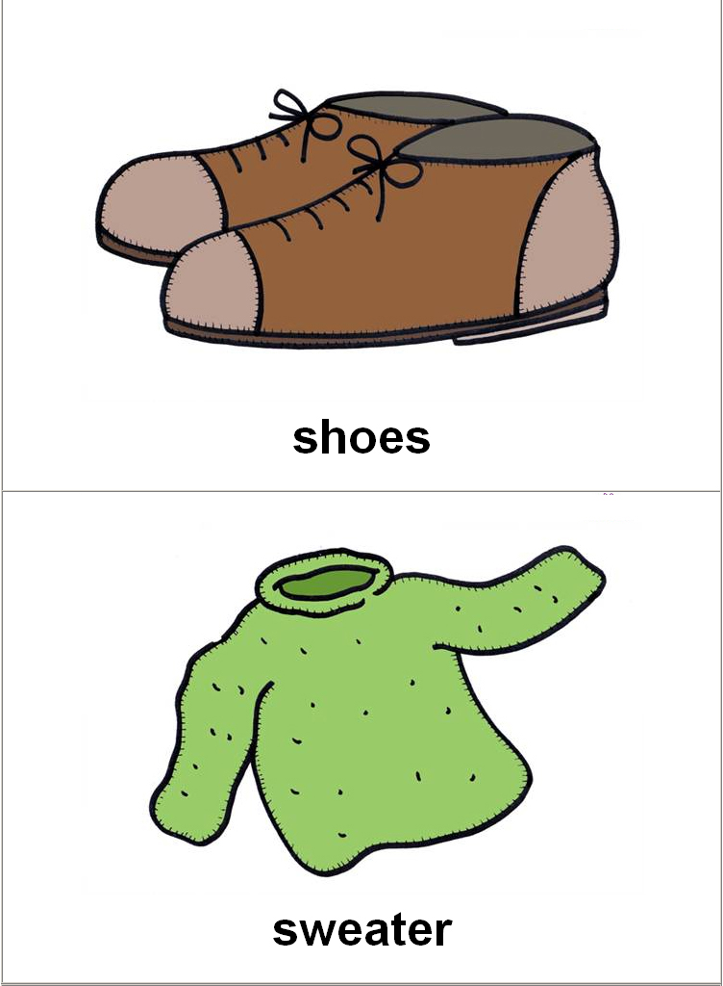
IT’S A T-SHIRT.
NEXT

Slide 15
IT’S A DRESS.
NEXT

Slide 16
IT’S A SHIRT.
NEXT

Slide 17
IT’S A HAT.
NEXT

Slide 18
Good job!

Slide 19
Structures
Is this your (T-shirt)?
Yes, it is.
Is this your (dress)?
No, it isn’t.

Slide 20

Presentation

Slide 21
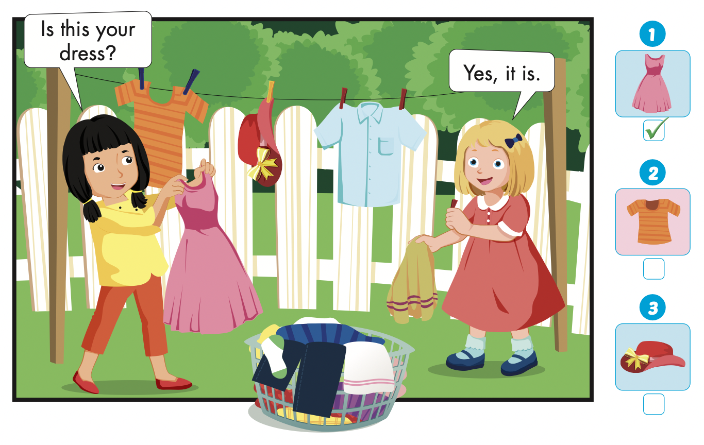



Slide 22
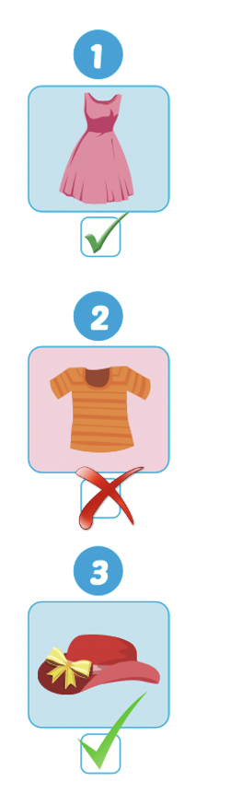
Listen and repeat.
Is this your dress?
Yes, it is.

Slide 23
Listen and repeat
Is this your T-shirt?
No, it isn’t.

Slide 24
Listen and repeat
Is this your hat?
Yes, it is.

Slide 25

Practice

Slide 26
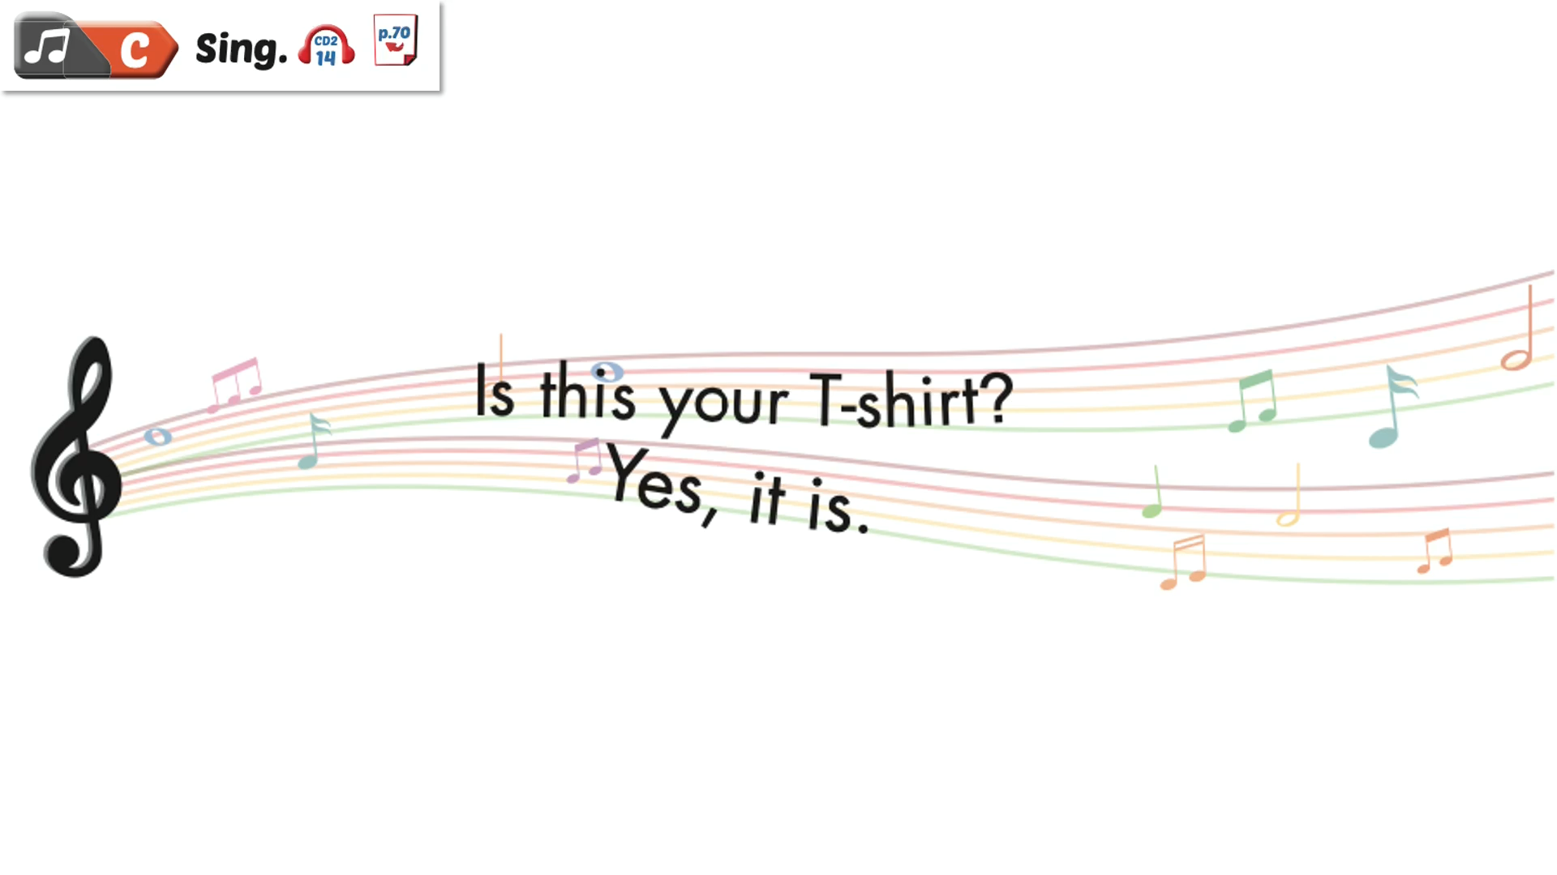

Slide 27

Production

Slide 28

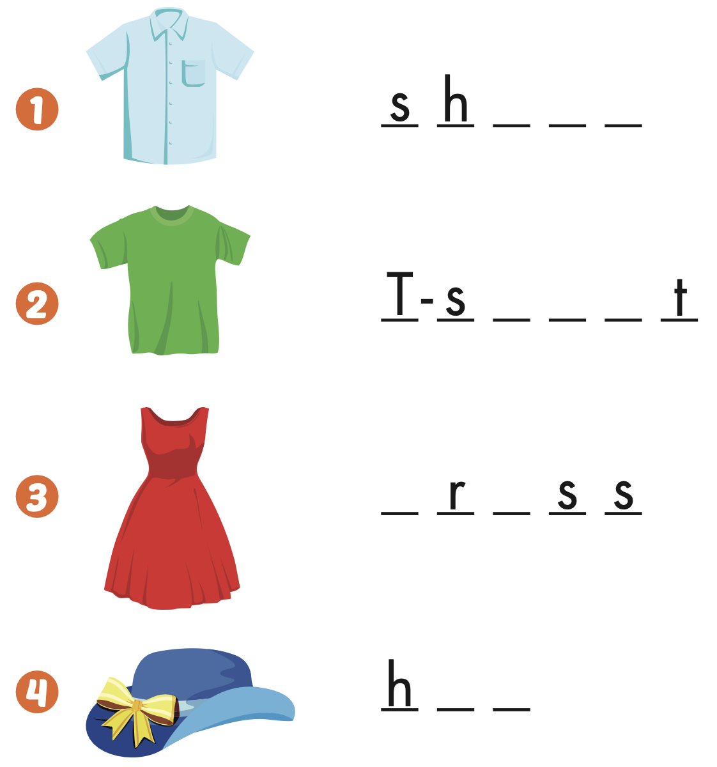
Extra Practice
WB, page 44
i r t
h i r

Slide 29
Extra Practice
WB, page 44
d e
a t

Slide 30
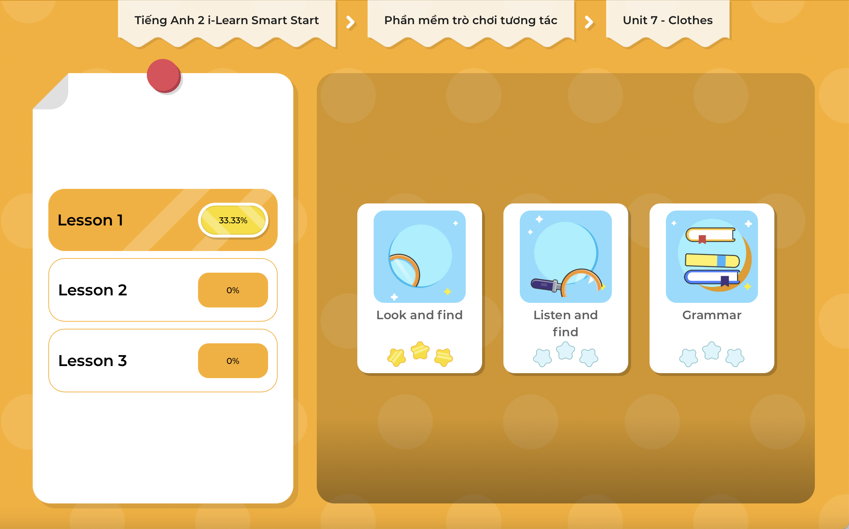
Extra Practice
DHA on Eduhome
LET’S PLAY!
Click on the picture below to play the games.

Slide 31

CONSOLIDATION

Slide 32

Let’s play!
Telephone game

Slide 33

WRAP-UP

Slide 34
Today’s lesson
Vocabularies
T-shirt,
Dress,
Hat,
Shirt.
Structures/ Sentence patterns
Is this your (T-shirt)?
Yes, it is.
Is this your (dress)?
No, it isn’t.

Slide 35
Homework
Practice the vocabulary and structure, and make sentences using them.
Do the exercises in Tiếng Anh 2 i-Learn Smart Start WB (page 44).
Do the exercises in Tiếng Anh 2 i-Learn Smart Start Notebook (page 46).
Prepare the next lesson (page 47 SB).
Play the consolidation games in Tiếng Anh 2 i-Learn Smart Start DHA App on www.eduhome.com.vn

Slide 36

Enjoy your day!

