Slide 1

Unit 7 : Clothes
Lesson 1.2: Vocabulary & Sentence Patterns
Page: 47

Slide 2
Lesson Outline
Warm-up
Practice
Production
Consolidation
Wrap-up

Slide 3
Objectives
By the end of this lesson, students will be able to identify clothes.
Vocabulary: T-shirt, dress, hat, shirt
Structure: Is this your (T-shirt)?
Yes, it is.
        Is this your (dress)?
        No, it isn’t.

Slide 4

WARM-UP

Slide 5
Let’s sing!

Slide 6
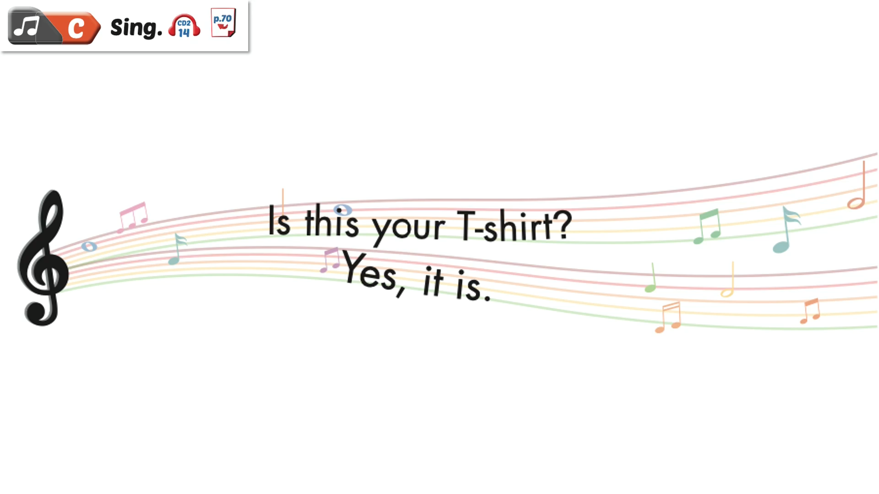

Slide 7

It’s time to learn …

Slide 8

New words
T-shirt,
dress,
hat,
shirt.

Slide 9
Let’s play!
Read and click on the correct picture!

Slide 10




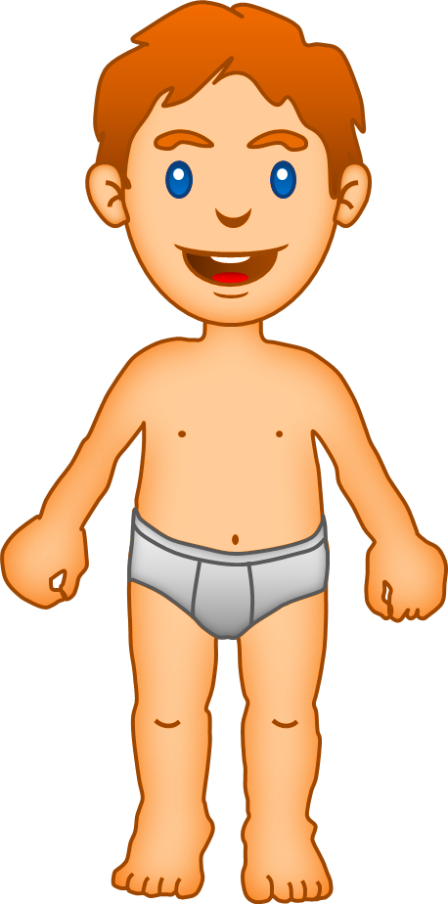
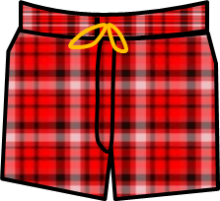



Hello!
CLOTHES

Slide 11

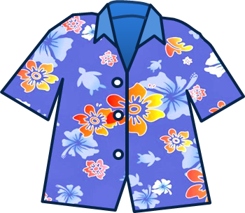
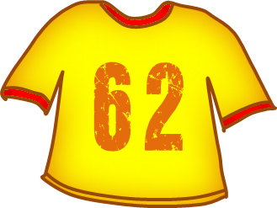

I need my T-shirt.

Slide 12
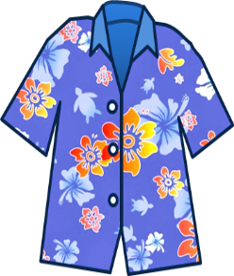

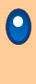
I need my shirt.
GOOD!

Slide 13


Thank you.
GOOD!

Slide 14


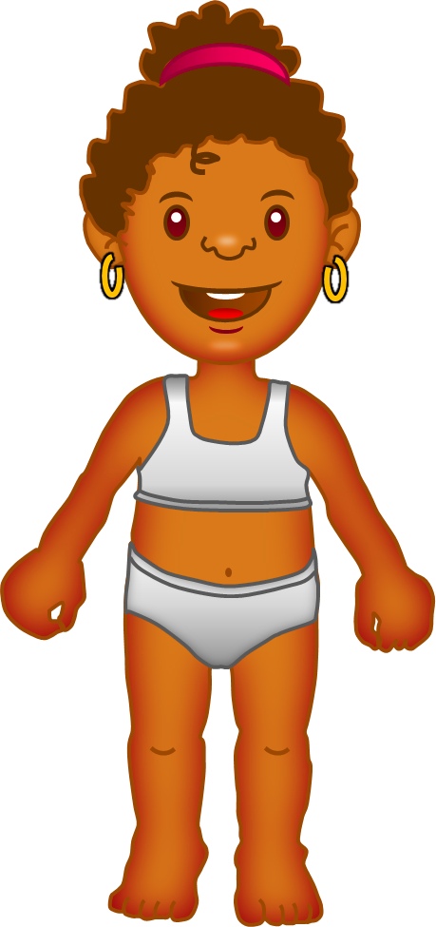
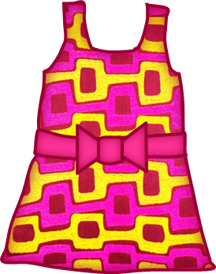
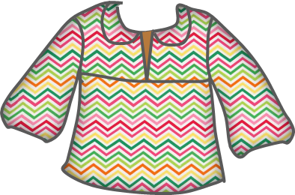


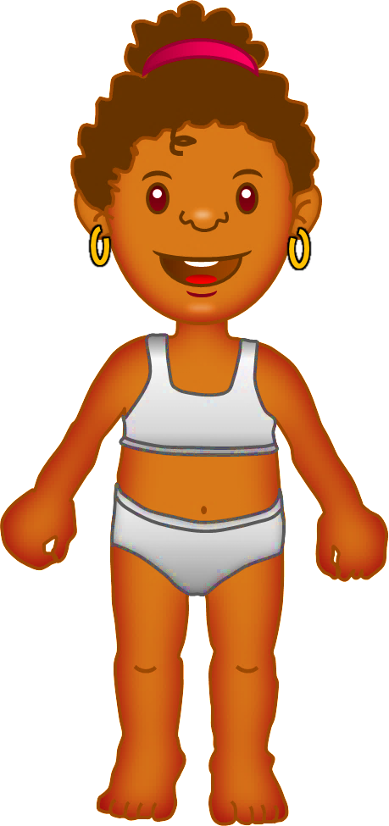

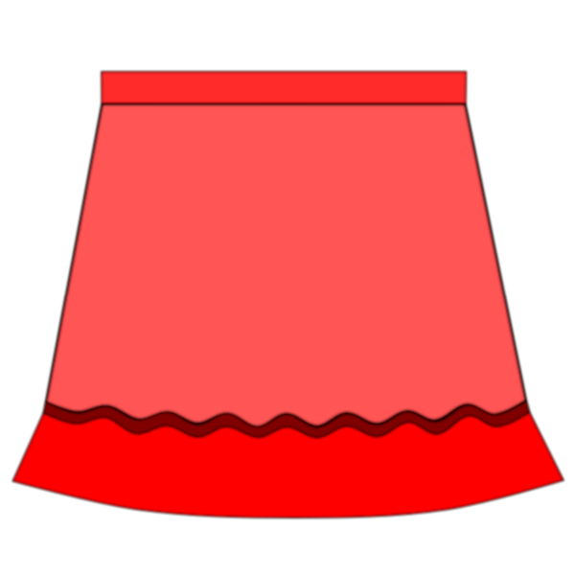

I need my dress.

Slide 15

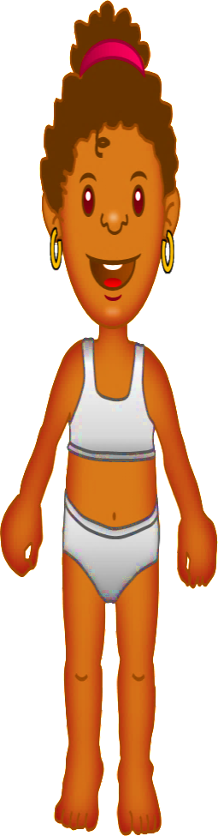

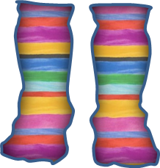
I need my hat.
GOOD!

Slide 16
I need my bag.
GOOD!

Slide 17

Thank you!
GOOD!

Slide 18
Structures
Is this your (T-shirt)?
Yes, it is.
Is this your (dress)?
No, it isn’t.

Slide 19

Practice

Slide 20

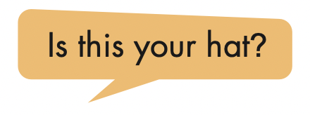
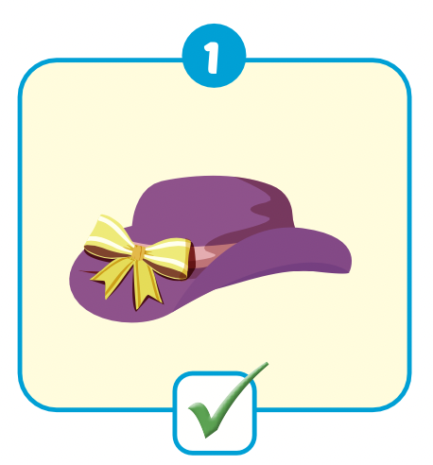
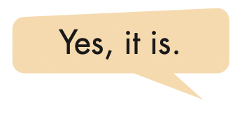

Slide 21
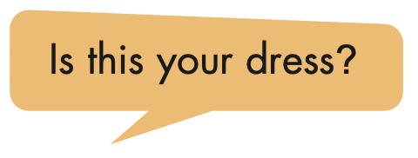
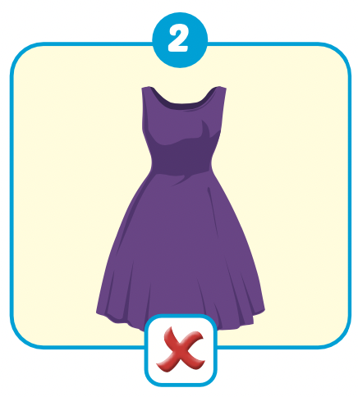
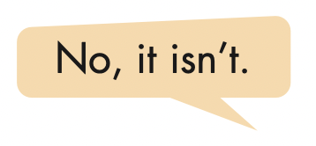

Slide 22

Speaking

Slide 23
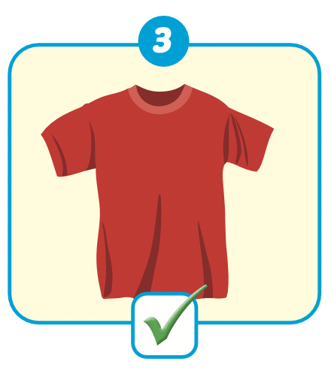
Is this your T-shirt?
Yes, it is.

Slide 24
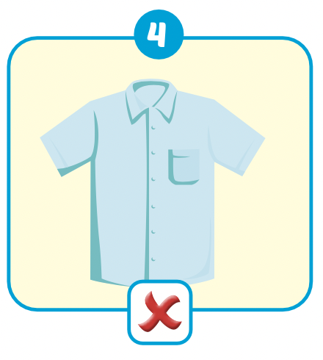
Is this your shirt?
No, it isn’t.

Slide 25
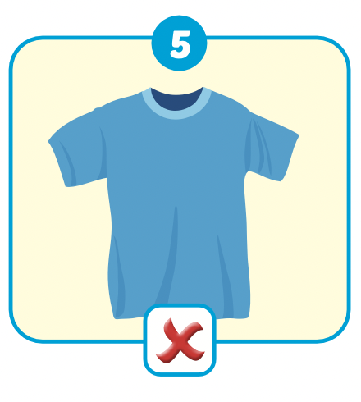
Is this your T-shirt?
No, it isn’t.

Slide 26
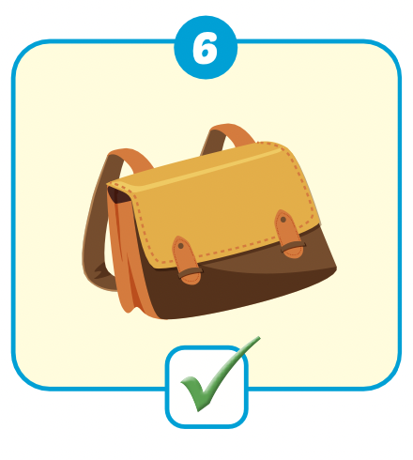
Is this your bag?
Yes, it is.

Slide 27
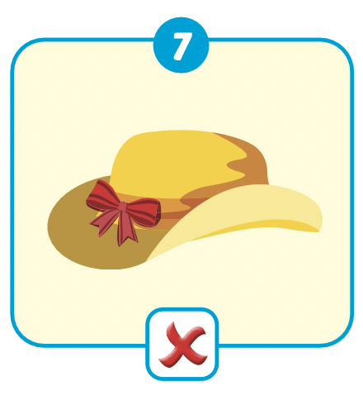
Is this your hat?
No, it isn’t.

Slide 28
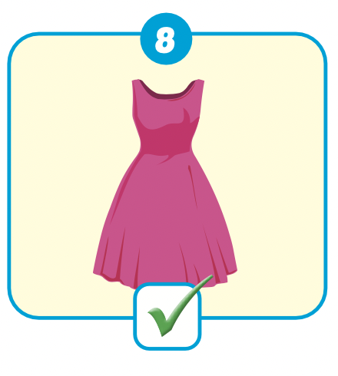
Is this your dress?
Yes, it is.

Slide 29

Production

Slide 30

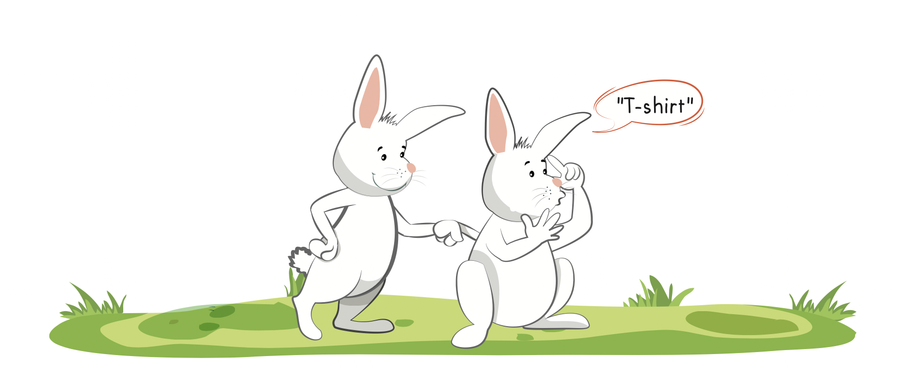

Slide 31
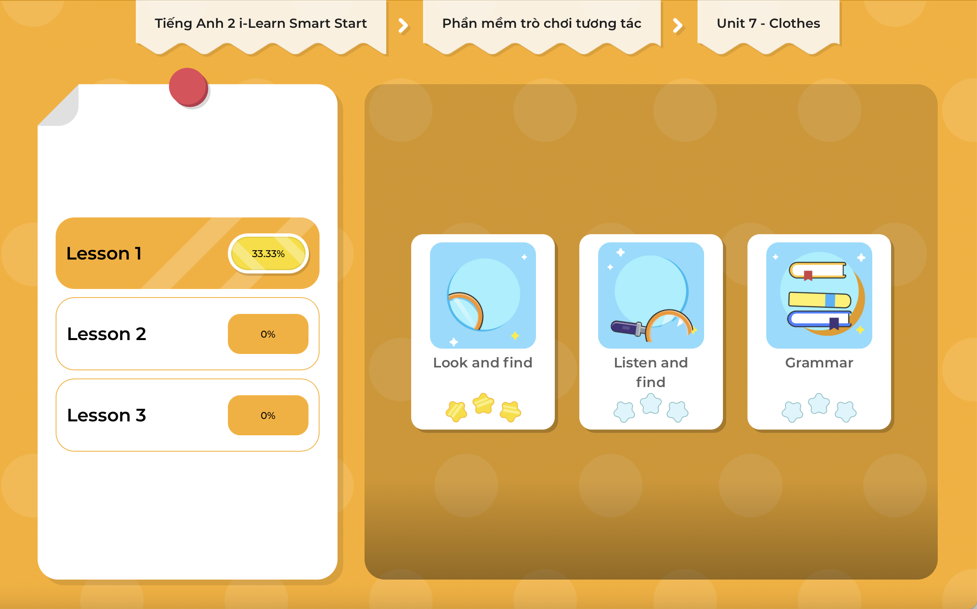
Extra Practice
DHA on Eduhome
LET’S PLAY!
Click on the picture below to play the games.

Slide 32


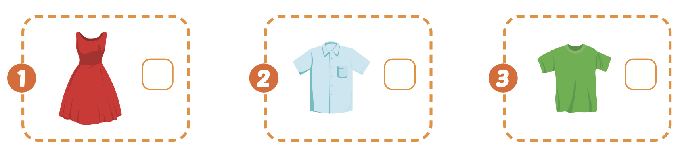


Extra Practice
WB, page 45

Slide 33

CONSOLIDATION

Slide 34
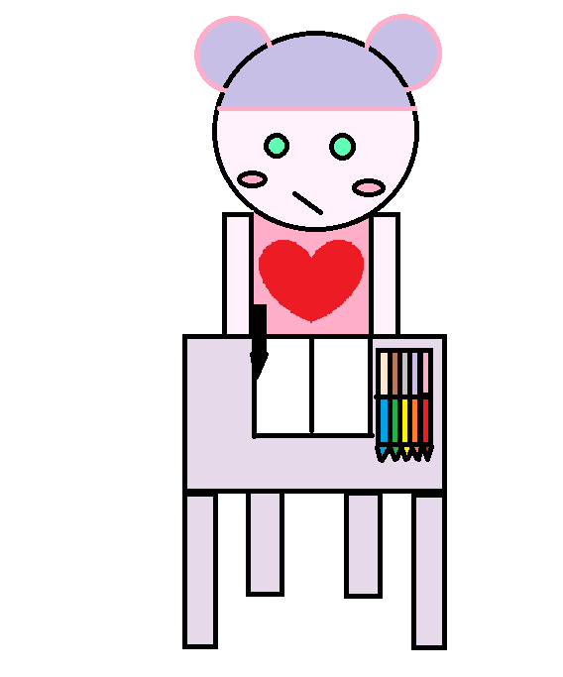
Let’s play!
Pictionary game

Slide 35

WRAP-UP

Slide 36
Today’s lesson
Vocabularies
T-shirt,
Dress,
Hat,
Shirt.
Structures/ Sentence patterns
Is this your (T-shirt)?
Yes, it is.
Is this your (dress)?
No, it isn’t.

Slide 37
Homework
Practice the vocabulary and structure, and make sentences using them.
Do the exercises in Tiếng Anh 2 i-Learn Smart Start WB (page 45).
Do the exercises in Tiếng Anh 2 i-Learn Smart Start Notebook (page 47).
Prepare the next lesson (page 48 SB).
Play the consolidation games in Tiếng Anh 2 i-Learn Smart Start DHA App on www.eduhome.com.vn

Slide 38
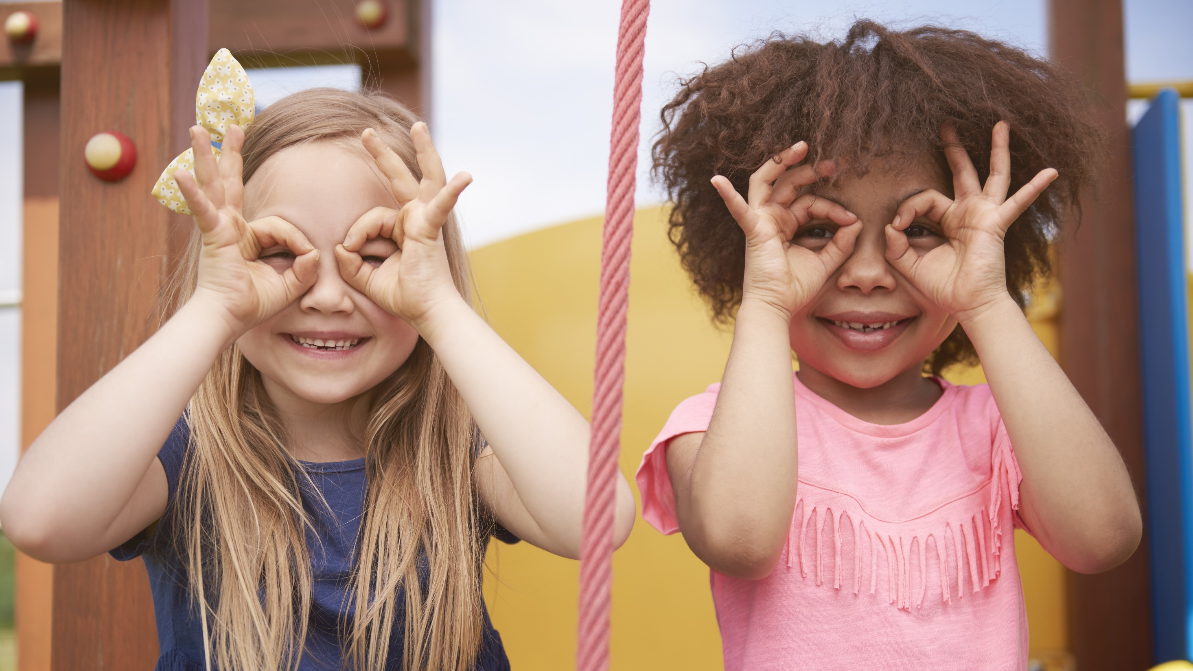
Enjoy your day!

