Slide 1

Unit 7 : Clothes
Lesson 2.1: Phonics
Page: 48

Slide 2
Lesson Outline
Warm-up
Practice
Production
Consolidation
Wrap-up

Slide 3
Objectives
By the end of this lesson, students will be able to recognize:
Vocabulary: violin, vest, watch, window
Phonics: /v/, /w/

Slide 4

WARM-UP

Slide 5

Let’s play!
Read my lips

Slide 6
Let’s sing!

Slide 7


Alphabet song

Slide 8

It’s time to learn …

Slide 9

Phonics
/v/,
/w/.

Slide 10

V, v
/ v /

Slide 11
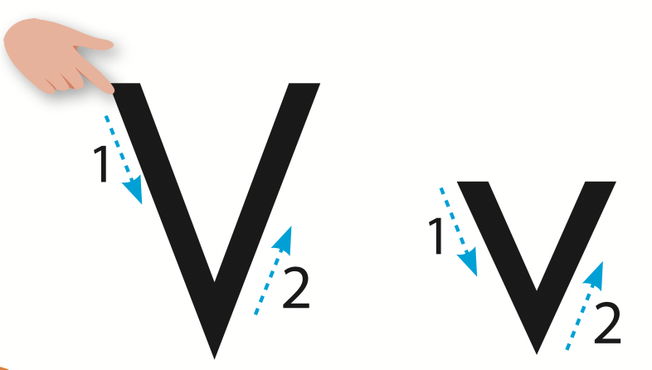
Let’s trace!

Slide 12



/v/
violin
vest
/ˌvaɪəˈlɪn/
/vest/

Slide 13
/v/
violin
/ˌvaɪəˈlɪn/

Slide 14
/v/
vest
/vest/

Slide 15


Let’s write!

Slide 16

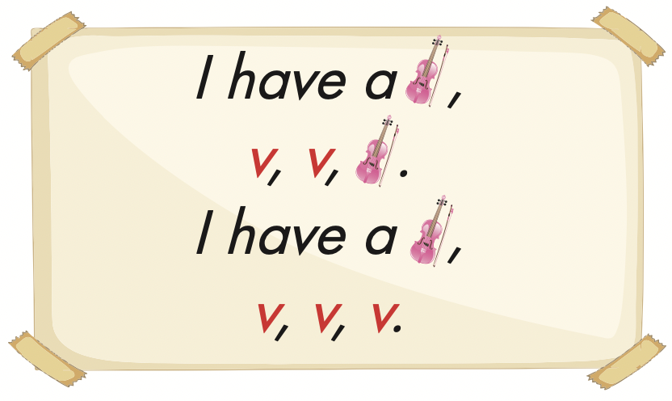

Slide 17
Let’s play!

Slide 18


/v/
V
violin

Slide 19
/v/
V
violin

Slide 20
/v/
violin
vest

Slide 21
/v/
violin
vest

Slide 22


Slide 23

Production

Slide 24



Slide 25
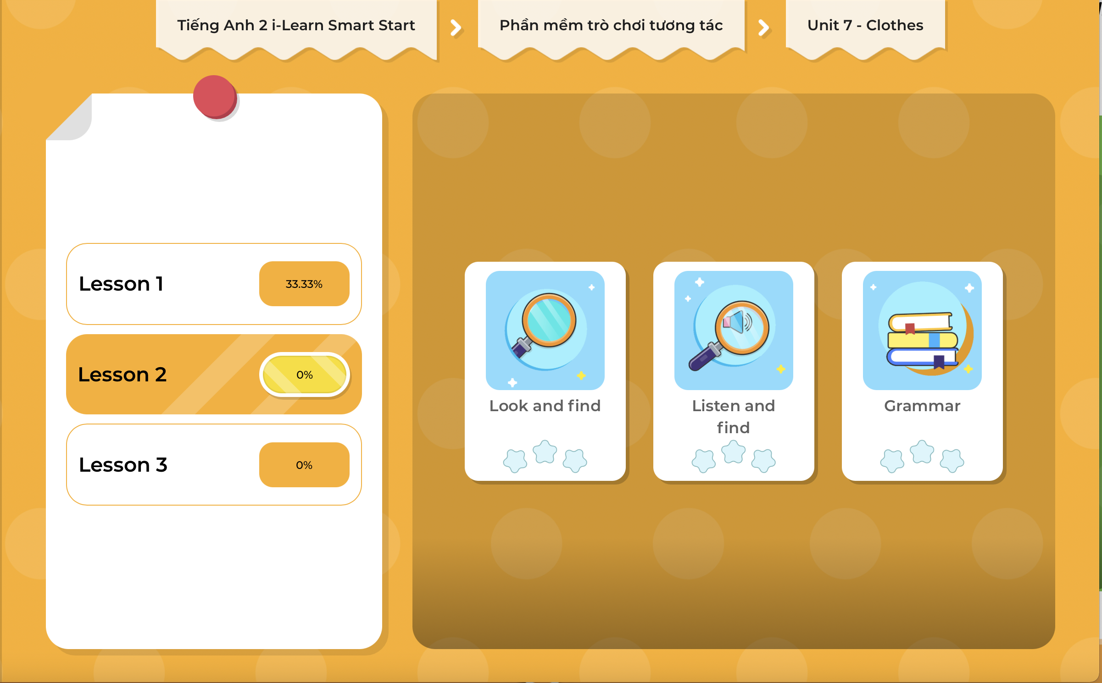
Extra Practice
DHA on Eduhome
LET’S PLAY!
Click on the picture below to play the games.

Slide 26

CONSOLIDATION

Slide 27

Let’s play!
Telephone game

Slide 28

WRAP-UP

Slide 29
Today’s lesson
Vocabularies
violin,
vest,
watch,
window.
Phonics
/v/, /w/

Slide 30
Homework
Practice the vocabulary and structure, and make sentences using them.
Do the exercises in Tiếng Anh 2 i-Learn Smart Start WB (page 46).
Do the exercises in Tiếng Anh 2 i-Learn Smart Start Notebook (page 48).
Prepare the next lesson (page 49 SB).
Play the consolidation games in Tiếng Anh 2 i-Learn Smart Start DHA App on www.eduhome.com.vn

Slide 31

Enjoy your day!

