Slide 1

Unit 7 : Clothes
Lesson 2.2: Phonics
Page: 49

Slide 2
Lesson Outline
Warm-up
Practice
Production
Consolidation
Wrap-up

Slide 3
Objectives
By the end of this lesson, students will be able to recognize:
Vocabulary: violin, vest, watch, window
Phonics: /v/, /w/

Slide 4

WARM-UP

Slide 5
Let’s sing!

Slide 6


Alphabet song

Slide 7

It’s time to learn …

Slide 8

Phonics
/v/,
/w/.

Slide 9

W, w
/ w /

Slide 10
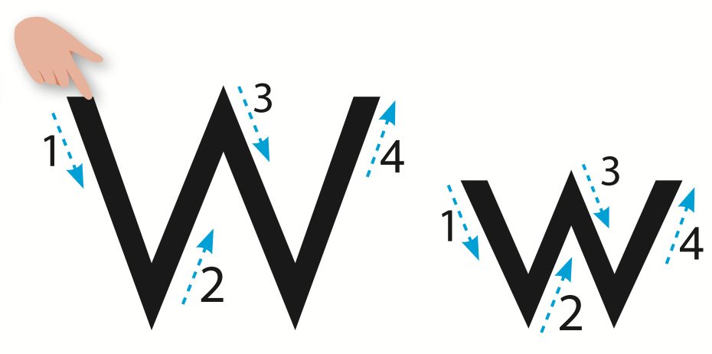
Let’s trace!

Slide 11

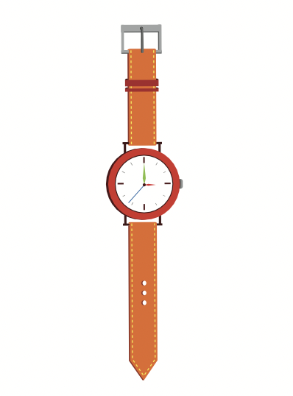

/w/
watch
window
/wɒtʃ/
/ˈwɪndoʊ/

Slide 12
/w/
window
/ˈwɪndoʊ/

Slide 13
/w/
watch
/wɒtʃ/

Slide 14

Let’s write!

Slide 15

Let’s write!

Slide 16

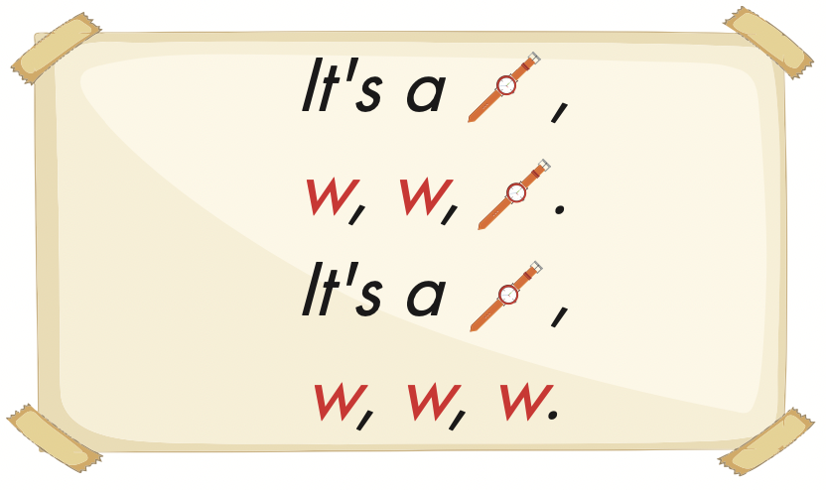

Slide 17
Let’s play!

Slide 18

Start
Check
Next

Slide 19

Start
Check
Next

Slide 20

Start
Check
Next

Slide 21
Start
Check
Next

Slide 22


Slide 23

Production

Slide 24
Let’s play!

Slide 25



Slide 26

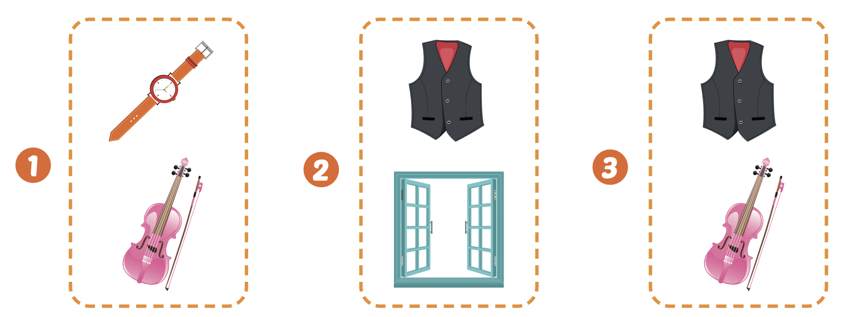
Extra Practice
WB, page 47

Slide 27
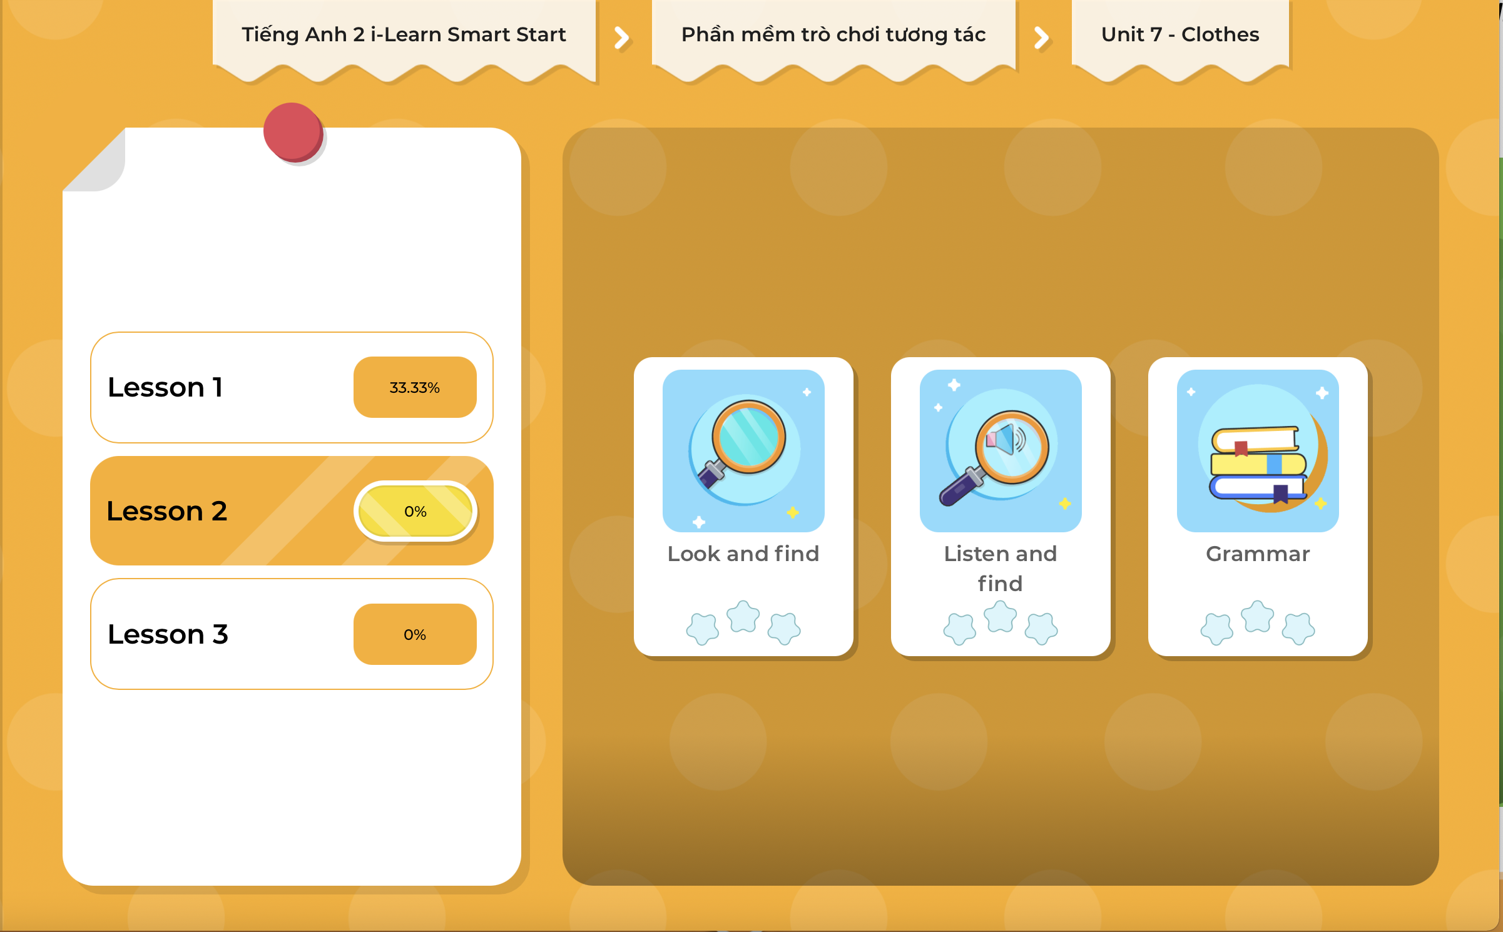
Extra Practice
DHA on Eduhome
LET’S PLAY!
Click on the picture below to play the games.

Slide 28

CONSOLIDATION

Slide 29

Let’s play!
BODY WRITING GAME

Slide 30

WRAP-UP

Slide 31
Today’s lesson
Vocabularies
violin,
vest,
watch,
window.
Phonics
/v/, /w/

Slide 32
Homework
Practice the vocabulary and structure, and make sentences using them.
Do the exercises in Tiếng Anh 2 i-Learn Smart Start WB (page 47).
Do the exercises in Tiếng Anh 2 i-Learn Smart Start Notebook (page 49).
Prepare the next lesson (page 50 SB).
Play the consolidation games in Tiếng Anh 2 i-Learn Smart Start DHA App on www.eduhome.com.vn

Slide 33

Enjoy your day!

