Slide 1

Unit 7 : Clothes
Lesson 3.1: Vocabulary & Sentence Patterns
Page: 50

Slide 2
Lesson Outline
Warm-up
Vocabulary
Structure
Consolidation
Wrap-up

Slide 3
Objectives
By the end of this lesson, students will be able to identify clothes.
Vocabulary: socks, pants, shoes, shorts
Structure: These are my (pants).

Slide 4

WARM-UP

Slide 5

Let’s play!
Hot seat game

Slide 6

It’s time to learn …

Slide 7

New words
Pants,
Shoes,
Shorts,
Socks.

Slide 8

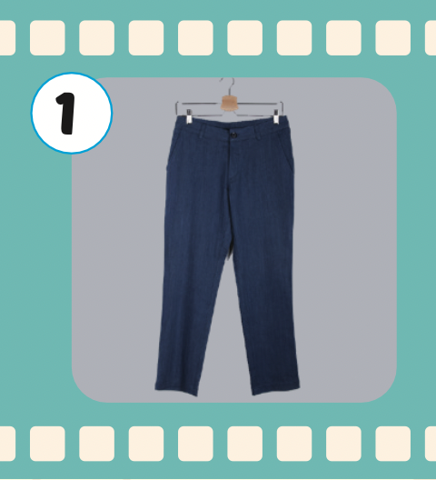

pants
/pænts/
quần dài

Slide 9
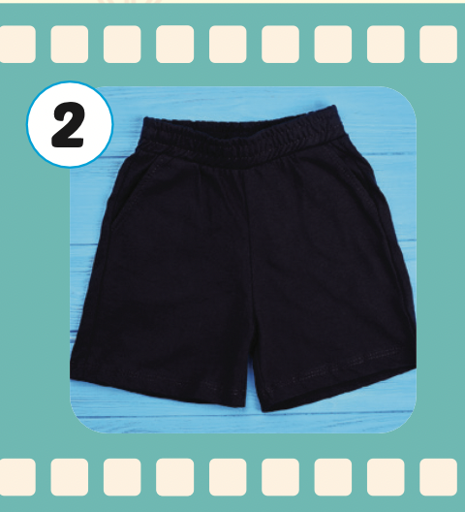
shorts
/ʃɔːrts/
quần ngắn

Slide 10

shoes
/ʃuːz/
đôi giày

Slide 11
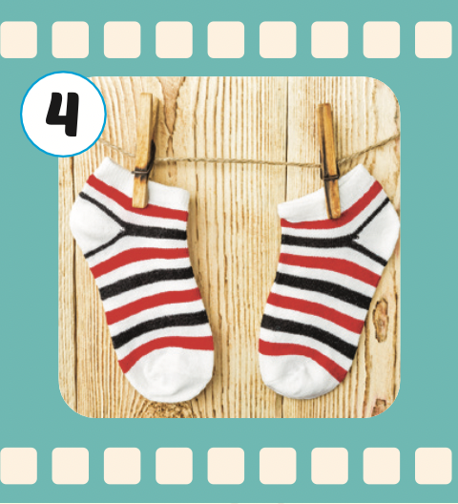
socks
/sɒks/
đôi tất, vớ

Slide 12
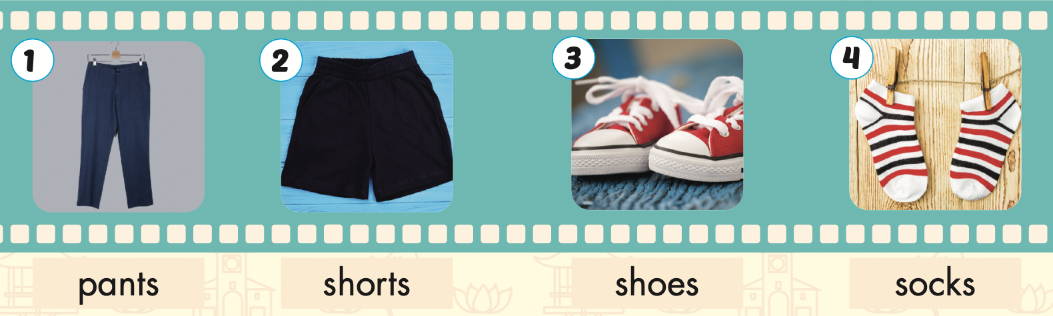

Slide 13
Let’s play!

Slide 14

CLOTHES
GAME
Notes:
14

Slide 15

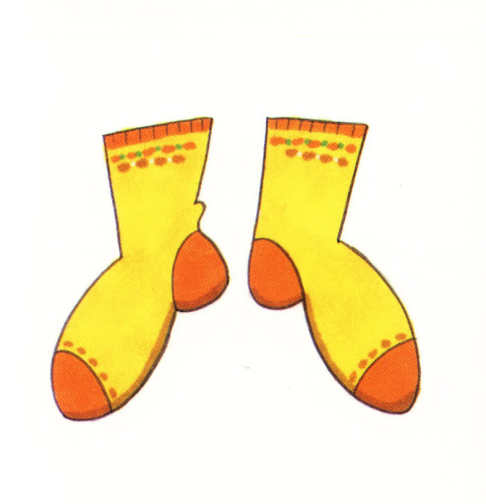
SOCKS
SHOES
SHORTS
SOCKS
Notes:
15

Slide 16
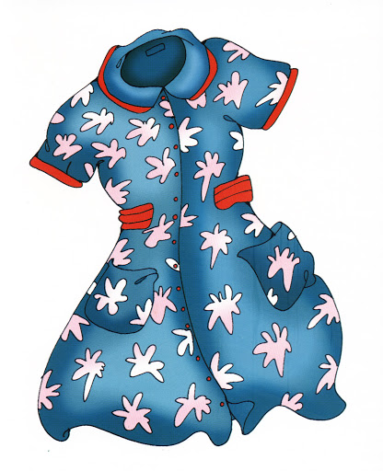
T-SHIRT
SKIRT
DRESS
DRESS
Notes:
16

Slide 17
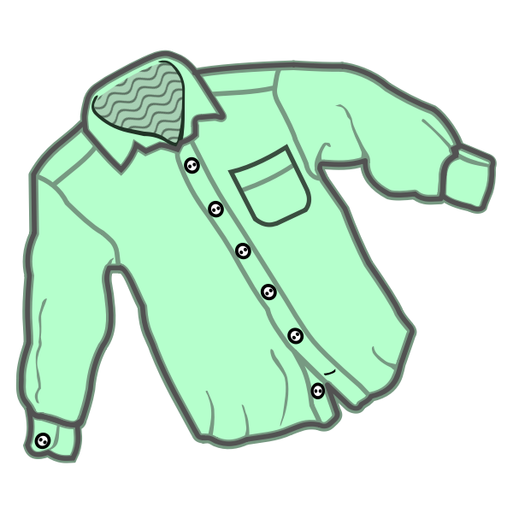
SOCKS
SHIRT
T-SHIRT
SHIRT
Notes:
17

Slide 18

SHORTS
SHOES
SOCKS
SHOES
Notes:
18

Slide 19
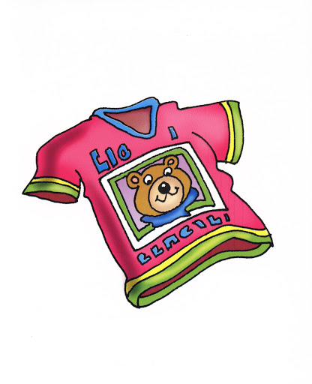
SHIRT
DRESS
T-SHIRT
T-SHIRT
Notes:
19

Slide 20

SHIRT
PANTS
SHORTS
PANTS
Notes:
20

Slide 21
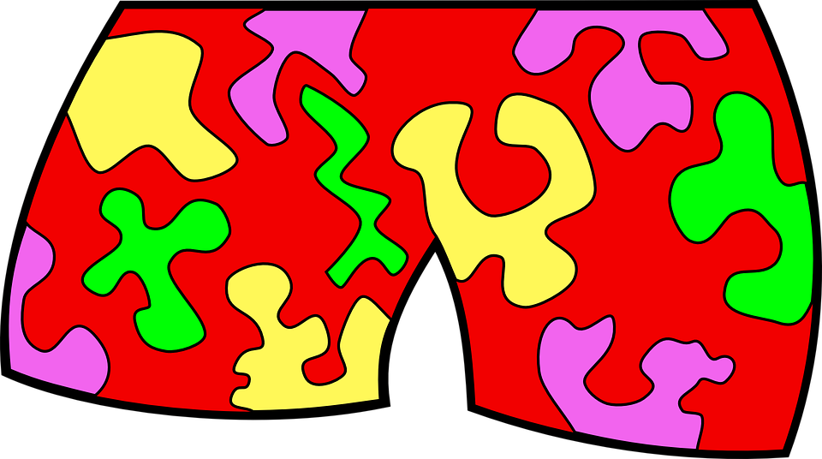
SHORTS
SHOES
SOCKS
SHORTS
Notes:
21

Slide 22
Structures
These are my (pants).

Slide 23

Presentation

Slide 24

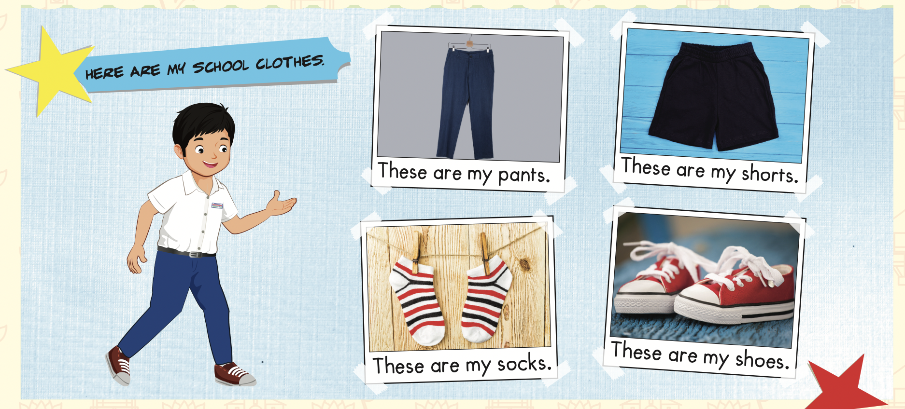

Slide 25

Practice

Slide 26

Speaking

Slide 27

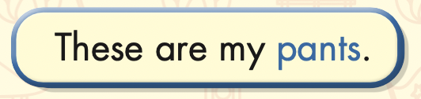

Slide 28
These are my pants.

Slide 29
These are my shorts.

Slide 30
These are my shoes.

Slide 31
These are my socks.

Slide 32

Production

Slide 33

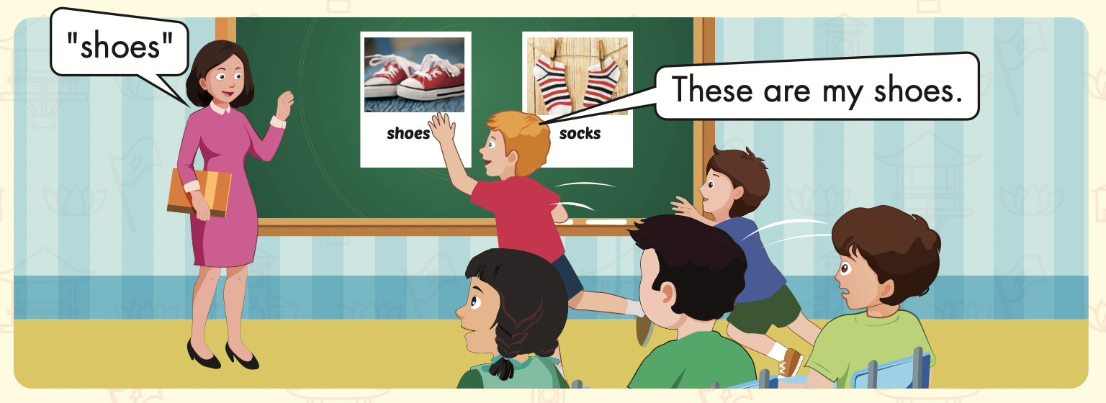

Slide 34
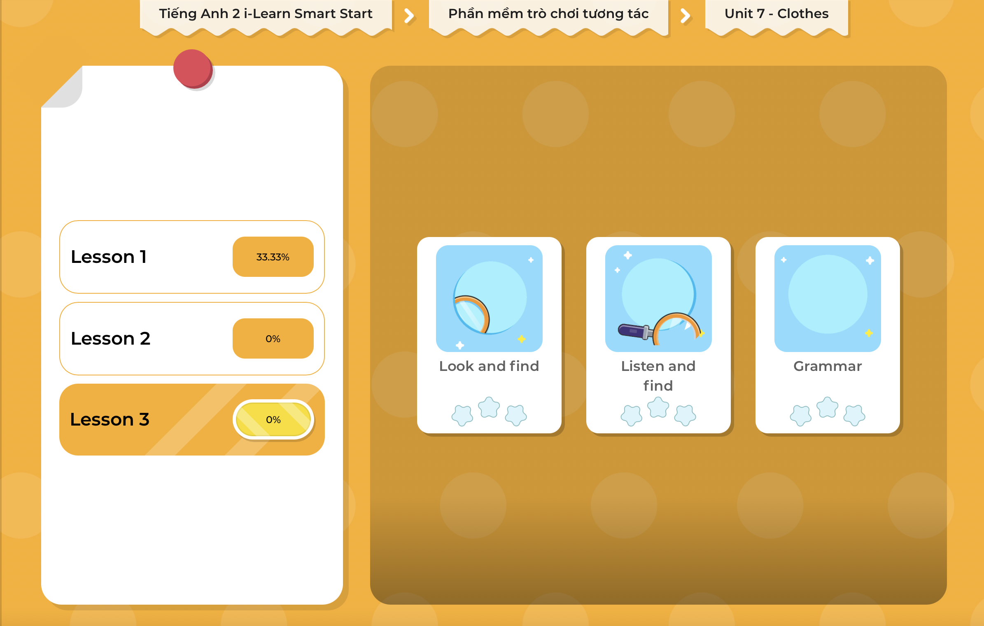
Extra Practice
DHA on Eduhome
LET’S PLAY!
Click on the picture below to play the games.

Slide 35

CONSOLIDATION

Slide 36
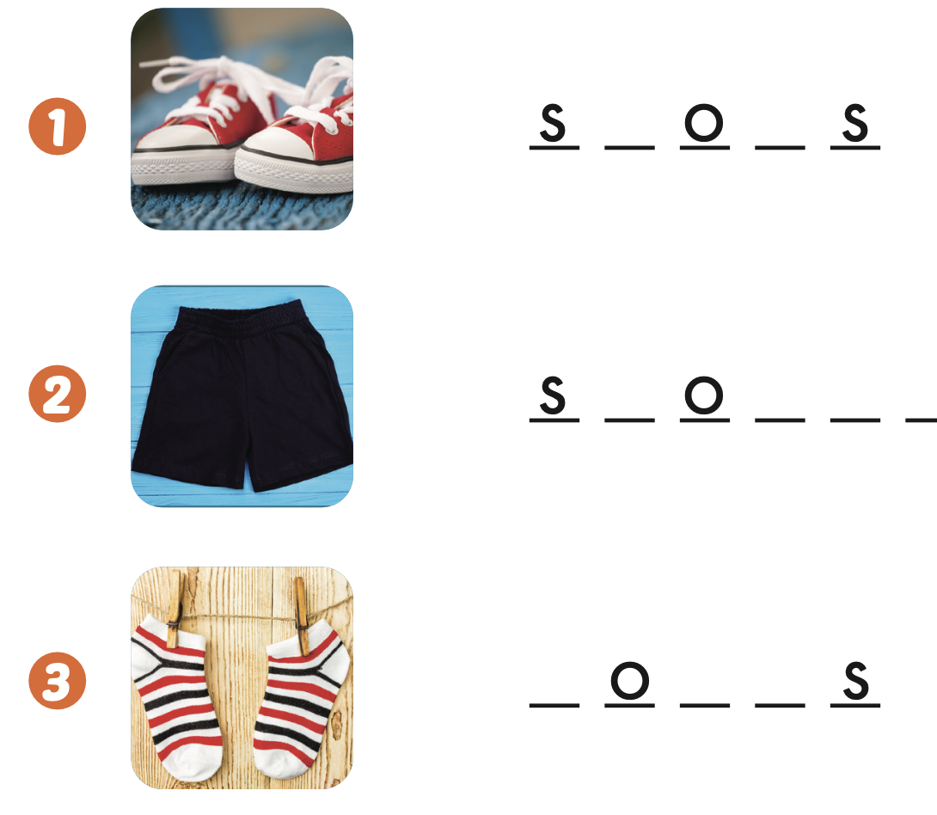

Extra Practice
WB, page 48
h e
h r t s
s c k

Slide 37

WRAP-UP

Slide 38
Today’s lesson
Vocabularies
shorts, pants, shoes, socks
Structures/ Sentence patterns
These are my (pants).

Slide 39
Homework
Practice the vocabulary and structure, and make sentences using them.
Do the exercises in Tiếng Anh 2 i-Learn Smart Start WB (page 48).
Do the exercises in Tiếng Anh 2 i-Learn Smart Start Notebook (page 50).
Prepare the next lesson (page 51 SB).
Play the consolidation games in Tiếng Anh 2 i-Learn Smart Start DHA App on www.eduhome.com.vn

Slide 40

Enjoy your day!

