Slide 1

Unit 7 : Clothes
Lesson 3.2: Vocabulary & Sentence Patterns
Page: 51

Slide 2
Lesson Outline
Warm-up
Listening
Speaking
Consolidation
Wrap-up

Slide 3
Objectives
By the end of this lesson, students will be able to accept and refuse an offer.
Structure: Yes, please.
No, thank you.

Slide 4

WARM-UP

Slide 5
Let’s play!
Bingo
B | I | N | G | O

Slide 6

It’s time to learn …

Slide 7

Structures
Yes, please.
No, thank you.

Slide 8
Let’s play!
Guess the words
1. Look at the picture
2. Say
3. Spell

Slide 9
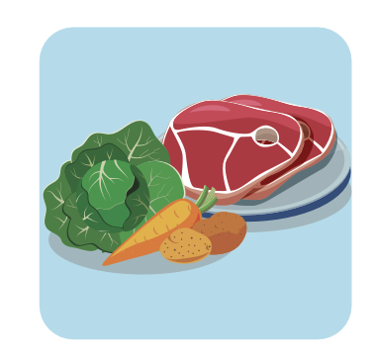


F _ _ d
o o
/fuːd/

Slide 10

j _ _ c _
u i e
/dʒuːs/

Slide 11
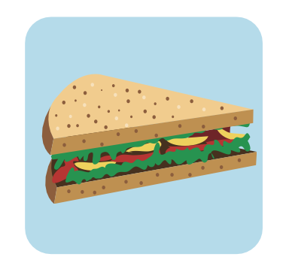
a n w c
s _ _ d _ i _ h
/ˈsænwɪtʃ/

Slide 12

c _ _ k _ _
o o i e
/ˈkʊki/

Slide 13
_ a _ a _ a
b n n
/bəˈnænə/

Slide 14

Listening

Slide 15
Pre-Listening
Look at the pictures and answer these questions.

Slide 16
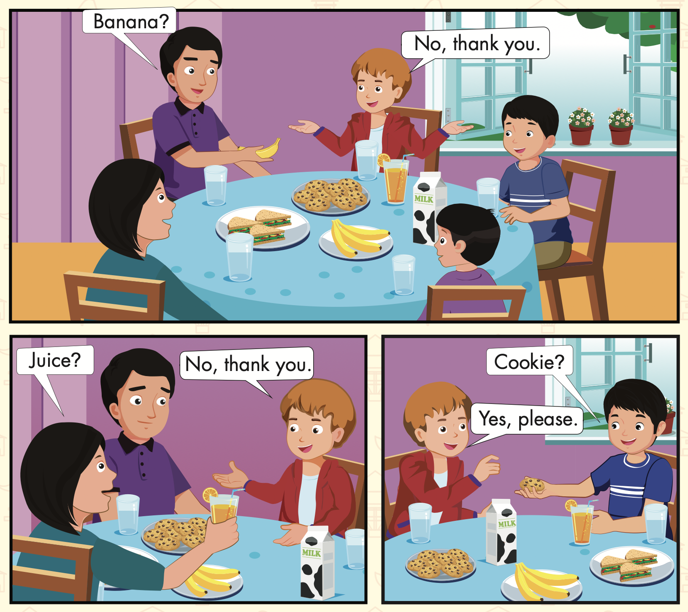
Who can you see?
What can you see?

Slide 17

While-Listening
Click on the icon to hear the sound

Slide 18
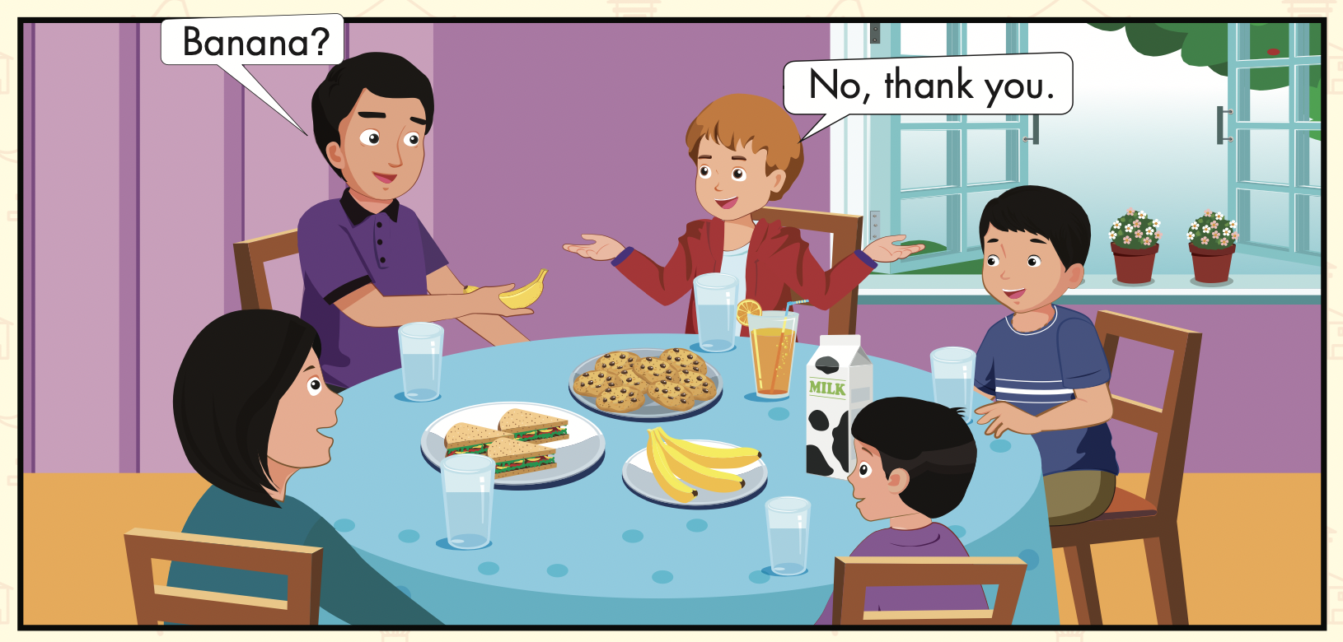
Let’s read!

Slide 19
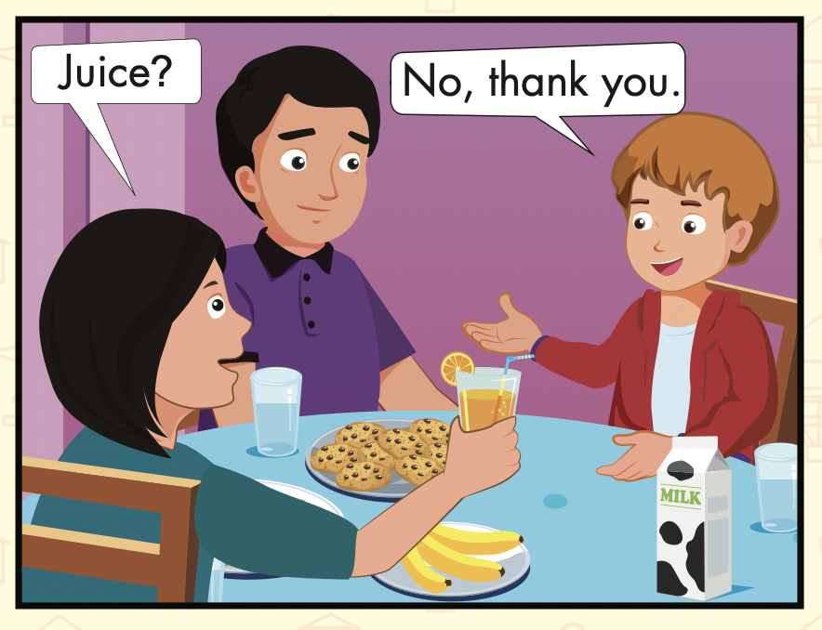
Let’s read!

Slide 20
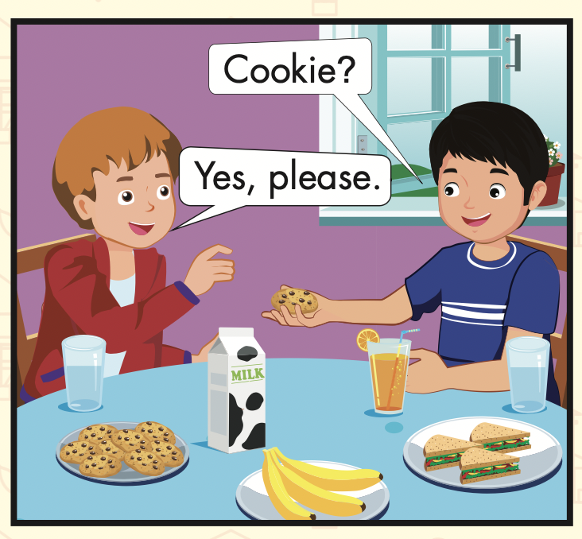
Let’s read!

Slide 21

Presentation

Slide 22

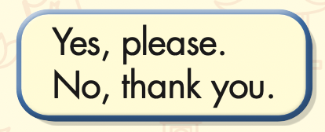
Click on the icon to hear the sound

Slide 23

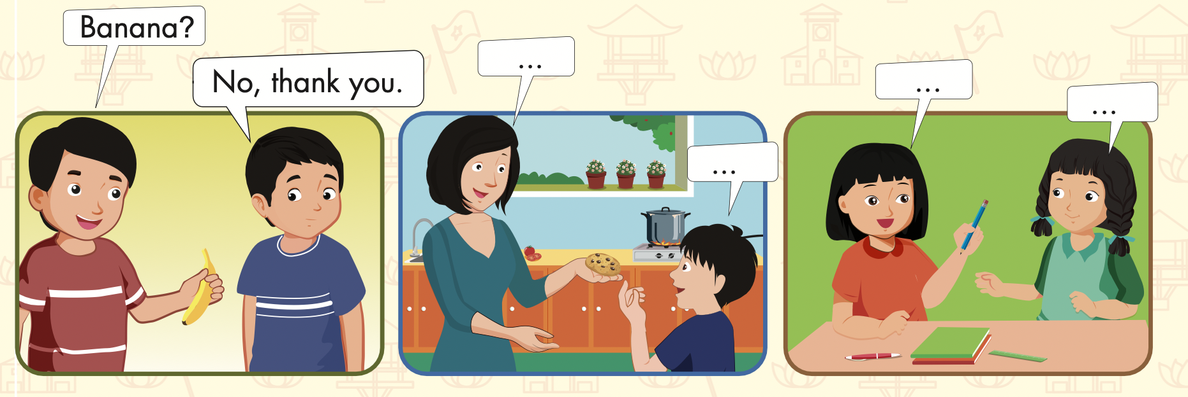

Slide 24

Practice

Slide 25

Speaking

Slide 26
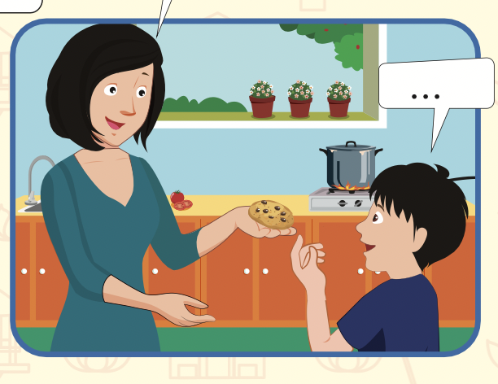
Cookie?
Yes, please.

Slide 27
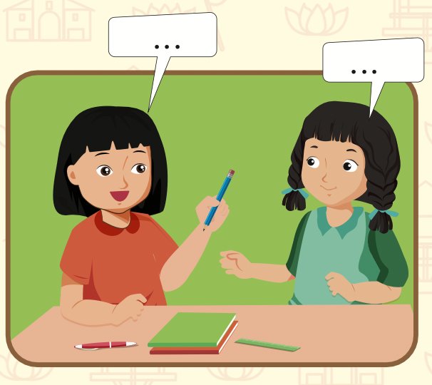
Pencil?
Yes, please.

Slide 28

Production

Slide 29

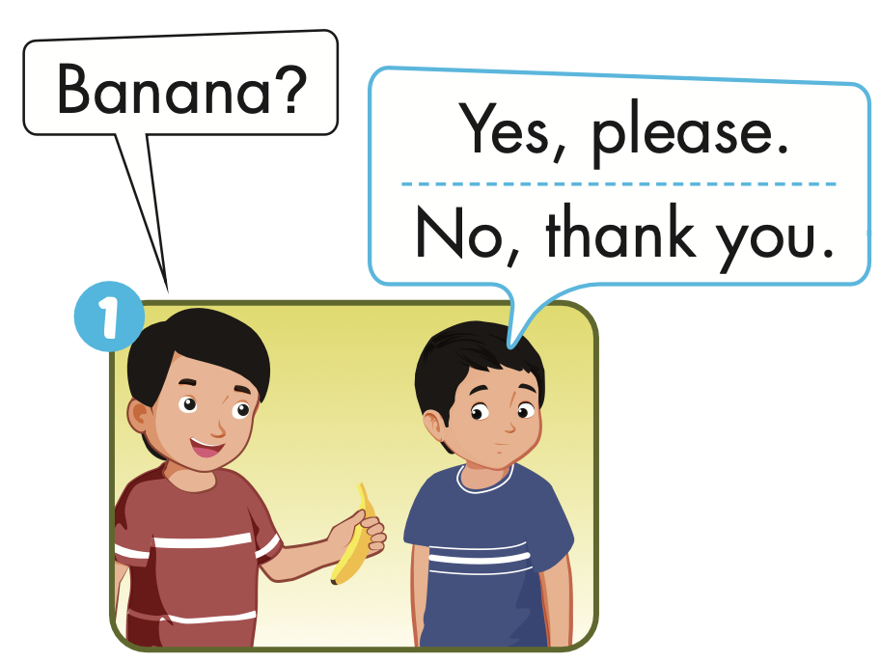
Extra Practice
WB, page 49

Slide 30
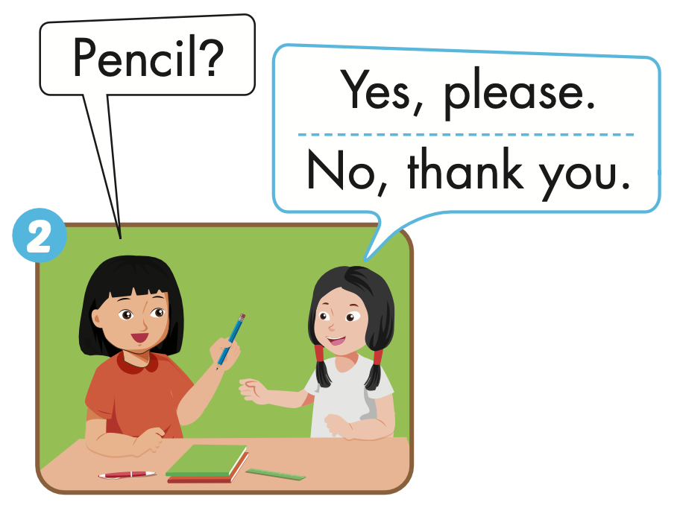
Extra Practice
WB, page 49

Slide 31
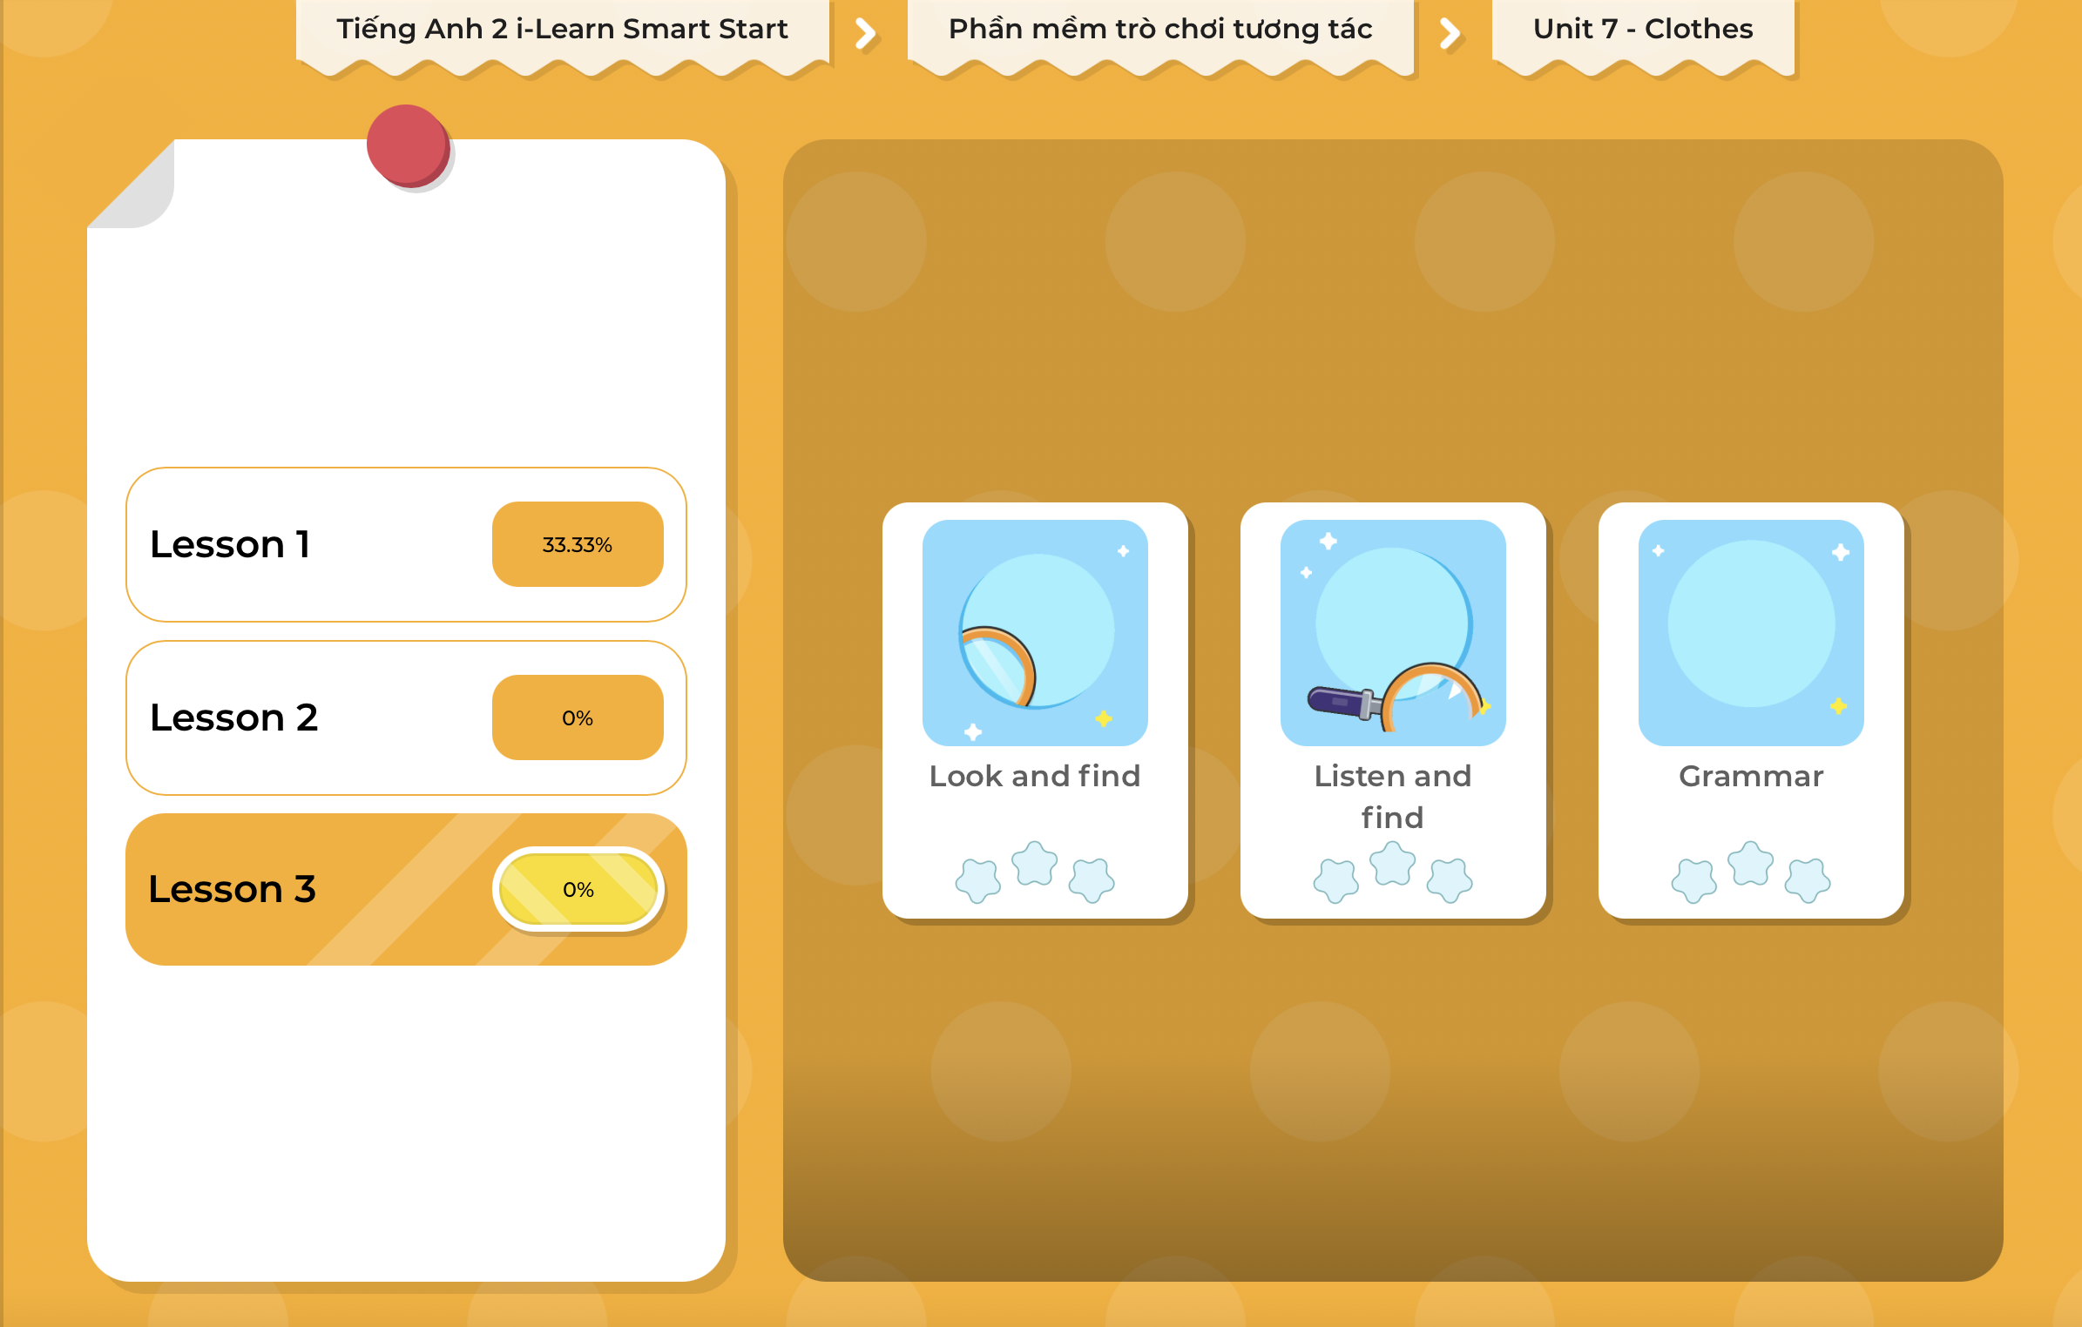
Extra Practice
DHA on Eduhome
LET’S PLAY!
Click on the picture below to play the games.

Slide 32

CONSOLIDATION

Slide 33

Let’s play!
Pass the bag game

Slide 34

WRAP-UP

Slide 35
Today’s lesson
Vocabularies
pants, shorts, shoes, socks.
Structures/ Sentence patterns
Yes, please.
No, thank you.

Slide 36
Homework
Practice the vocabulary and structure, and make sentences using them.
Do the exercises in Tiếng Anh 2 i-Learn Smart Start WB (page 49).
Do the exercises in Tiếng Anh 2 i-Learn Smart Start Notebook (page 51).
Prepare the next lesson (page 52 SB).
Play the consolidation games in Tiếng Anh 2 i-Learn Smart Start DHA App on www.eduhome.com.vn

Slide 37

Enjoy your day!

