Slide 1

Unit 10: Days of the week
Lesson 1.1: Vocabulary & Sentence Patterns
Page: 65

Slide 2
Lesson Outline
Warm-up
Vocabulary
Structure
Practice
Consolidation
Wrap-up

Slide 3
Objectives
By the end of this lesson, students will be able to gain the following:
Vocabulary: Thursday, Friday, Saturday, Sunday
Sentence pattern:
What day is it today? - It's (Monday).
Skills:
To be able to say days of the week/weekdays. Ask and answer about weekdays “What day is it today?” “It's (Monday).”

Slide 4

WARM UP

Slide 5






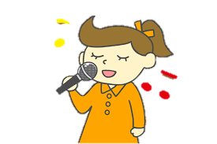
Listen and choose
Tuesday
Wednesday
A
B

Slide 6
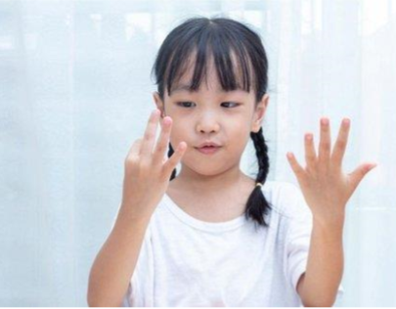
Listen and choose
Monday
Tuesday
A
B

Slide 7
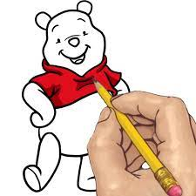
Listen and choose
Tuesday
Monday
A
B

Slide 8

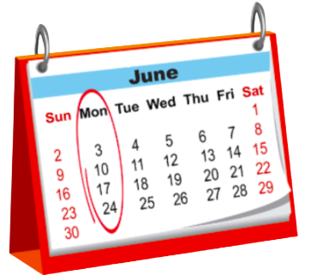
Listen and choose
A
B

Slide 9

Listen and choose
A
B

Slide 10
Listen and choose
A
B

Slide 11

It’s time to learn …

Slide 12

New words
Thursday, Friday, Saturday, Sunday

Slide 13

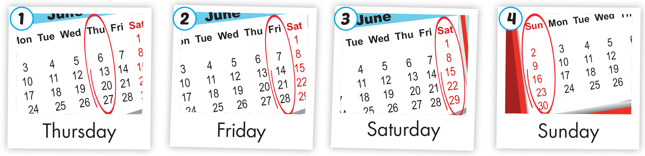
Click A to hear the sound
Notes:
Click vào hình A. 1. Listen and point. Repeat để cho cả audio full chạy

Slide 14

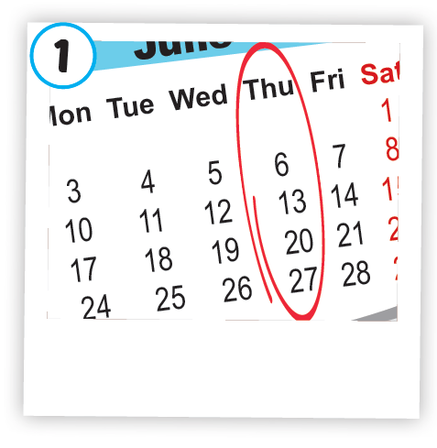
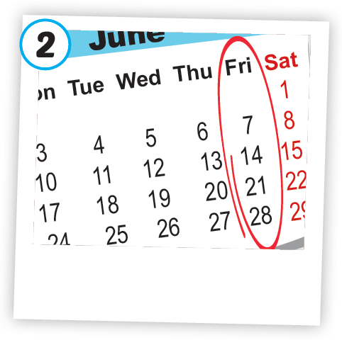
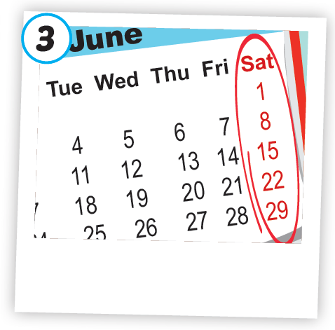
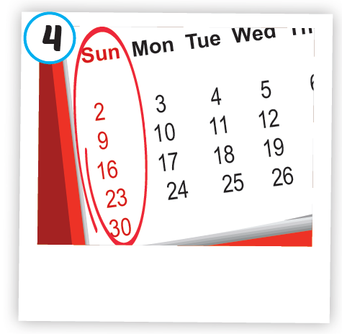




Click A to hear the sound
/ˈθɜːrzdeɪ/
thứ năm
/ˈfraɪdeɪ/
thứ sáu
/ˈsætərdeɪ/
thứ bảy
/ˈsʌndeɪ/
chủ nhật
Notes:
Click vào hình A. 1. Listen and point. Repeat để cho cả audio full chạy

Slide 15
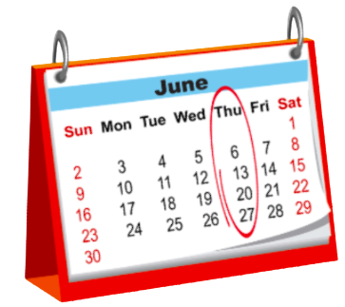
/ˈθɜːrzdeɪ/
thứ năm
Notes:
Click vào hình A. 1. Listen and point. Repeat để cho cả audio full chạy

Slide 16
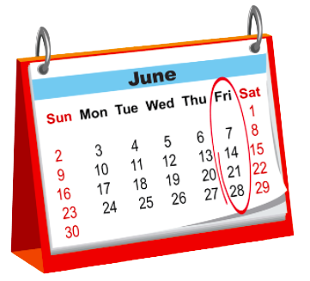
/ˈfraɪdeɪ/
thứ sáu
Notes:
Click vào hình A. 1. Listen and point. Repeat để cho cả audio full chạy

Slide 17

/ˈsætərdeɪ/
thứ bảy
Notes:
Click vào hình A. 1. Listen and point. Repeat để cho cả audio full chạy

Slide 18
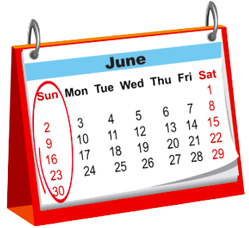
/ˈsʌndeɪ/
chủ nhật
Notes:
Click vào hình A. 1. Listen and point. Repeat để cho cả audio full chạy

Slide 19

Structures
What day is it today?
It's (Monday).

Slide 20

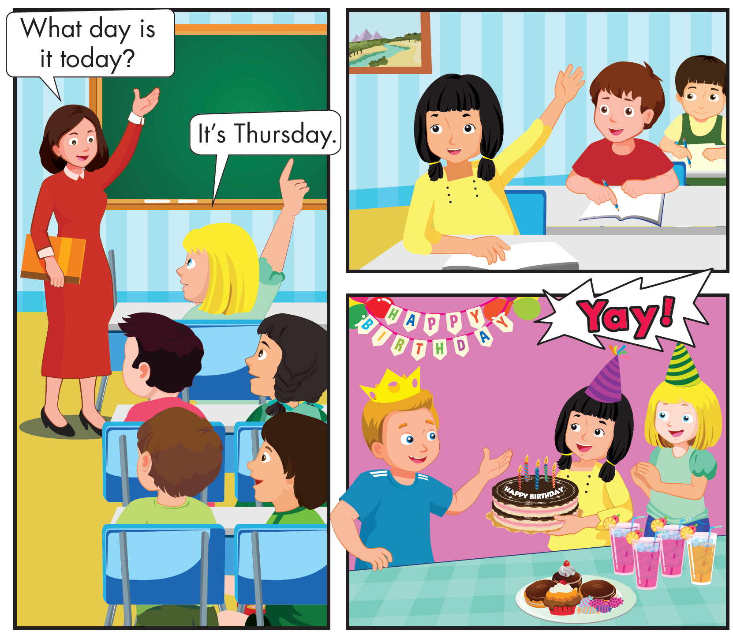
Who are they?
Notes:
B. Listen and point. Repeat. Role-play. (CD1 Track 03)
Have students call out the things they can see in each picture.
Play the audio and have them point to the characters.
Play the audio again and have them repeat the new words.
Divide the class into pairs to role-play the dialogue.
Swap roles and repeat.
Invite some pairs to demonstrate the activity in front of the whole class.
Go around the class and support them if necessary.

Slide 21
What are they talking about?
Notes:
B. Listen and point. Repeat. Role-play. (CD1 Track 03)
Have students call out the things they can see in each picture.
Play the audio and have them point to the characters.
Play the audio again and have them repeat the new words.
Divide the class into pairs to role-play the dialogue.
Swap roles and repeat.
Invite some pairs to demonstrate the activity in front of the whole class.
Go around the class and support them if necessary.

Slide 22
Notes:
B. Listen and point. Repeat. Role-play.
Have students call out the things they can see in each picture.
Play the audio and have them point to the characters.
Play the audio again and have them repeat the new words.
Divide the class into pairs to role-play the dialogue.
Swap roles and repeat.
Invite some pairs to demonstrate the activity in front of the whole class.
Go around the class and support them if necessary.

Slide 23

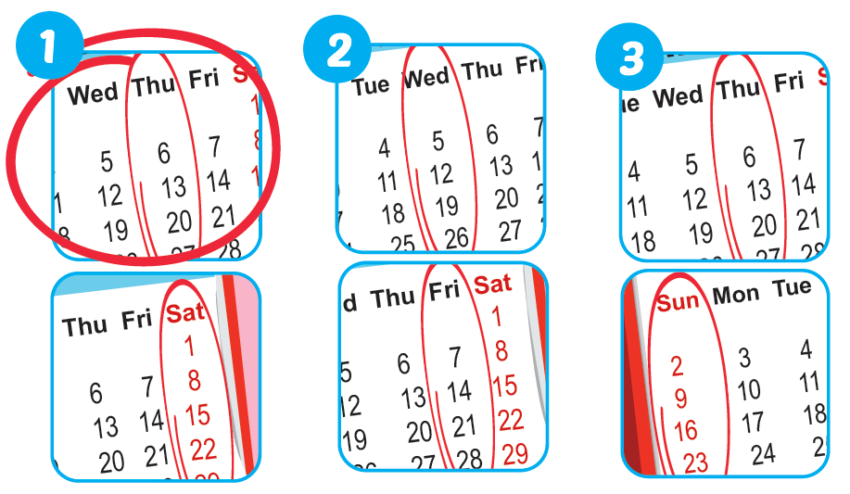

Notes:
B. Listen and point. Repeat. Role-play. (CD1 Track 03)
Have students call out the things they can see in each picture.
Play the audio and have them point to the characters.
Play the audio again and have them repeat the new words.
Divide the class into pairs to role-play the dialogue.
Swap roles and repeat.
Invite some pairs to demonstrate the activity in front of the whole class.
Go around the class and support them if necessary.

Slide 24

Practice

Slide 25
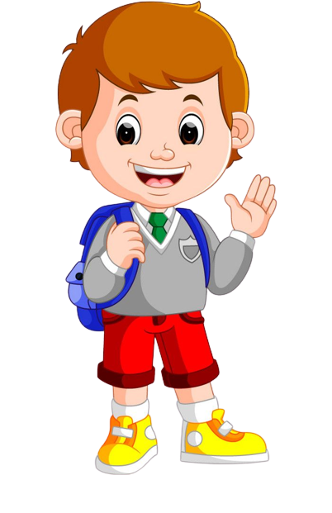

What day is it today?
It’s Monday.

Slide 26
What day is it today?
It’s Friday.

Slide 27
What day is it today?
It’s Thursday.

Slide 28
What day is it today?
It’s Sunday.

Slide 29


What day is it today?
What day is it today?
It's Monday.
It's Monday.
What day is it today?
What day is it today?
What day is it today?
What day is it today?
What day is it today?
What day is it today?
It's Tuesday.
It's Wednesday.
It's Thursday.
It's Tuesday.
It's Wednesday.
It's Thursday.
What day is it today?
What day is it today?
What day is it today?
What day is it today?
What day is it today?
What day is it today?
It's Friday.
It's Saturday.
It's Sunday.
It's Friday.
It's Saturday.
It's Sunday.
Notes:
B. Listen and point. Repeat. Role-play. (CD1 Track 03)
Have students call out the things they can see in each picture.
Play the audio and have them point to the characters.
Play the audio again and have them repeat the new words.
Divide the class into pairs to role-play the dialogue.
Swap roles and repeat.
Invite some pairs to demonstrate the activity in front of the whole class.
Go around the class and support them if necessary.

Slide 30
It’s time to play …

Slide 31

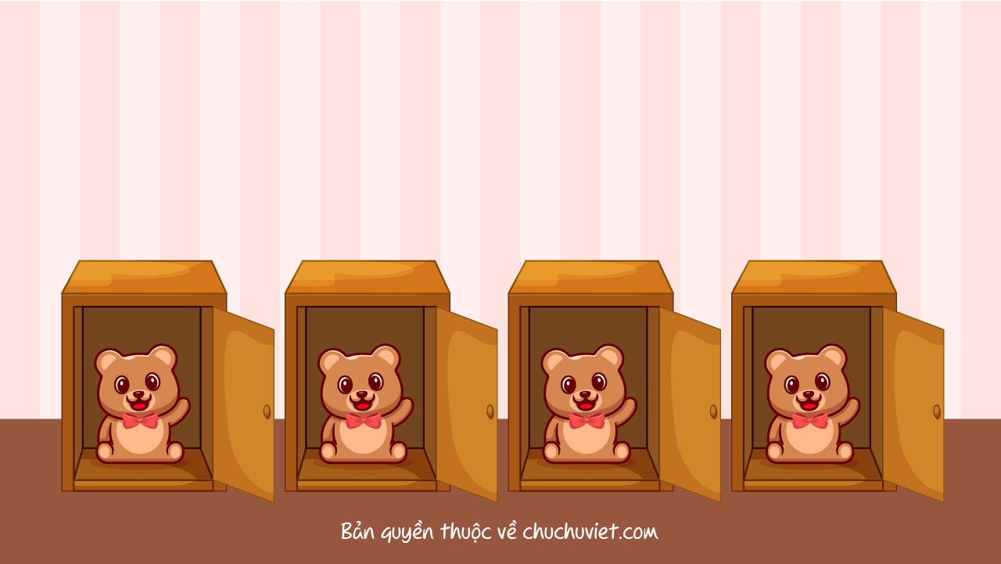


Slide 32






Listen and choose
Friday
Thursday
Sunday
Saturday
A
B
C
D

Slide 33
Listen and choose
Thursday
Saturday
Friday
Sunday
A
B
C
D

Slide 34
Listen and choose
Sunday
Friday
Thursday
Saturday
A
B
C
D

Slide 35
Listen and choose
Sunday
Friday
Saturday
Thursday
A
B
C
D

Slide 36

Further Practice

Slide 37

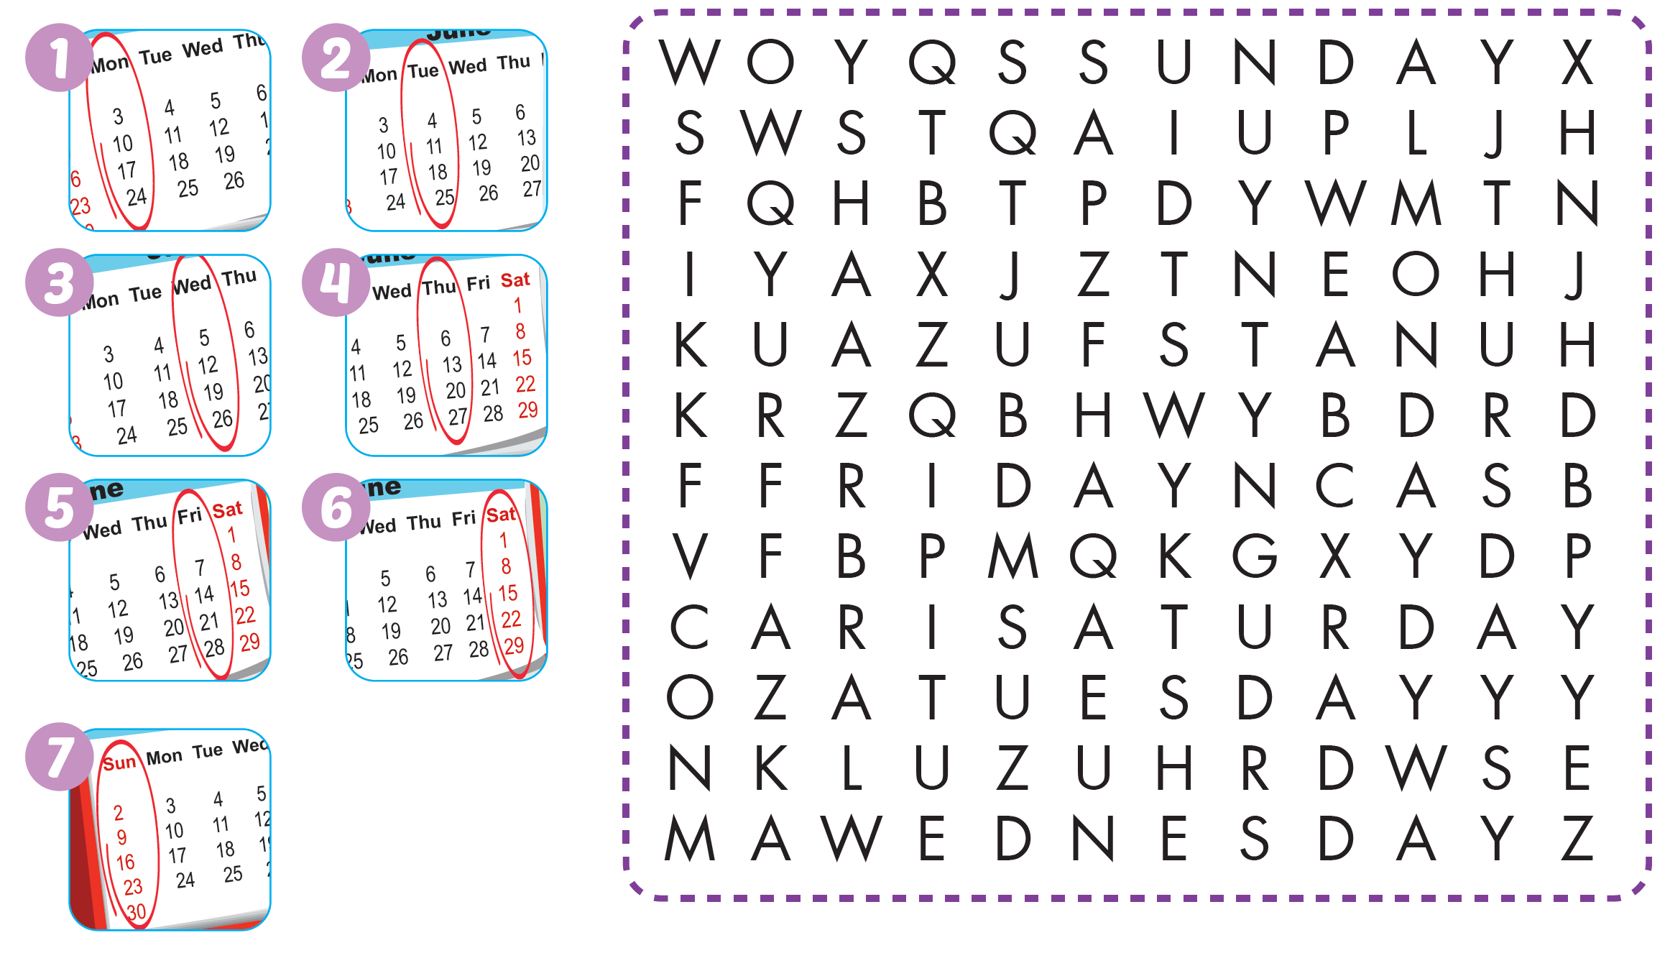

Slide 38

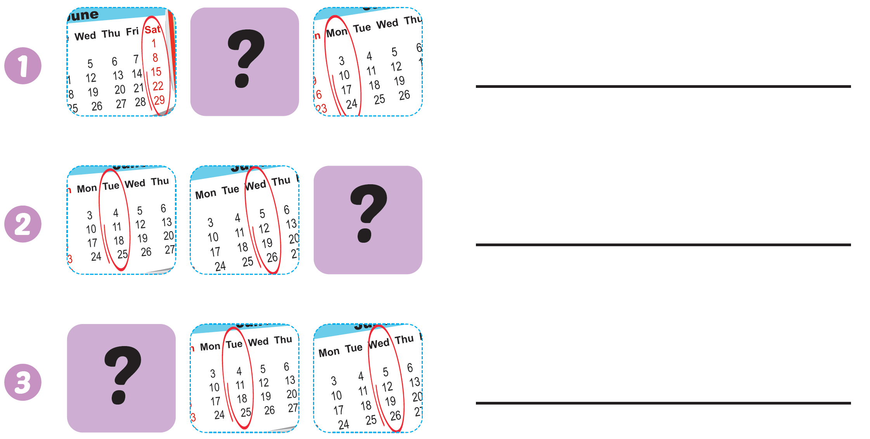
sunday
Thursday
Monday

Slide 39

CONSOLIDATION

Slide 40
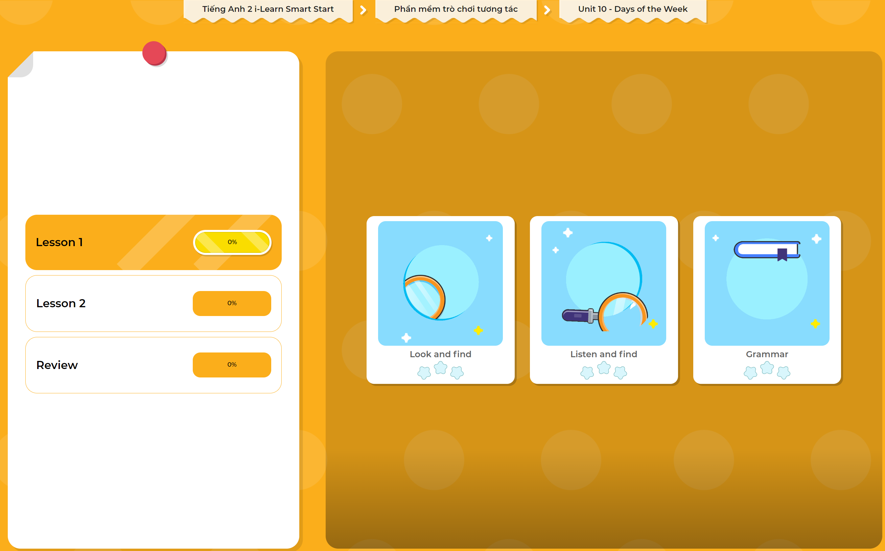
Extra Practice
DHA App
LET’S PLAY!
Click here to play the games

Slide 41

WRAP-UP

Slide 42
Today’s lesson
Structures/ Sentence patterns
What day is it today?
It's (Monday).
Vocabulary
Thursday, Friday, Saturday, Sunday

Slide 43
Homework
Practice vocabularies and structure. Make sentences using them.
Practice the vocabulary and structure in Tiếng Anh 2 i-Learn Smart Start Notebook (page 62)
Do the exercises in Tiếng Anh 2 i-Learn Smart Start Workbook (page 62)
Play the consolidation games in Tiếng Anh 2 i-Learn Smart Start DHA App on www.eduhome.com.vn
Prepare the next lesson (page 65)

Slide 44

Enjoy your day!

