Slide 1

Unit 10: Days of the week
Lesson 1.2: Speaking
Page: 65

Slide 2
Lesson Outline
Warm-up
Speaking
Practice
Consolidation
Wrap-up

Slide 3
Objectives
By the end of this lesson, students will be able to gain the following:
Vocabulary:
Revise Monday, Tuesday, Wednesday, Thursday, Friday, Saturday, Sunday
Sentence pattern:
Revise “What day is it today?” - “It's (Monday).”
Skills:
Ask about what day it is and talk about the days of the week.

Slide 4

WARM UP

Slide 5

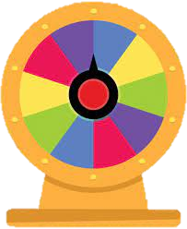
Wheel of Fortune

Slide 6
STOP
EXIT
1
2
8
3
7
4
6
5
SPIN

Slide 7


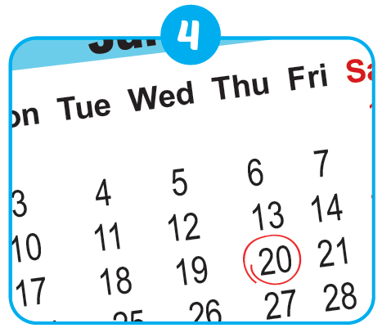

What day is it today?
It’s Thursday.

Slide 8
STOP
1
2
8
3
7
4
6
5
SPIN

Slide 9
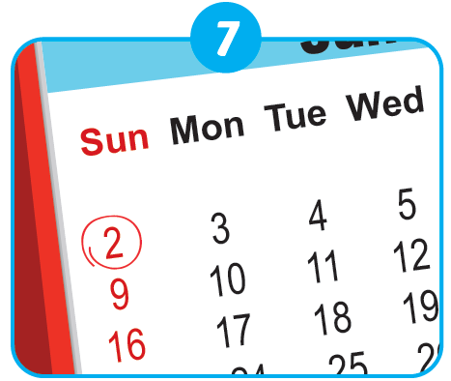
What day is it today?
It’s Sunday.

Slide 10
STOP
1
2
8
3
7
4
6
5
SPIN

Slide 11

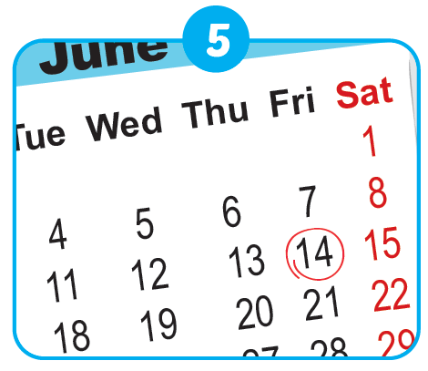

What day is it today?
It’s Friday.

Slide 12
STOP
1
2
8
3
7
4
6
5
SPIN

Slide 13
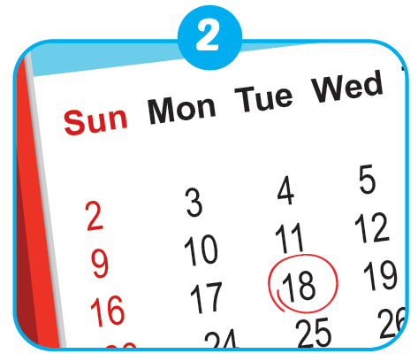
What day is it today?
It’s Tuesday.

Slide 14
STOP
1
2
8
3
7
4
6
5
SPIN

Slide 15
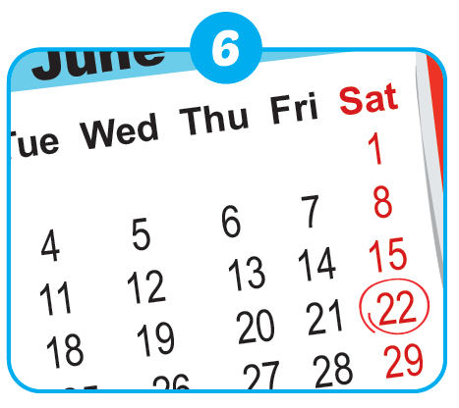
What day is it today?
It’s Saturday.

Slide 16
STOP
1
2
8
3
7
4
6
5
SPIN

Slide 17
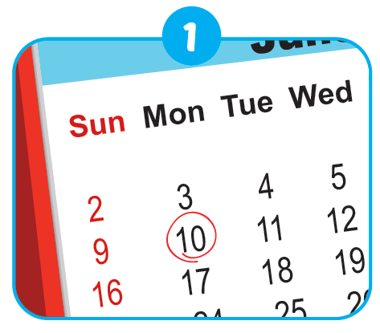
What day is it today?
It’s Monday.

Slide 18
STOP
1
2
8
3
7
4
6
5
SPIN

Slide 19
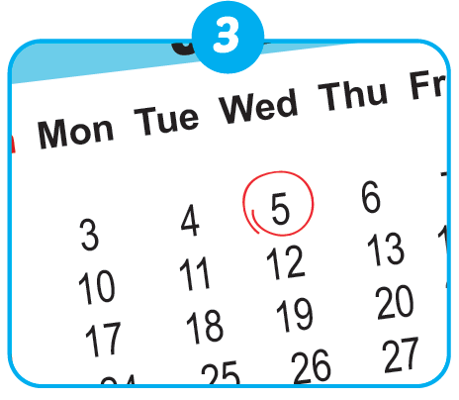
What day is it today?
It’s Wednesday.

Slide 20
STOP
1
2
8
3
7
4
6
5
SPIN

Slide 21
What day is it today?
It’s Saturday.

Slide 22

It’s time to learn …

Slide 23

Speaking

Slide 24

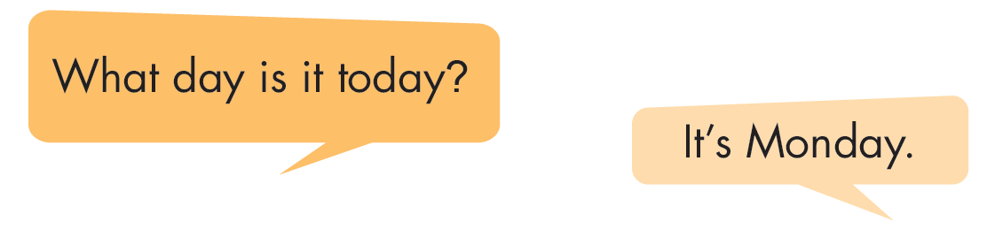
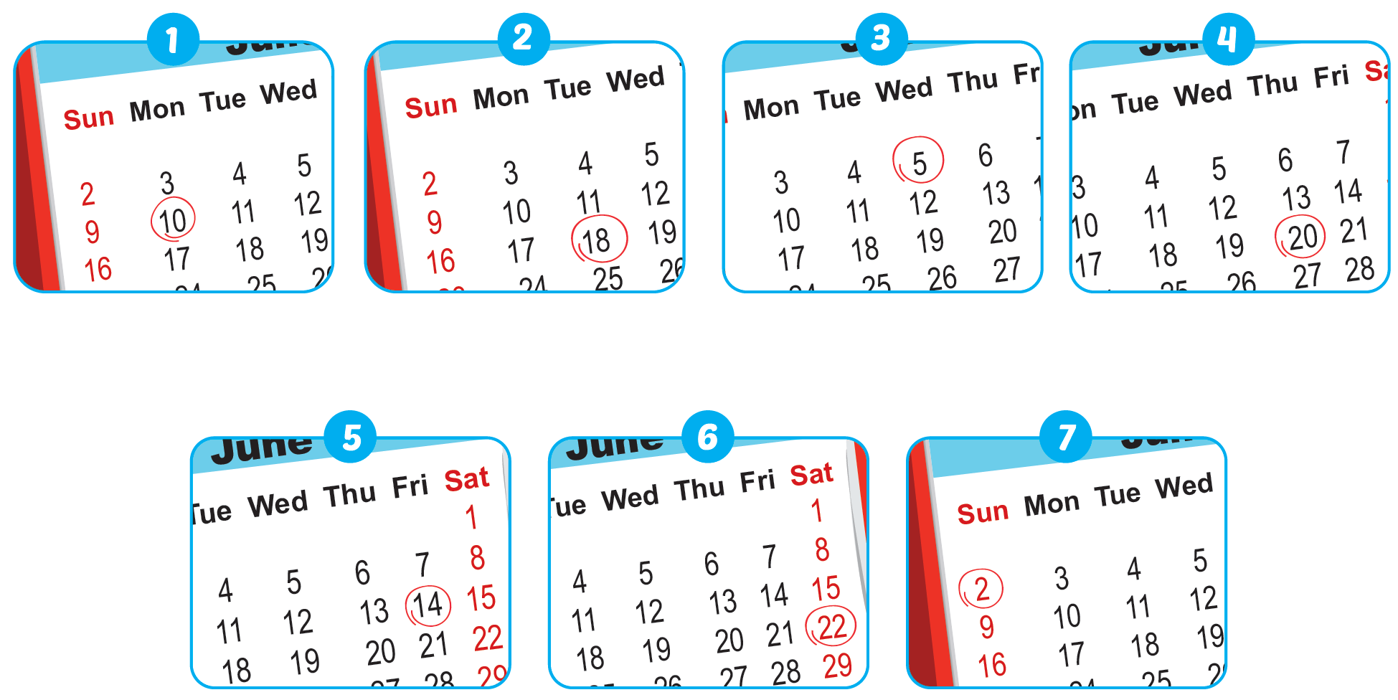

Slide 25

What day is it today?
It's __________
Monday.

Slide 26
What day is it today?
It's __________
Tuesday.

Slide 27
What day is it today?
It's __________
Wednesday.

Slide 28
What day is it today?
It's __________
Thursday.

Slide 29
What day is it today?
It's __________
Friday.

Slide 30
What day is it today?
It's __________
Saturday.

Slide 31
What day is it today?
It's __________
Sunday.

Slide 32

Practice

Slide 33
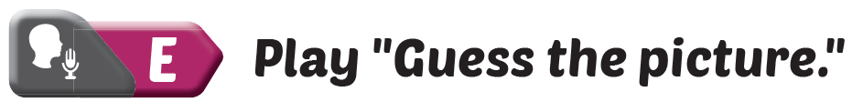
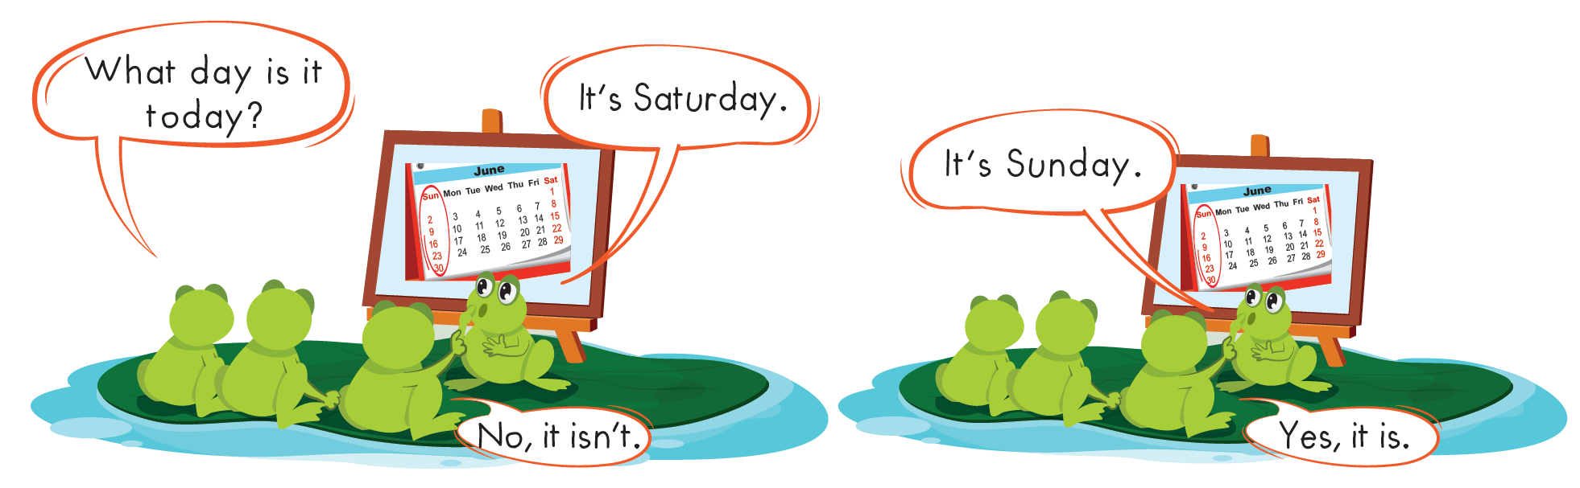

Slide 34
Further Practice

Slide 35


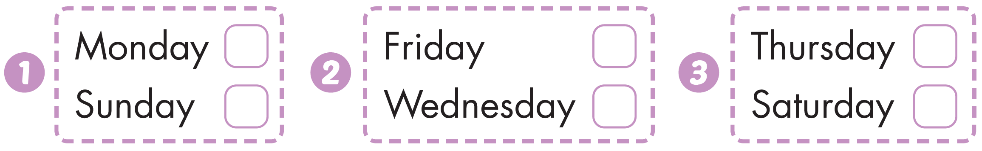




Workbook - Page 63
Click the icon to hear the sound

Slide 36
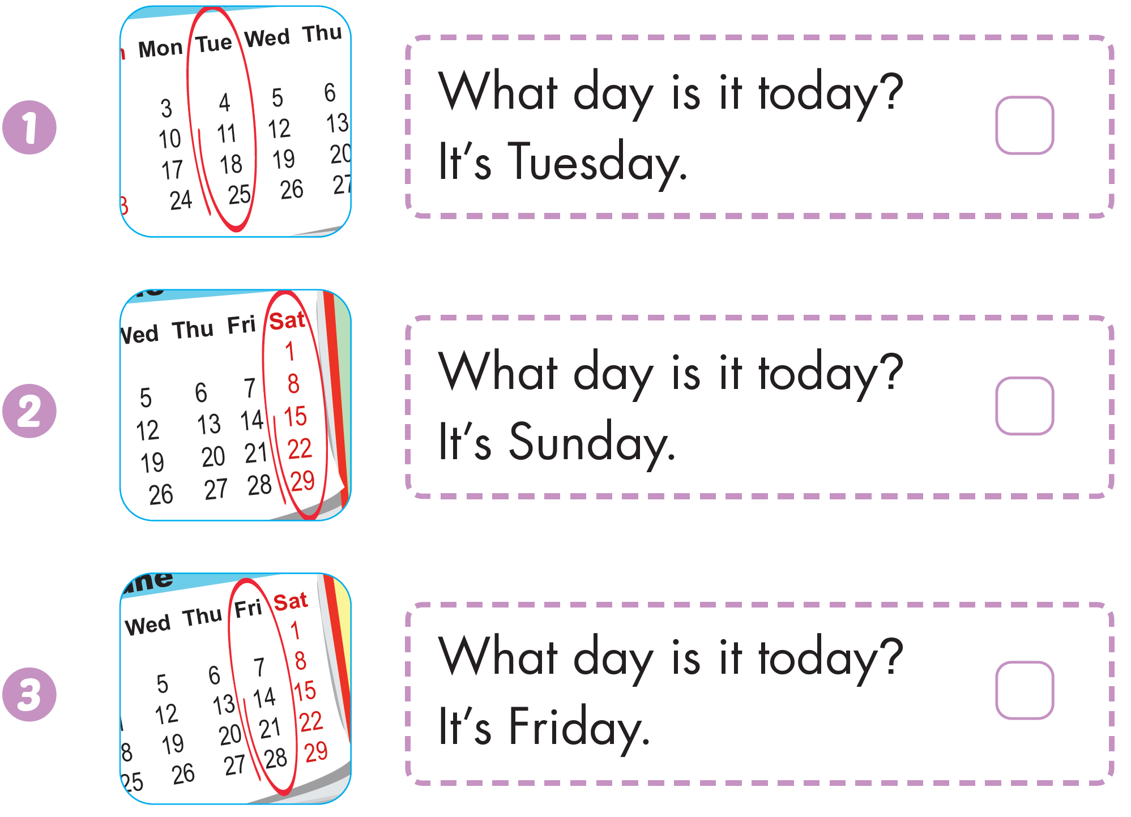

Workbook - Page 63

Slide 37
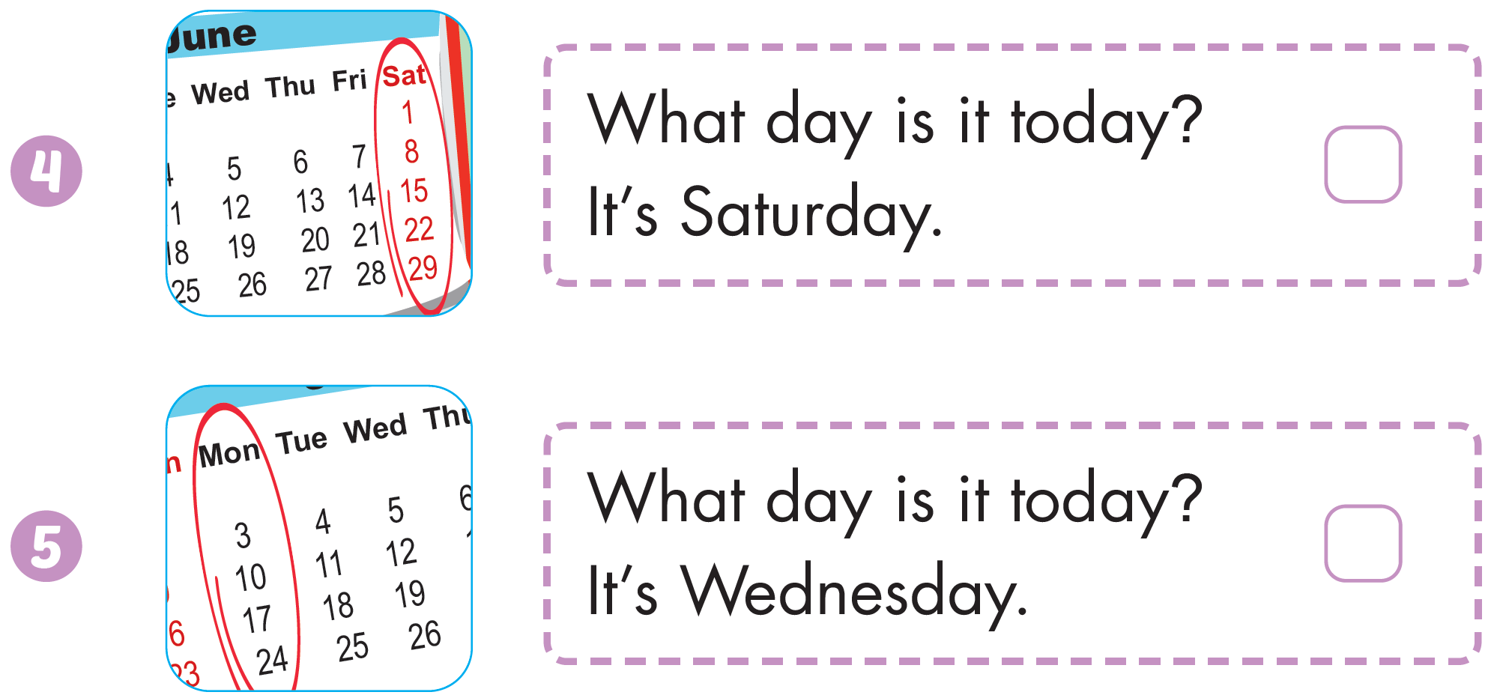
Workbook - Page 63

Slide 38

CONSOLIDATION

Slide 39
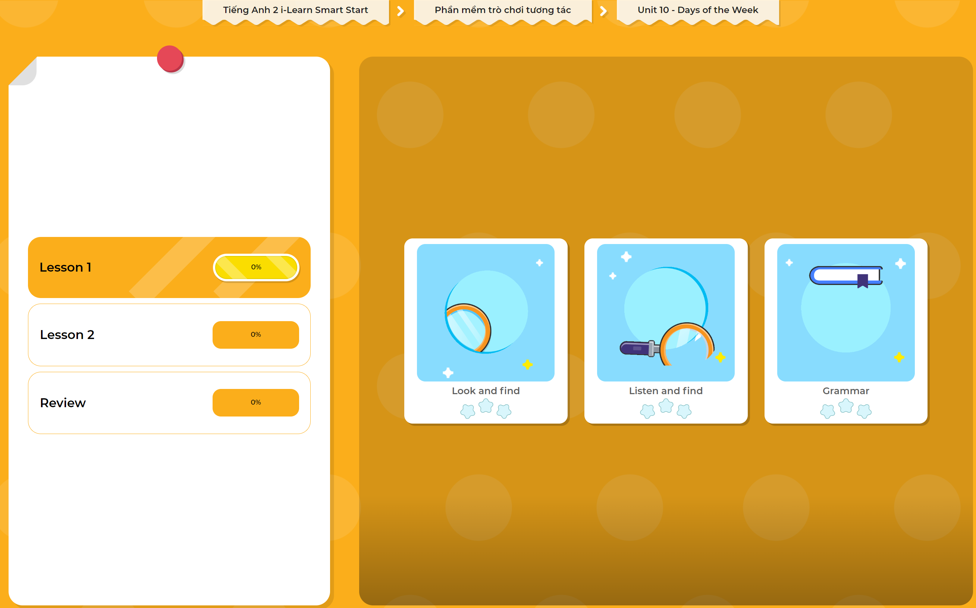
Extra Practice
DHA App
LET’S PLAY!
Click here to play the games

Slide 40

WRAP-UP

Slide 41
Today’s lesson
Vocabulary
Monday, Tuesday, Wednesday, Thursday, Friday, Saturday, Sunday
Structures/ Sentence patterns
“What day is it today?” “It's (Monday).”

Slide 42
Homework
Review the vocabularies and structures. Make sentences using them.
Practice the vocabulary and structure in Tiếng Anh 2 i-Learn Smart Start Notebook (page 63)
Do the exercises in Tiếng Anh 2 i-Learn Smart Start Workbook (page 63)
Play the consolidation games in Tiếng Anh 2 i-Learn Smart Start DHA App on www.eduhome.com.vn
Prepare the next lesson (page 66)

Slide 43

Enjoy your day!

