Slide 1

Unit 10: Days of the week
Lesson 2.1: Vocabulary & Phonics
Page: 66

Slide 2
Lesson Outline
Warm-up
Phonics
Practice
Consolidation
Wrap-up

Slide 3
Objectives
By the end of this lesson, students will be able to gain the following:
Phonics: /x/, /y/
Skills:
Review the letters (A to Z), letters X/x and Y/y.

Slide 4

WARM UP

Slide 5
Aa
Bb
Cc
Dd
Ee
Ff
Gg
Hh
Ii
Jj
Kk
Ll
Mm
Nn
Oo
Pp
Qq
Rr
Ss
Tt
Uu
Vv
Ww
Xx
Yy
Zz

Slide 6

It’s time to learn …

Slide 7

Phonics
/x/, /y/

Slide 8





Click each icon to hear the sound

Slide 9

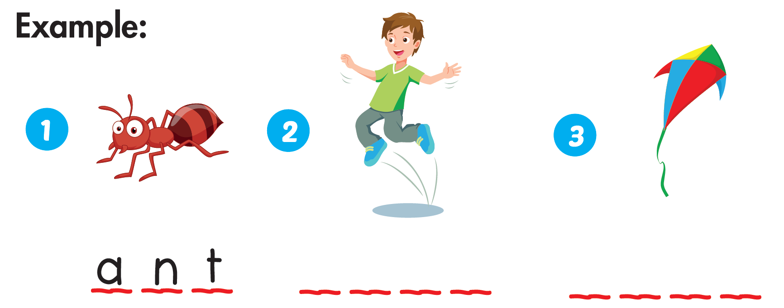
j u m p
k i t e

Slide 10
It’s time to play …

Slide 11


Choose a letter to fill in.
u n
_ _ _
s
o
p
q
r
s
t
u
v
w
x
y
z

Slide 12

Choose a letter to fill in.
f o
_ _ _
x
o
p
q
r
s
t
u
v
w
x
y
z

Slide 13

Choose a letter to fill in.
_ _ _ _ _ _
i o l i n
v
o
p
q
r
s
t
u
v
w
x
y
z

Slide 14

Choose a letter to fill in.
p
e n g u i n
_ _ _ _ _ _ _
o
p
q
r
s
t
u
v
w
x
y
z

Slide 15

Choose a letter to fill in.
y
o y o
_ _ _ _
o
p
q
r
s
t
u
v
w
x
y
z

Slide 16

Choose a letter to fill in.
i g e r
t
_ _ _ _ _
o
p
q
r
s
t
u
v
w
x
y
z

Slide 17

Choose a letter to fill in.
u
m b r e l l a
_ _ _ _ _ _ _ _
o
p
q
r
s
t
u
v
w
x
y
z

Slide 18

Choose a letter to fill in.
o o
_ _ _
z
o
p
q
r
s
t
u
v
w
x
y
z

Slide 19

Choose a letter to fill in.
_ _ _ _ _
o b o t
r
r
p
q
r
s
t
u
v
w
x
y
z

Slide 20

Choose a letter to fill in.
c t o p u s
_ _ _ _ _ _ _
o
o
p
q
r
s
t
u
v
w
x
y
z

Slide 21

Practice

Slide 22



Slide 23

Further Practice

Slide 24

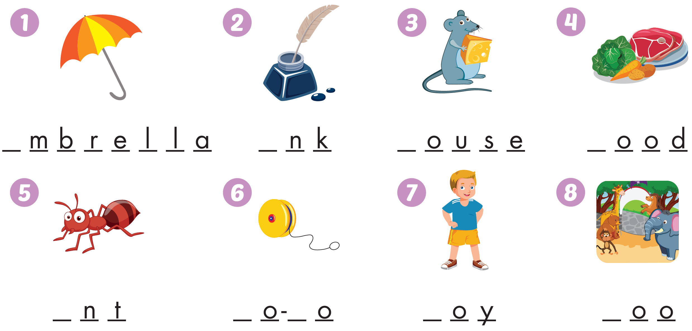
Workbook - Page 64
u
i
m
f
a
y
y
b
z

Slide 25







Workbook - Page 64

Slide 26

CONSOLIDATION

Slide 27
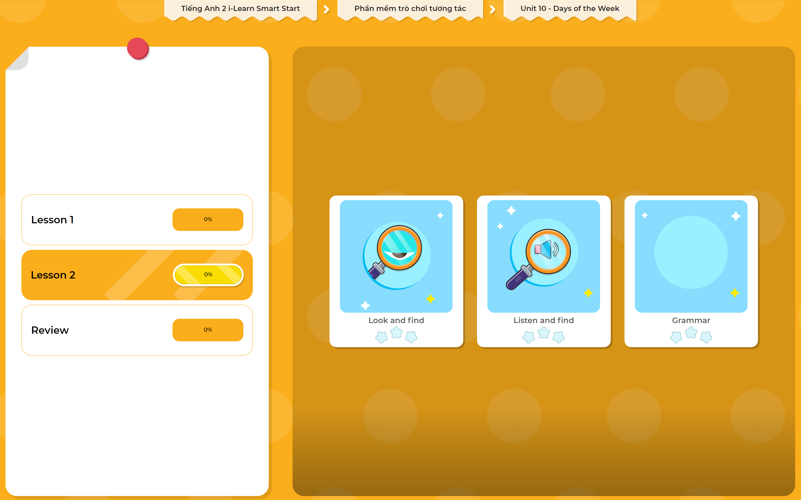
Extra Practice
DHA App
LET’S PLAY!
Click here to play the games

Slide 28

WRAP-UP

Slide 29
Today’s lesson
Phonics
/x/, /y/
Skills
Review the letters (A to Z), letters X/x and Y/y.

Slide 30
Homework
Practice vocabularies and phonics. Make sentences using them.
Practice the vocabulary and phonics in Tiếng Anh 2 i-Learn Smart Start Notebook (page 64)
Do the exercises in Tiếng Anh 2 i-Learn Smart Start Workbook (page 64)
Play the consolidation games in Tiếng Anh 2 i-Learn Smart Start DHA App on www.eduhome.com.vn
Prepare the next lesson (page 67)

Slide 31

Enjoy your day!

