Slide 1

Unit 10: Days of the weeks
Review 10
Page: 69

Slide 2
Lesson Outline
Warm-up
Practice
Consolidation
Wrap-up

Slide 3
Objectives
By the end of this lesson, students will be able to gain the following:
Skills:
Review the related vocabulary items and structures to talk about the days of the week.

Slide 4

WARM UP

Slide 5

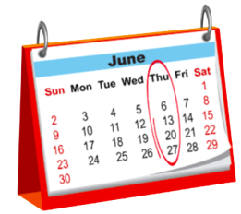
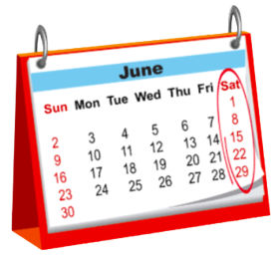


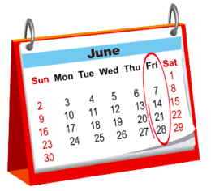
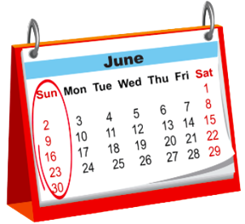


Review 10: Days of the week

Slide 6

It’s time to learn …

Slide 7

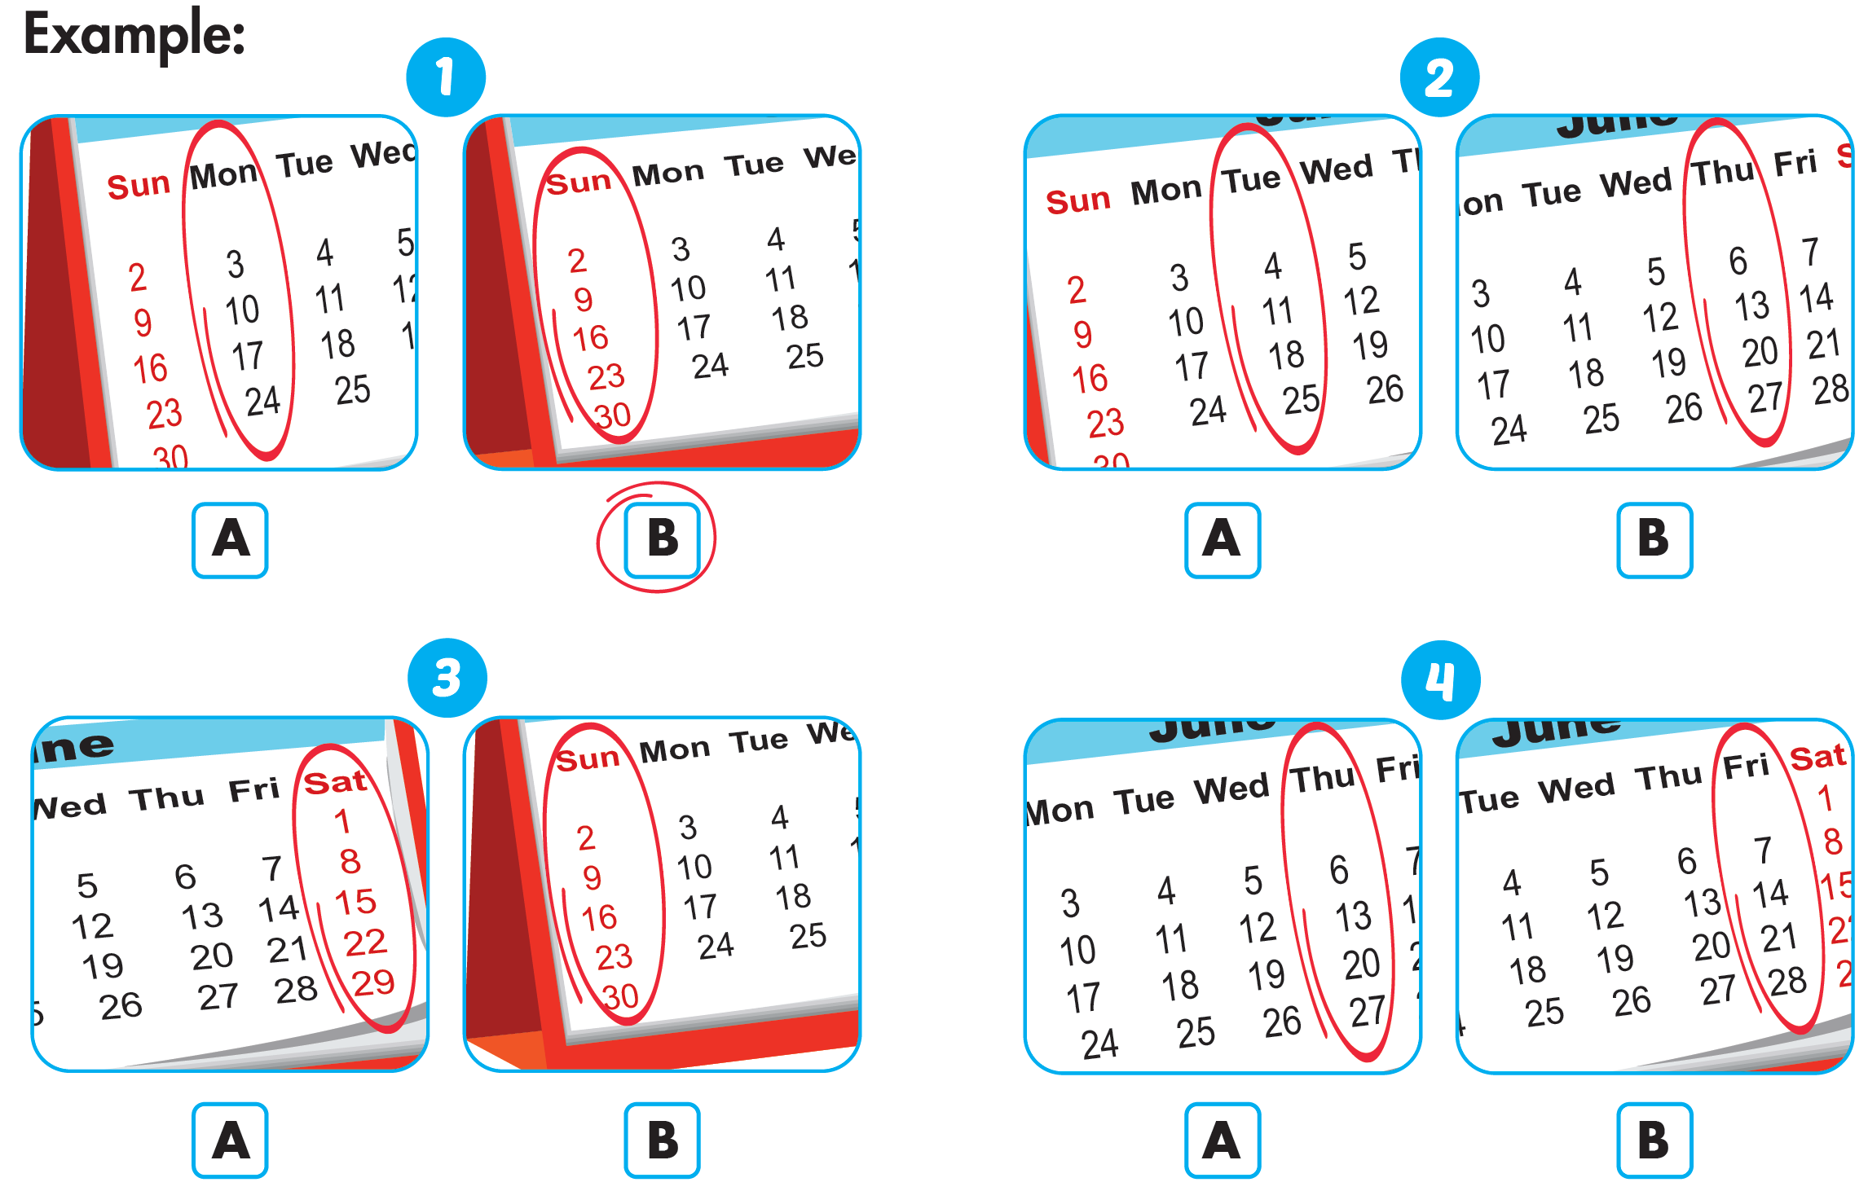
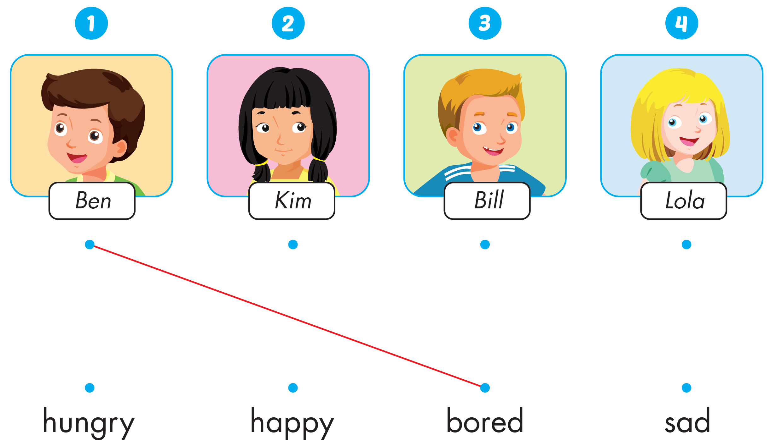


Click the icon to hear the sound
Notes:
Click vào hình A. 1. Listen and point. Repeat để cho cả audio full chạy

Slide 8

Practice

Slide 9

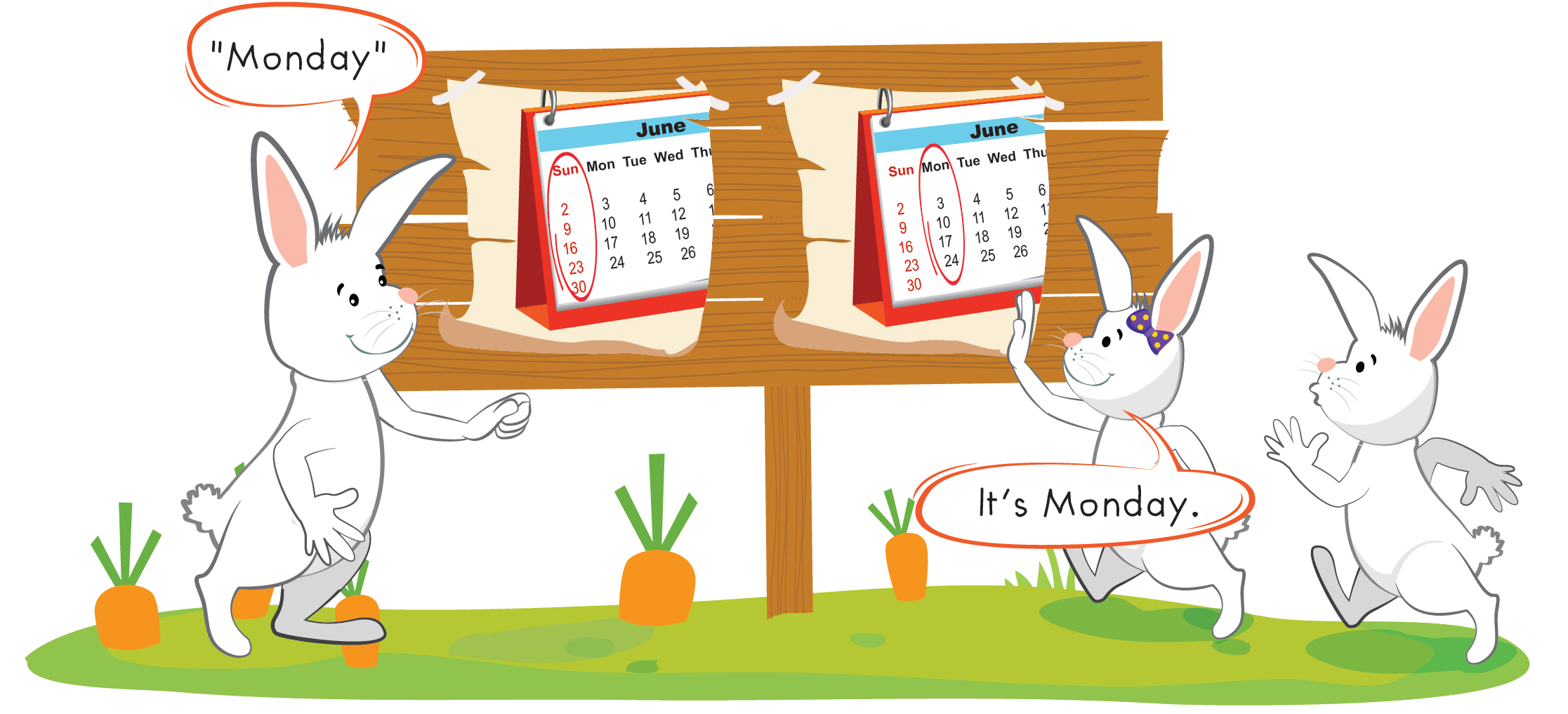

Slide 10
It’s time to speaking …

Slide 11

Speaking
What day is it today?
It's...........................

Slide 12
It’s time to play ....

Slide 13


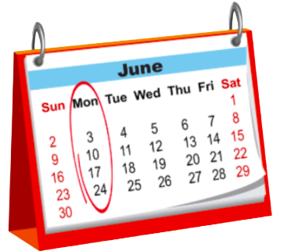


What day is it today?
A. Tuesday
B. Thursday
C. Monday

Slide 14
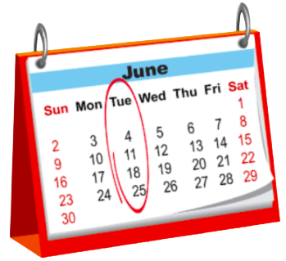
What day is it today?
A.Monday
B. Tuesday
C. Wednesday

Slide 15
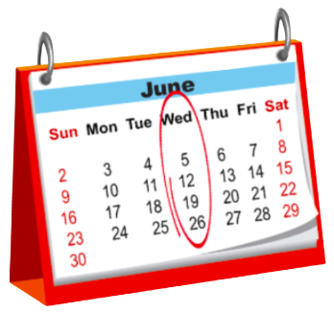
What day is it today?
A. Thursday
B. Friday
C. Wednesday

Slide 16
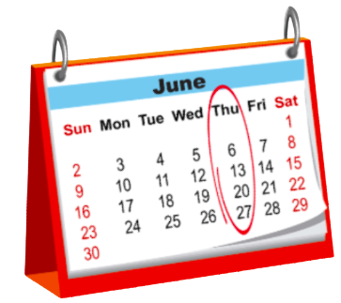
What day is it today?
A. Monday
B. Thursday
C. Friday

Slide 17
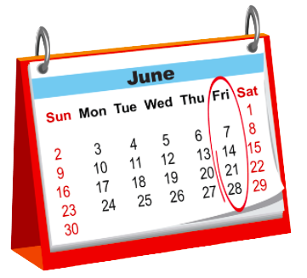
What day is it today?
A. Sunday
B. Thursday
C. Friday

Slide 18

What day is it today?
A. Sunday
B. Saturday
C. Monday

Slide 19
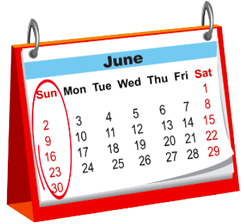
What day is it today?
A. Monday
B. Friday
C. Sunday

Slide 20

Further Practice

Slide 21

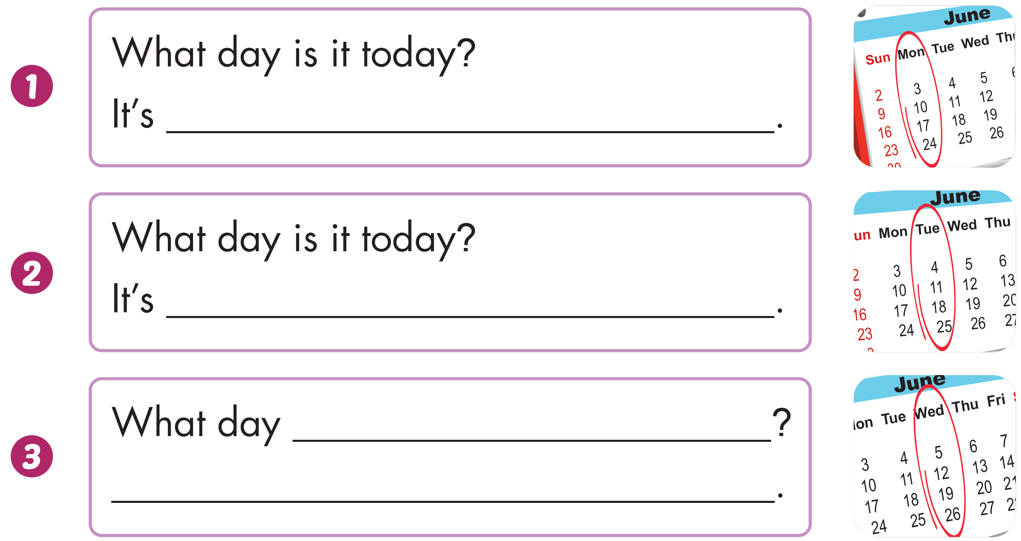
Workbook - Page 67
Monday
Tuesday
is it today
It's Wednesday

Slide 22
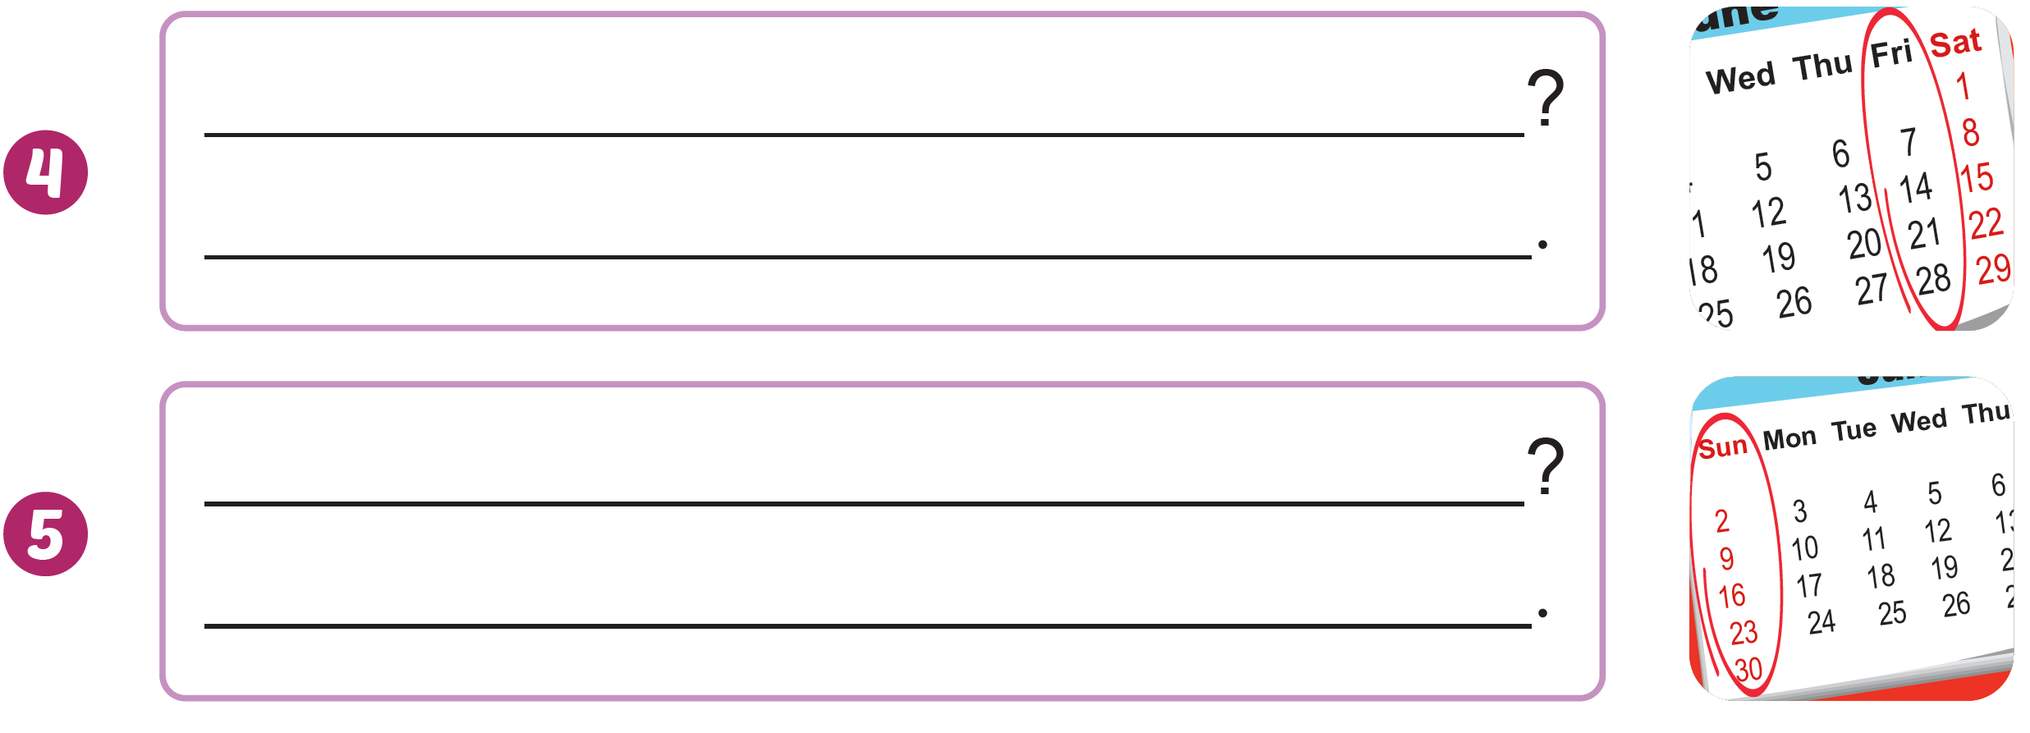
Workbook - Page 67
What day is it today
It's Friday
What day is it today
It's Sunday

Slide 23







Workbook - Page 67
Click the icon to hear the sound

Slide 24

CONSOLIDATION

Slide 25
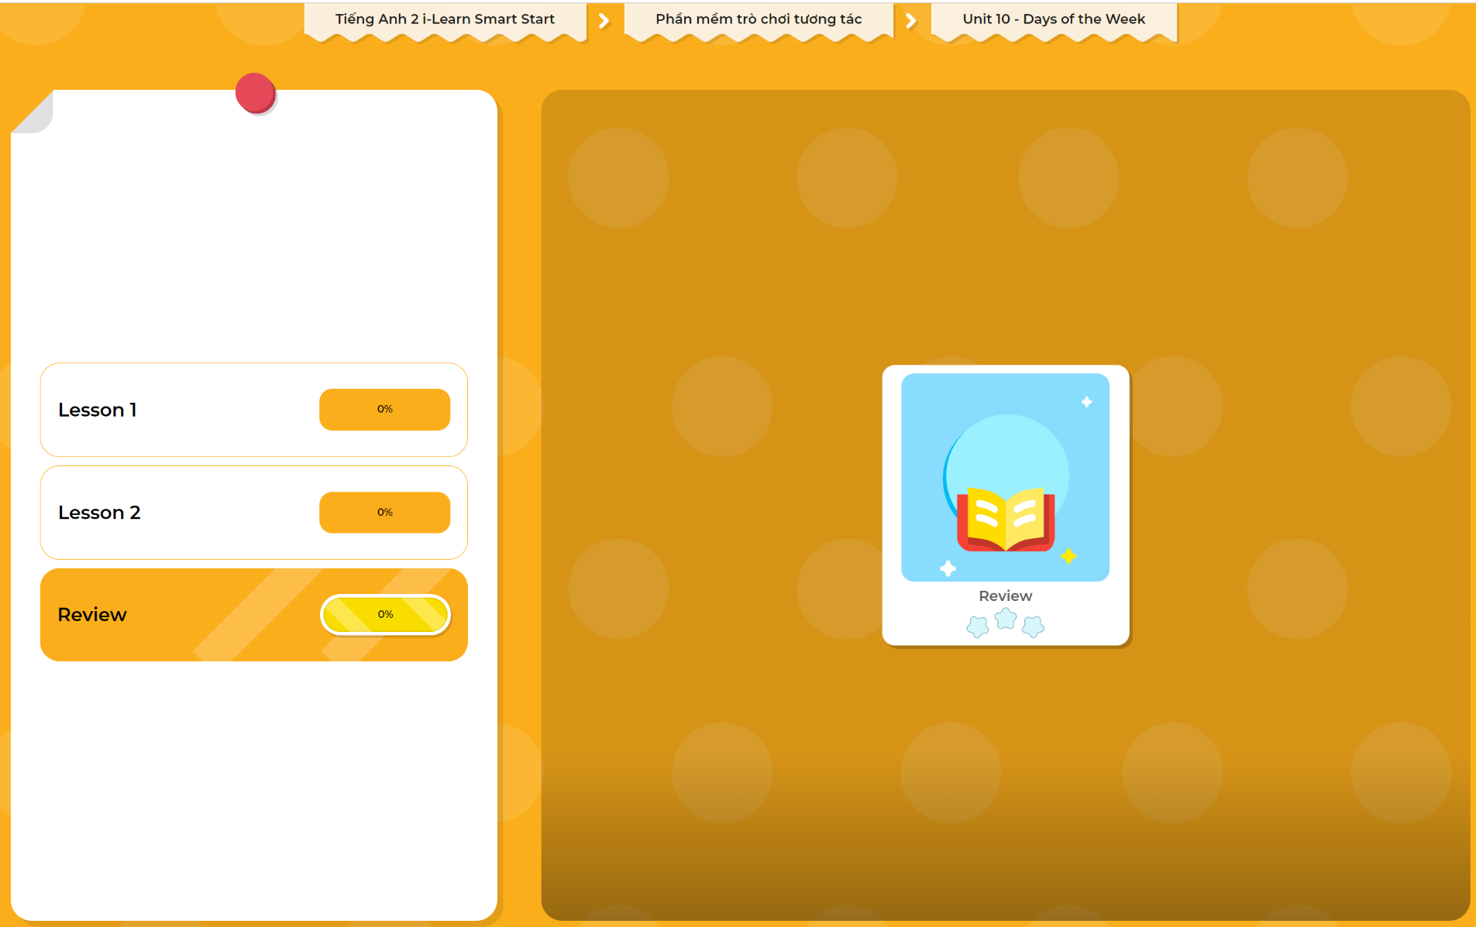
Extra Practice
DHA App
LET’S PLAY!
Click here to play the games

Slide 26

WRAP-UP

Slide 27
Today’s lesson
Skills
Review the related vocabulary items and structures to talk about the days of the week.

Slide 28
Homework
Practice vocabularies and structures. Make sentences using them.
Practice the vocabulary and structure in Tiếng Anh 2 i-Learn Smart Start Notebook (page 67)
Do the exercises in Tiếng Anh 2 i-Learn Smart Start Workbook (page 67)
Play the consolidation games in Tiếng Anh 2 i-Learn Smart Start DHA App on www.eduhome.com.vn

Slide 29

Enjoy your day!

