Slide 1

Unit 10: Days of the Week
Review 9
Page: 68

Slide 2
Lesson Outline
Warm-up
Practice
Consolidation
Wrap-up

Slide 3
Objectives
By the end of this lesson, students will be able to gain the following:
Skills:
Review the related vocabulary items and structures to about their classroom activities/things.

Slide 4

WARM UP

Slide 5




















Review 9: Class room activities

Slide 6

It’s time to learn …

Slide 7


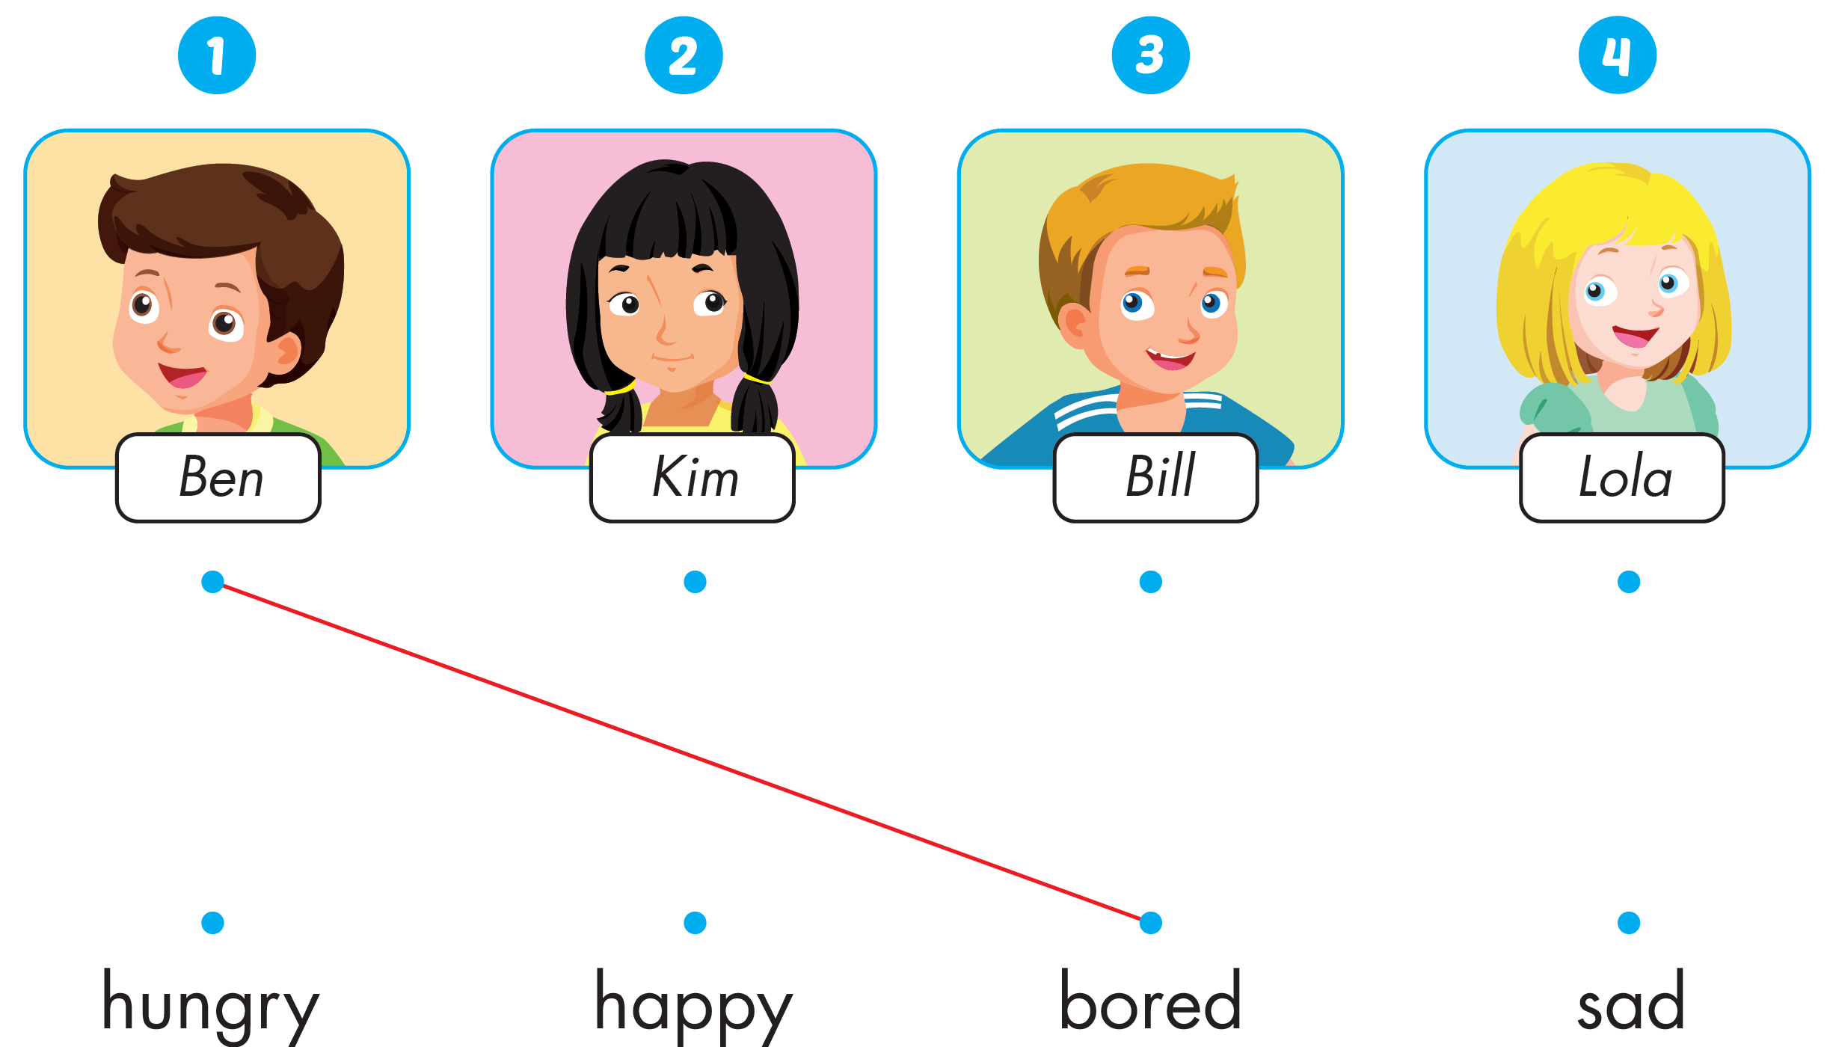
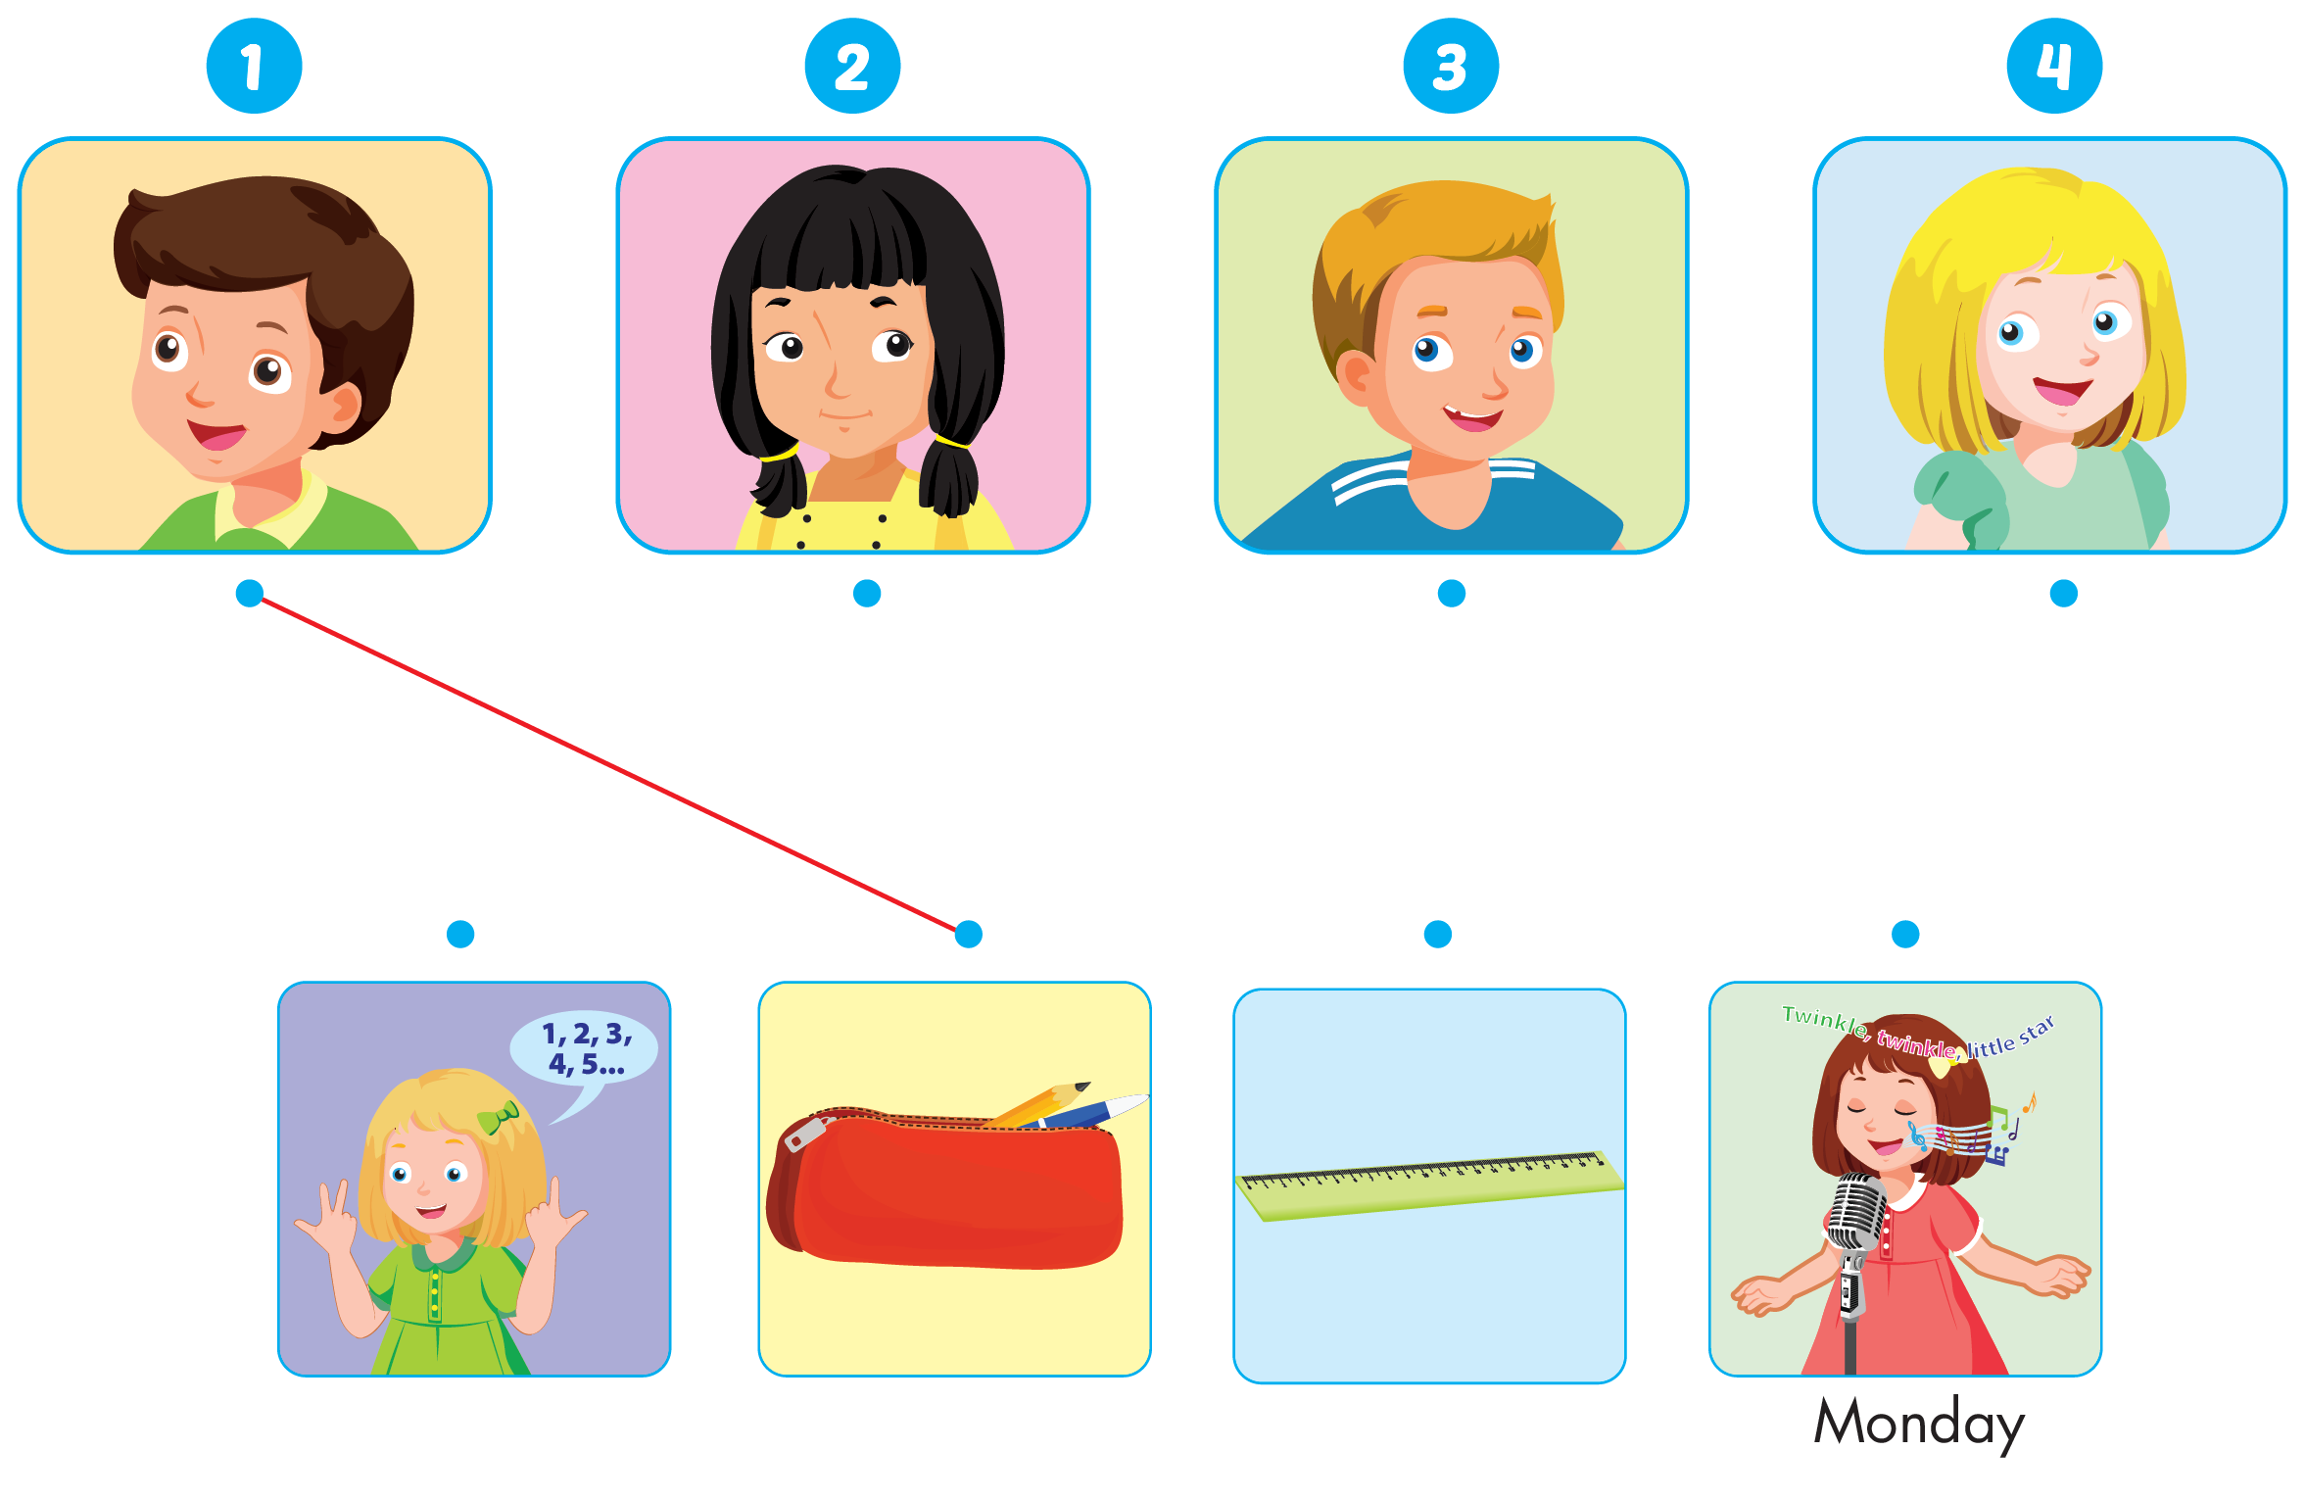
Click the icon to hear the sound

Slide 8

Practice

Slide 9

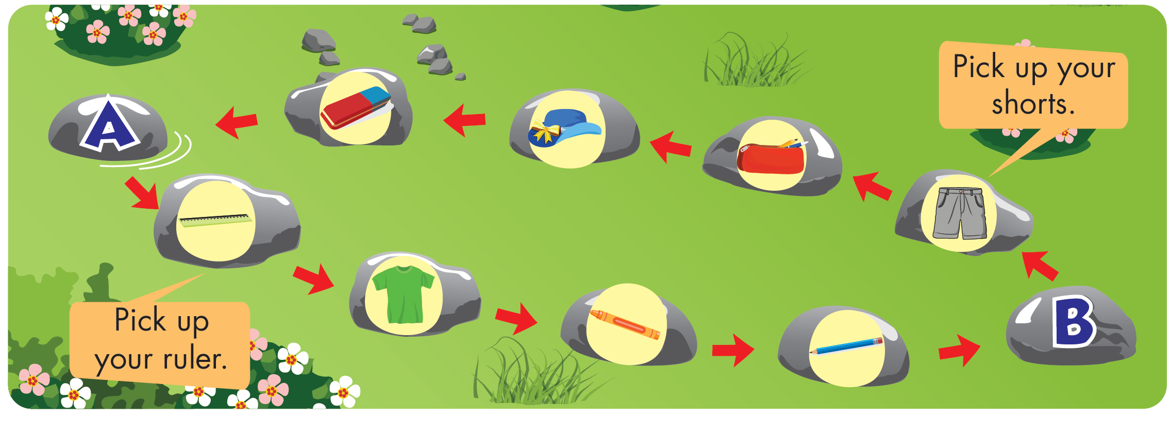

Slide 10
It’s time to speaking …

Slide 11

Speaking
Pick up your.............

Slide 12
Speaking
I can.......................

Slide 13

Further Practice

Slide 14

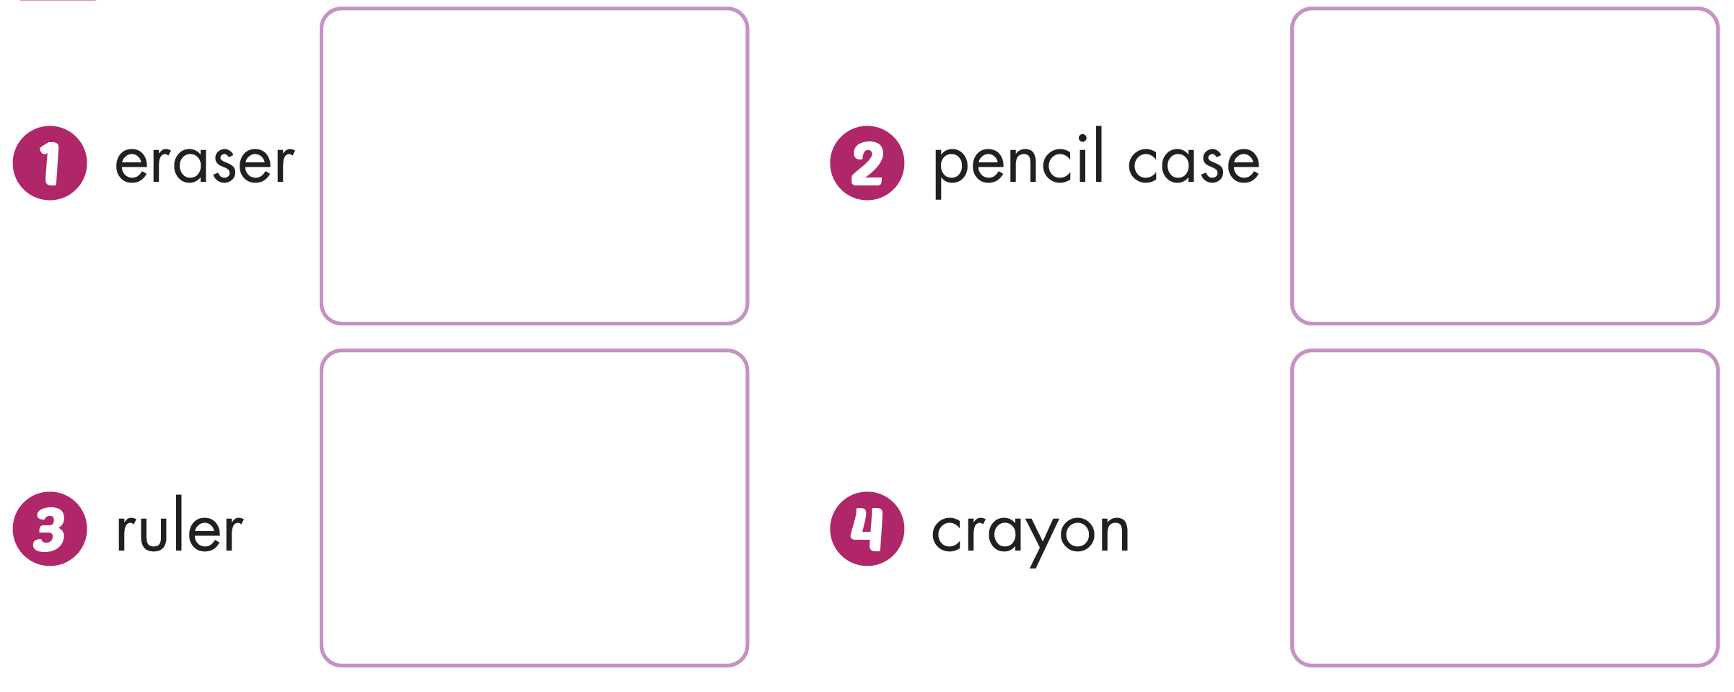
Workbook - Page 66

Slide 15






Workbook - Page 66
Click the icon to hear the sound
2
3
1
4
Notes:
Click the numbers to see the answers

Slide 16

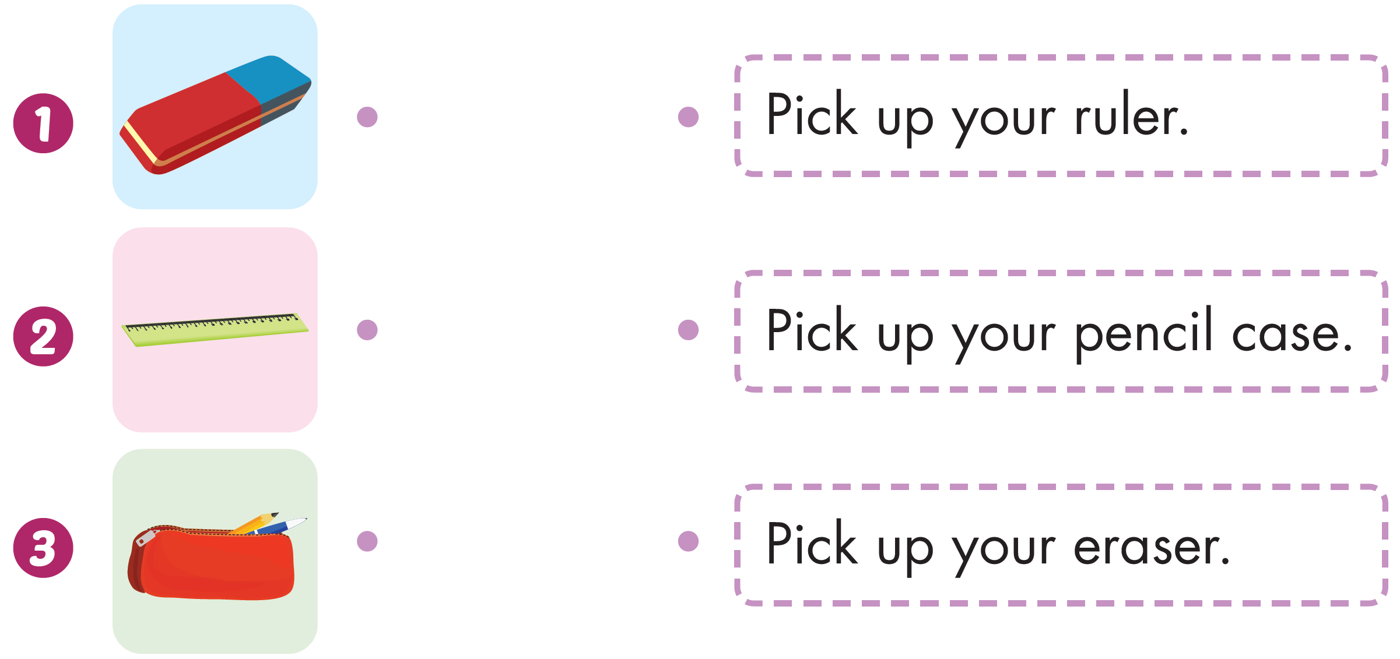
Workbook - Page 66

Slide 17

CONSOLIDATION

Slide 18
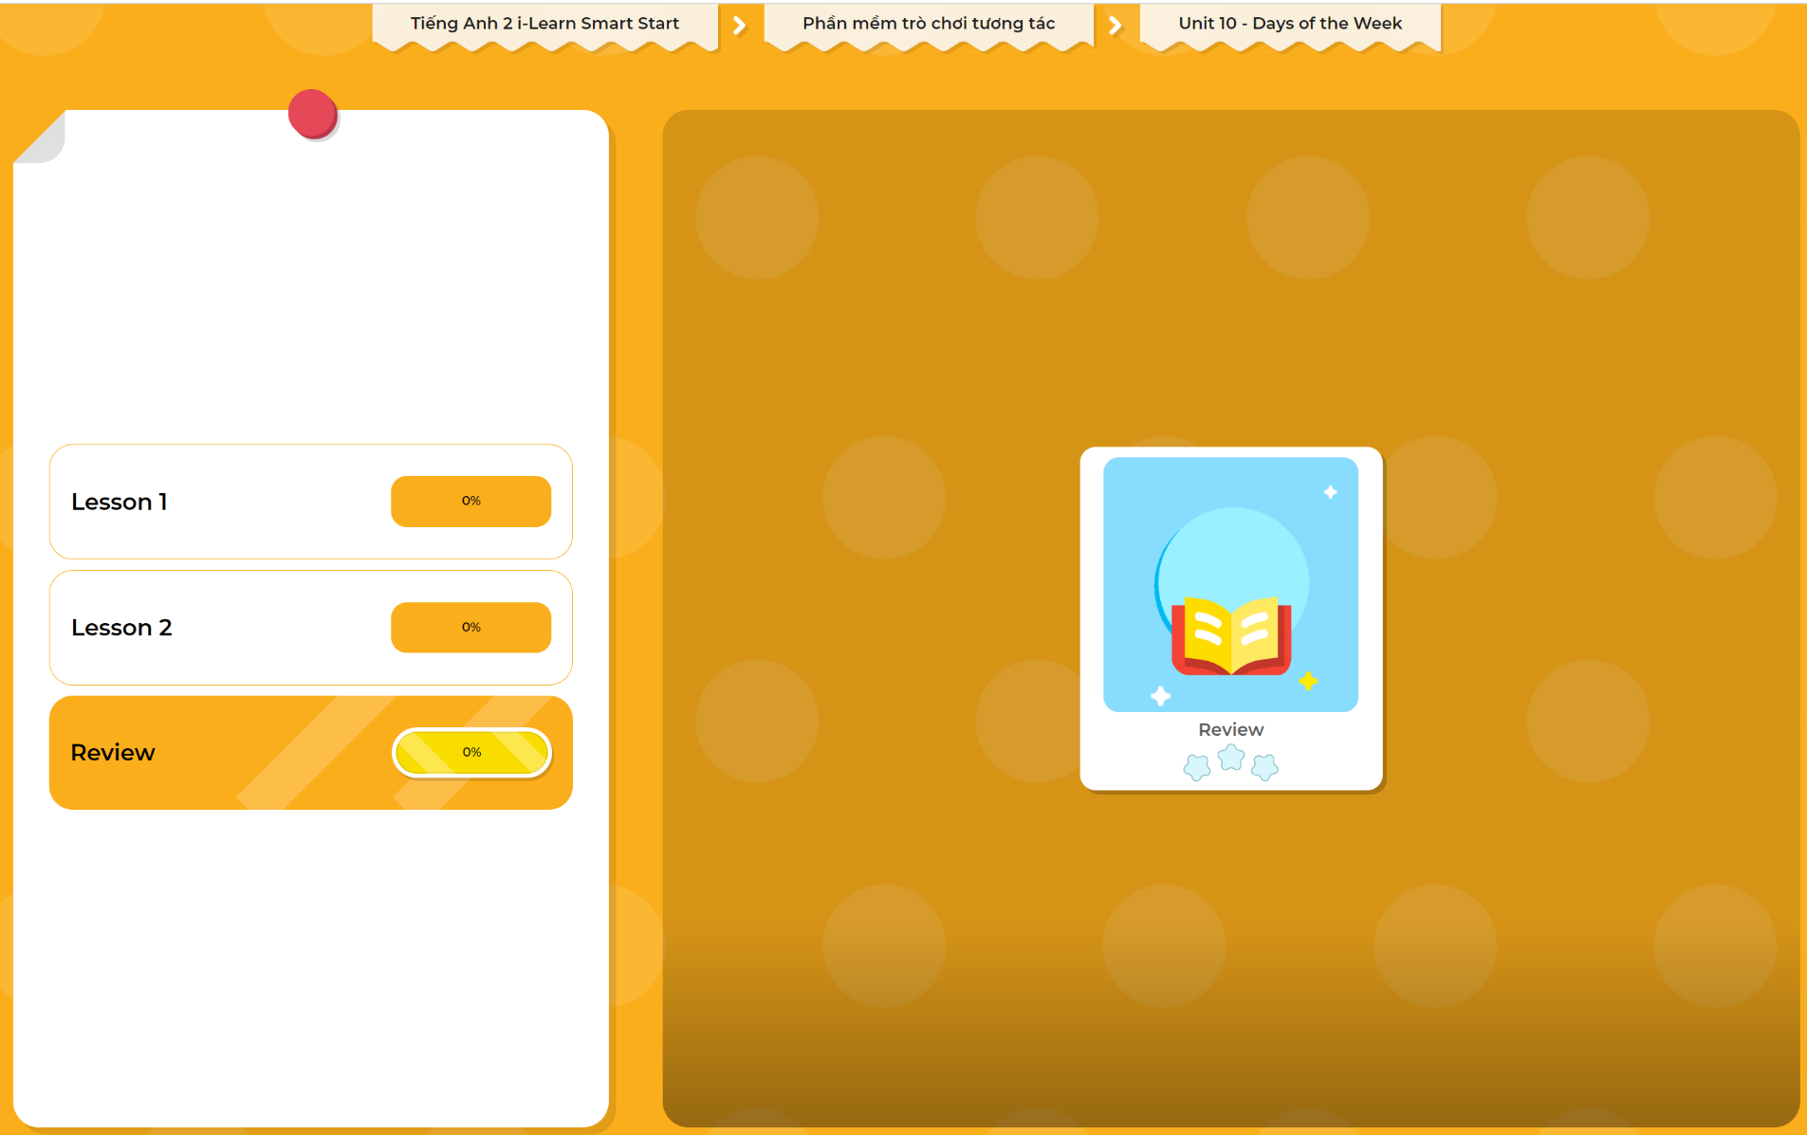
Extra Practice
DHA App
LET’S PLAY!
Click here to play the games

Slide 19

WRAP-UP

Slide 20
Today’s lesson
Skills
Review the related vocabulary items and structures to about their classroom activities/things.

Slide 21
Homework
Practice vocabularies and structures. Make sentences using them.
Practice the vocabulary and structure in Tiếng Anh 2 i-Learn Smart Start Notebook (page 66)
Do the exercises in Tiếng Anh 2 i-Learn Smart Start Workbook (page 66)
Play the consolidation games in Tiếng Anh 2 i-Learn Smart Start DHA App on www.eduhome.com.vn
Prepare the next lesson (page 69)

Slide 22

Enjoy your day!

