Slide 1

Unit 8 : Transportation
Lesson 1.1: Vocabulary & Sentence Patterns
Page: 52

Slide 2
Lesson Outline
Warm-up
Vocabulary
Structure
Consolidation
Wrap-up

Slide 3
Objectives
By the end of this lesson, students will be able to identify types of transportation.
Vocabulary: bus, boat, plane, motorbike
Structure: Can you see the (motorbike)?
Yes, I can.
Can you see the (bus)?
No, I can’t.

Slide 4

WARM-UP

Slide 5

Let’s play!
Find the card

Slide 6

It’s time to learn …

Slide 7

New words
bus,
boat,
plane, motorbike.

Slide 8



Click on the picture to hear the sound
bus
/bʌs/
xe buýt

Slide 9
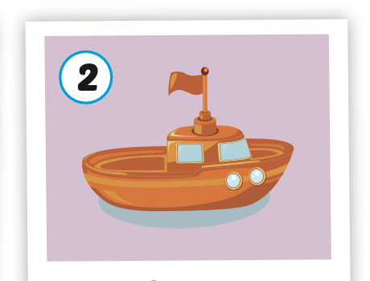
Click on the picture to hear the sound
boat
/boʊt/ con thuyền, con tàu

Slide 10
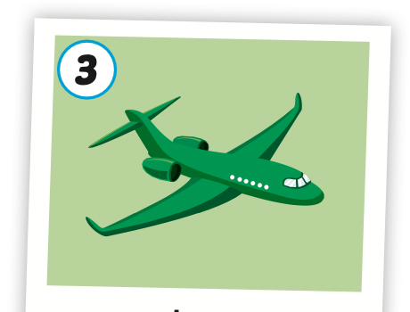
Click on the picture to hear the sound
plane
/pleɪn/
máy bay

Slide 11
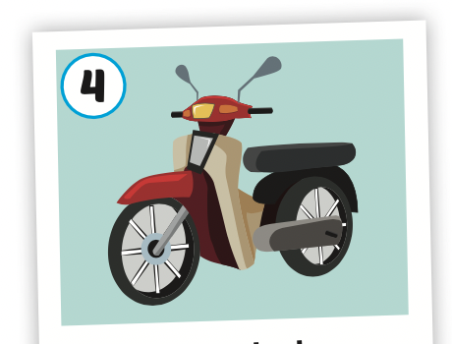
Click on the picture to hear the sound
motorbike
/ˈmoʊtəbaɪk/
xe gắn máy

Slide 12
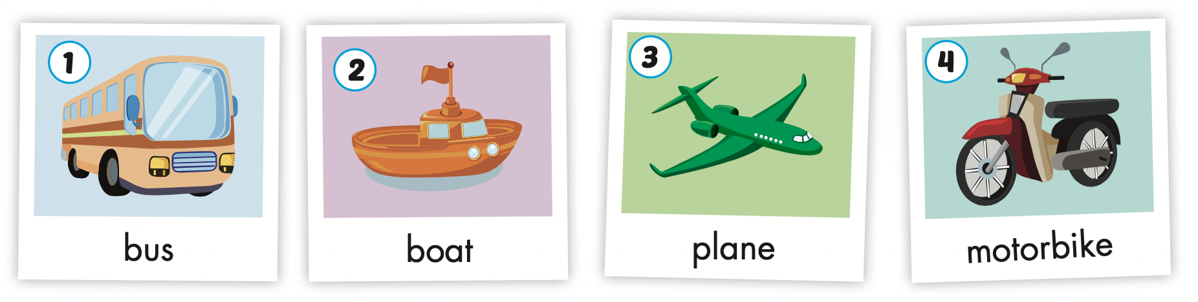
Click on A to hear the sound

Slide 13
Let’s play!

Slide 14
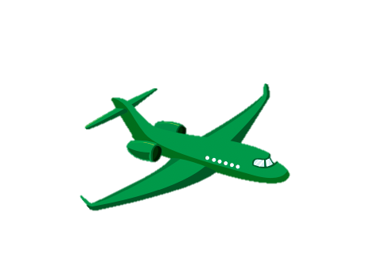


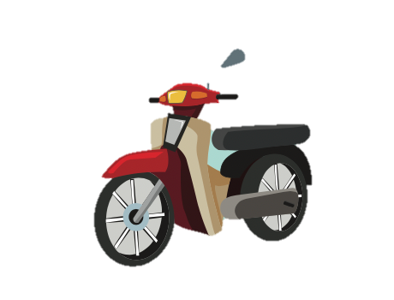
MEANS
OF
TRANSPORT
CLICK ON THE SPEAKER AND GUESS WHAT MEAN OF TRANSPORT
PLAY

Slide 15




OH YEAH!
plane
boat
bus

Slide 16
OH YEAH!
plane
motorbike
bus

Slide 17
OH YEAH!
bus
boat
motorbike

Slide 18
OH YEAH!
bike
boat
bus

Slide 19
Good job!

Slide 20
Structures
Can you see the (motorbike)?
Yes, I can.
Can you see the (bus)?
No, I can’t.

Slide 21

Presentation

Slide 22

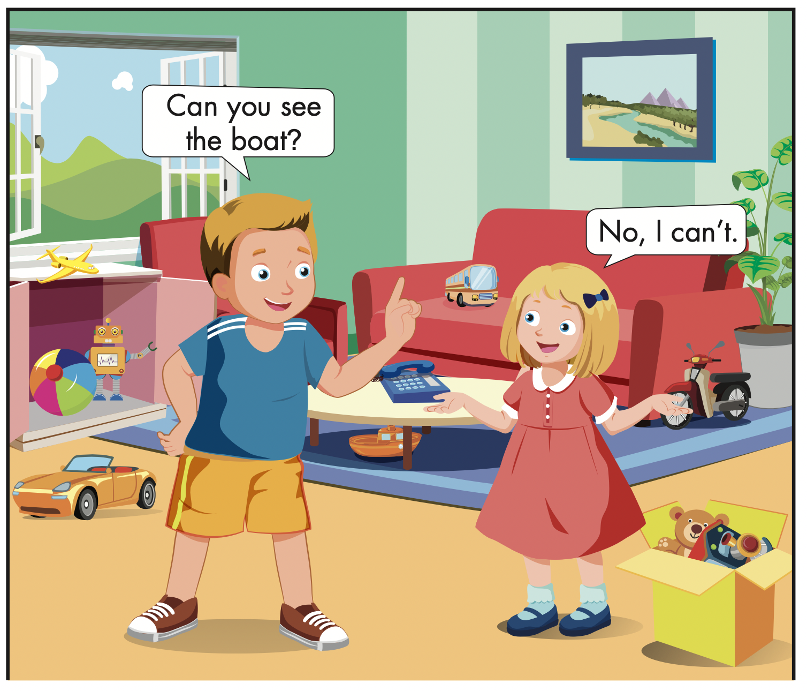
Click on B/ the icon to hear the sound

Slide 23

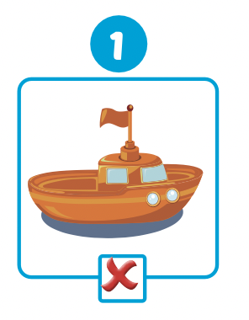
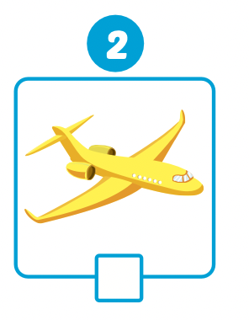
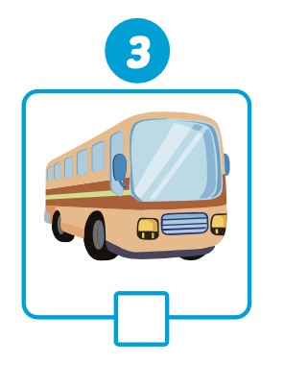


Slide 24
Listen and repeat
Can you see the boat?
No, I can’t.

Slide 25
Listen and repeat
Can you see the plane?
Yes, I can.

Slide 26
Listen and repeat
Can you see the bus?
Yes, I can.

Slide 27

Practice

Slide 28



Slide 29
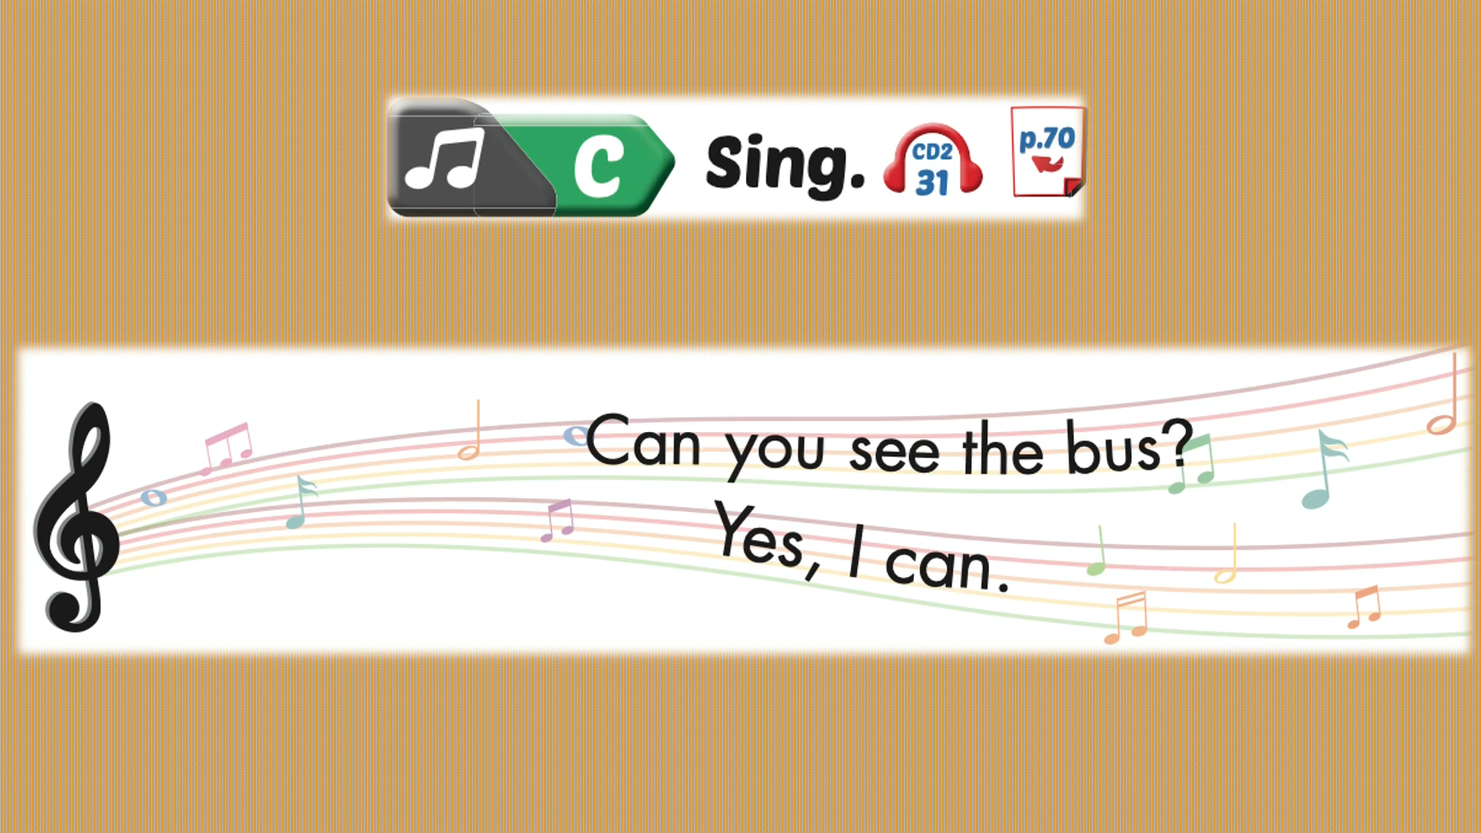

Slide 30

Production

Slide 31

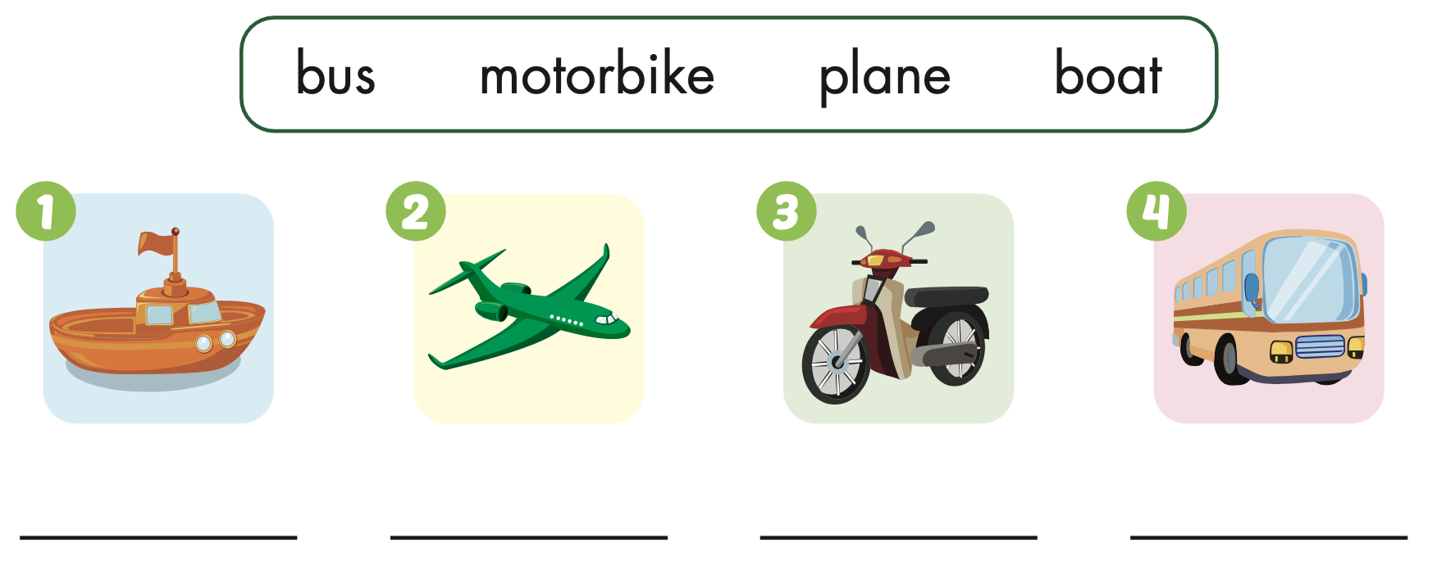
Extra Practice
WB, page 50
boat
plane
motorbike
bus

Slide 32
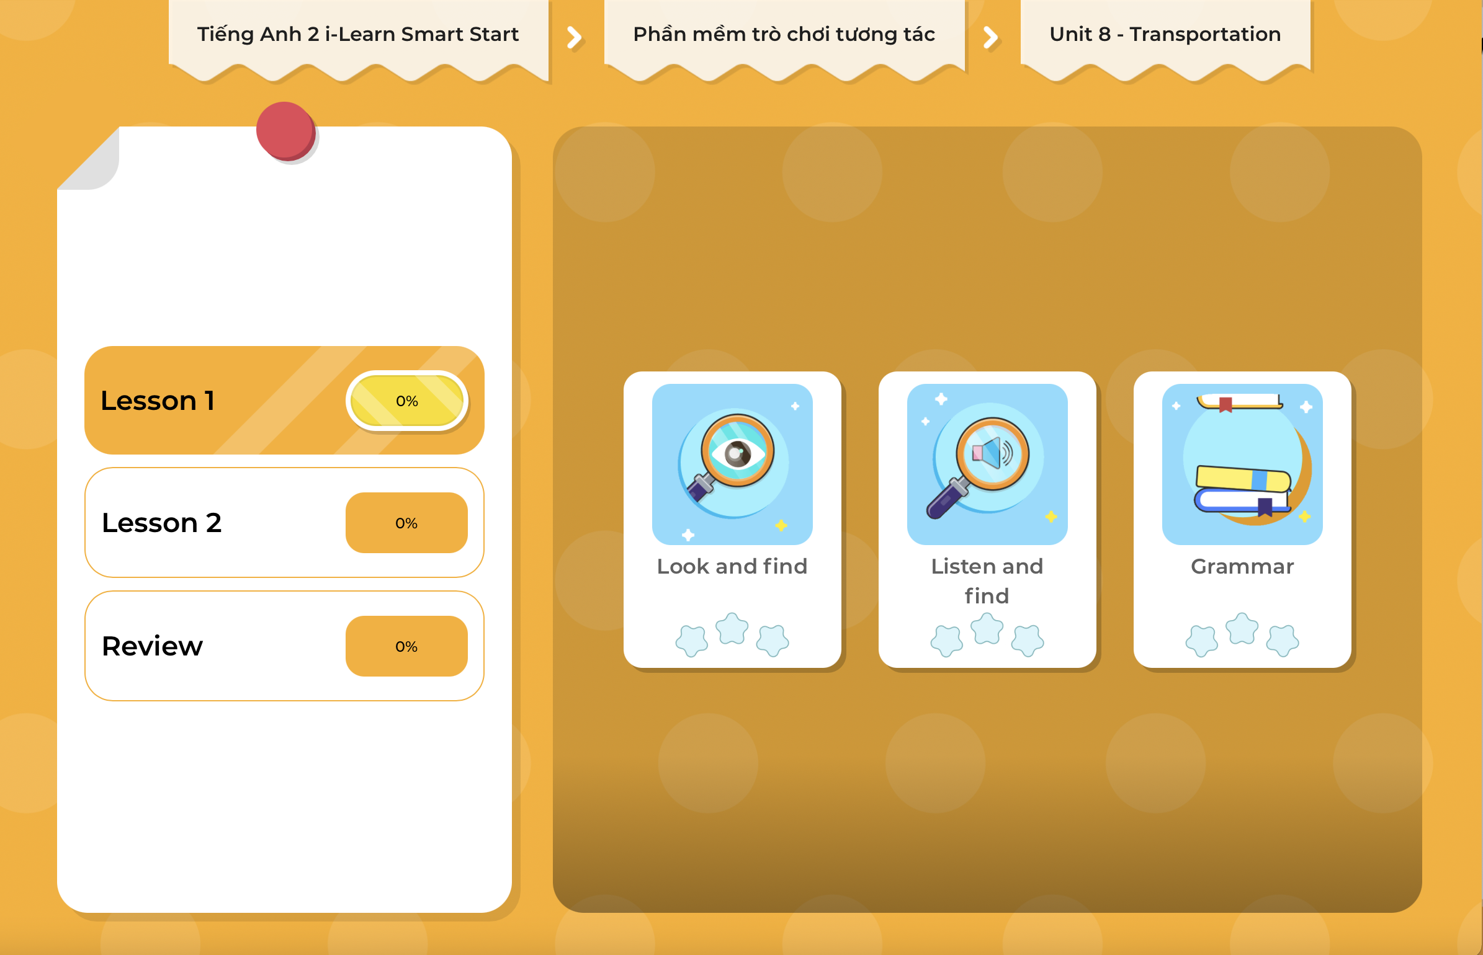
Extra Practice
DHA on Eduhome
LET’S PLAY!
Click on the picture below to play the games.

Slide 33

CONSOLIDATION

Slide 34

LET’S PLAY!
What’s missing?

Slide 35

WRAP-UP

Slide 36
Today’s lesson
Vocabularies
bus, boat, plane, motorbike
Structures/ Sentence patterns
Can you see the (motorbike)?
Yes, I can.
Can you see the (bus)?
No, I can’t.

Slide 37
Homework
Practice the vocabulary and structure, and make sentences using them.
Do the exercises in Tiếng Anh 2 i-Learn Smart Start WB (page 50).
Do the exercises in Tiếng Anh 2 i-Learn Smart Start Notebook (page 52).
Prepare the next lesson (page 53 SB).
Play the consolidation games in Tiếng Anh 2 i-Learn Smart Start DHA App on www.eduhome.com.vn

Slide 38

Enjoy your day!

