Slide 1

Unit 8 : Transportation
Lesson 1.2: Vocabulary & Sentence Patterns
Page: 53

Slide 2
Lesson Outline
Warm-up
Practice
Production
Consolidation
Wrap-up

Slide 3
Objectives
By the end of this lesson, students will be able to identify types of transportation.
Vocabulary: bus, boat, plane, motorbike
Structure: Can you see the (motorbike)?
Yes, I can.
Can you see the (bus)?
No, I can’t.

Slide 4

WARM-UP

Slide 5
Let’s sing!

Slide 6
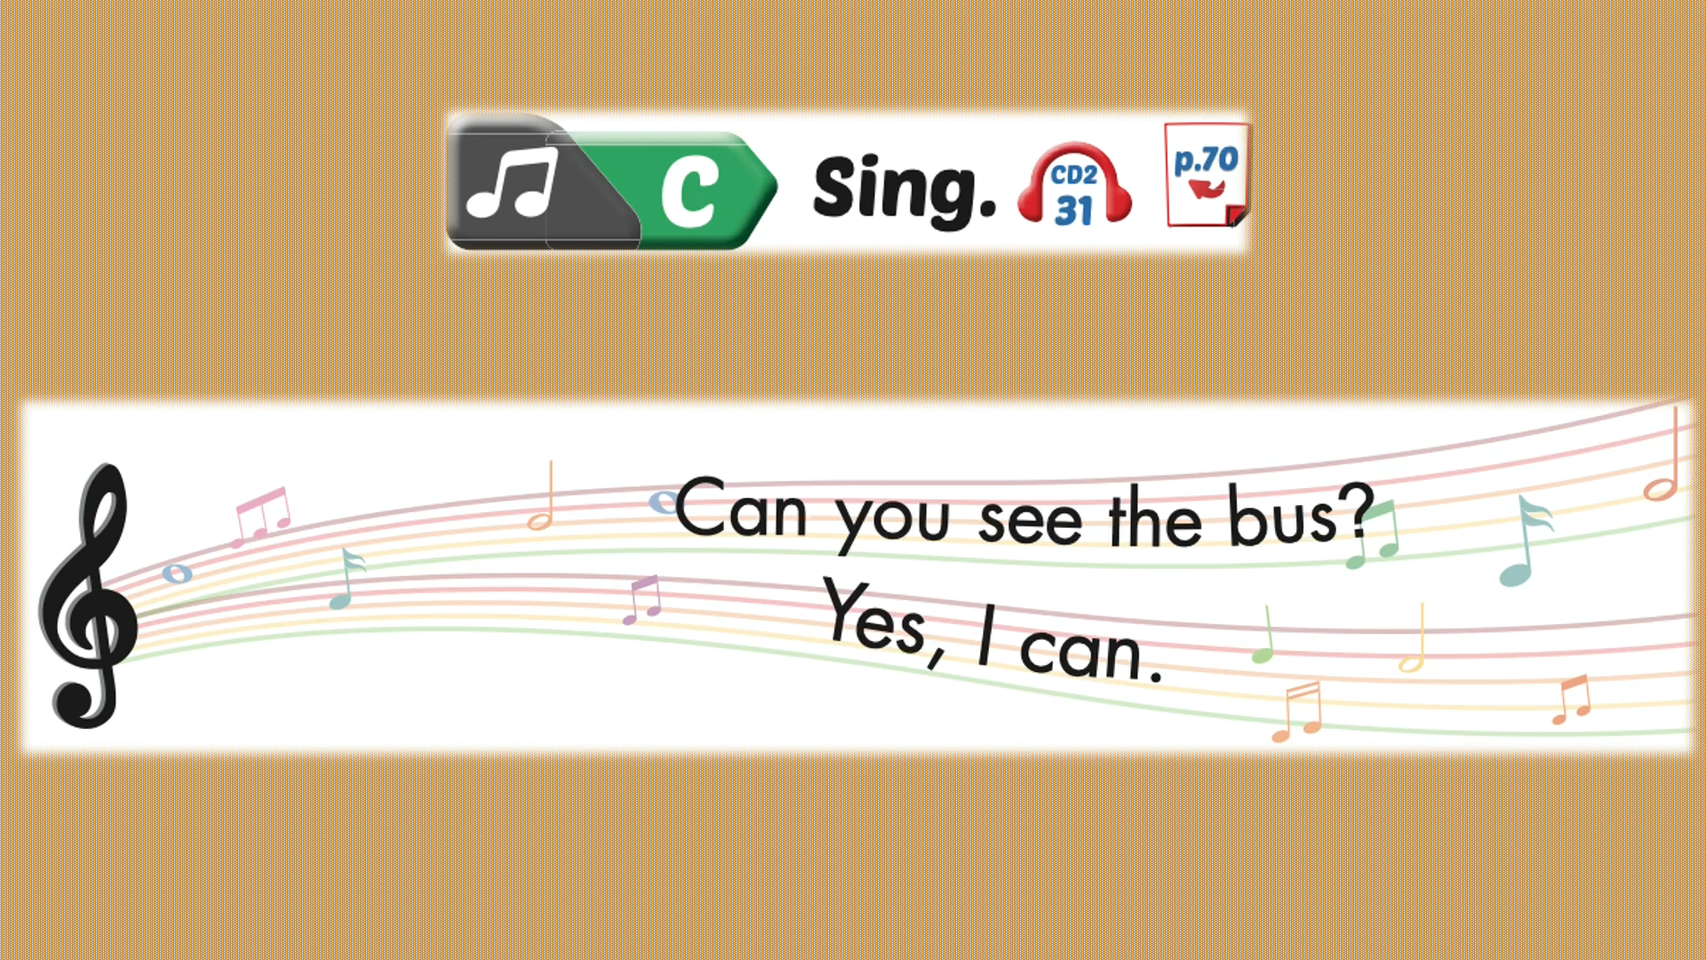

Slide 7

It’s time to learn …

Slide 8

New words
bus,
boat,
plane, motorbike.

Slide 9
Let’s play!
LISTEN
AND
CHOOSE

Slide 10



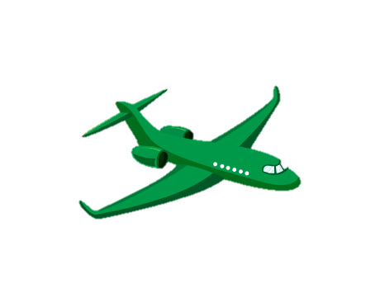

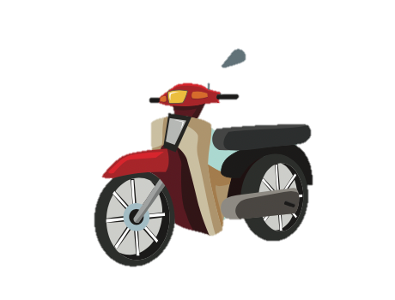


Slide 14
GOOD JOB!

Slide 15
Structures
Can you see the (motorbike)?
Yes, I can.
Can you see the (bus)?
No, I can’t.

Slide 16

Practice

Slide 17
Look at the picture and answer questions:
Divide the class into 2 teams
Team A asks
Team B answers
Swap roles

Slide 18
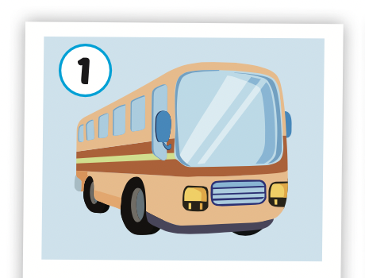
Can you see the bus?
Yes, I can.
Yes

Slide 19
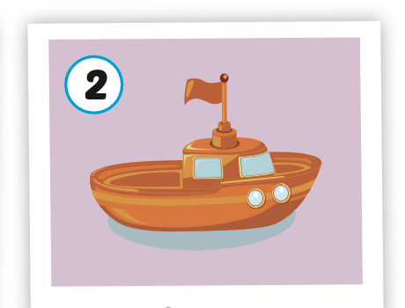
Can you see the boat?
No, I can’t.
No

Slide 20
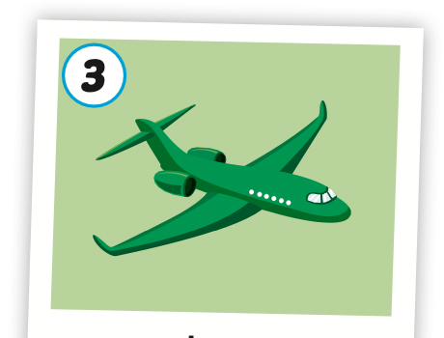
Can you see the plane?
No, I can’t.
No

Slide 21
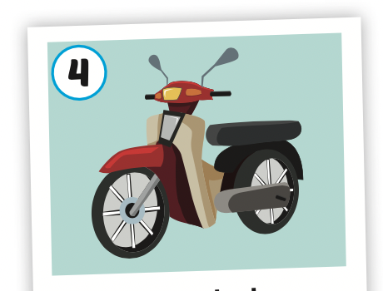
Can you see the motorbike?
Yes, I can.
Yes

Slide 22

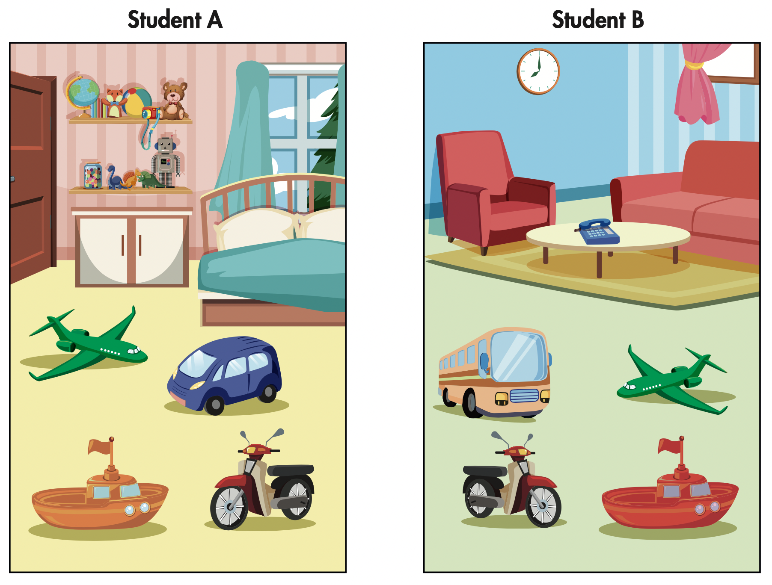

Slide 23






A
B

Slide 24

Speaking

Slide 25
Students work in pairs.

Slide 26

Production

Slide 27

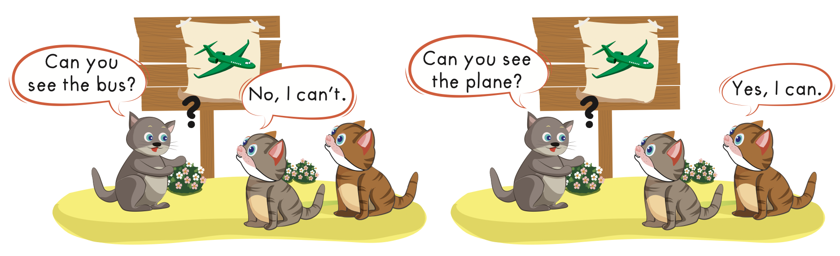

Slide 28
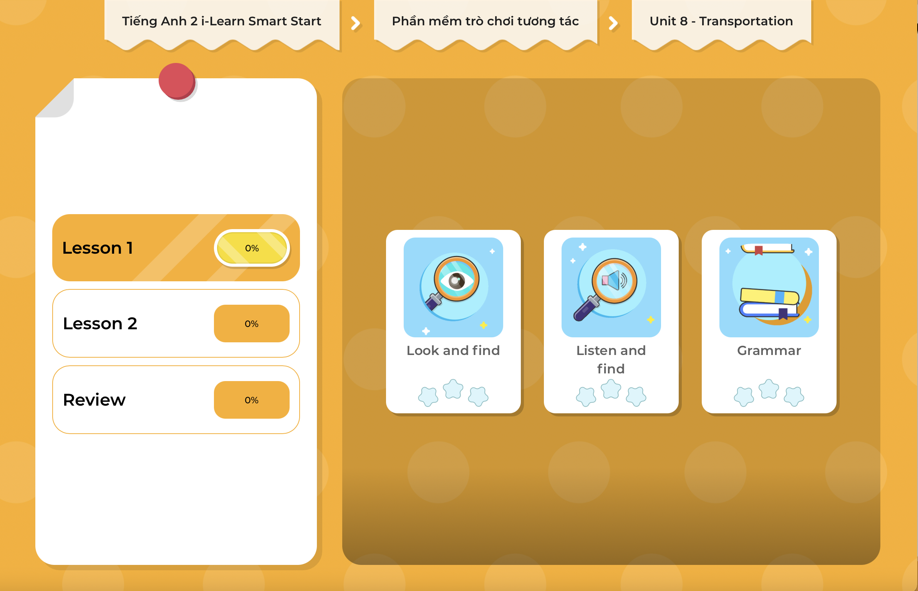
Extra Practice
DHA on Eduhome
LET’S PLAY!
Click on the picture below to play the games.

Slide 29

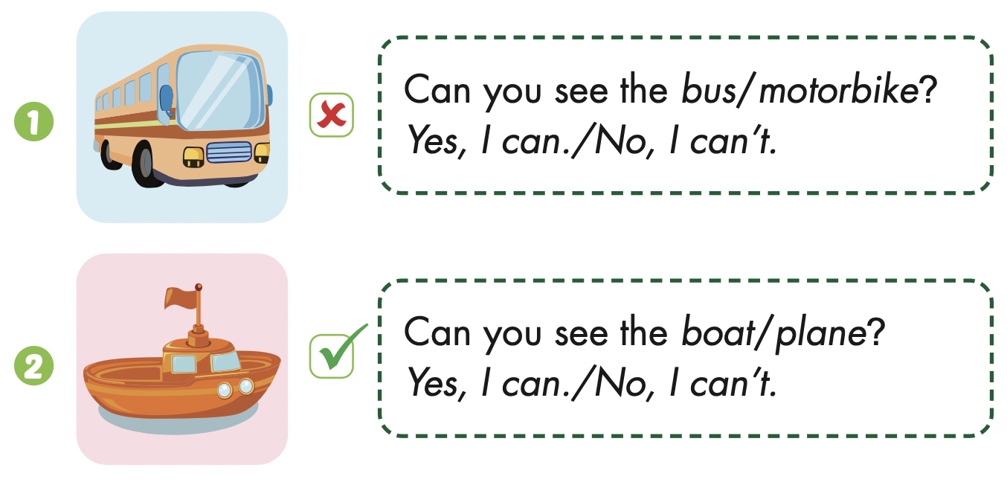
Extra Practice
WB, page 51

Slide 30
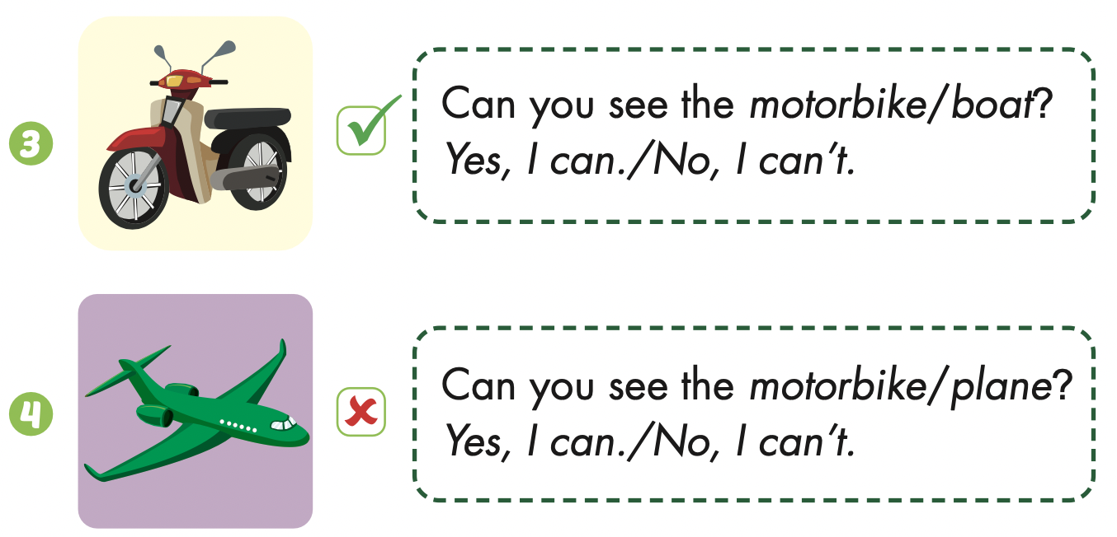

Slide 31

CONSOLIDATION

Slide 32

Let’s play!
Pictionary game

Slide 33

WRAP-UP

Slide 34
Today’s lesson
Vocabularies
Bus,
Boat,
Plane
Motorbike
Structures/ Sentence patterns
Can you see the (motorbike)?
Yes, I can.
Can you see the (bus)?
No, I can’t.

Slide 35
Homework
Practice the vocabulary and structure, and make sentences using them.
Do the exercises in Tiếng Anh 2 i-Learn Smart Start WB (page 51).
Do the exercises in Tiếng Anh 2 i-Learn Smart Start Notebook (page 53).
Prepare the next lesson (page 54 SB).
Play the consolidation games in Tiếng Anh 2 i-Learn Smart Start DHA App on www.eduhome.com.vn

Slide 36

Enjoy your day!

