Slide 1

Unit 8 : Transportation
Lesson 2.1: Phonics
Page: 54

Slide 2
Lesson Outline
Warm-up
Practice
Production
Consolidation
Wrap-up

Slide 3
Objectives
By the end of this lesson, students will be able to recognize the /ks/ and /j/ sounds.
Vocabulary: fox, box, yo-yo, yogurt
Phonics: /ks/, /j/

Slide 4

WARM-UP

Slide 5

LET’S PLAY!
What’s missing?

Slide 6
Let’s sing!

Slide 7


Alphabet song

Slide 8

It’s time to learn …

Slide 9

Phonics
/ks/,
/j/.

Slide 10


X, x
/ ks /

Slide 11
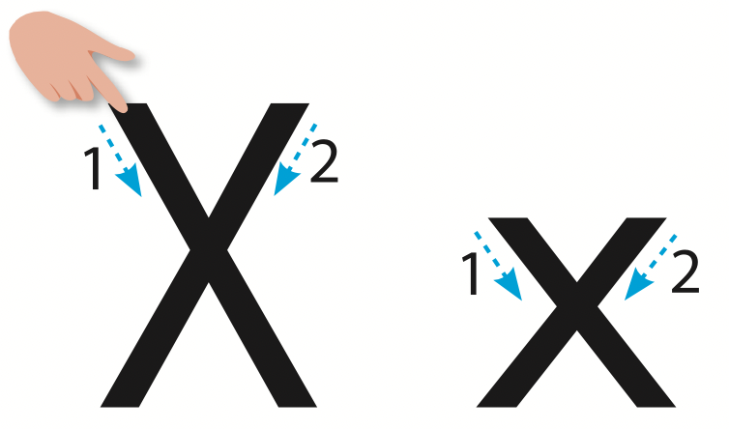
Let’s trace!

Slide 12



/ks/
fox
box
/fɒks/
/bɒks/

Slide 13
/ks/
fox
/fɒks/

Slide 14
/ks/
box
/bɒks/

Slide 15


Let’s write!

Slide 16

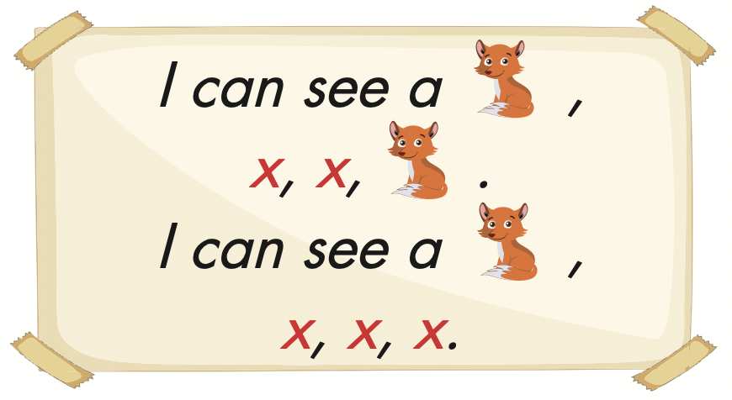

Slide 17
Let’s play!

Slide 18


/ks/
X
box

Slide 19
/ks/
X
fox

Slide 20
/kx/
box
fox

Slide 21
/ks/
box
fox

Slide 22


Slide 23

Production

Slide 24



Slide 25
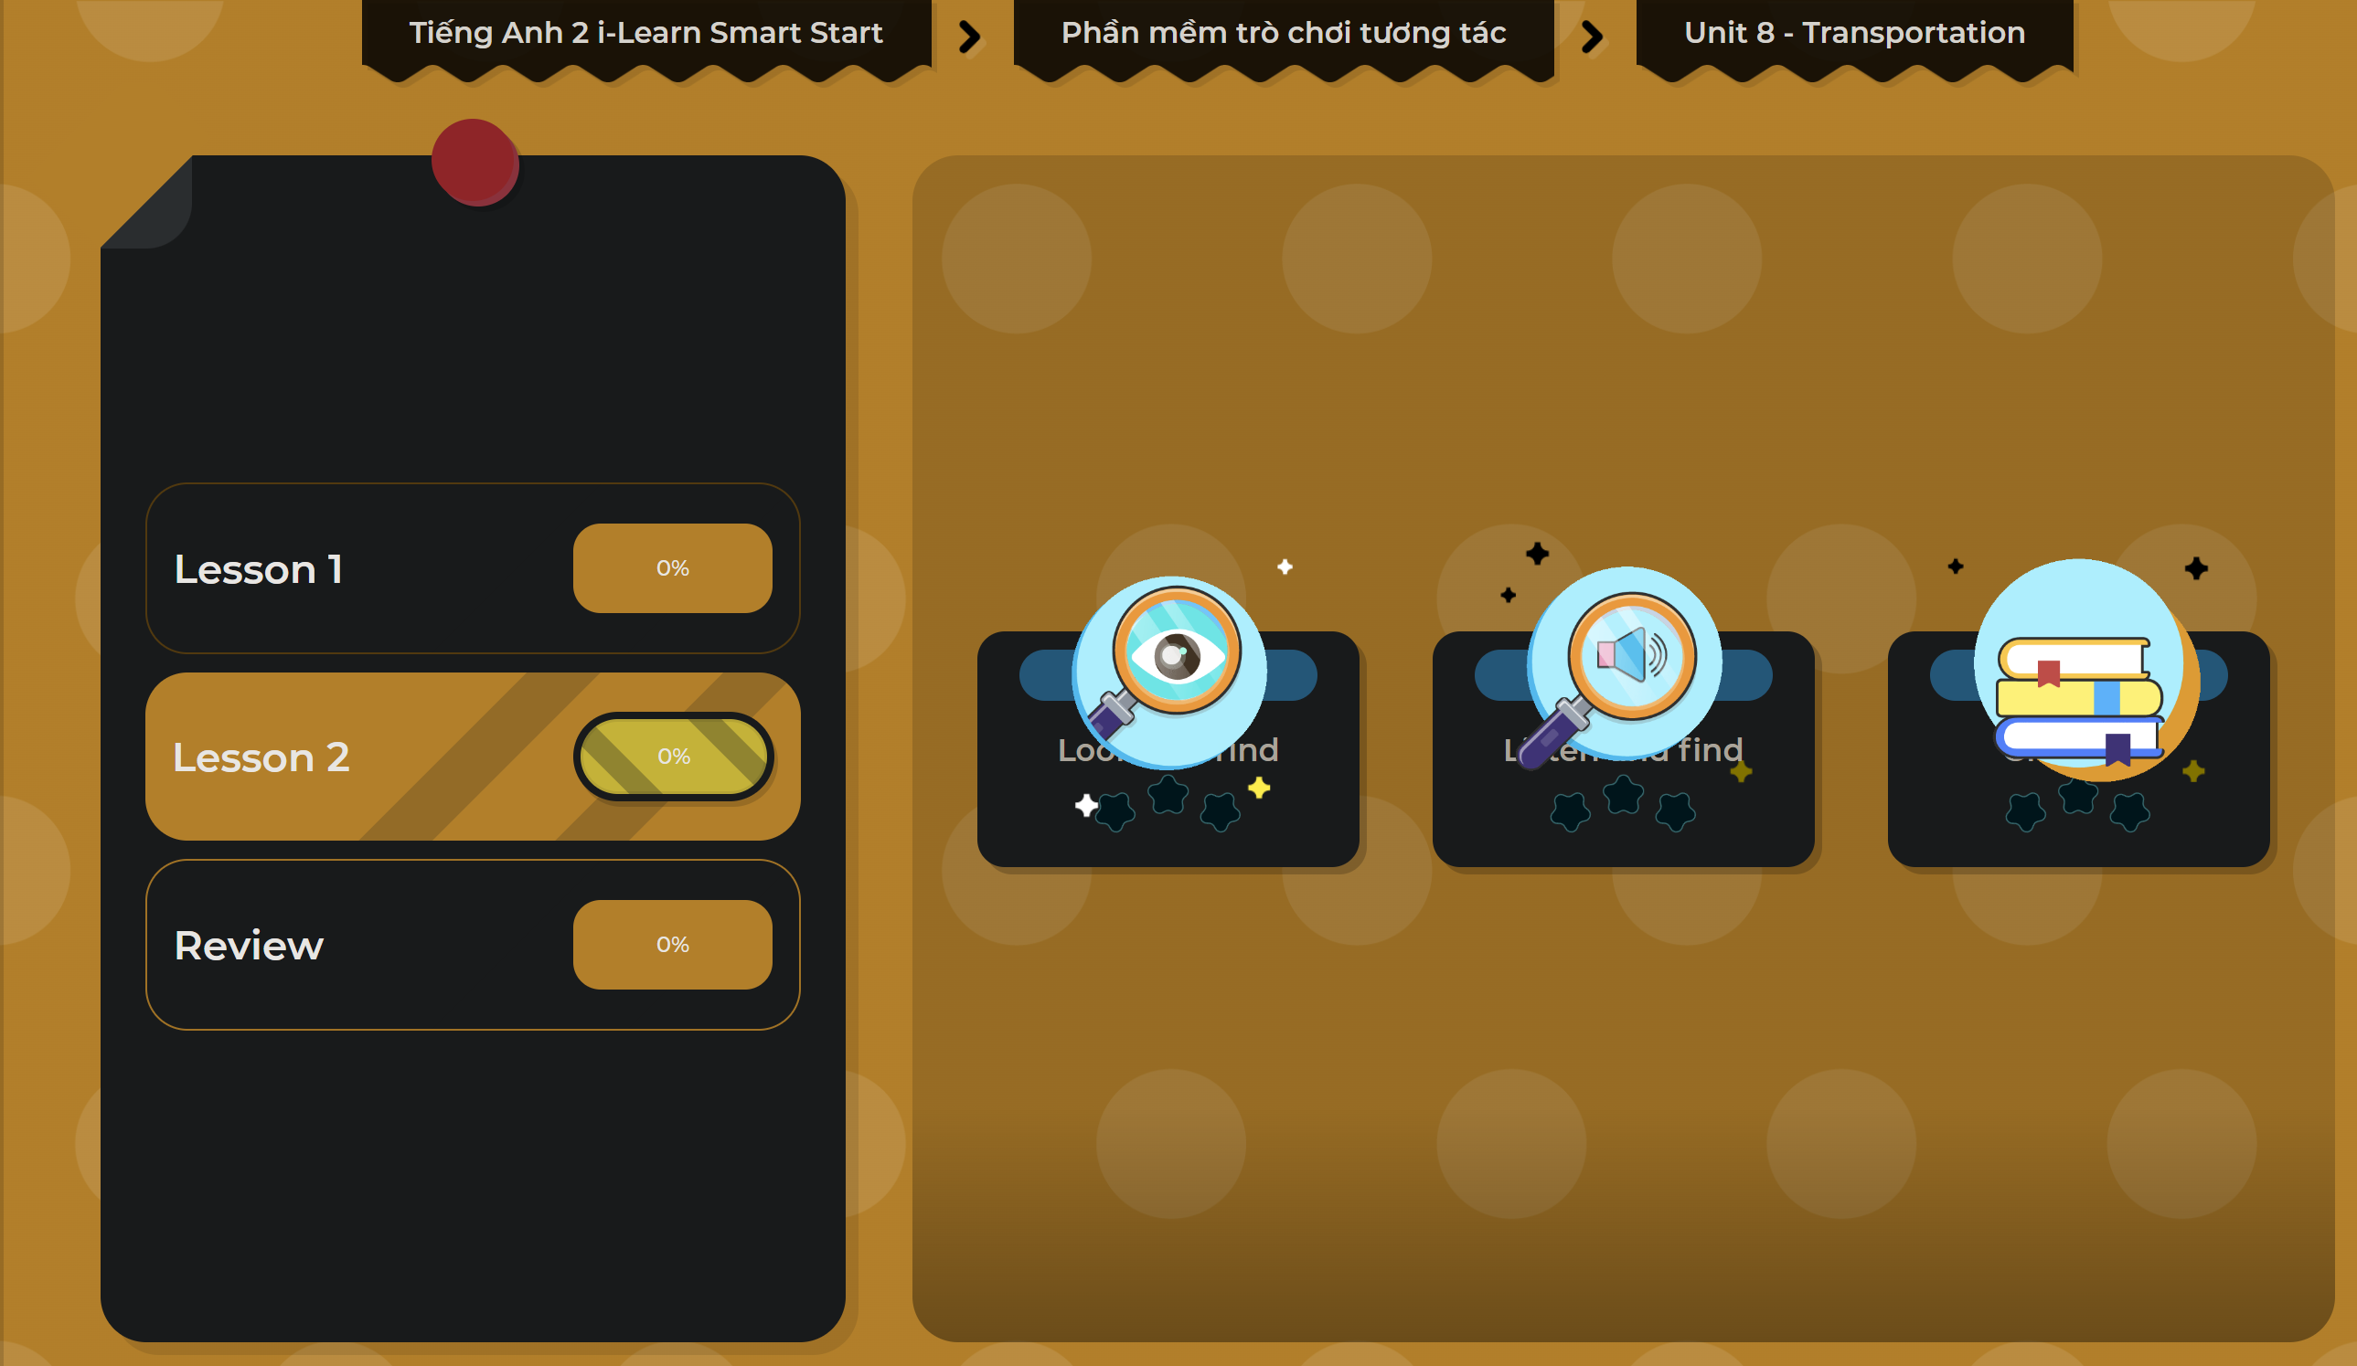
Extra Practice
DHA on Eduhome
LET’S PLAY!
Click on the picture below to play the games.

Slide 26

CONSOLIDATION

Slide 27

Let’s play!
Read my lips

Slide 28

WRAP-UP

Slide 29
Today’s lesson
Vocabularies
box,
fox,
yoyo,
yogurt.
Phonics
/ks/, /j/

Slide 30
Homework
Practice the vocabulary and structure, and make sentences using them.
Do the exercises in Tiếng Anh 2 i-Learn Smart Start WB (page 52).
Do the exercises in Tiếng Anh 2 i-Learn Smart Start Notebook (page 54).
Prepare the next lesson (page 55 SB).
Play the consolidation games in Tiếng Anh 2 i-Learn Smart Start DHA App on www.eduhome.com.vn

Slide 31

Enjoy your day!

