Slide 1

Unit 8: Transportation
Review 7
Page: 56

Slide 2
Lesson Outline
Warm-up
Practice
Production
Consolidation
Wrap-up

Slide 3
Objectives
By the end of this lesson, students will be able to review identifying clothes.
Vocabulary: T-shirt, dress, hat, shirt, shorts, shoes, socks, pants
Structure: Is this your (T-shirt)?
Yes, it is.
Is this your (dress)?
No, it isn’t.
These are my (pants).

Slide 4

WARM-UP

Slide 5
Let’s sing!

Slide 6
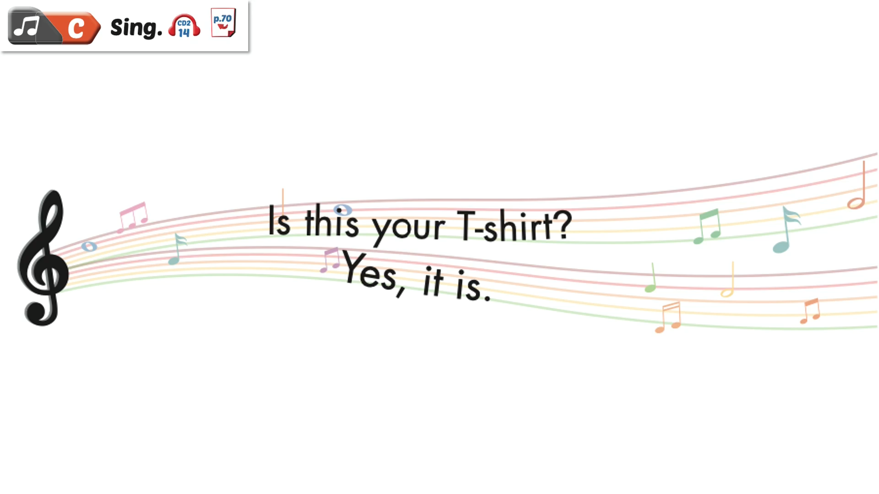

Slide 7

It’s time to learn …

Slide 8
Let’s play!

Slide 9
Guess
the
clothes

Slide 10

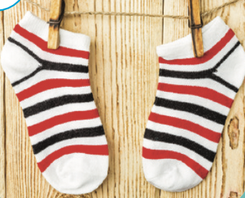



CLOTHES
These are….
shirt
socks
shoes
NEXT
Choose the word.

Slide 11

CLOTHES
These are….
shorts
socks
shoes
NEXT
Choose the word.

Slide 12
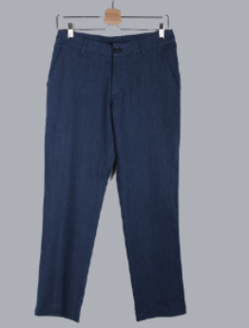
CLOTHES
These are….
socks
pants
shorts
NEXT
Choose the word.

Slide 13
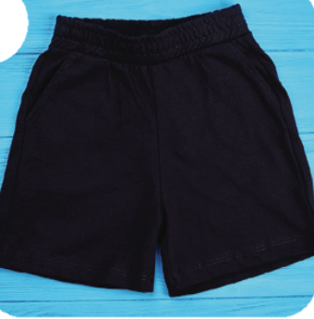
CLOTHES
These are….
shorts
pants
shoes
NEXT
Choose the word.

Slide 14
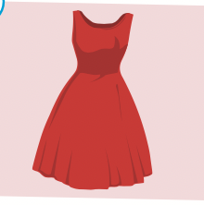
CLOTHES
What’s this?
shirt
dress
bag
NEXT
Choose the word.

Slide 15
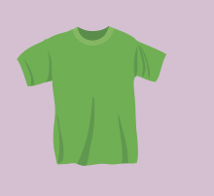
CLOTHES
What’s this?
dress
shirt
T-shirt
NEXT
Choose the word.

Slide 16
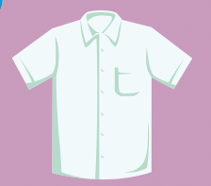
CLOTHES
What’s this?
T-shirt
shirt
dress
NEXT
Choose the word.

Slide 17

CLOTHES
What’s this?
hat
dress
bag
NEXT
Choose the word.

Slide 18
Good
job!

Slide 19

Practice

Slide 20

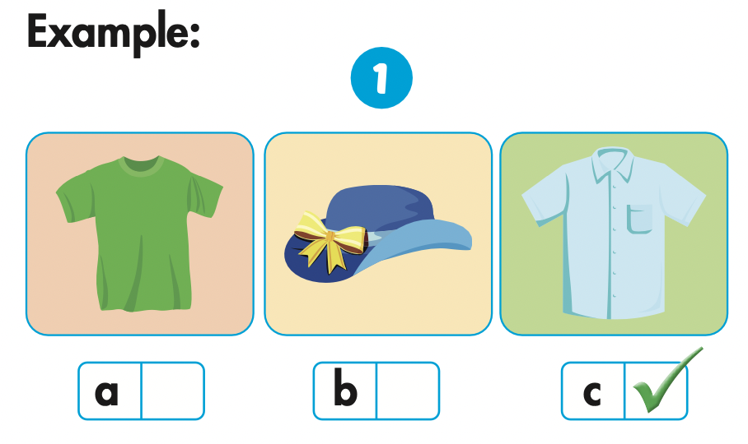
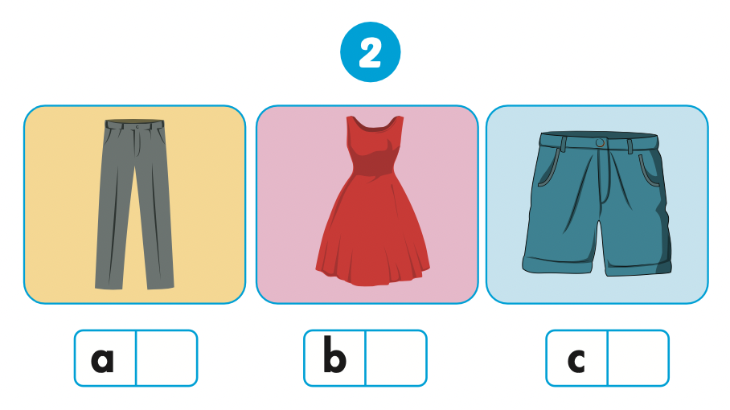
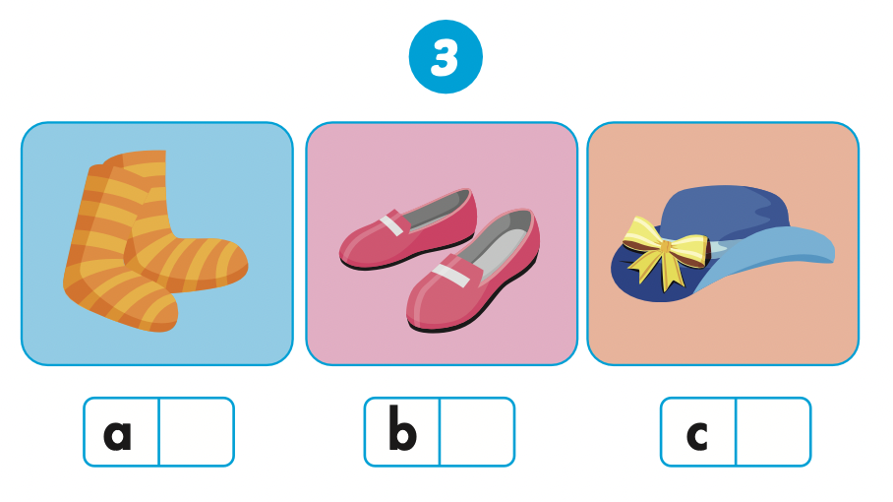
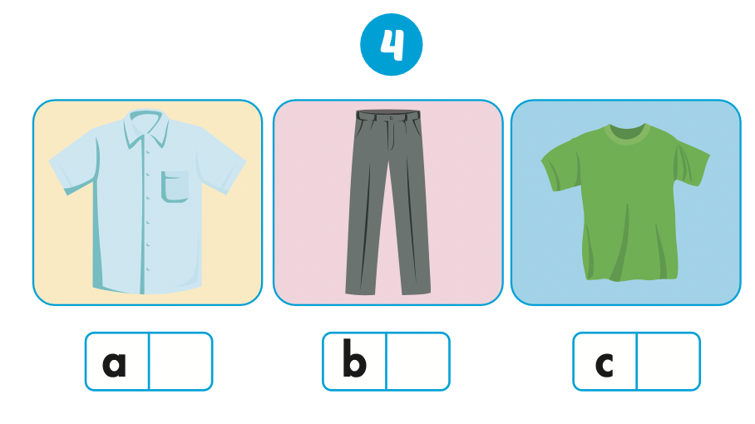

Slide 21

Let’s check!

Slide 22
Let’s check!

Slide 23
Let’s check!

Slide 24

Production

Slide 25

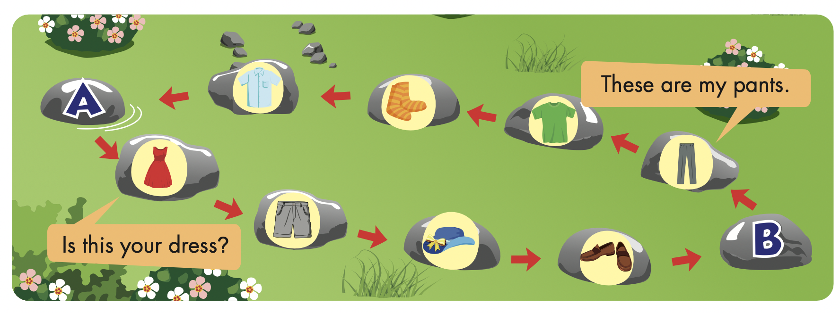

Slide 26
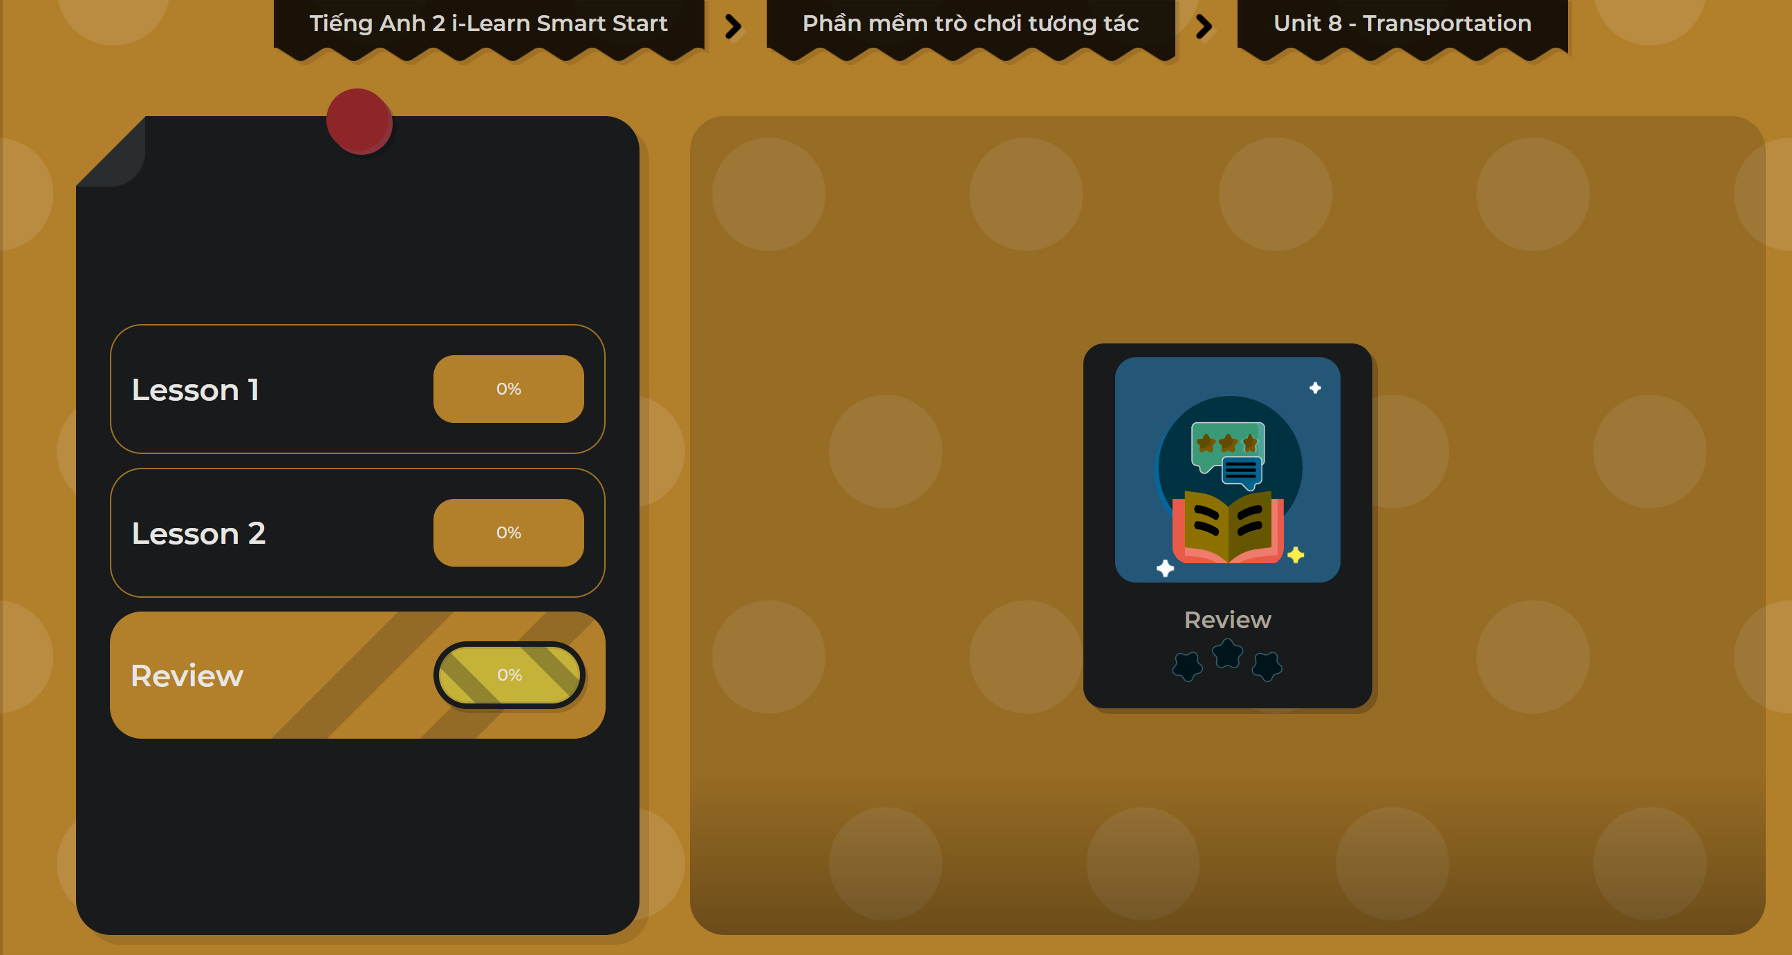
Extra Practice
DHA on Eduhome
LET’S PLAY!
Click on the picture below to play the games.

Slide 27

CONSOLIDATION

Slide 28

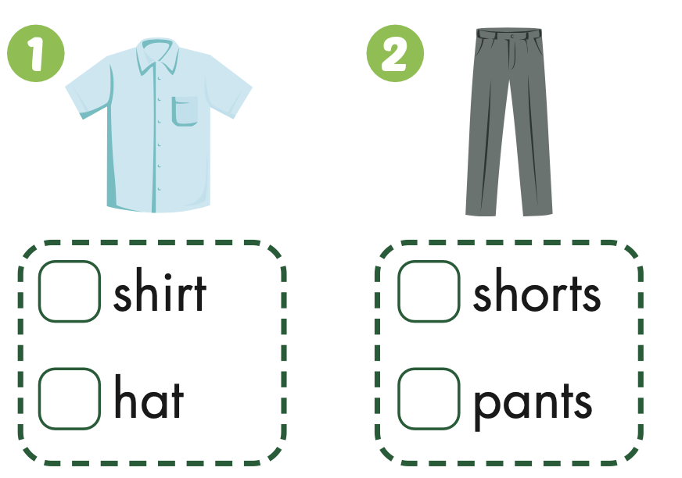
Extra Practice
WB, page 54

Slide 29
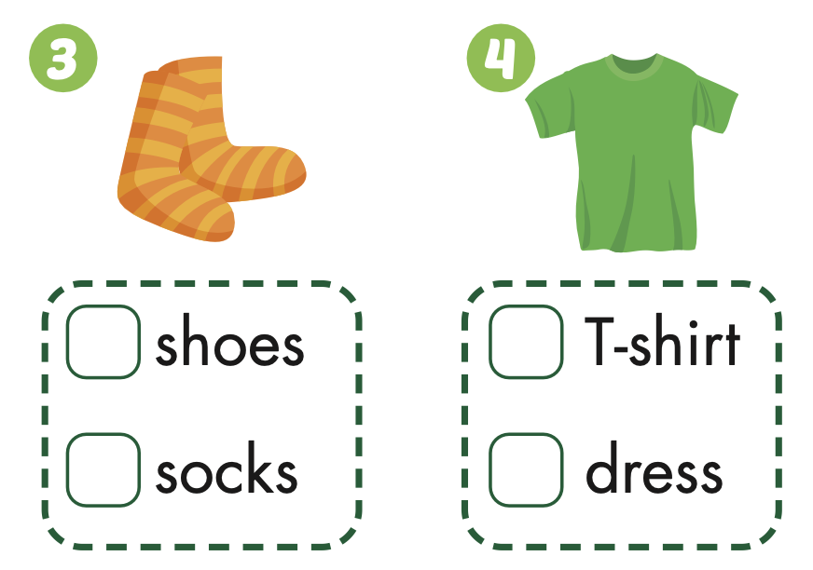
Extra Practice
WB, page 54

Slide 30

WRAP-UP

Slide 31
Today’s lesson
Vocabularies
T-shirt, dress, hat, shirt, shorts, shoes, socks, pants.
Structures/ Sentence patterns
Is this your (T-shirt)?
Yes, it is.
Is this your (dress)?
No, it isn’t.
These are my (pants).

Slide 32
Homework
Practice the vocabularies and structure, and make sentences using them.
Do the exercises in Tiếng Anh 2 i-Learn Smart Start WB (page 54).
Prepare the next lesson (page 57 SB).
Play the consolidation games in Tiếng Anh 2 i-Learn Smart Start DHA App on www.eduhome.com.vn

Slide 33

Enjoy your day!

