Slide 1

Unit 9: Classroom activities
Lesson 1.1: Vocabulary & Sentence Patterns
Page: 58

Slide 2
Lesson Outline
Warm-up
Vocabulary
Structure
Practice
Consolidation
Wrap-up

Slide 3
Objectives
By the end of this lesson, students will be able to gain the following:
Vocabulary:
eraser, ruler, crayon, pencil case
Sentence pattern:
Pick up your (eraser).
Skills:
To be able to suggest activities. Identify and use vocabulary items about classroom activities.

Slide 4

WARM UP

Slide 5



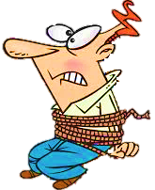




NEXT
Choose the picture of “box”

Slide 6


NEXT
Choose the picture of “yoghurt”

Slide 7
NEXT
Choose the picture of “fox”

Slide 8

NEXT
Choose the picture of “yo-yo”

Slide 9

It’s time to learn …

Slide 10

New words
eraser, ruler, crayon, pencil case

Slide 11

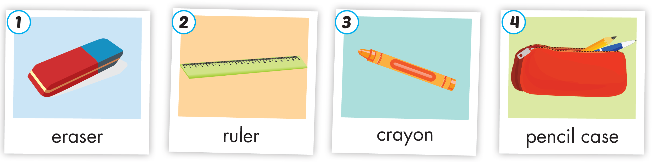
Click the icon to hear the sound
Notes:
Click vào hình A. 1. Listen and point. Repeat để cho cả audio full chạy

Slide 12

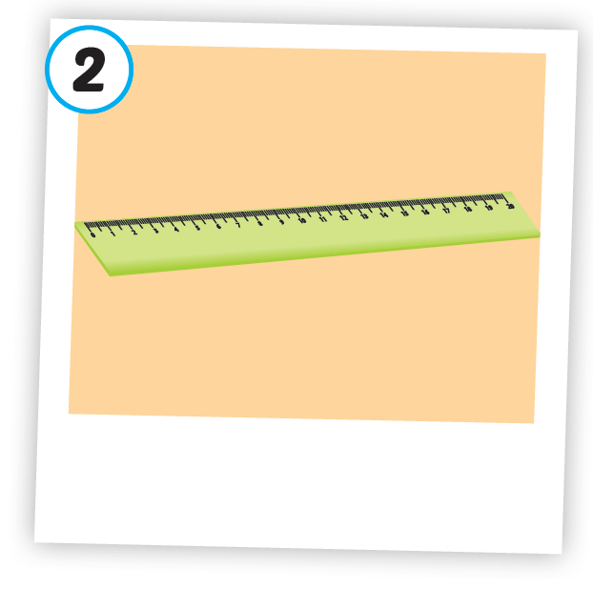

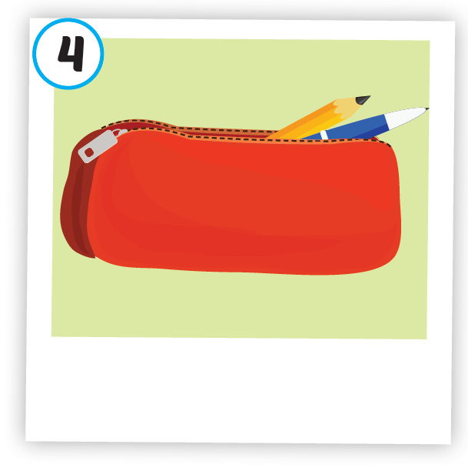




Click each icon to hear the sound
/ɪˈreɪ.sər/
cục tẩy
/ˈruː.lər/
thước kẻ
/ˈkreɪ.ɑːn/
bút sáp màu
/ˈpen.səl ˌkeɪs/
hộp bút
Notes:
Click vào hình A. 1. Listen and point. Repeat để cho cả audio full chạy

Slide 13

Click the icon to hear the sound
/ɪˈreɪ.sər/
cục tẩy

Slide 14

Click the icon to hear the sound
/ˈruː.lər/
thước kẻ

Slide 15

Click the icon to hear the sound
/ˈkreɪ.ɑːn/
bút sáp màu

Slide 16
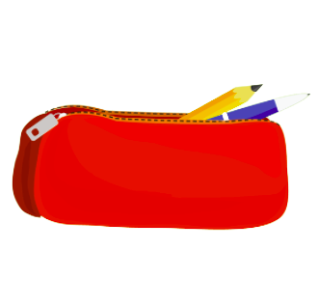
Click the icon to hear the sound
/ˈpensl keɪs/
hộp bút

Slide 17

Structures
Pick up your (eraser).

Slide 18

Pick up your eraser.
→ Yêu cầu người khác nhặt đồ vật gì đó lên

Slide 19

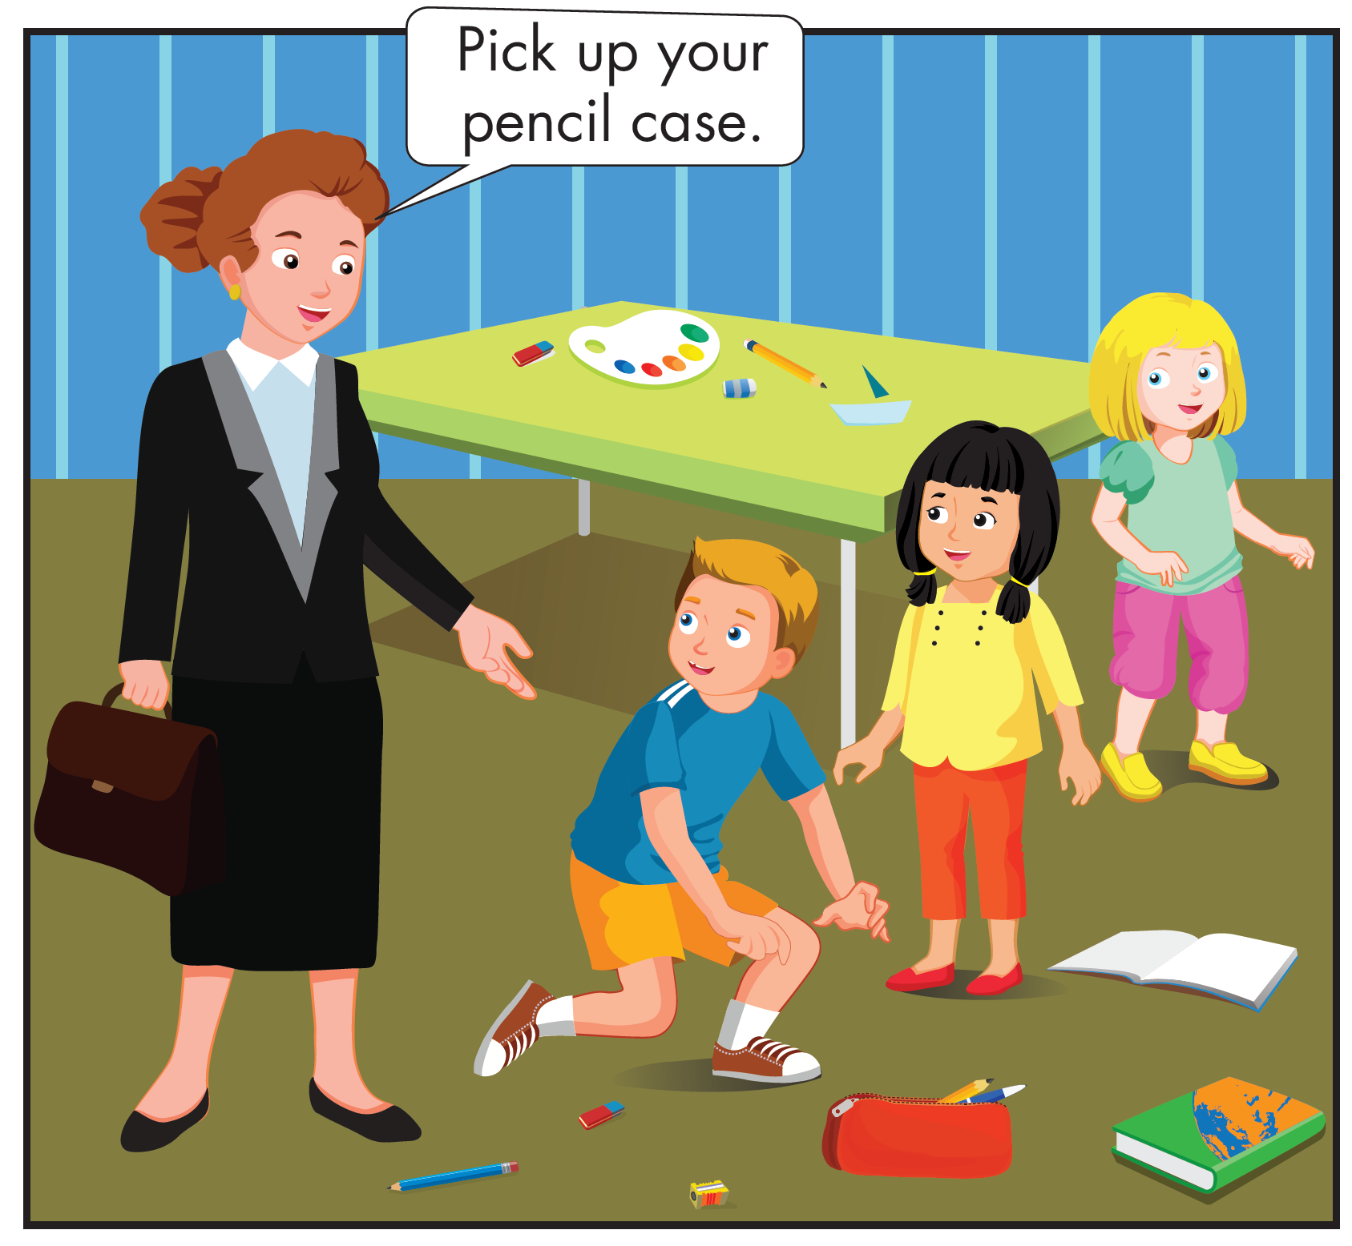
Click the icon to hear the sound
Who are they?

Slide 20
Click the icon to hear the sound
What are they doing?

Slide 21
Click the icon to hear the sound

Slide 22

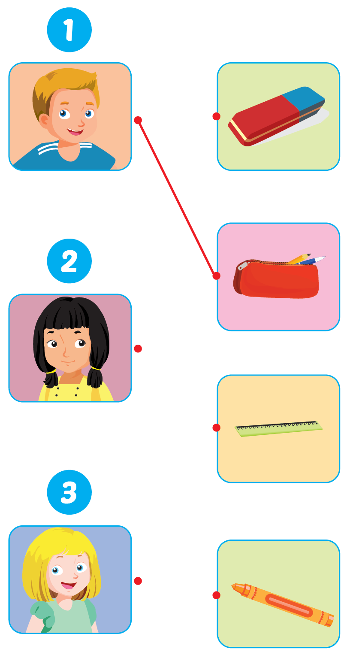
Click the icon to hear the sound

Slide 23

Practice

Slide 24


Click the icon to hear the sound
Pick up your eraser.
Pick up your crayon.
Pick up your eraser.
Pick up your crayon.
Pick up your ruler.
Pick up your pencil case.
Pick up your ruler.
Pick up your pencil case.

Slide 25
It’s time to play …

Slide 26












Time
Egg
Question 1: Pick up your_____________ .
eraser
bag
ruler
pencil case
A
B
C
D
Notes:
Click vào con gà có đáp án đúng để hiện hiệu ứng

Slide 27

Time
Egg
Question 2: Pick up your_____________ .
crayon
eraser
pencil
pencil case
A
B
C
D

Slide 28

Time
Egg
Question 3: Pick up your_____________ .
eraser
bag
ruler
pencil case
A
B
C
D

Slide 29

Time
Egg
Question 4: Pick up your_____________ .
crayon
pencil
ruler
pencil case
A
B
C
D

Slide 30

Further Practice

Slide 31

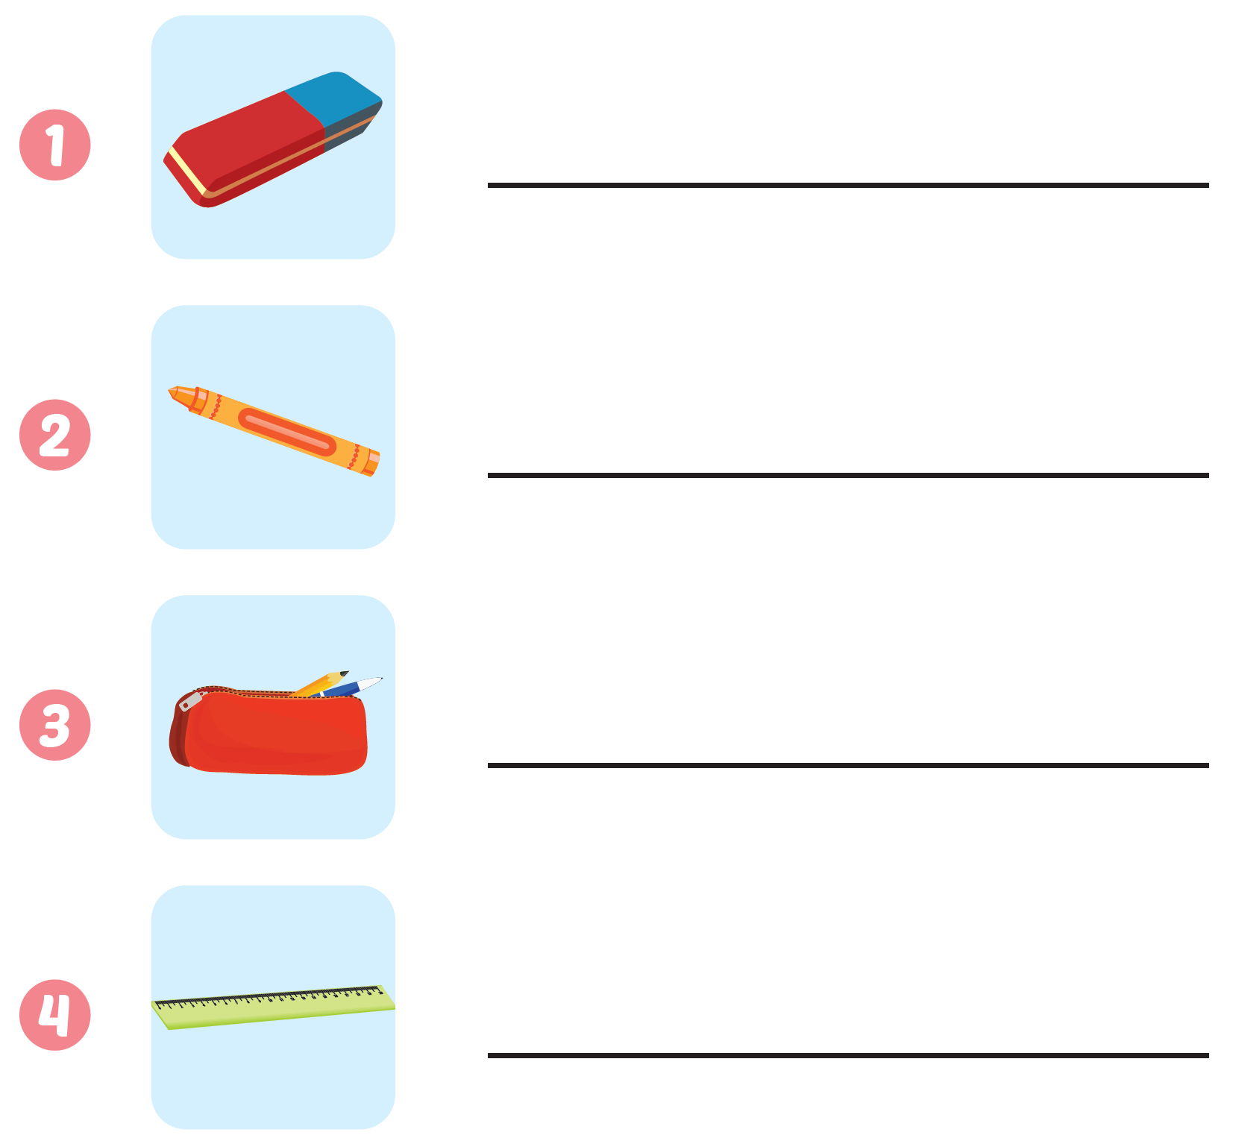
eraser
Workbook - Page 56
crayon
pencil case
ruler

Slide 32

CONSOLIDATION

Slide 33
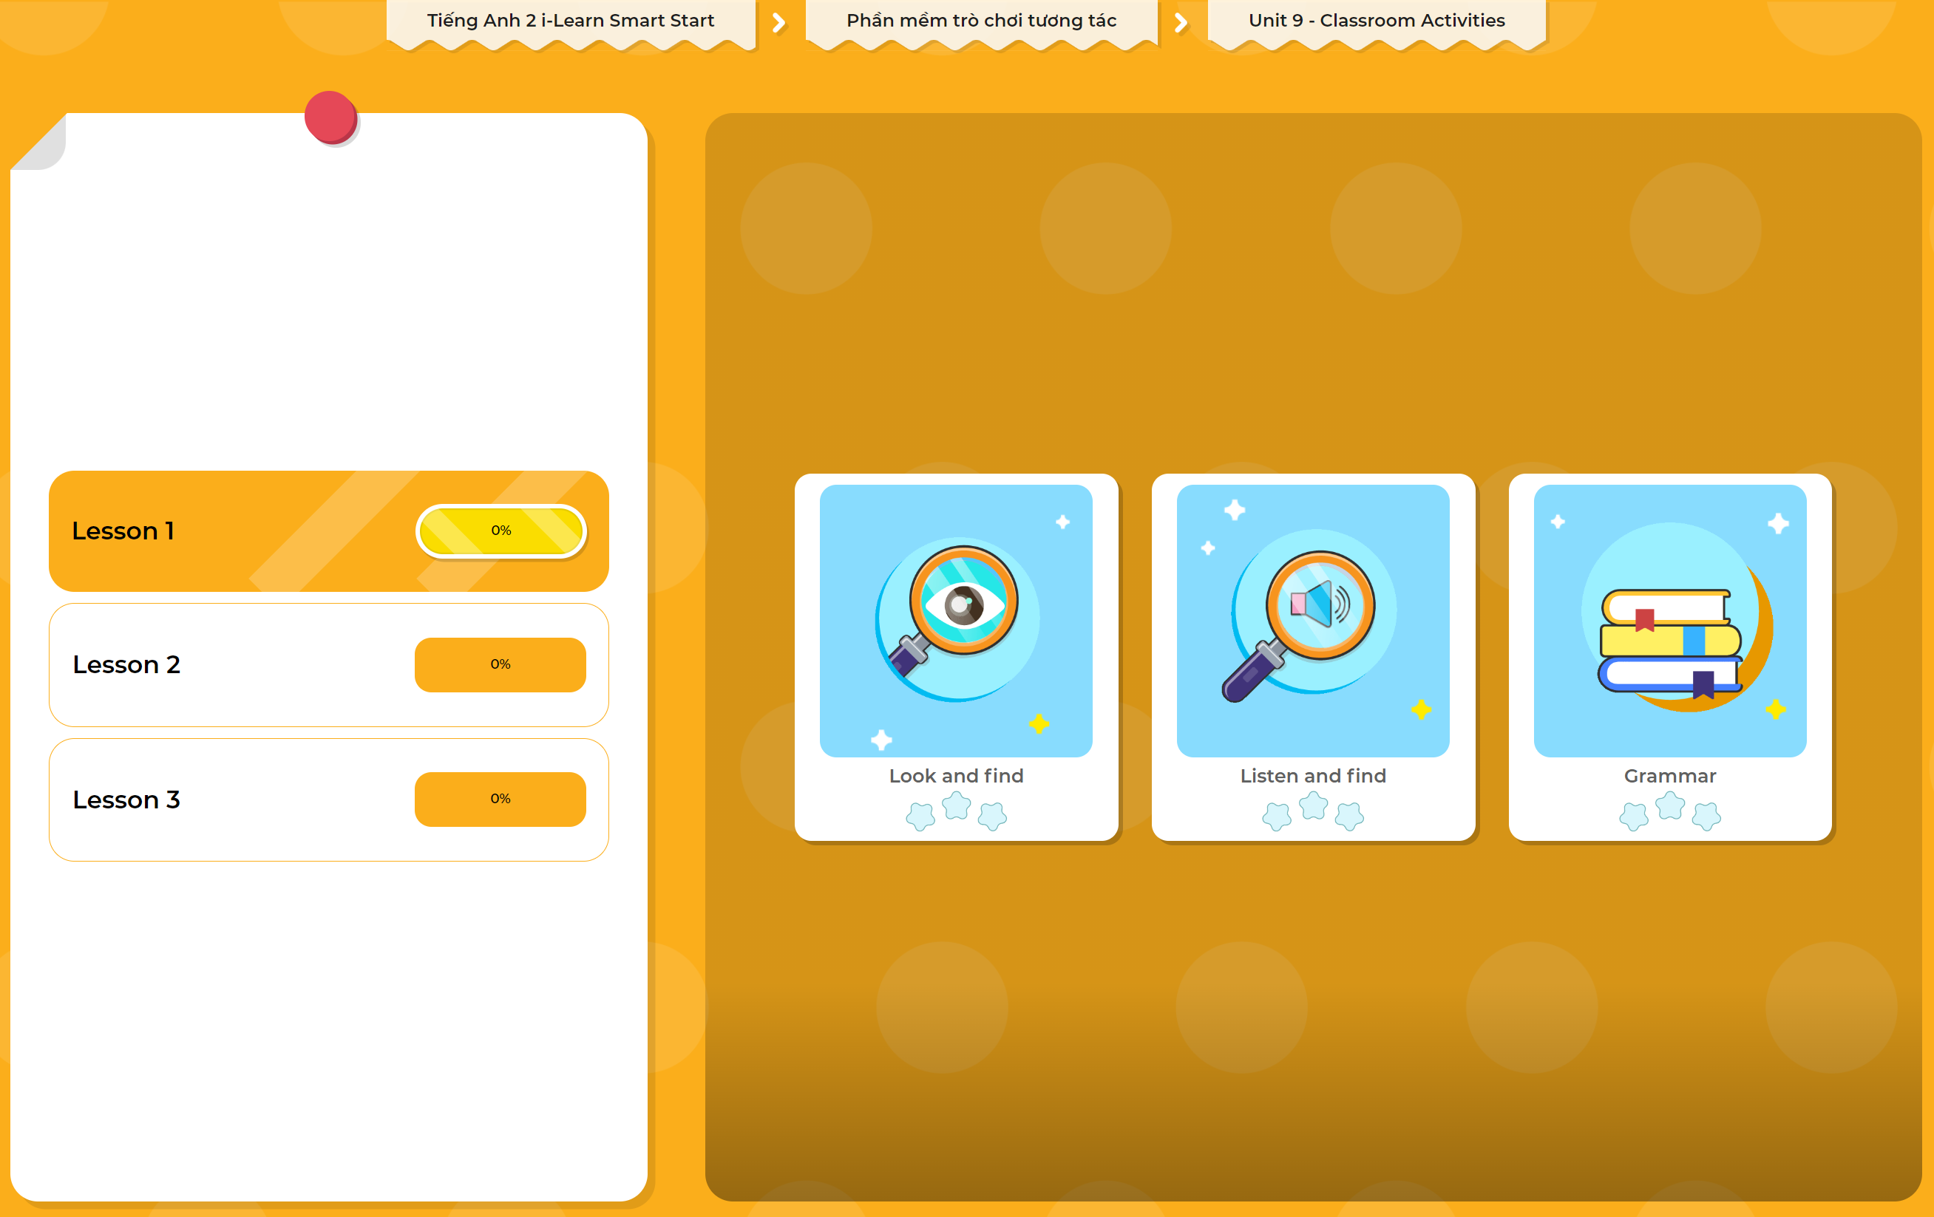
Extra Practice
DHA App
LET’S PLAY!
Click here to play the games

Slide 34

WRAP-UP

Slide 35
Today’s lesson
Vocabulary
eraser, ruler, crayon, pencil case
Structures/ Sentence patterns
Pick up your (eraser).

Slide 36
Homework
Practice vocabularies and structures. Make sentences using them.
Practice the vocabulary and structure in Tiếng Anh 2 i-Learn Smart Start Notebook (page 56)
Do the exercises in Tiếng Anh 2 i-Learn Smart Start Workbook (page 56)
Play the consolidation games in Tiếng Anh 2 i-Learn Smart Start DHA App on www.eduhome.com.vn
Prepare the next lesson (page 59)

Slide 37

Enjoy your day!

