Slide 1

Unit 9: Classroom activities
Lesson 1.2: Vocabulary & Sentence Patterns
Page: 59

Slide 2
Lesson Outline
Warm-up
Vocabulary
Structure
Practice
Consolidation
Wrap-up

Slide 3
Objectives
By the end of this lesson, students will be able to gain the following:
Vocabulary:
eraser, ruler, crayon, pencil case
Sentence pattern:
Pick up your (eraser).
Skills:
To get used to classroom activities. Practice language skills – the structure “Pick up your….”

Slide 4

WARM UP

Slide 5





What is in your schoolbag?
Click the icon to hear the sound
Ruler

Slide 6


What is in your schoolbag?
Click the icon to hear the sound
Crayon

Slide 7

What is in your schoolbag?
Click the icon to hear the sound
Eraser

Slide 8

What is in your schoolbag?
Click the icon to hear the sound
Pencil case

Slide 9

It’s time to learn …

Slide 10

Speaking

Slide 11

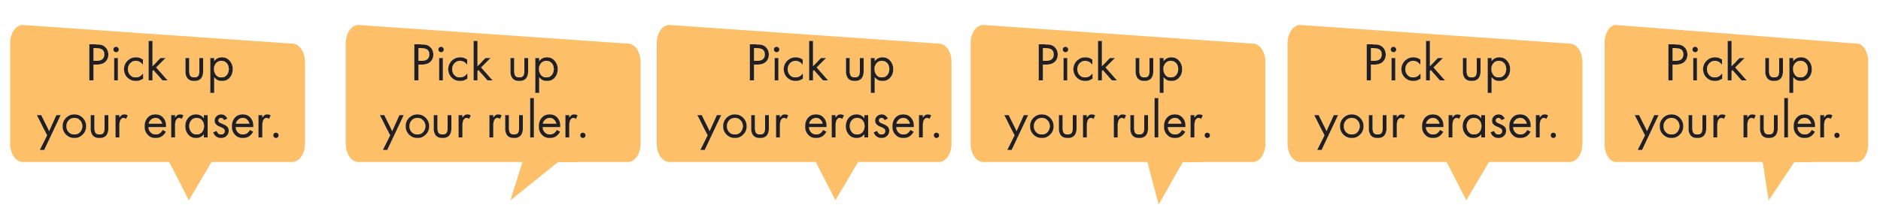
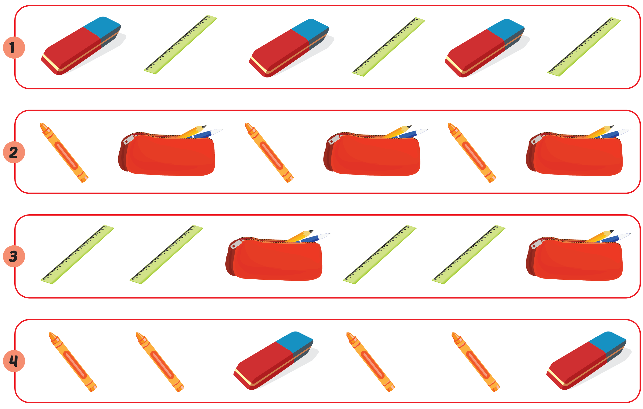

Slide 12

Pick up your eraser.
Pick up your ruler.
Pick up your eraser.
Pick up your ruler.
Pick up your eraser.
Pick up your ruler.

Slide 13

Pick up your crayon.
Pick up your pencil case.
Pick up your crayon.
Pick up your pencil case.
Pick up your crayon.
Pick up your pencil case.

Slide 14
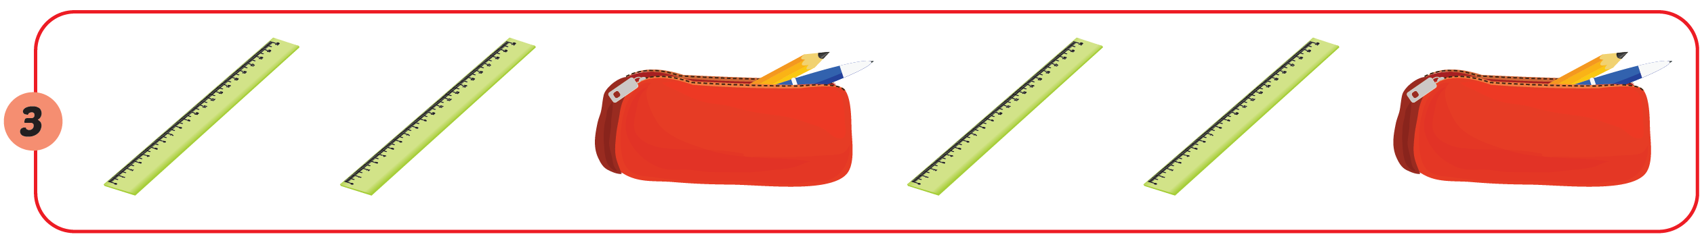
Pick up your pencil case.
Pick up your pencil case.
Pick up your ruler.
Pick up your ruler.
Pick up your ruler.
Pick up your ruler.

Slide 15

Pick up your crayon.
Pick up your crayon.
Pick up your eraser.
Pick up your crayon.
Pick up your crayon.
Pick up your eraser.

Slide 16

Practice

Slide 17

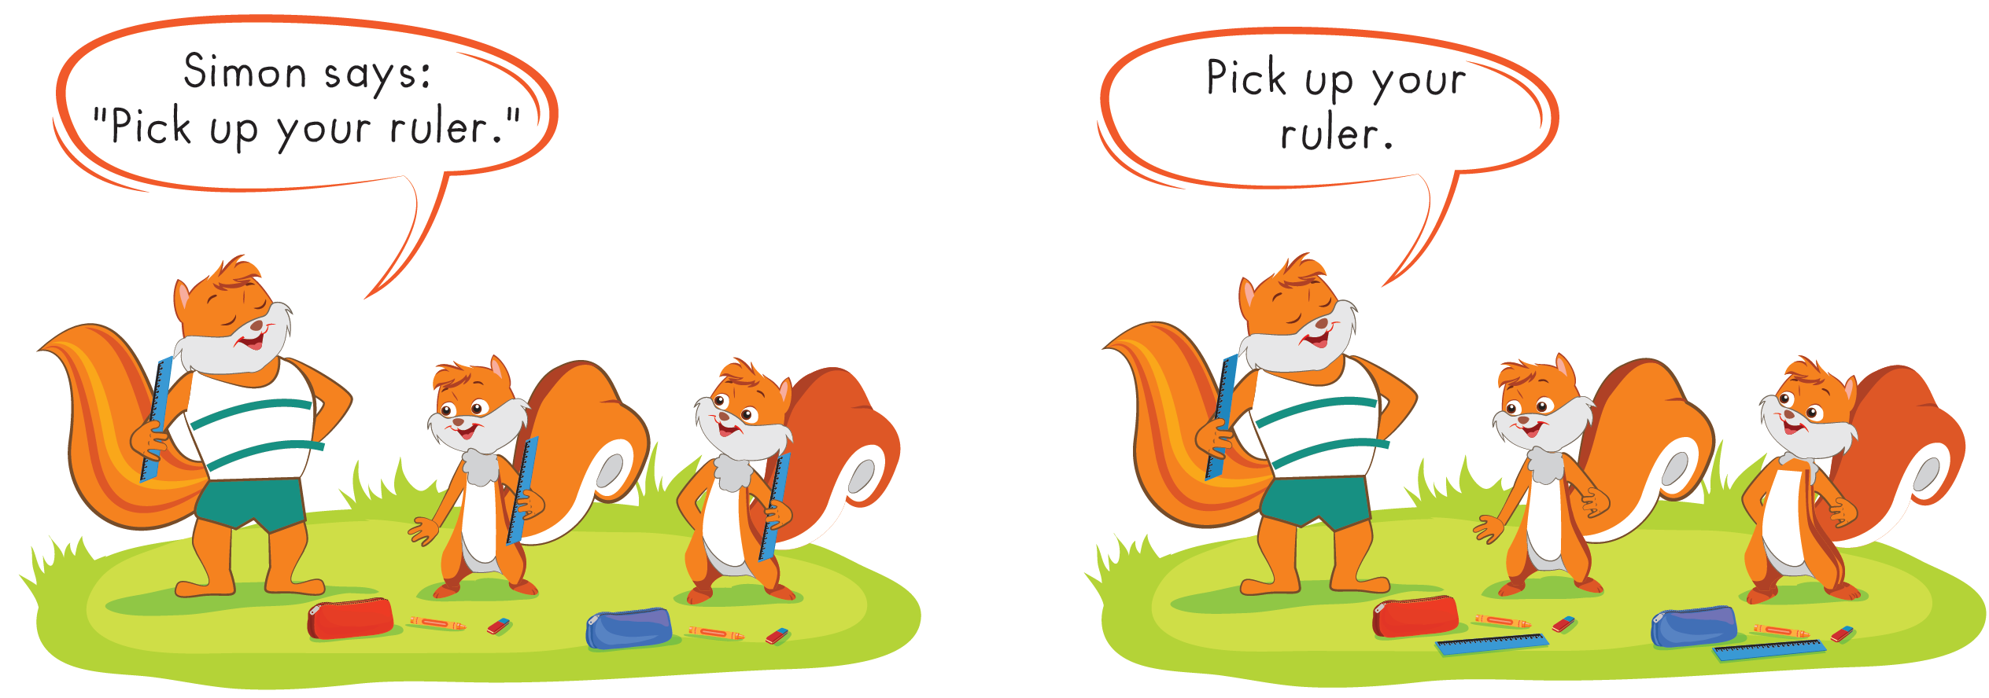

Slide 18
Further Practice

Slide 19

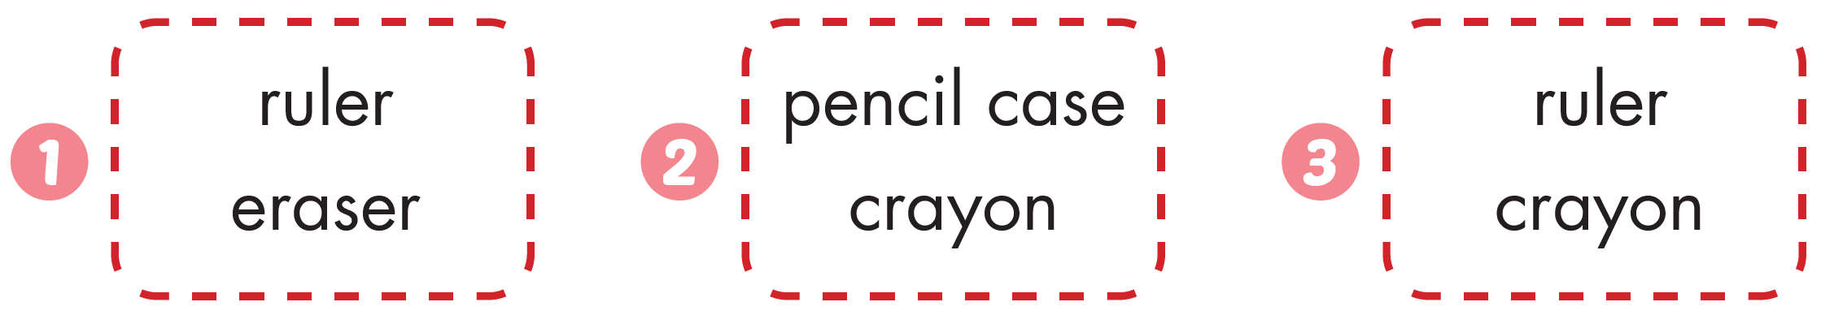




Click the icon to hear the sound
Workbook - Page 57

Slide 20

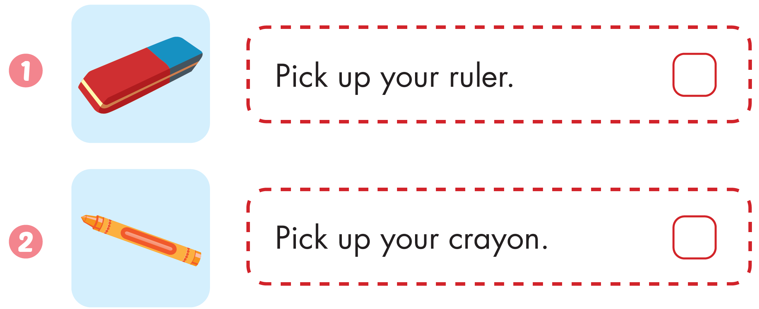


Workbook - Page 57

Slide 21
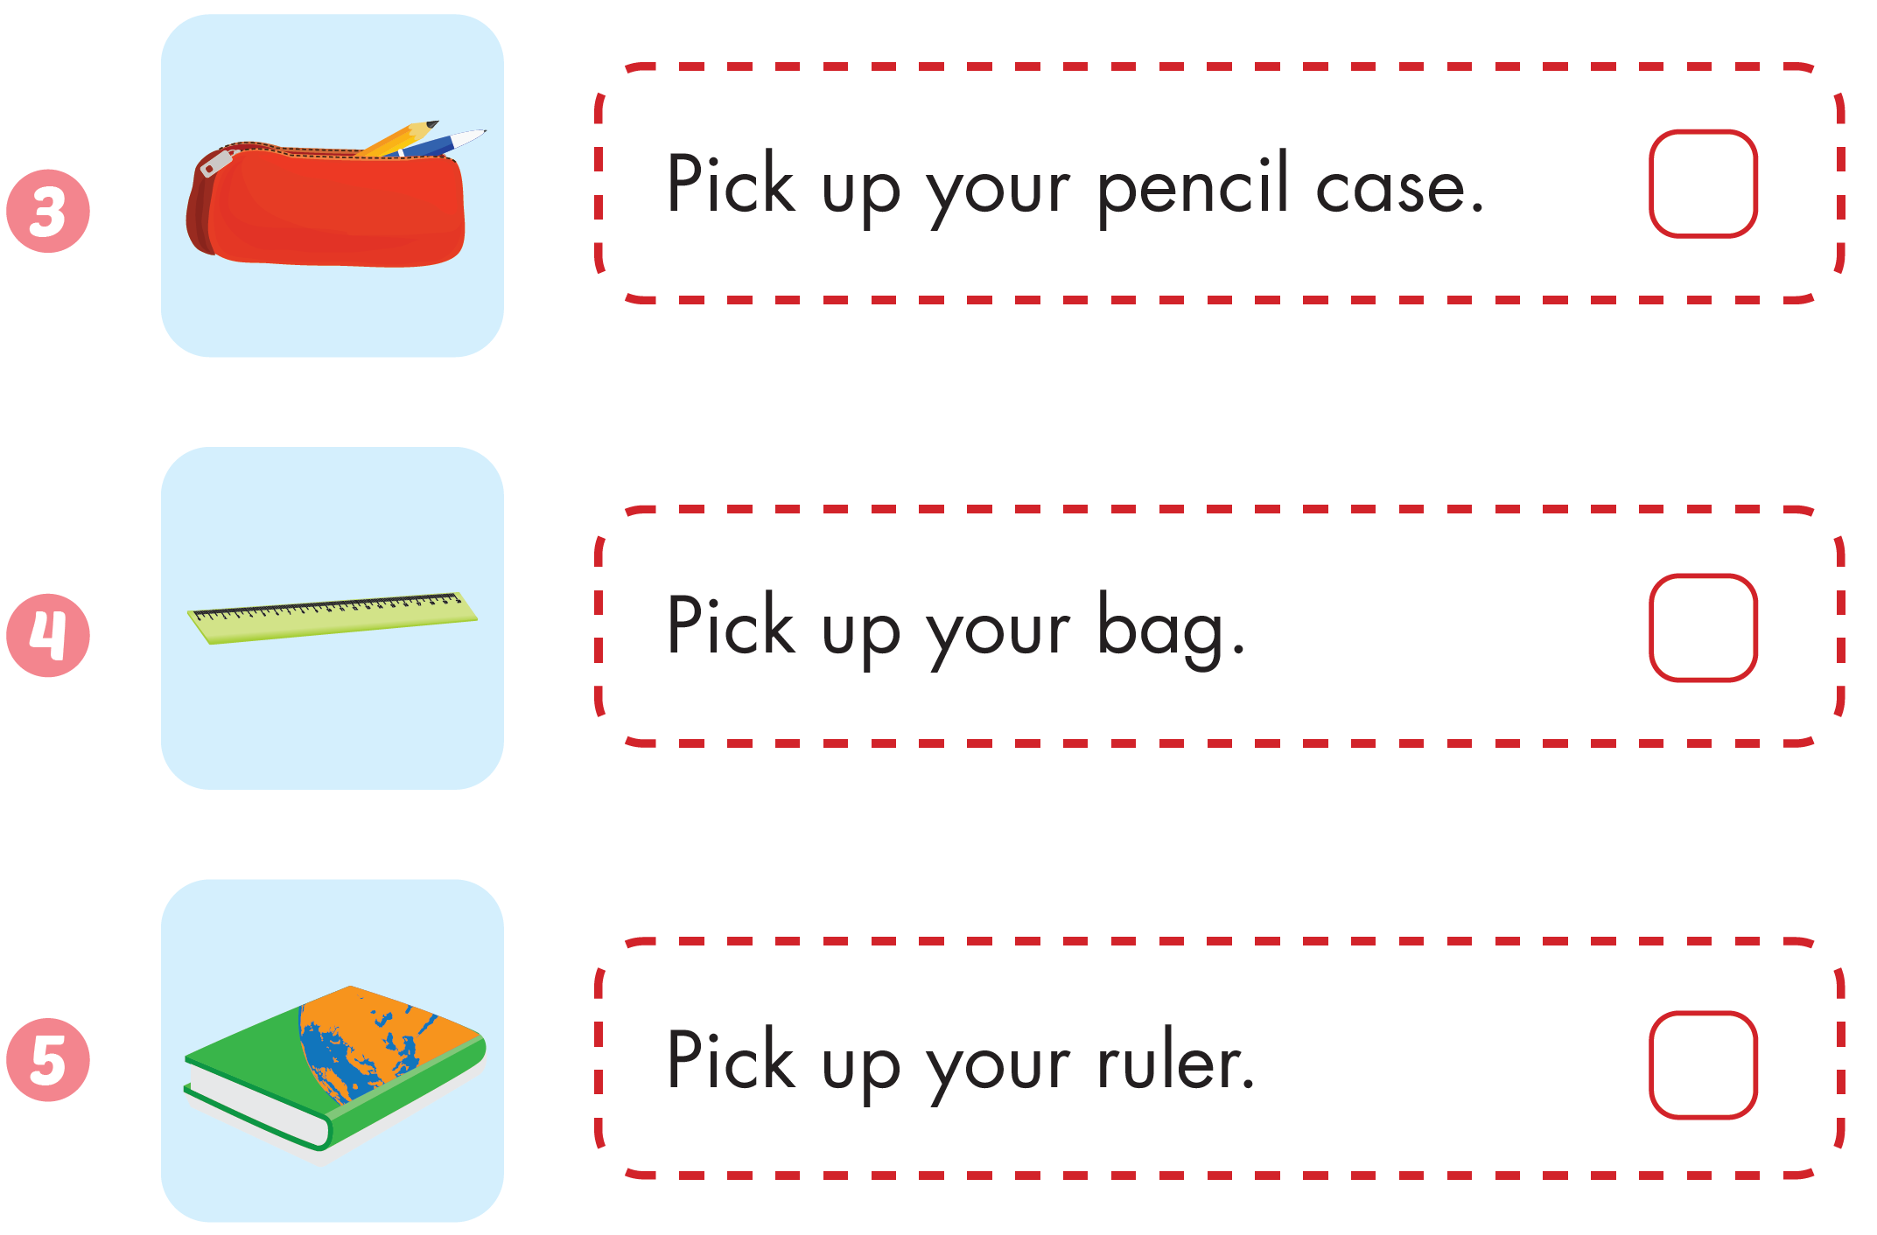
Workbook - Page 57

Slide 22

CONSOLIDATION

Slide 23
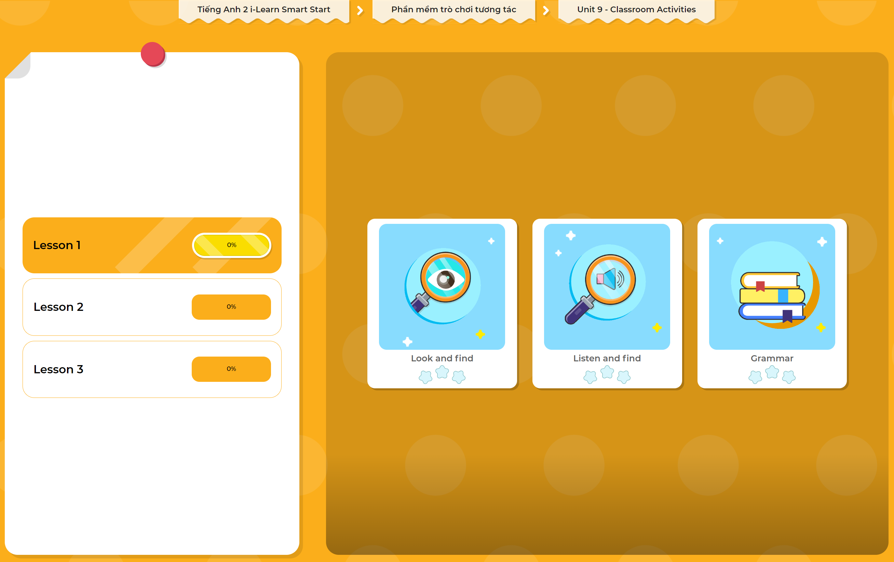
Extra Practice
DHA App
LET’S PLAY!
Click here to play the games

Slide 24

WRAP-UP

Slide 25
Today’s lesson
Vocabulary
eraser, ruler, crayon, pencil case
Structures/ Sentence patterns
Pick up your (eraser).

Slide 26
Homework
Review the vocabularies and structures. Make sentences using them.
Practice the vocabulary and structure in Tiếng Anh 2 i-Learn Smart Start Notebook (page 57)
Do the exercises in Tiếng Anh 2 i-Learn Smart Start Workbook (page 57)
Play the consolidation games in Tiếng Anh 2 i-Learn Smart Start DHA App on www.eduhome.com.vn
Prepare the next lesson (page 60)

Slide 27

Enjoy your day!

