Slide 1

Unit 9: Classroom activities
Lesson 2.2: Vocabulary & Phonics
Page: 61

Slide 2
Lesson Outline
Warm-up
Phonics
Practice
Consolidation
Wrap-up

Slide 3
Objectives
By the end of this lesson, students will be able to gain the following:
Phonics: /v/ and /w/
Vocabulary:
violin, window, vest
Sentence pattern:
Revision.
Skills:
Recognize letters V/v and W/w and the sound /v/; /w/ in words and produce them individually.

Slide 4

WARM UP

Slide 5
Review
Letter Vv and Ww

Slide 6



Letter Vv
violin
vest

Slide 7


Letter Ww
watch
window

Slide 8

It’s time to learn …

Slide 9

Phonics
/v/, /w/

Slide 10



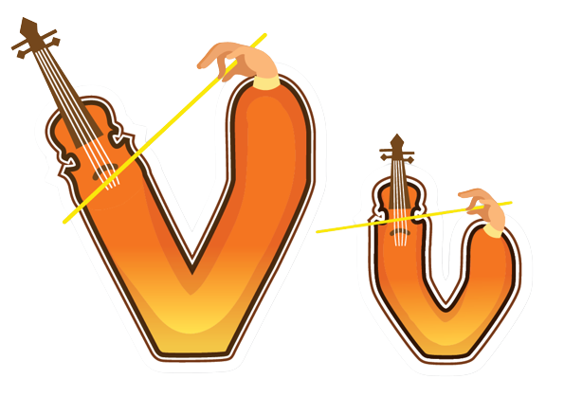

Click each icon to hear the sound

Slide 11

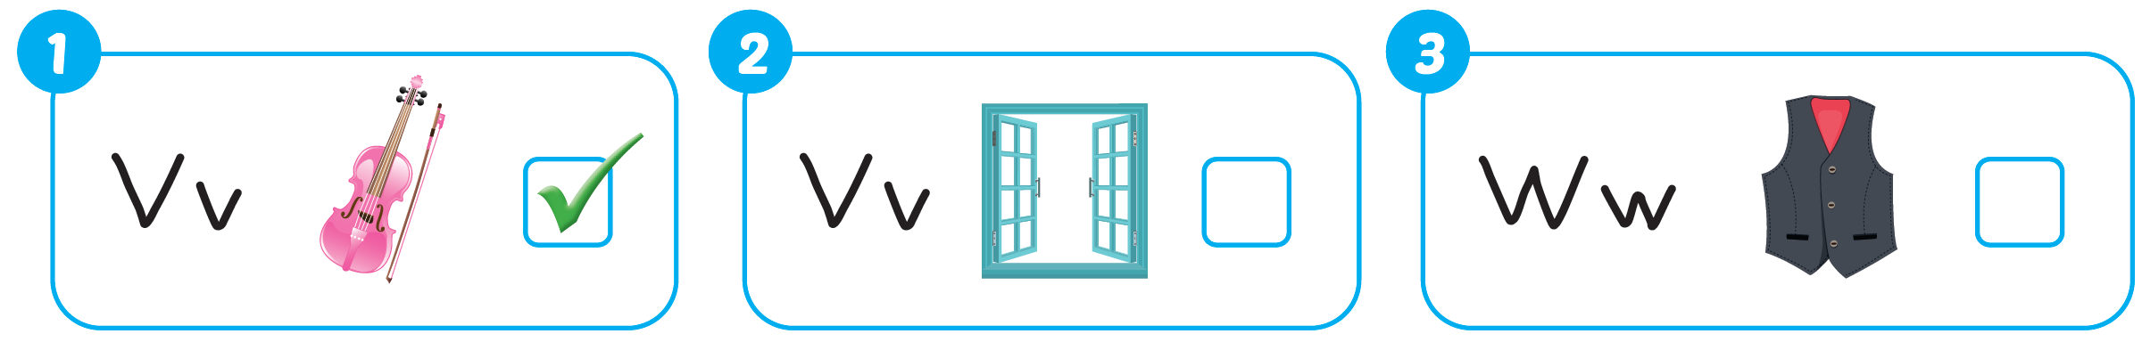


Slide 12

Practice

Slide 13

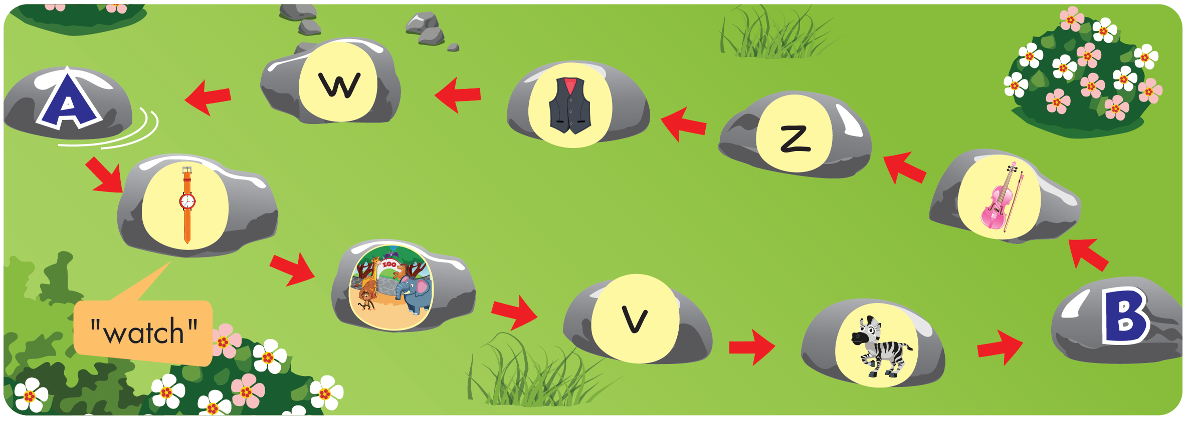

Slide 14
It’s time to play …

Slide 15
Letter W is for….
watch

Slide 16
Letter V is for….
violin

Slide 17

Letter Z is for….
zoo

Slide 18
What sound is this?
“z”

Slide 19
What sound is this?
“v”

Slide 20
Letter V is for….
vest

Slide 21

Letter Z is for….
zebra

Slide 22
What letter is this?
W

Slide 23

Further Practice

Slide 24


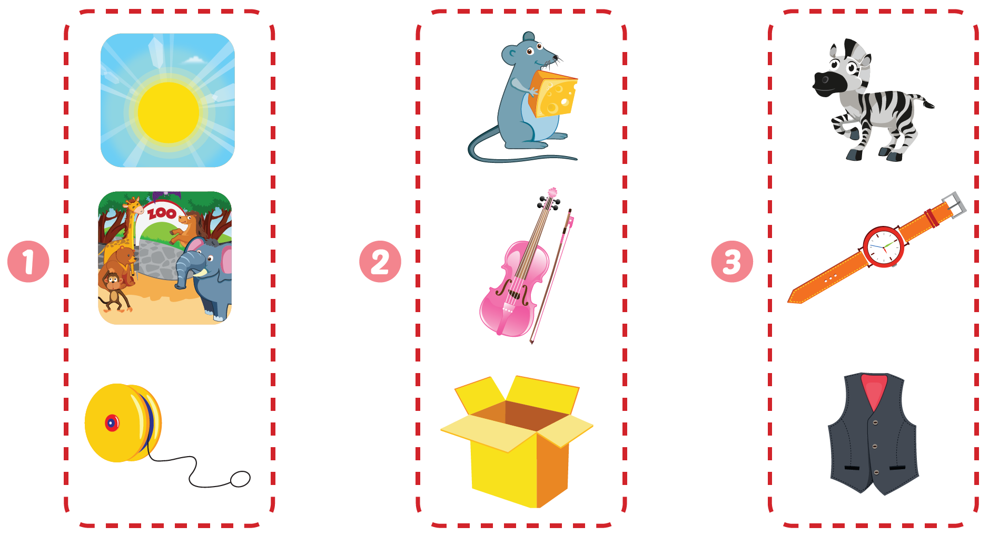



Click the icon to hear the sound
Workbook - Page 59

Slide 25

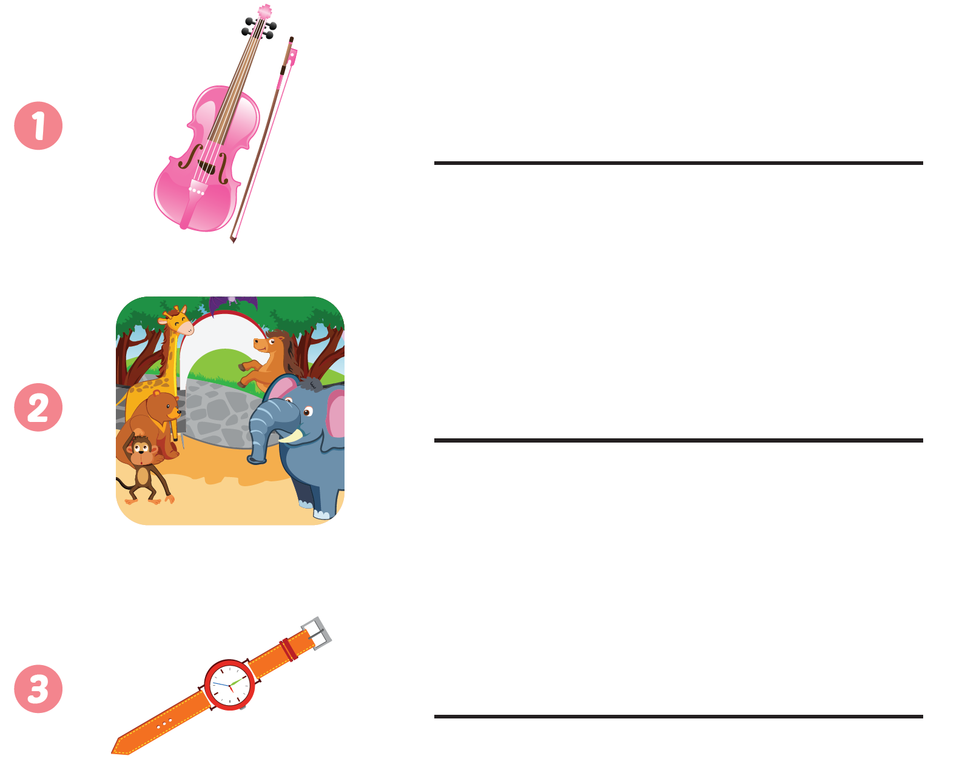
Workbook - Page 59
violin
zoo
watch

Slide 26

CONSOLIDATION

Slide 27
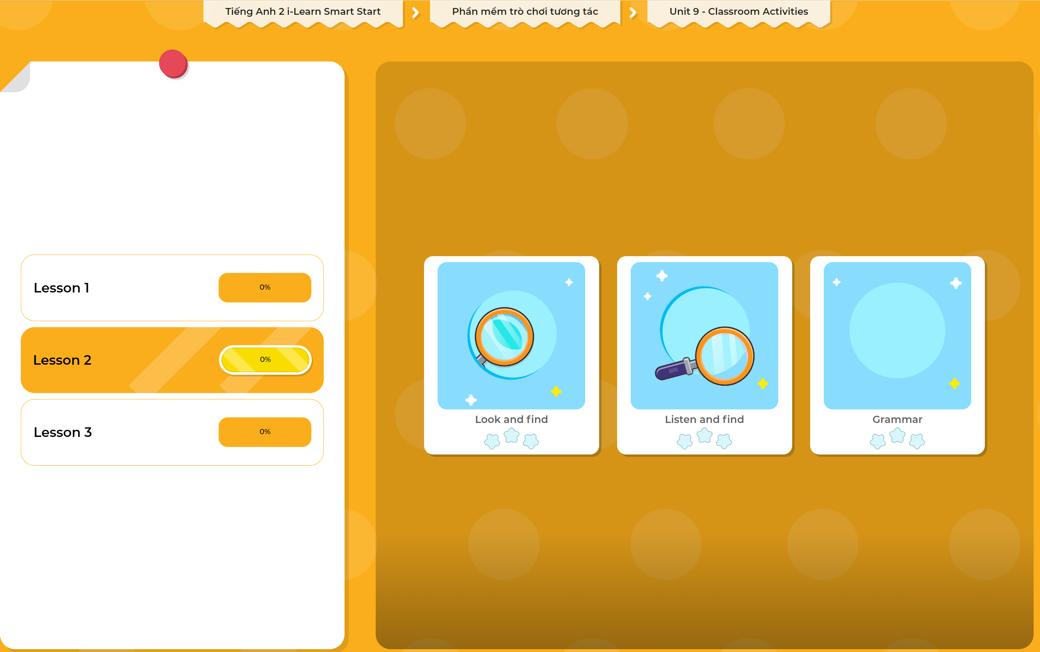
Extra Practice
DHA App
LET’S PLAY!
Click here to play the games

Slide 28

WRAP-UP

Slide 29
Today’s lesson
Phonics
/v/, /w/
Vocabulary
violin, window, vest

Slide 30
Homework
Practice vocabularies and phonics. Make sentences using them.
Practice the vocabulary and phonics in Tiếng Anh 2 i-Learn Smart Start Notebook (page 59)
Do the exercises in Tiếng Anh 2 i-Learn Smart Start Workbook (page 59)
Play the consolidation games in Tiếng Anh 2 i-Learn Smart Start DHA App on www.eduhome.com.vn
Prepare the next lesson (page 62)

Slide 31

Enjoy your day!

