Slide 1

Unit 9: Classroom activities
Lesson 3.1: Vocabulary & Sentence Patterns
Page: 62

Slide 2
Lesson Outline
Warm-up
Vocabulary
Structure
Practice
Consolidation
Wrap-up

Slide 3
Objectives
By the end of this lesson, students will be able to gain the following:
Vocabulary:
Count numbers, draw pictures, spell words, sing songs Sentence pattern:
I can (count numbers).
Skills:
Talk about activities they do, using the structure “I can (count numbers)”.

Slide 4

WARM UP

Slide 5





Click on picture to listen to the word
ruler
eraser
crayon
pencil case

Slide 6

It’s time to learn …

Slide 7

New words
Count numbers, draw pictures,
spell words,
sing songs

Slide 8




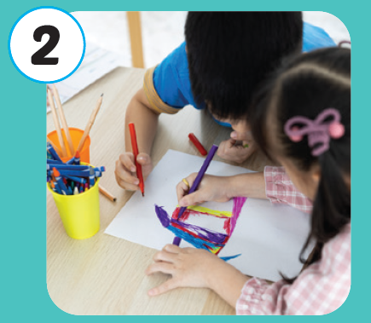

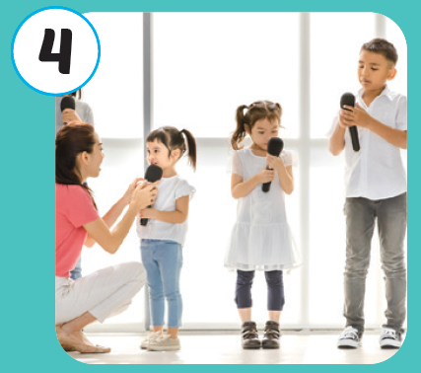




Click the icon to hear the sound
Notes:
Click vào hình A. 1. Listen and point. Repeat để cho cả audio full chạy

Slide 9
Click the icon to hear the sound
/kaʊnt ˈnʌmbərz/
đếm số
/drɑː ˈpɪkʧərz/
vẽ tranh
/spel wɜːrdz/
đánh vần
/sɪŋ sɑːŋz/
hát
Notes:
Click vào hình A. 1. Listen and point. Repeat để cho cả audio full chạy

Slide 10

Click the icon to hear the sound
/kaʊnt ˈnʌmbərz/
đếm số

Slide 11

Click the icon to hear the sound
/drɑː ˈpɪkʧərz/
vẽ tranh

Slide 12

Click the icon to hear the sound
/spel wɜːrdz/
đánh vần

Slide 13

Click the icon to hear the sound
/sɪŋ sɑːŋz/
hát

Slide 14

Structures
I can (count numbers).

Slide 15
Structure
I can count numbers
→ Nói về khả năng: Tôi có thể làm gì đó.

Slide 16

Practice

Slide 17

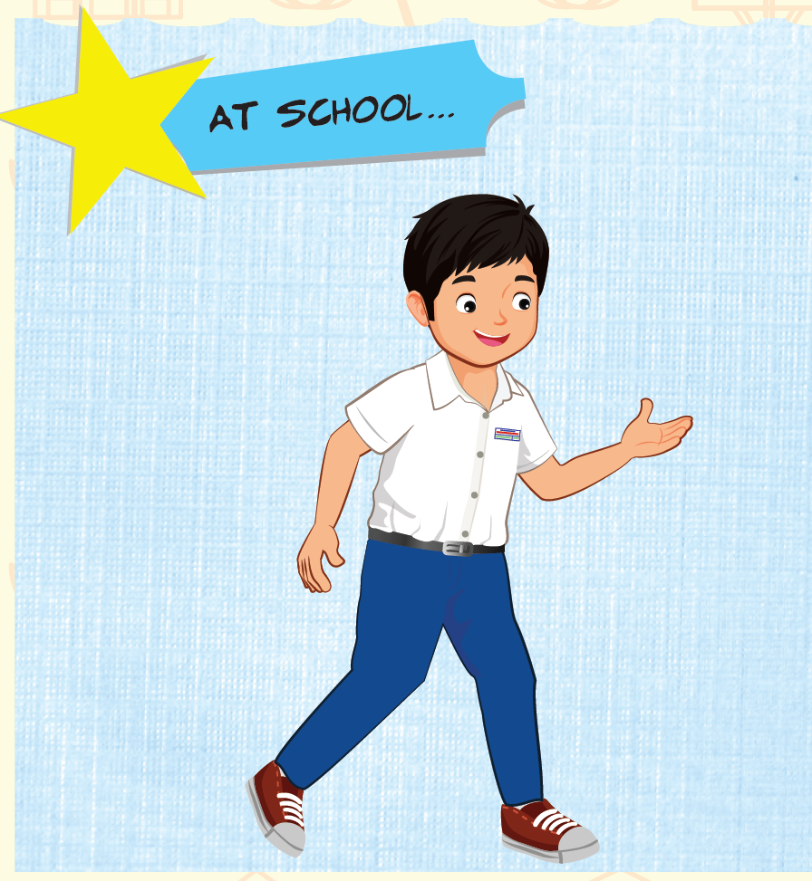
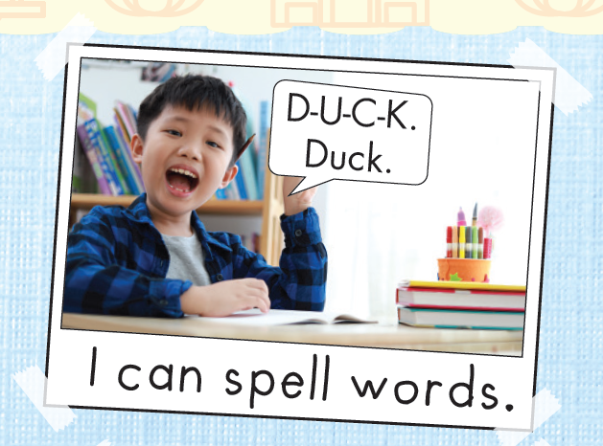


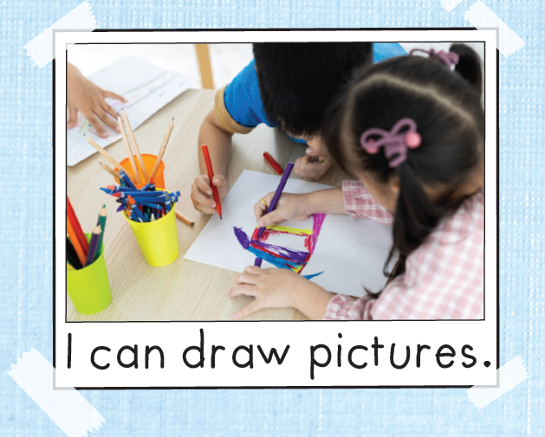
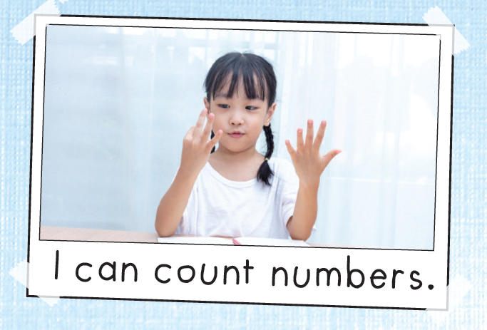
Click the icon to hear the sound

Slide 18

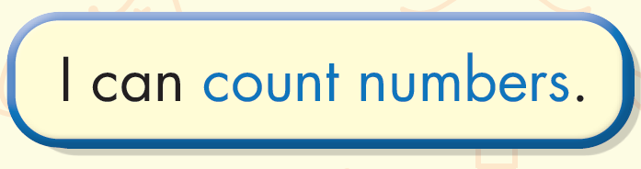
Click the icon to hear the sound

Slide 19
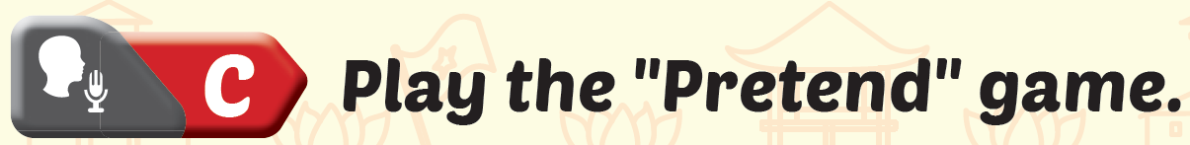
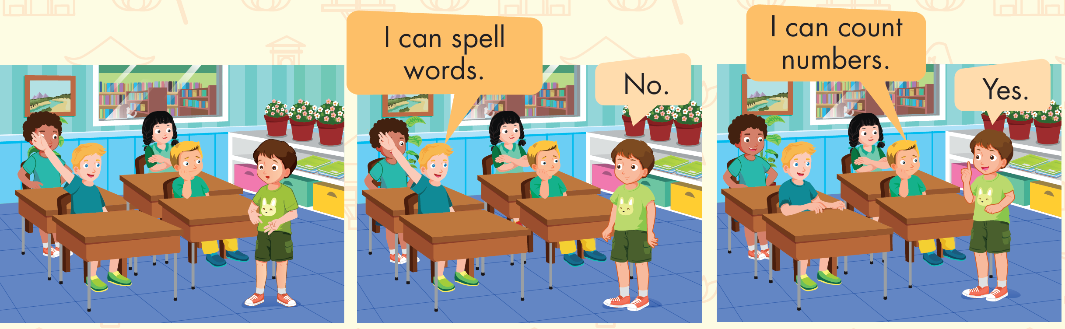

Slide 20
It’s time to play …

Slide 21





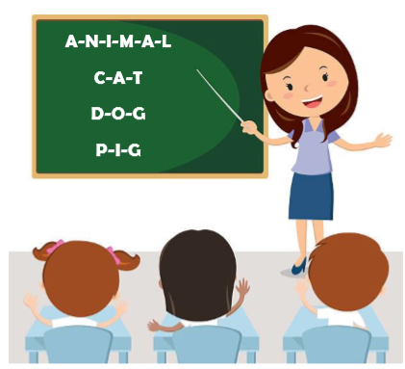
spell words
A
B
C

Slide 22

count numbers
A
C
B

Slide 23
A
B
draw pictures
C

Slide 24
sing songs
A
C
B

Slide 25
count numbers
A
C
B

Slide 26
spell words
A
B
C

Slide 27
B
draw pictures
A
C

Slide 28

Further Practice

Slide 29

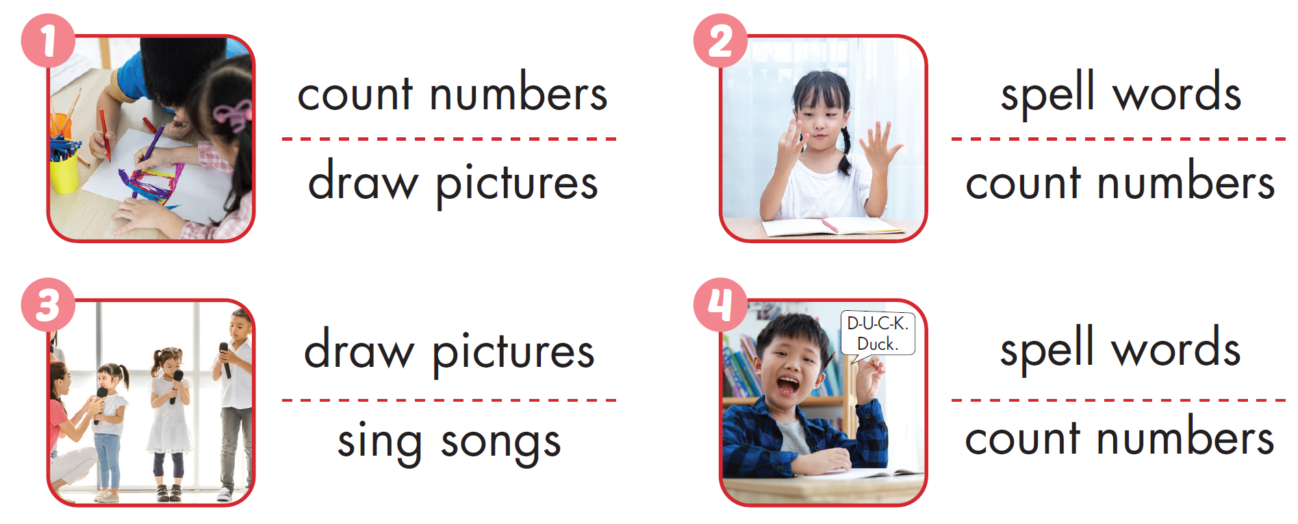

Workbook - Page 6

Slide 30

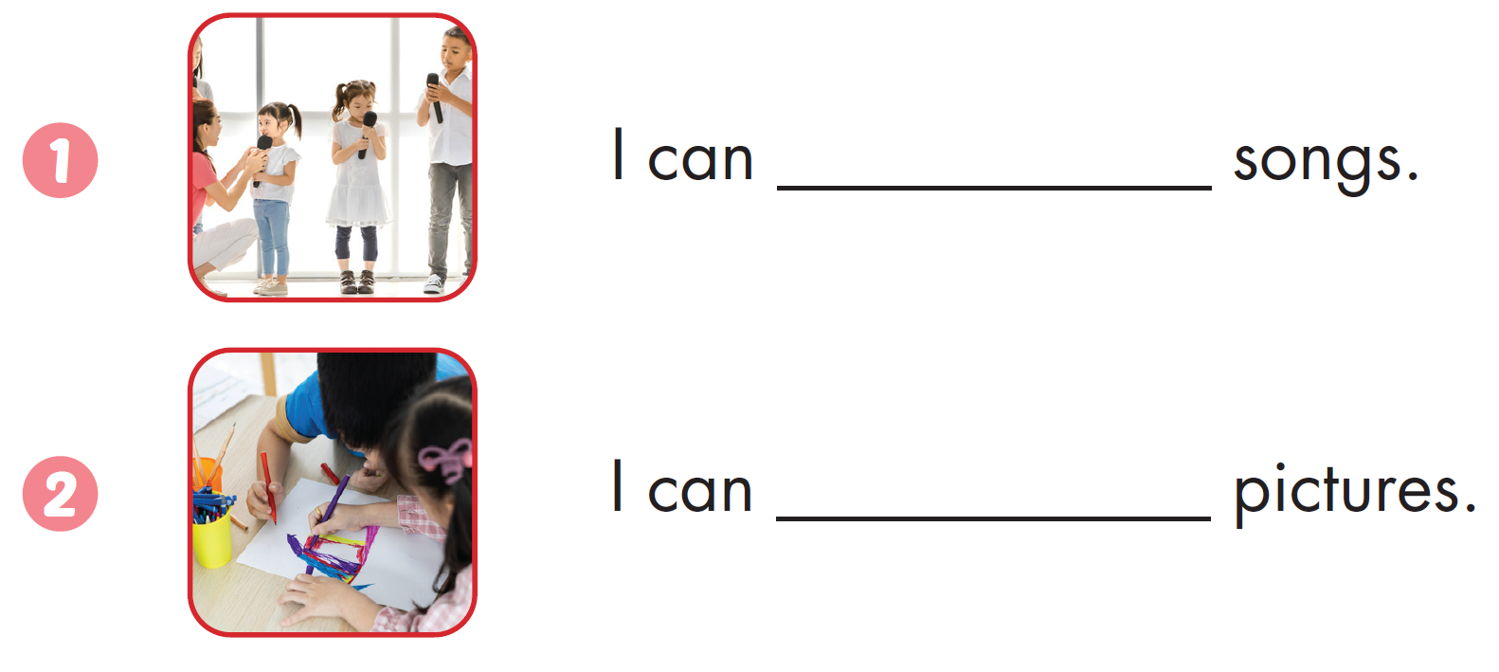
Workbook - Page 60
sing
draw

Slide 31
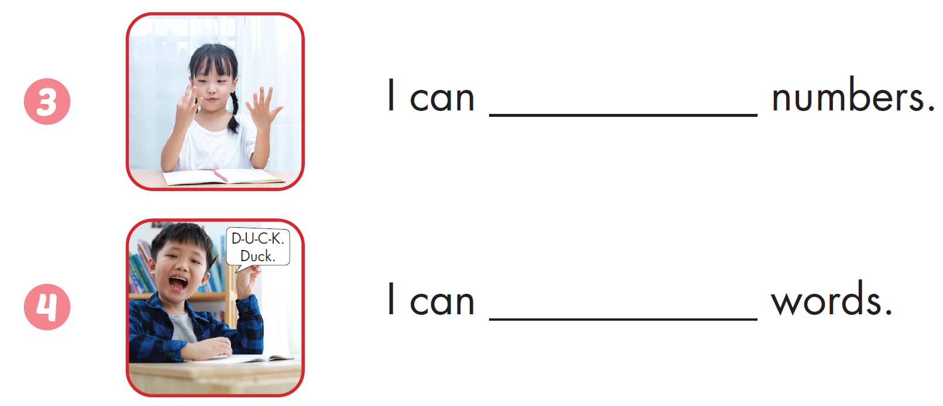
Workbook - Page 60
count
spell

Slide 32

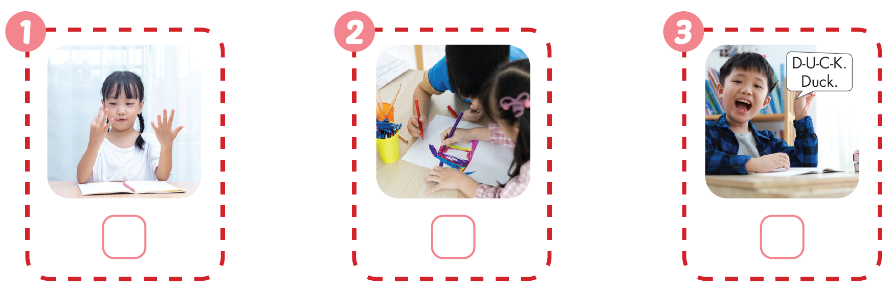





Click the icon to hear the sound
Workbook - Page 61

Slide 33

CONSOLIDATION

Slide 34
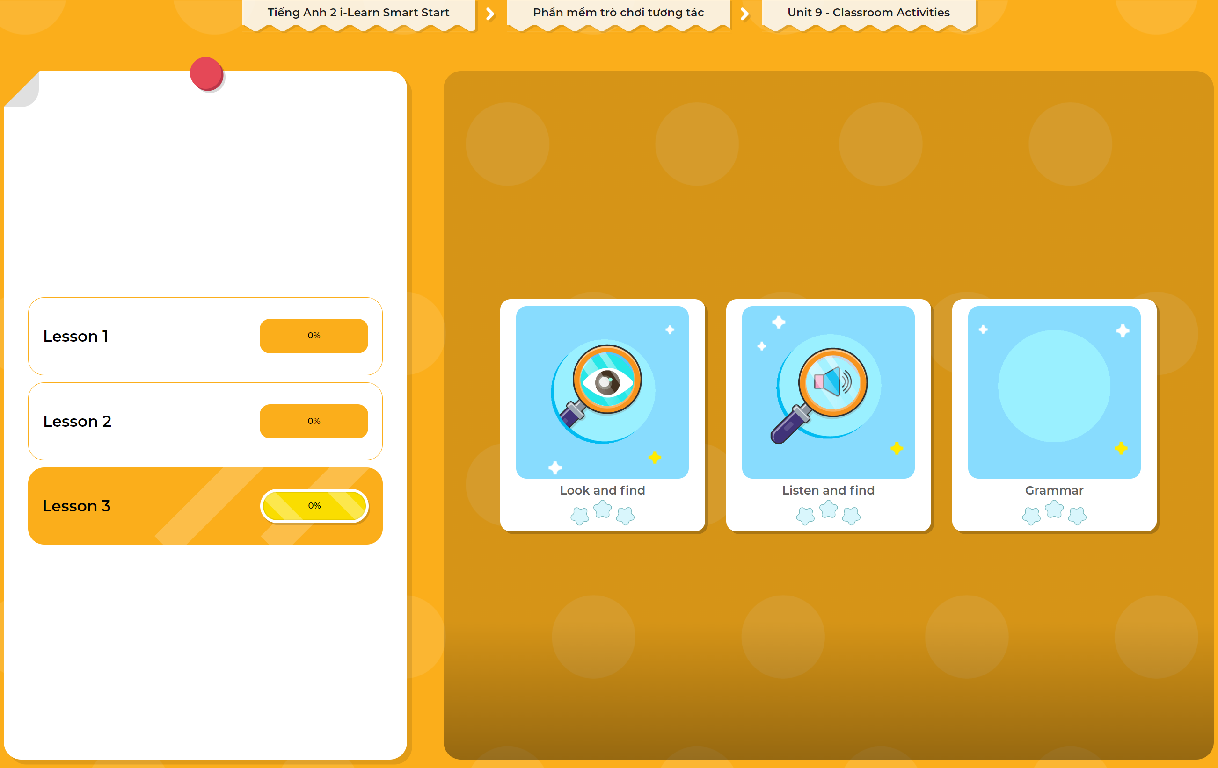
Extra Practice
DHA App
LET’S PLAY!
Click here to play the games

Slide 35

WRAP-UP

Slide 36
Today’s lesson
Vocabulary
Count numbers, draw pictures,
spell words,
sing songs
Structures/ Sentence patterns
I can (count numbers).

Slide 37
Homework
Practice vocabularies and structures. Make sentences using them.
Practice the vocabulary and structure in Tiếng Anh 2 i-Learn Smart Start Notebook (page 60)
Do the exercises in Tiếng Anh 2 i-Learn Smart Start Workbook (page 60)
Play the consolidation games in Tiếng Anh 2 i-Learn Smart Start DHA App on www.eduhome.com.vn
Prepare the next lesson (page 63)

Slide 38

Enjoy your day!

