Slide 1

Unit 9: Classroom activities
Lesson 3.1: Vocabulary & Sentence Patterns
Page: 63

Slide 2
Lesson Outline
Warm-up
Structure
Practice
Consolidation
Wrap-up

Slide 3
Objectives
By the end of this lesson, students will be able to gain the following:
Vocabulary: Revise: Count numbers, draw pictures,
spell words, sing songs, read books, play soccer.
Sentence pattern:
“I count numbers on Monday.”
“I draw pictures on Tuesday.”
Skills:
To be able to say the sentences “I count numbers on Monday”. “I draw pictures on Tuesday”.

Slide 4

WARM UP

Slide 5

Check your memory
Guessing what’s inside the wardrobe.

Slide 6


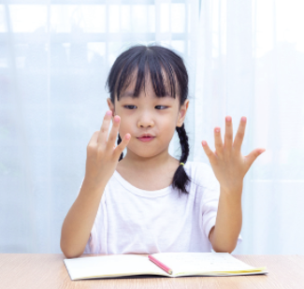
count numbers

Slide 7

spell words

Slide 8

sing songs

Slide 9
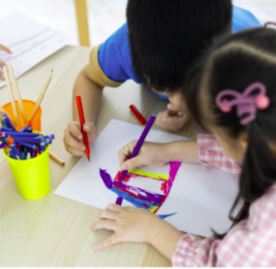
draw pictures

Slide 10

It’s time to learn …

Slide 11

Structures
“I count numbers on Monday.”
“I draw pictures on Tuesday.”

Slide 12
Structure
I sing songs on Wednesday.
→ Nói về thời gian biểu: Tôi làm gì đó vào thứ mấy

Slide 13



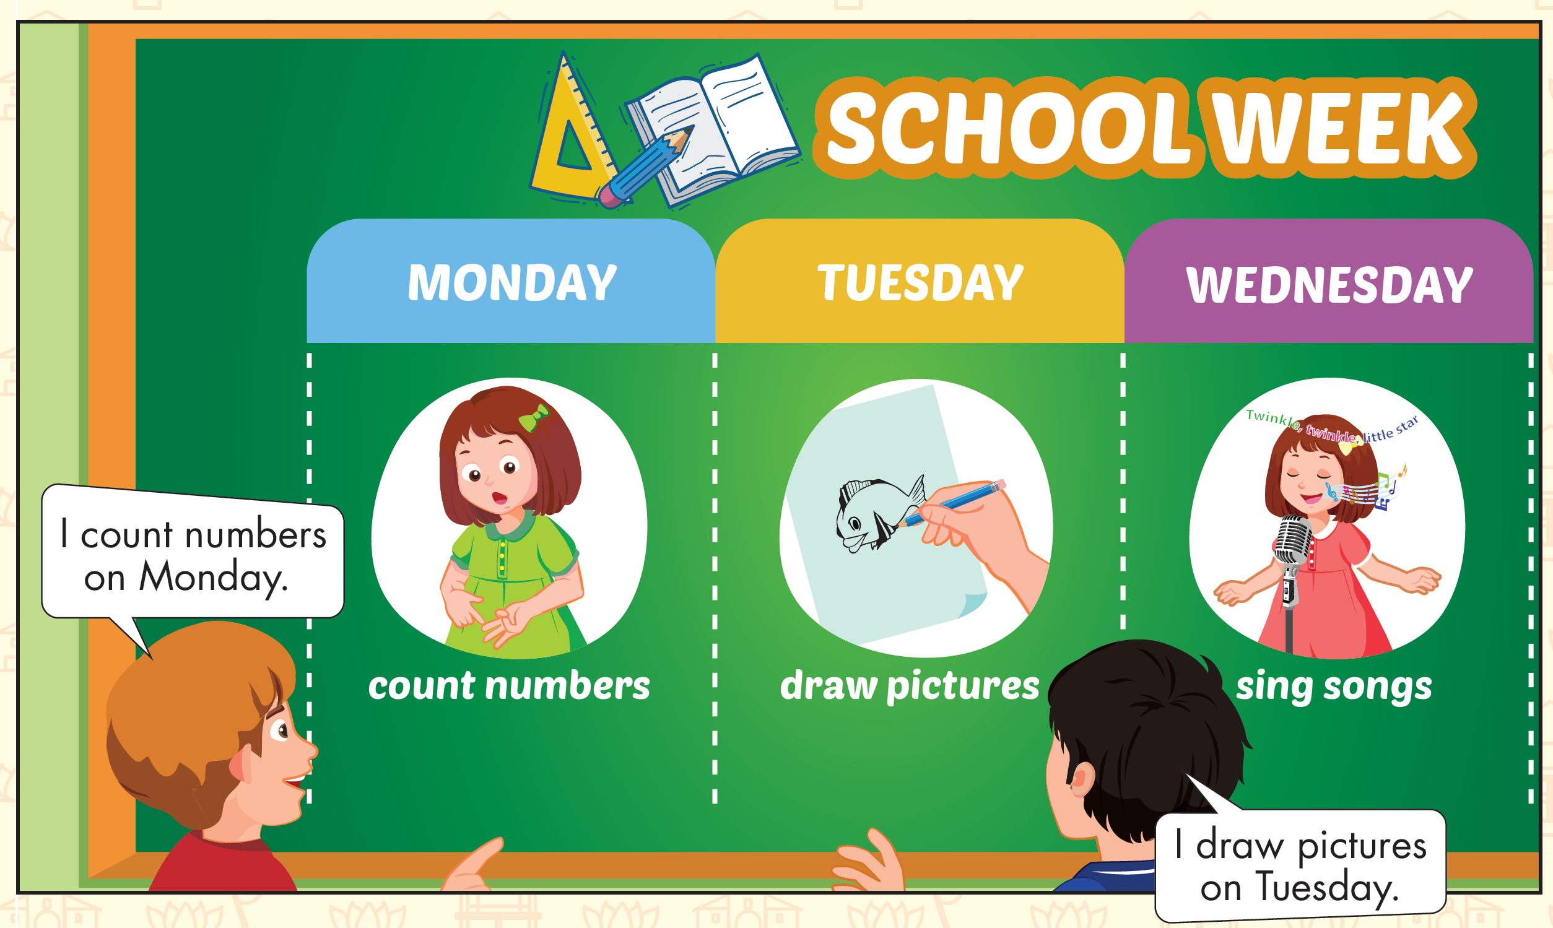
Click the icon to hear the sound

Slide 14
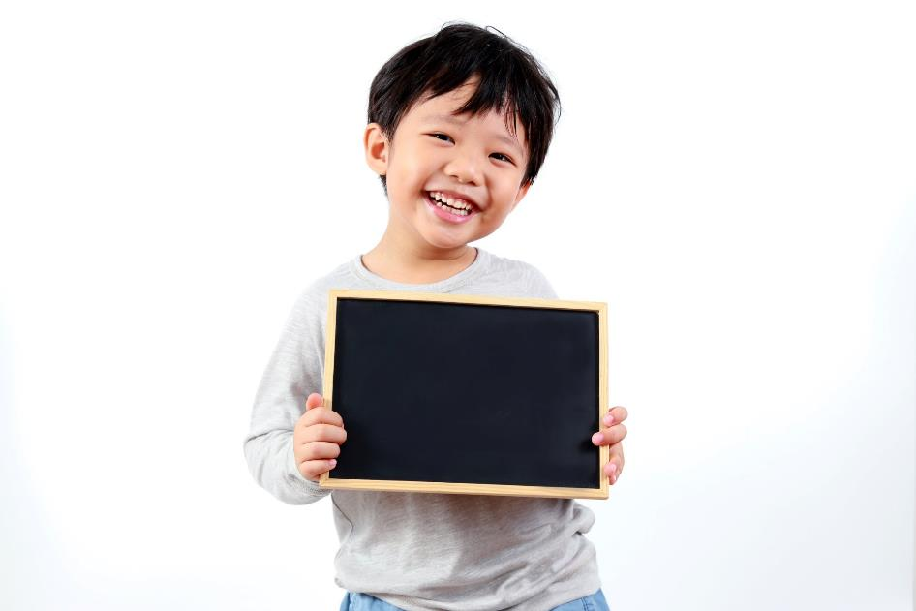
Practice

Slide 15
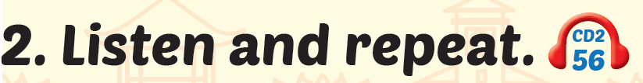
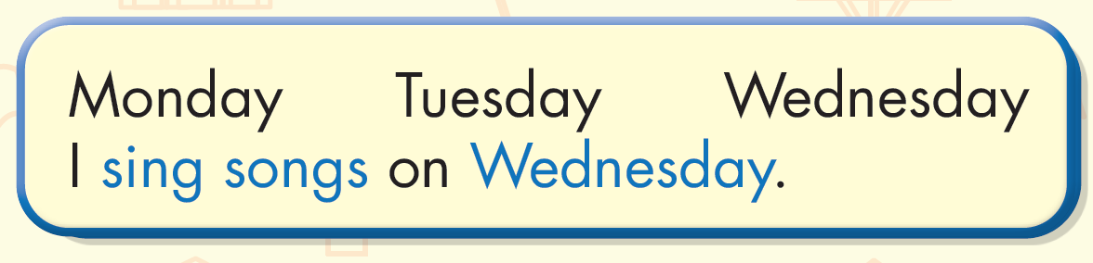
Click the icon to hear the sound

Slide 16

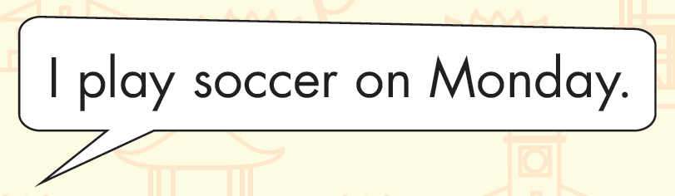
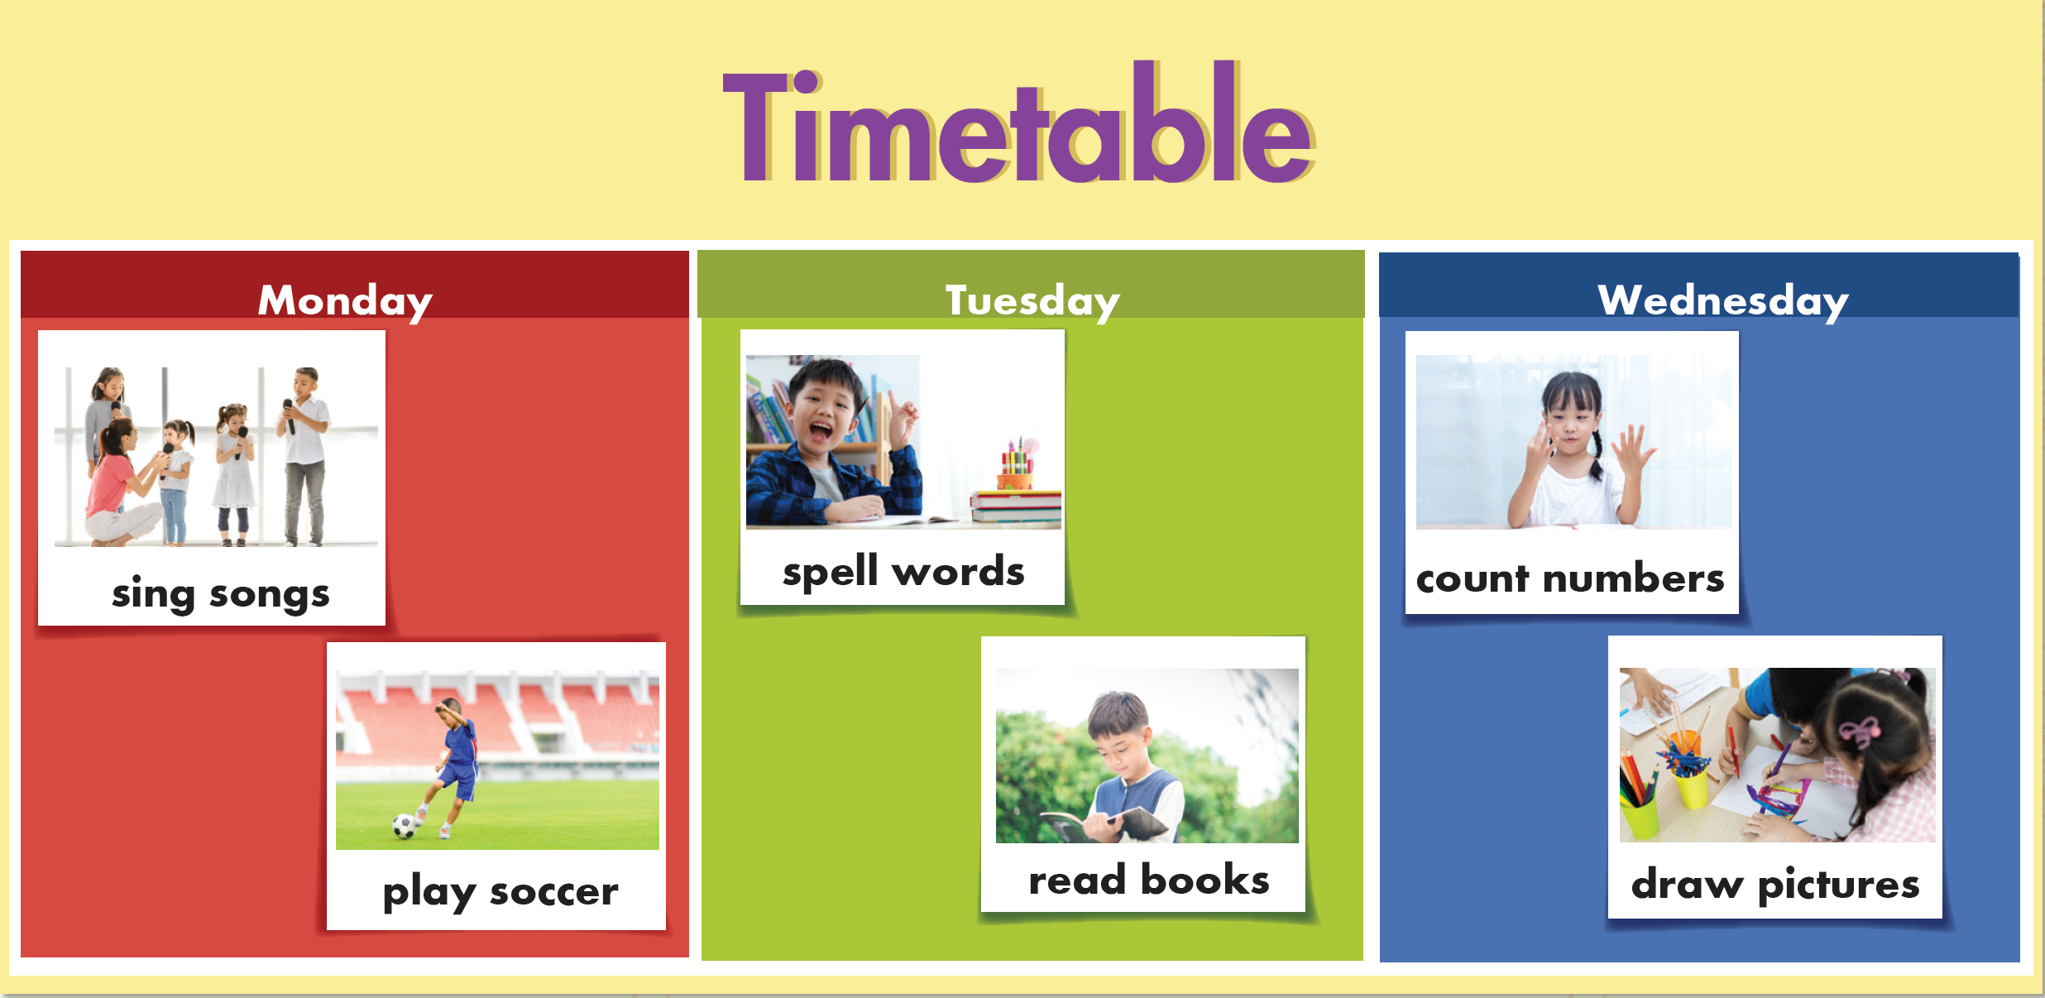

Slide 17
It’s time to play …

Slide 18

GRAMMAR PLANE
START

Slide 19

Look and say the timetable.
Tuesday
PLANE
I sing songs on Tuesday.
CHECK

Slide 20
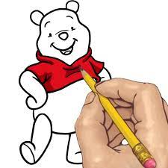
Look and say the timetable.
Monday
PLANE
I draw pictures on Monday.
CHECK

Slide 21
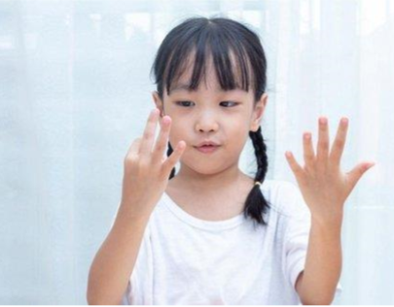
Look and say the timetable.
Monday
PLANE
I count numbers on Monday.
CHECK

Slide 22
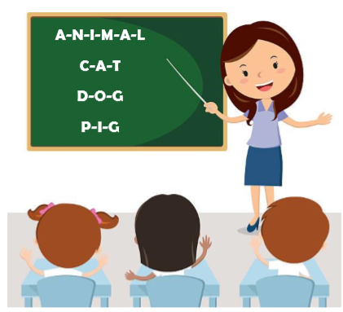
Look and say the timetable.
Wednesday
PLANE
I spell words on Wednesday.
CHECK

Slide 23
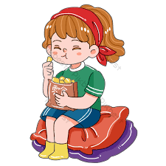
Look and say the timetable.
Tuesday
PLANE
I eat snacks on Tuesday.
CHECK

Slide 24
Look and say the timetable.
Wednesday
PLANE
I count numbers on Wednesday.
CHECK

Slide 25

Further Practice

Slide 26

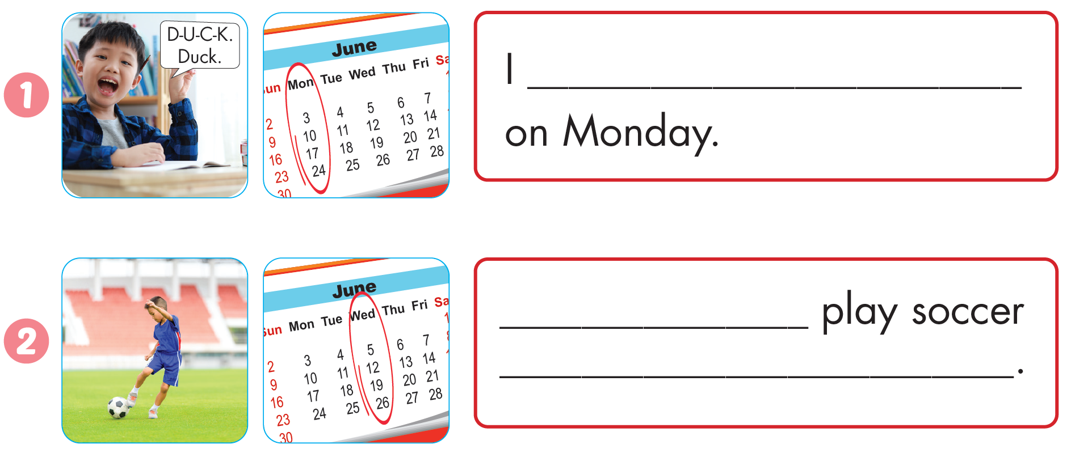
Workbook - Page 61
spell words
I
on Wednesday.

Slide 27
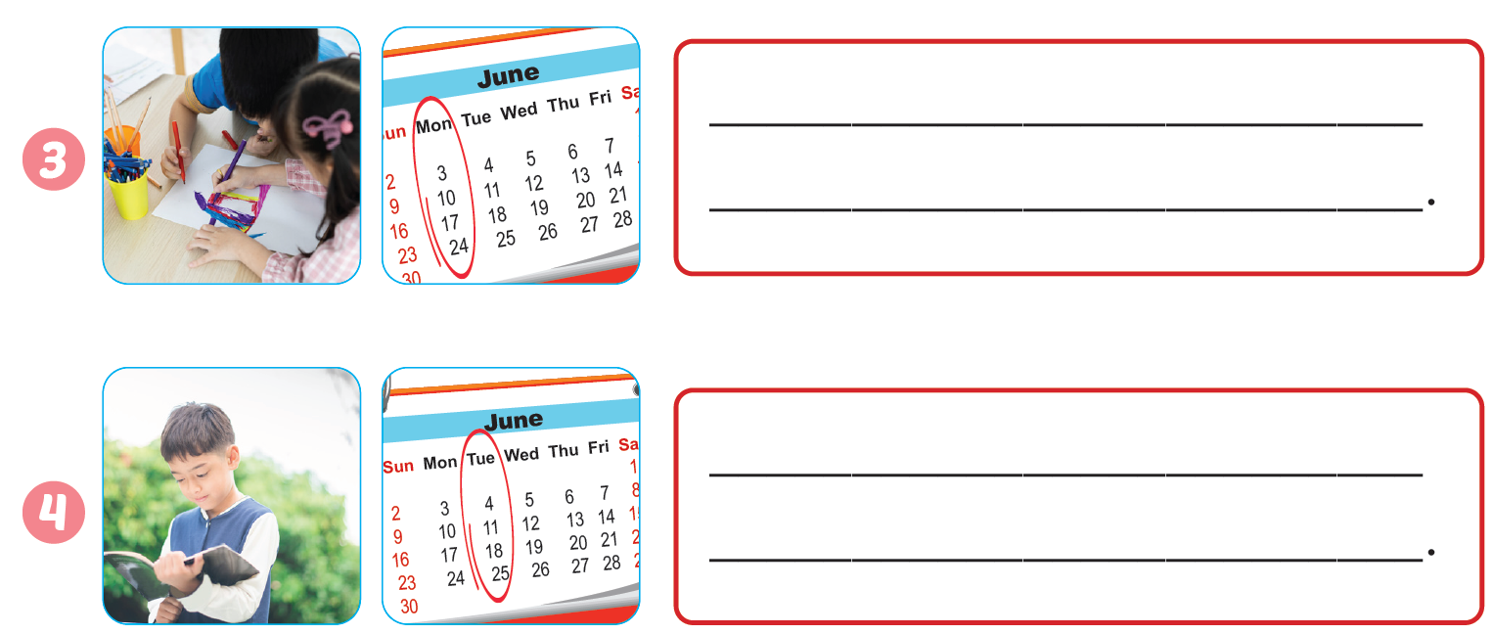
Workbook - Page 61
I draw pictures on Monday
I read books on Tuesday

Slide 28

CONSOLIDATION

Slide 29
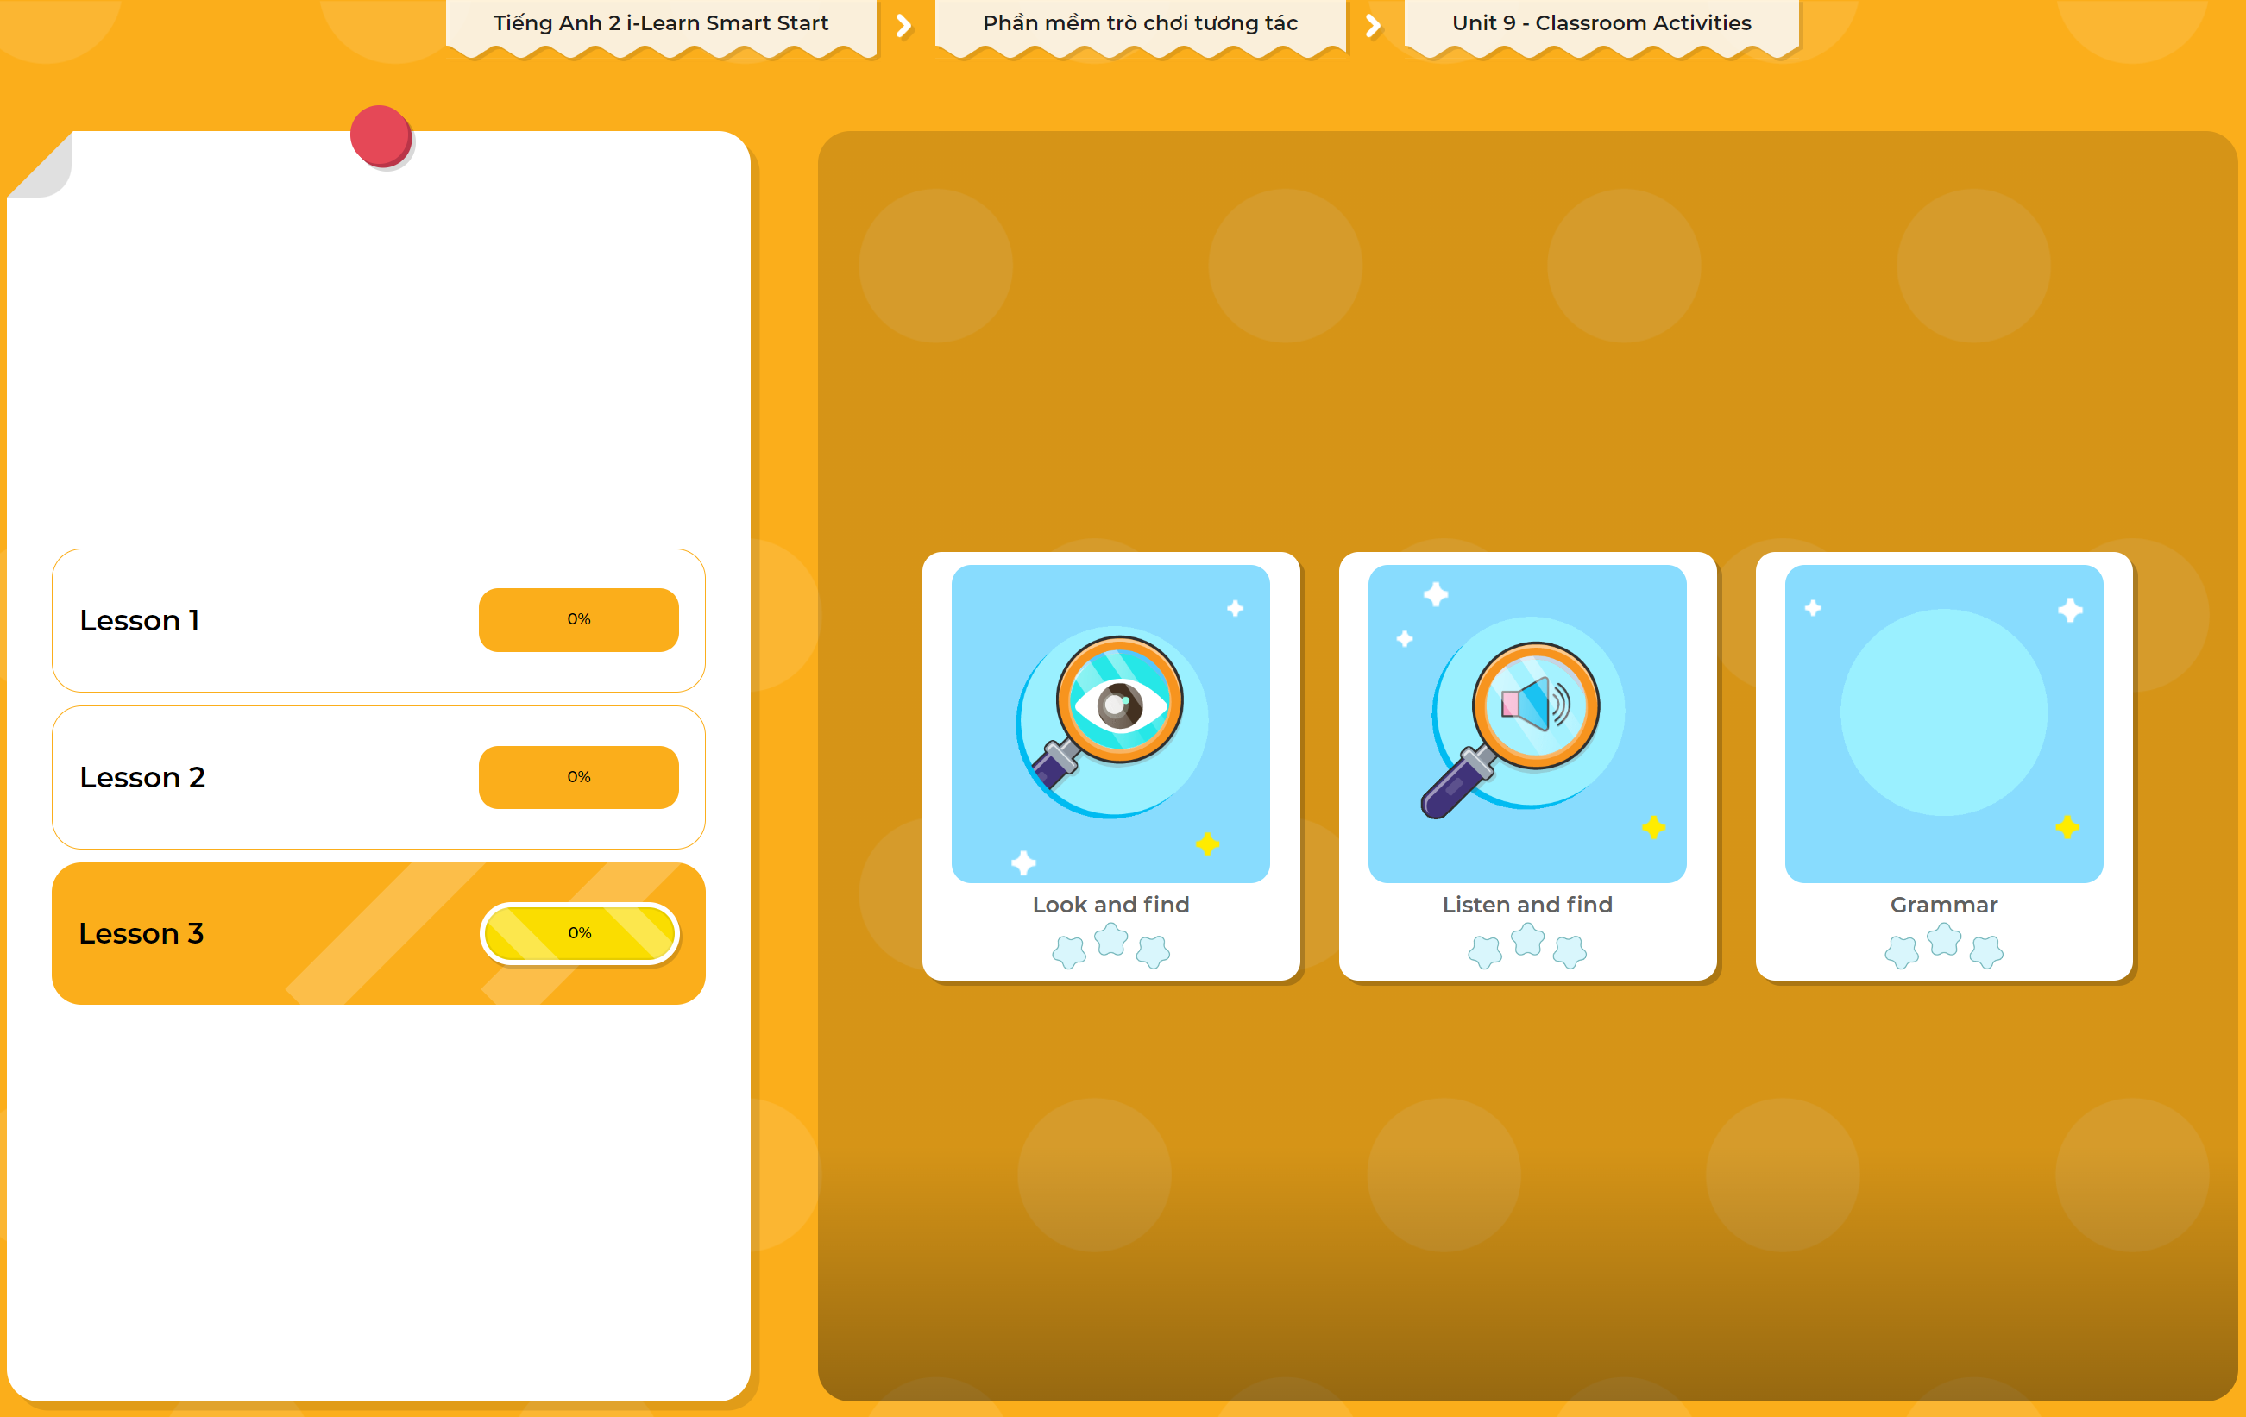
Extra Practice
DHA App
LET’S PLAY!
Click here to play the games

Slide 30

WRAP-UP

Slide 31
Today’s lesson
Vocabulary
Count numbers, draw pictures,
spell words, sing songs, read books, play soccer.
Structures/ Sentence patterns
“I count numbers on Monday.”
“I draw pictures on Tuesday.”

Slide 32
Homework
Practice vocabularies and structures. Make sentences using them.
Practice the vocabulary and structure in Tiếng Anh 2 i-Learn Smart Start Notebook (page 61)
Do the exercises in Tiếng Anh 2 i-Learn Smart Start Workbook (page 61)
Play the consolidation games in Tiếng Anh 2 i-Learn Smart Start DHA App on www.eduhome.com.vn
Prepare the next lesson (page 64)

Slide 33
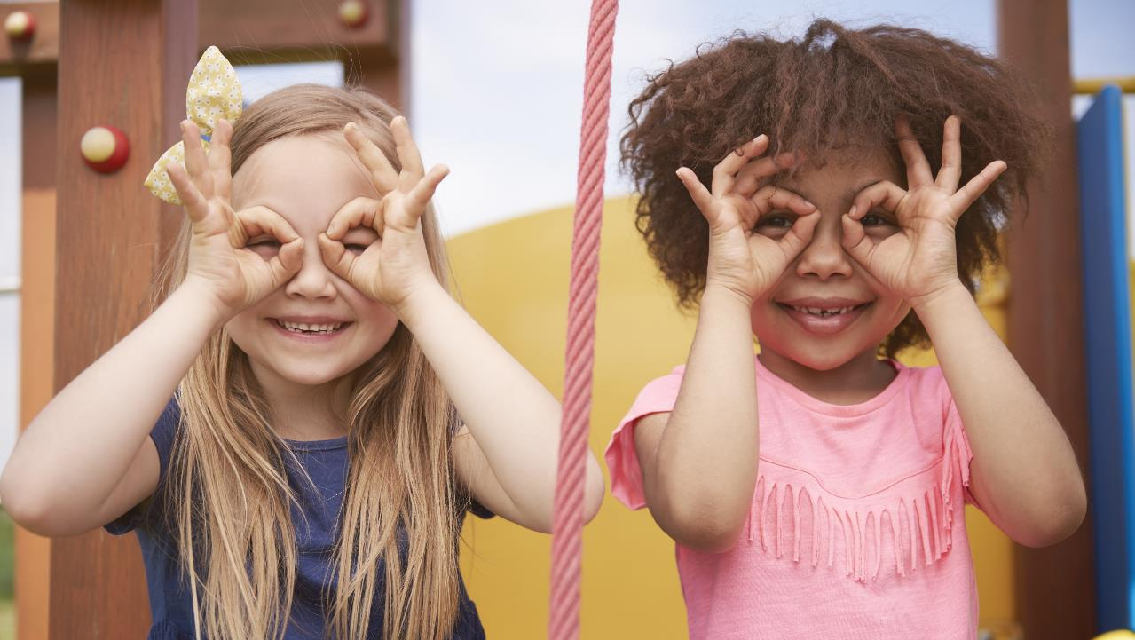
Enjoy your day!

