Slide 1


Unit 10: My House
Lesson 1.1
Page 62

Slide 2
Lesson Outline
Warm-up
Vocabulary
Structure
Consolidation
Wrap-up

Slide 3
Objectives
By the end of this lesson, students will be able to identify rooms in a house.
Vocabulary: bedroom, living room, kitchen
Structure: This is my (living room).

Slide 4

WARM UP

Slide 5

Let’s play!
What’s missing?
Notes:
Review unit 9

Slide 6

It’s time to learn …

Slide 7

New words
bedroom,
living room,
kitchen

Slide 8

Presentation

Slide 9


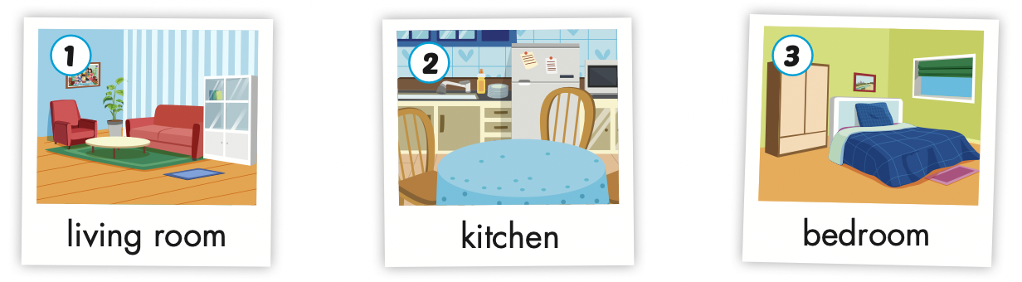
Click each icon to hear the sound
living room
kitchen
bedroom
/ˈlɪvɪŋ ruːm/ phòng khách
/ˈkɪtʃɪn/ nhà bếp
/ˈbedruːm/ phòng ngủ

Slide 10

Practice

Slide 11
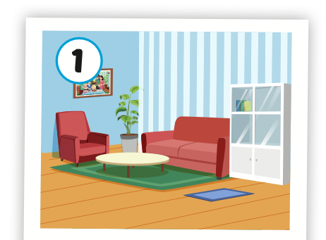
Click the icon to hear the sound
living room
/ˈlɪvɪŋ ruːm/ phòng khách

Slide 12
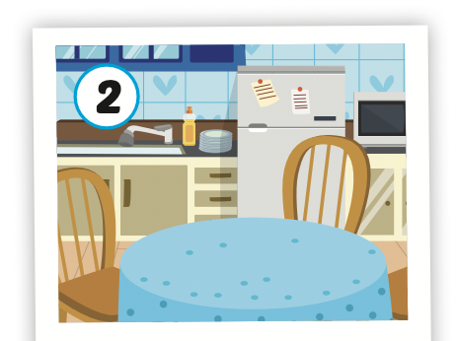
Click the icon to hear the sound
kitchen
/ˈkɪtʃɪn/ nhà bếp

Slide 13
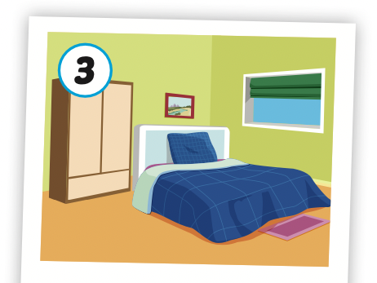
Click the icon to hear the sound
bedroom
/ˈbedruːm/ phòng ngủ

Slide 14

Let’s play!
Telephone game
Notes:
Divide the class into 4 teams
Have each team stand in a line.
Teacher shows a number to the first student of each line. Then says: "Start!"
Students whisper it to the person next to them.
The last students hear the word, will say what they think they heard out-loud.

Slide 15
Structures
This is my (living room).

Slide 16

Listening

Slide 17

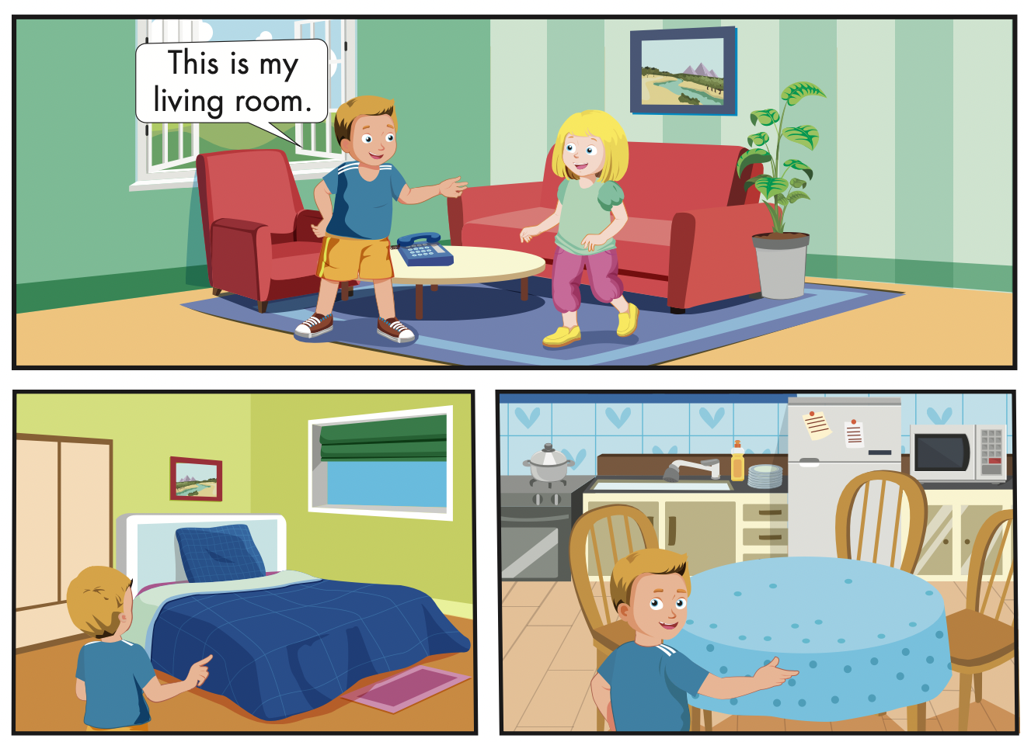
Click the icon to hear the sound

Slide 18

Speaking

Slide 19
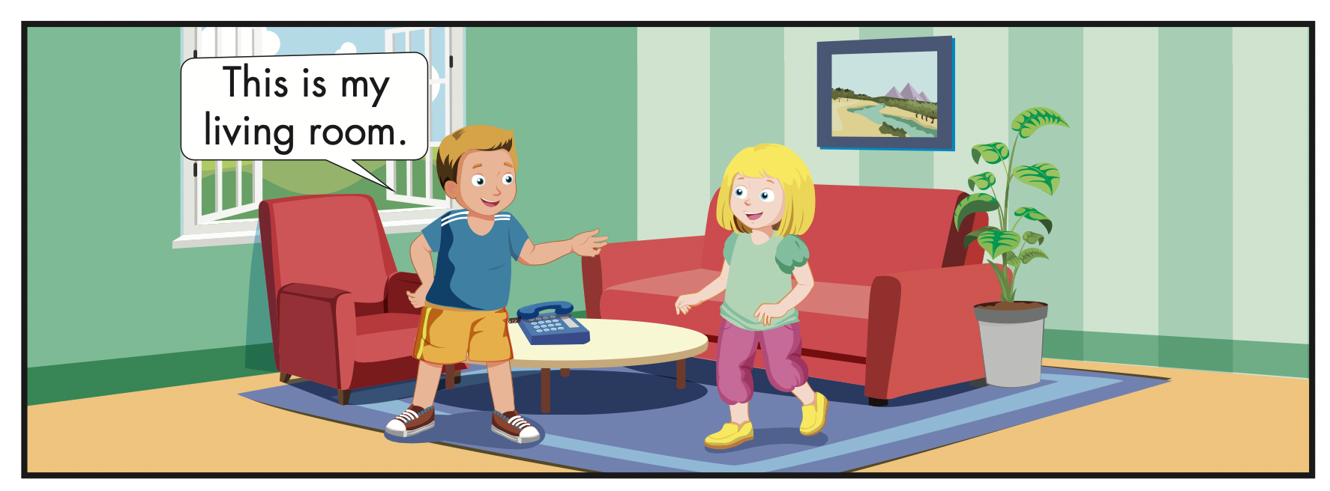
Let’s say!
living room
This is my living room.

Slide 20
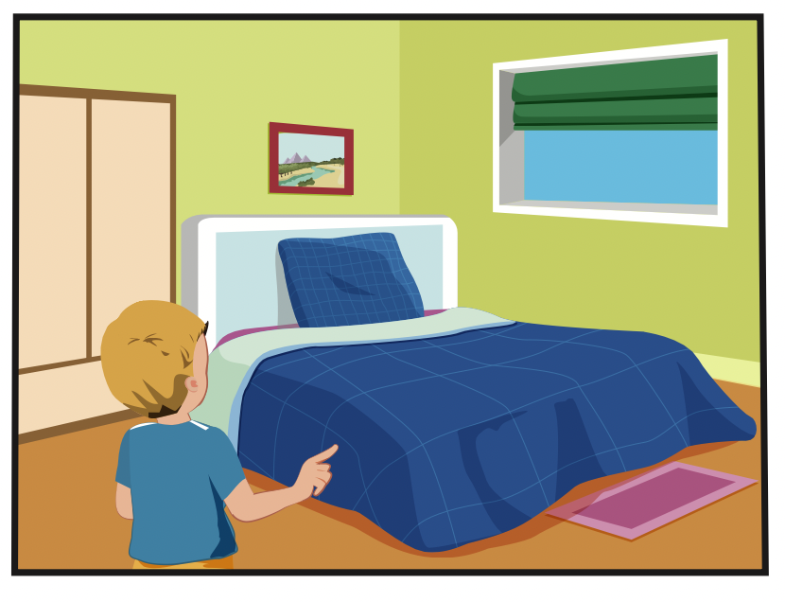
Let’s say!
bedroom
This is my bedroom.

Slide 21
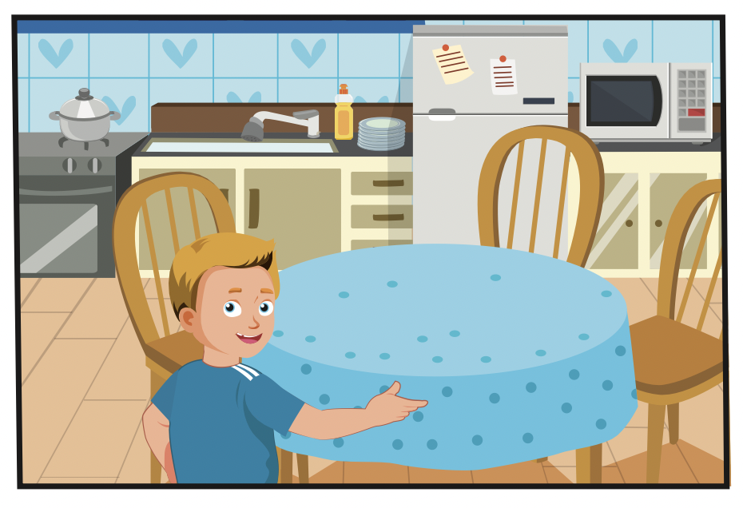
Let’s say!
kitchen
This is my kitchen.

Slide 22


Click the icon to hear the sound

Slide 23

Let’s play!

Slide 24


ANGRY BIRDS

Slide 25
HOW TO PLAY
Divide the class into 2 teams
Choose an egg, look and say what room it is.
If it is right, student will get a MYSTERY BOX.
He/she can keep it or give it to another team.

Slide 26
END!
1
2
3
4
5
CHOOSE ONE

Slide 27
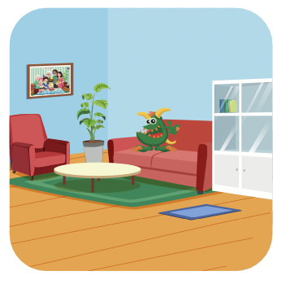
LOSE 100
Give it
or
Keep it?
H
O
M
E
Living room

Slide 28


Give it
or
Keep it?
GET 100
H
O
M
E
bedroom

Slide 29

Give it
or
Keep it?
LOSE 200
H
O
M
E
living room

Slide 30
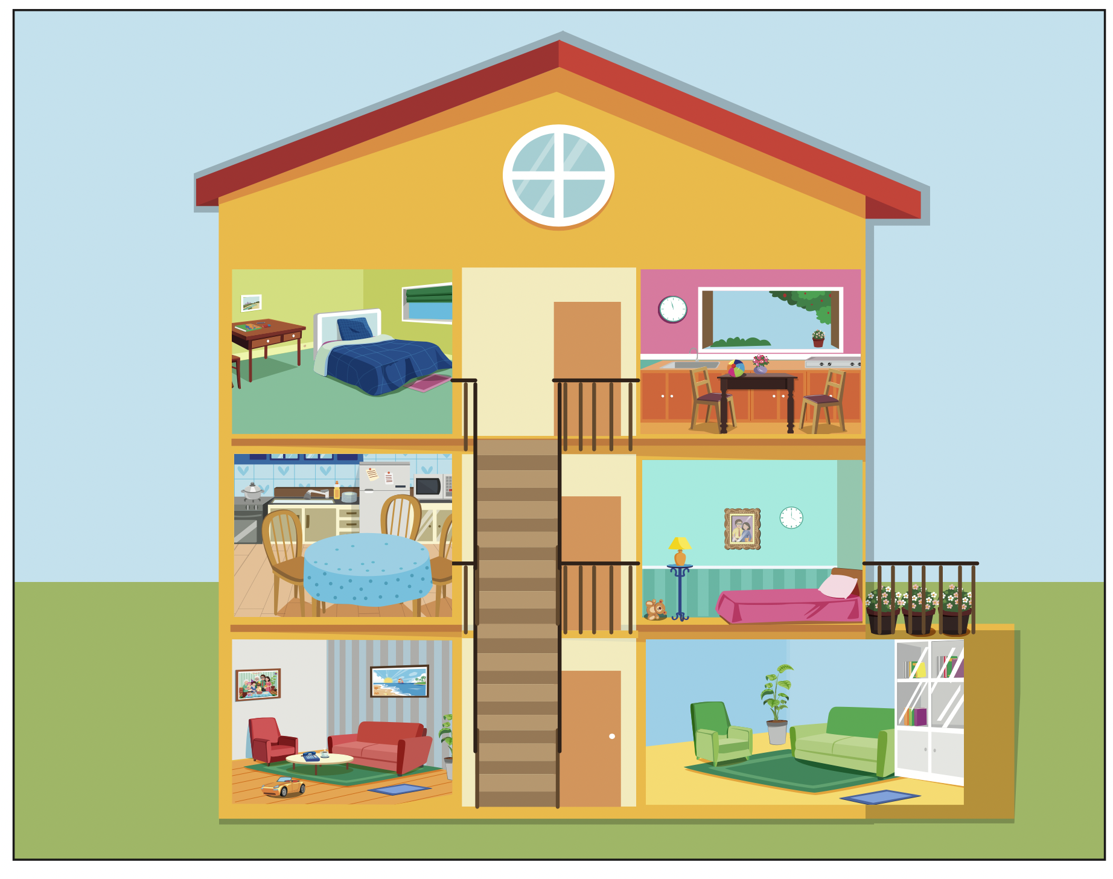

GET 200
Give it
or
Keep it?
H
O
M
E
house

Slide 31
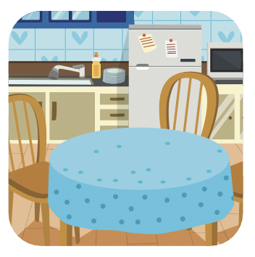

Give it
or
Keep it?
STEAL 100
H
O
M
E
kitchen

Slide 32


Slide 33

CONSOLIDATION

Slide 34

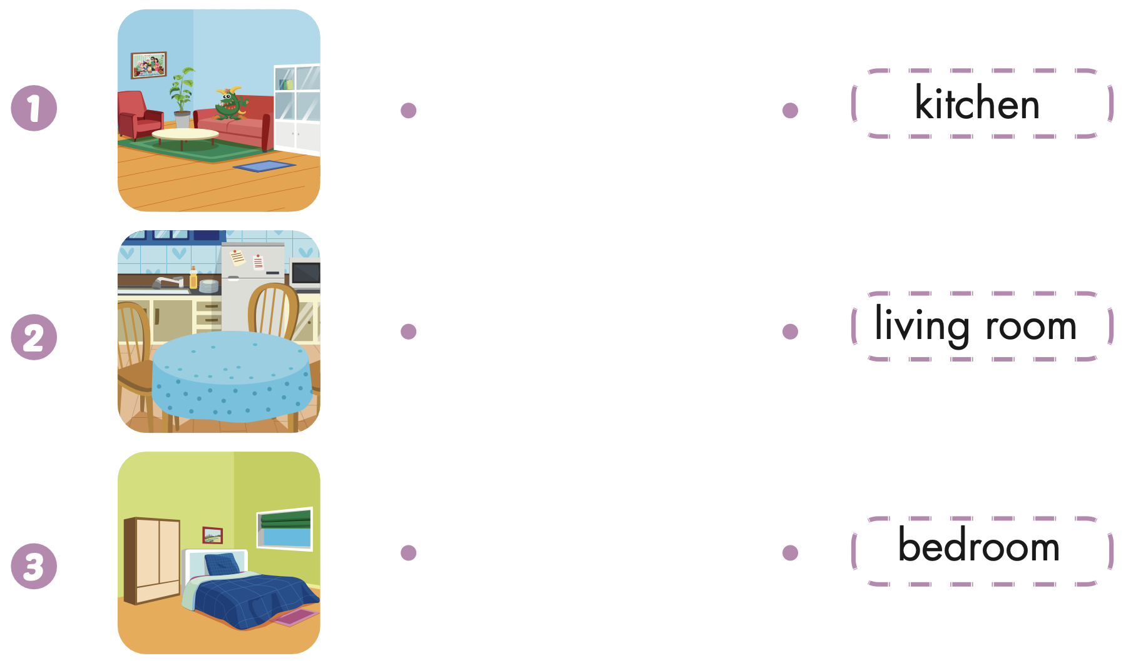
Extra Practice
WB, page 60

Slide 35
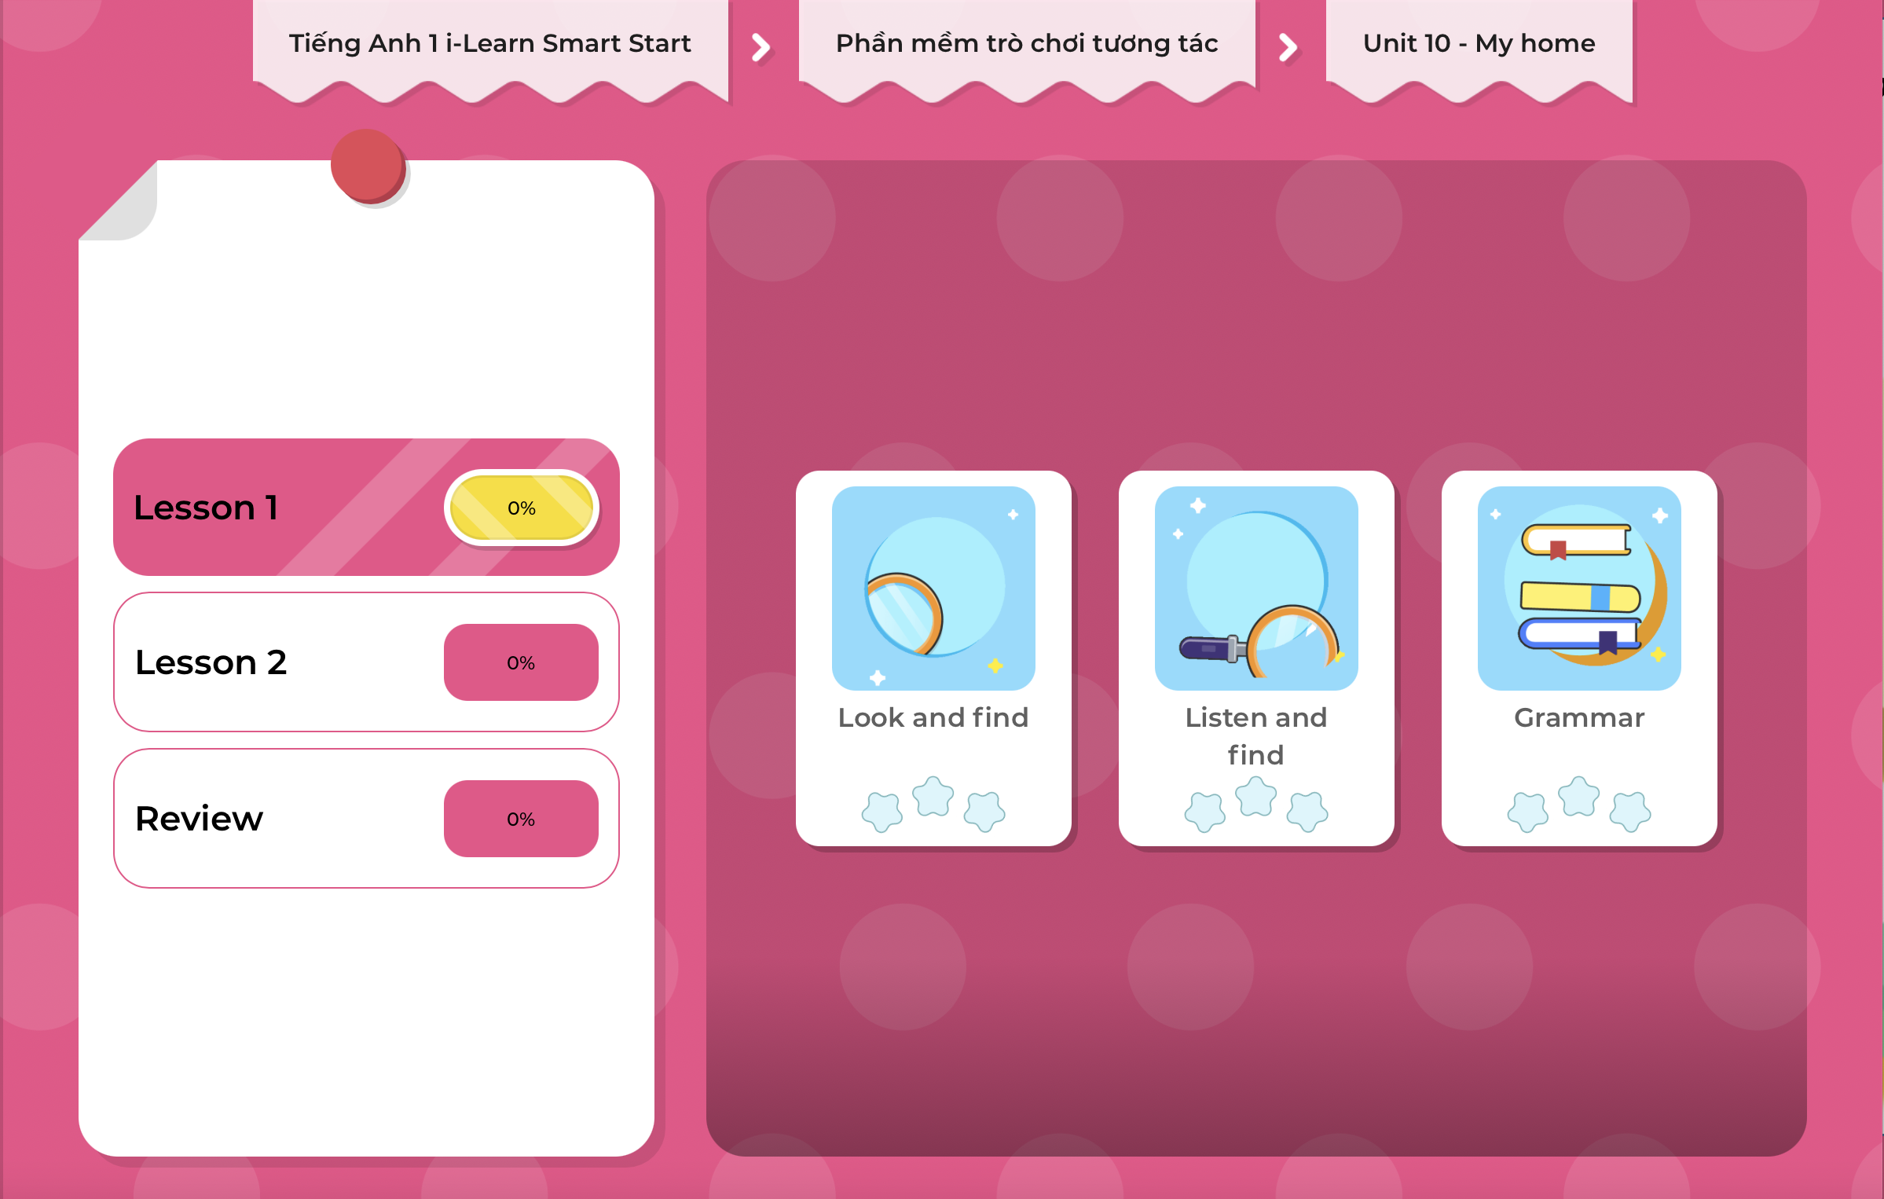
Extra Practice
DHA on Eduhome
LET’S PLAY!
Click on the picture below to play the games.

Slide 36

WRAP-UP

Slide 37
Today’s lesson
Vocabulary
living room,
kitchen,
bedroom
Structures/ Sentence patterns
This is my (living room).

Slide 38
Homework
Practice the vocabulary and structures. Make sentences using them.
Do the exercises in Tiếng Anh 1 i-Learn Smart Start WB (page 60).
Do the exercises in Tiếng Anh 1 i-Learn Smart Start Notebook (page 58).
Prepare for the next lesson (page 63 SB).
Play the consolidation games in Tiếng Anh 1 i-Learn Smart Start DHA App on www.eduhome.com.vn

Slide 39

Have a nice day!

