Slide 1


Unit 10: My House
Lesson 1.2
Page 63

Slide 2
Lesson Outline
Warm-up
Practice
Production
Consolidation
Wrap-up

Slide 3
Objectives
By the end of this lesson, students will be able to identify rooms in a house.
Vocabulary: bedroom, living room, kitchen
Structure: This is my (living room).

Slide 4

WARM UP

Slide 5
Let’s sing!

Slide 6


Slide 7

It’s time to learn …

Slide 8

New words
bedroom,
living room,
kitchen

Slide 9

Review

Slide 10

Let’s play!
Telephone game
Notes:
Divide the class into 4 teams
Have each team stand in a line.
Teacher shows a number to the first student of each line. Then says: "Start!"
Students whisper it to the person next to them.
The last students hear the word, will say what they think they heard out-loud.

Slide 11
Structures
This is my (living room).

Slide 12

Speaking

Slide 13
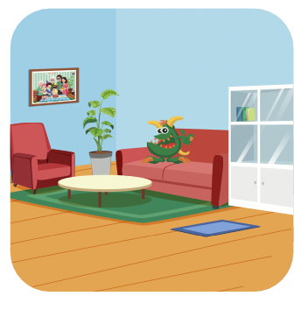
Let’s say!
living room
This is my living room.

Slide 14

Let’s say!
bedroom
This is my bedroom.

Slide 15

Let’s say!
kitchen
This is my kitchen.

Slide 16

Practice

Slide 17

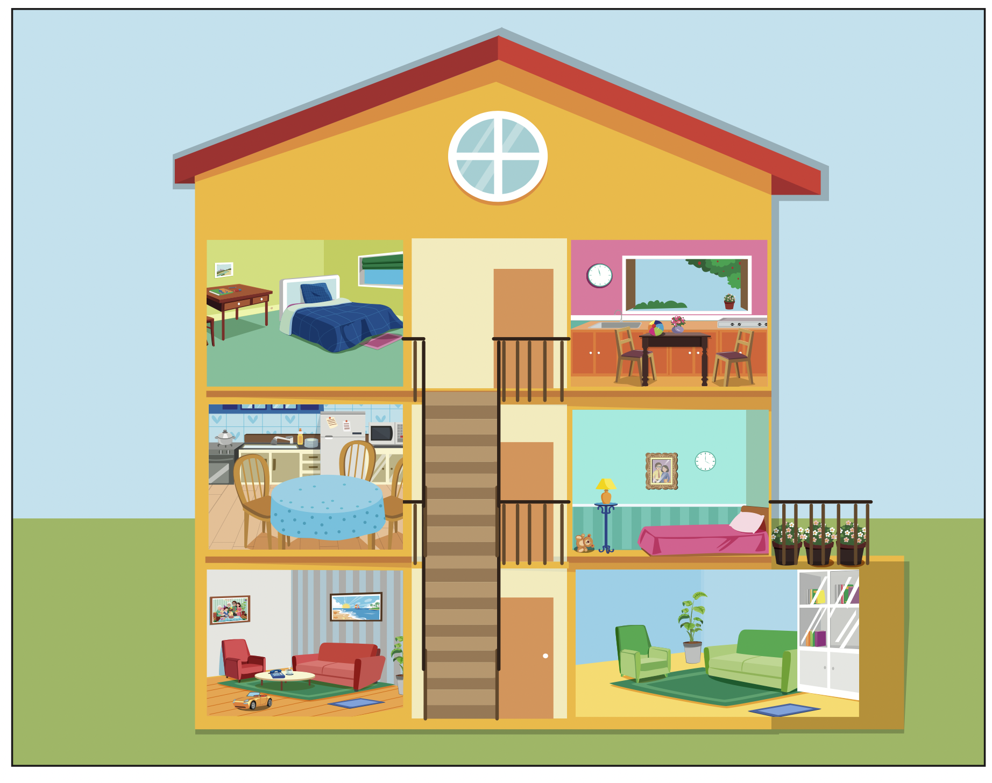


Slide 18
This is my living room.

Slide 19
This is my kitchen.

Slide 20
This is my bedroom.

Slide 21
This is my living room.

Slide 22
This is my kitchen.

Slide 23

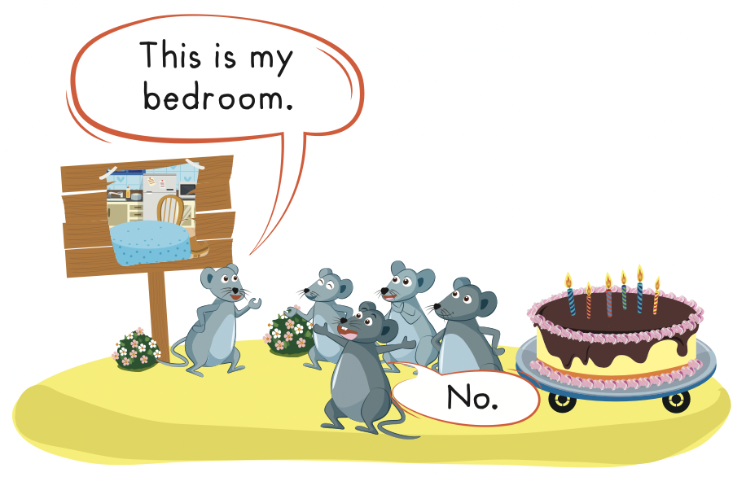
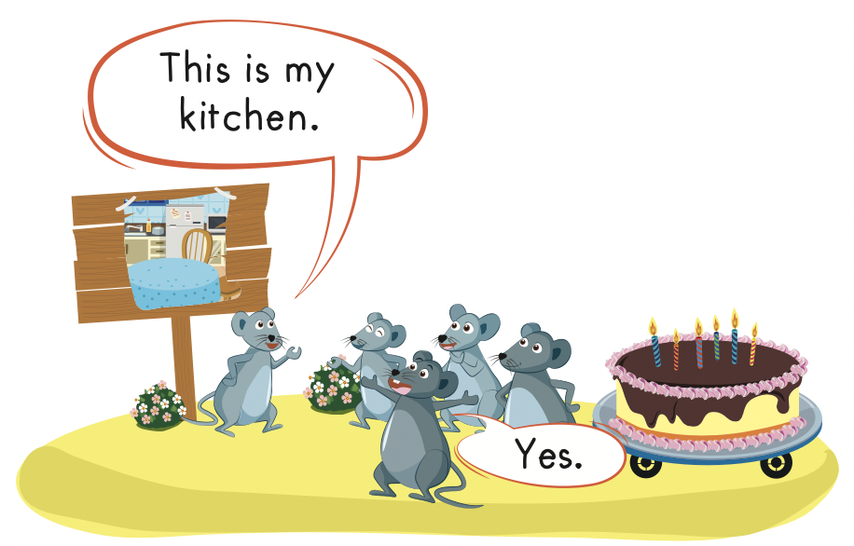

Slide 24

Let’s play!

Slide 25
Let’s play!
Read, look and choose

Slide 26

This is my bedroom.
This is my living room.
This is my kitchen.

Slide 27
This is my bedroom.
This is my kitchen.
This is my living room.

Slide 28
This is my bedroom.
This is my living room.
This is my kitchen.

Slide 29
This is my bedroom.

Slide 30

This is my kitchen.

Slide 31


Slide 32


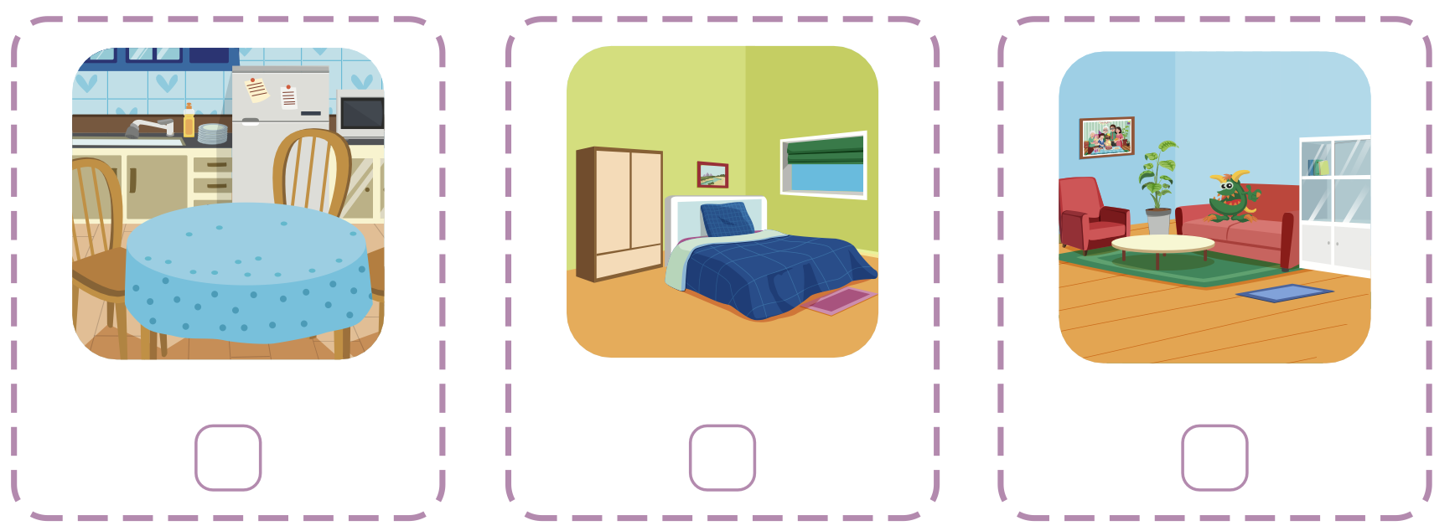
Extra Practice
WB, page 61
Click the icon to hear the sound
3
1
2

Slide 33

CONSOLIDATION

Slide 34
Let’s draw!
……………………………..
Notes:
Students draw and write: This is my house.

Slide 35
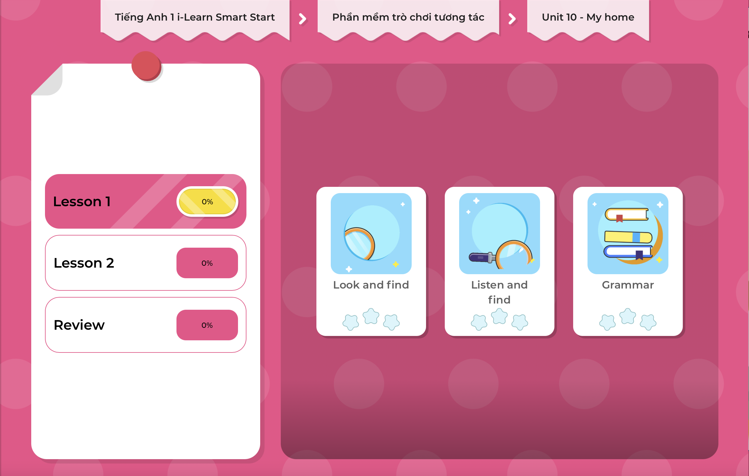
Extra Practice
DHA on Eduhome
LET’S PLAY!
Click on the picture below to play the games.

Slide 36

WRAP-UP

Slide 37
Lesson 3
Today’s lesson
Vocabularies
Living room,
Kitchen,
Bedroom
Structures/ Sentence patterns
This is my (living room).

Slide 38
Lesson 3
Homework
Practice the vocabulary and structures. Make sentences using them.
Do the exercises in Tiếng Anh 1 i-Learn Smart Start WB (page 61).
Do the exercises in Tiếng Anh 1 i-Learn Smart Start Notebook (page 59).
Prepare for the next lesson (page 64 SB).
Play the consolidation games in Tiếng Anh 1 i-Learn Smart Start DHA App on www.eduhome.com.vn

Slide 39

Enjoy your day!

