Slide 1


Unit 10: My House
Lesson 2.1
Page 64

Slide 2
Lesson Outline
Warm-up
Listening
Consolidation
Wrap-up

Slide 3
Objectives
By the end of this lesson, students will be able to review the /l/ and /k/ sounds.
Vocabulary: love, kick
Phonics: /l /, /k /

Slide 4

WARM UP

Slide 5
Let’s sing!

Slide 6




Slide 7

It’s time to learn …

Slide 8

Phonics
/l /, /k /

Slide 9

Review

Slide 10



Click the icon to hear the sound
K, k
L, l
/ l /
/ k /

Slide 11



Click the icon to hear the sound
Love
Kick
/ l /
/ k /

Slide 12

Practice

Slide 13

Let’s play!
Find the card
Notes:
Divide the class into teams.
Put some flashcards around the classroom.
Teacher call out a word.
Have students find the card.

Slide 14

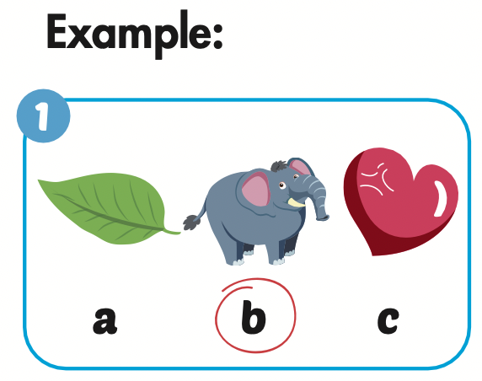

Slide 15
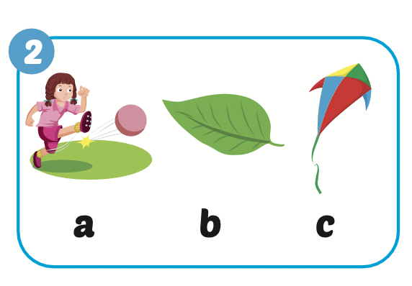

Slide 16
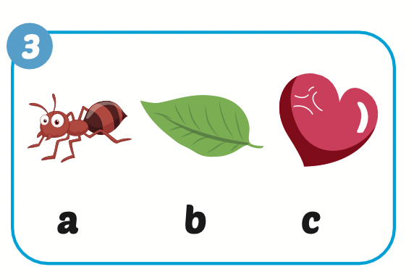

Slide 17

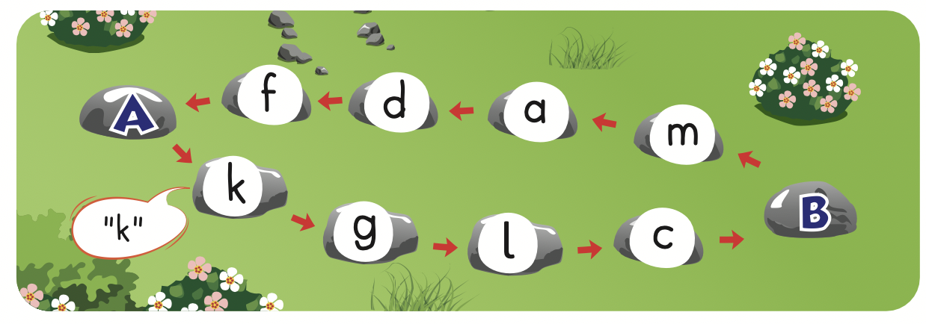

Slide 18

Let’s play!

Slide 19
Let’s play!
Listen and choose

Slide 20




Slide 21
/k/
/l/

Slide 22
C
K
L

Slide 23




Slide 24
C
K
L

Slide 25


Slide 26

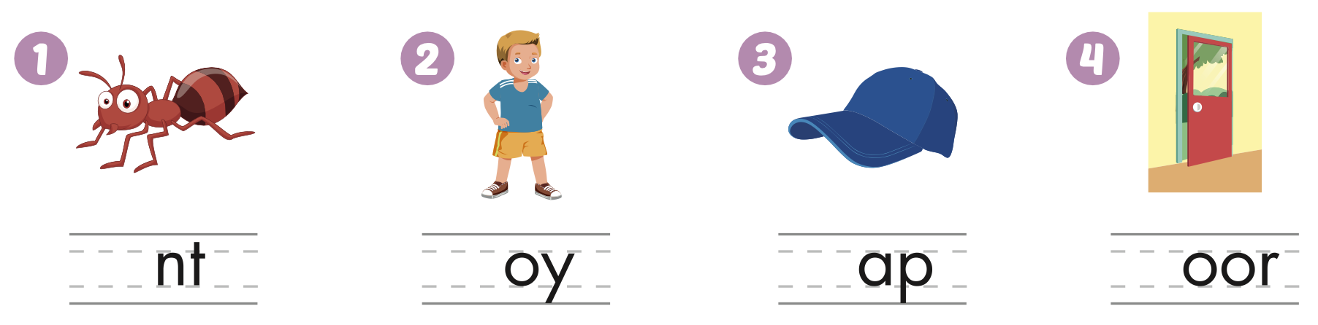
Extra Practice
WB, page 62
a
b
c
d

Slide 27
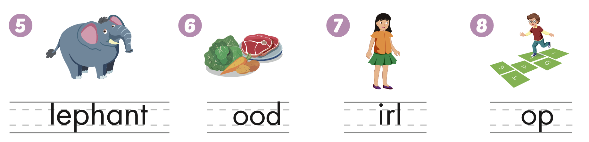
Extra Practice
WB, page 62
e
f
g
h

Slide 28

CONSOLIDATION

Slide 29
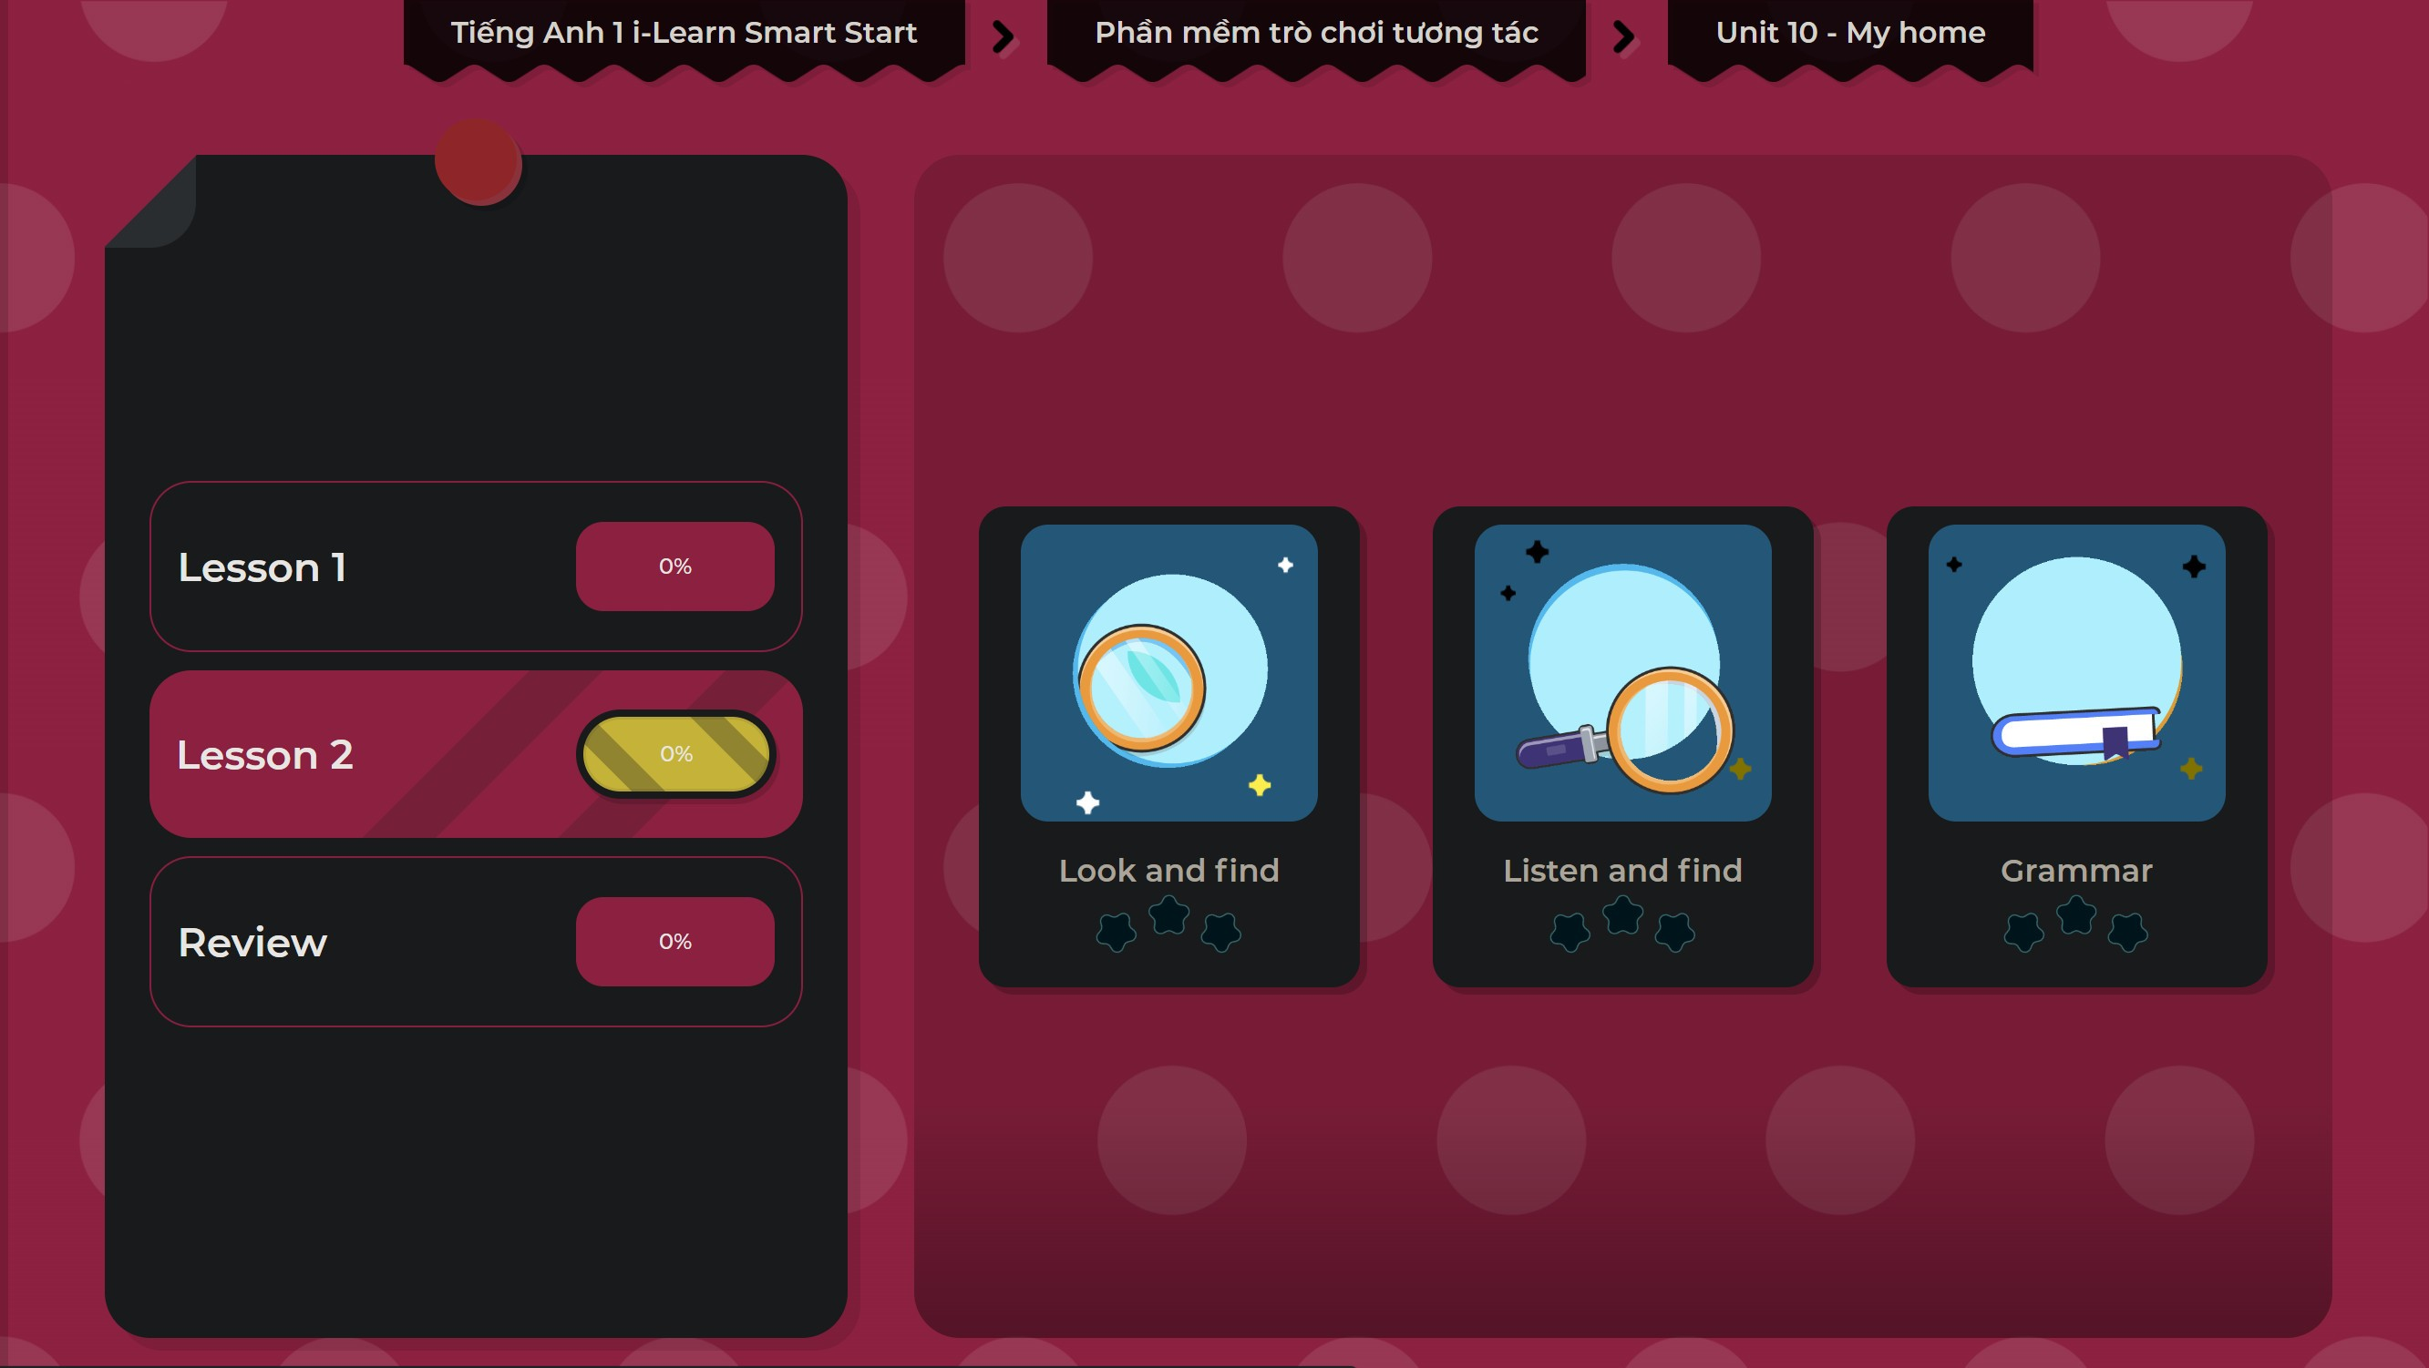
Extra Practice
DHA on Eduhome
LET’S PLAY!
Click on the picture below to play the games.

Slide 30

WRAP-UP

Slide 31
Today’s lesson
Vocabulary
love, kick
Phonics
/ k /, / l /

Slide 32
Homework
Practice the vocabulary and structures. Make sentences using them.
Do the exercises in Tiếng Anh 1 i-Learn Smart Start WB (page 62).
Do the exercises in Tiếng Anh 1 i-Learn Smart Start Notebook (page 60).
Prepare for the next lesson (page 65 SB).
Play the consolidation games in Tiếng Anh 1 i-Learn Smart Start DHA App on www.eduhome.com.vn

Slide 33

Enjoy your day!

