Slide 1


Unit 10: My House
Lesson 2.2
Page 65

Slide 2
Lesson Outline
Warm-up
Listening
Consolidation
Wrap-up

Slide 3
Objectives
By the end of this lesson, students will review the sounds for the letters A to M.

Slide 4

WARM UP

Slide 5
Let’s sing!

Slide 6




Slide 7

It’s time to learn …

Slide 8

Phonics
the sounds from letter A to M

Slide 9

Review

Slide 10


Slide 11

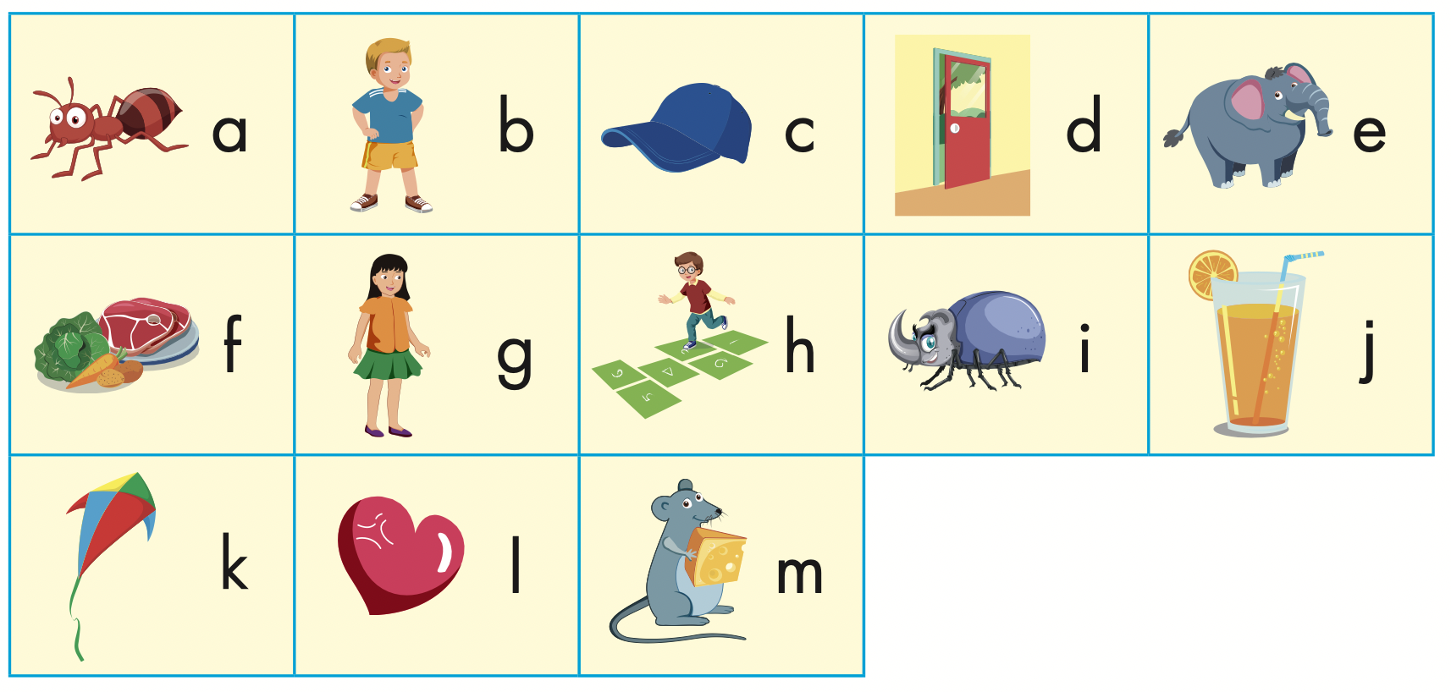
Click the icon to hear the sound.

Slide 12

Let’s play!
Read my lips
Notes:
Divide the class into teams.
Teacher says a letter silently.
Have the students guess what the teacher said.

Slide 13

Practice

Slide 14




Slide 15

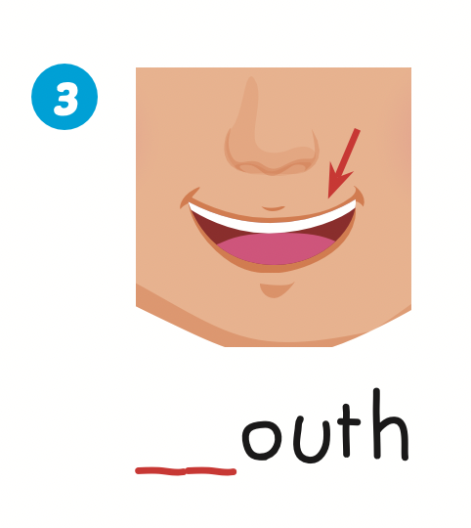
m
l

Slide 16

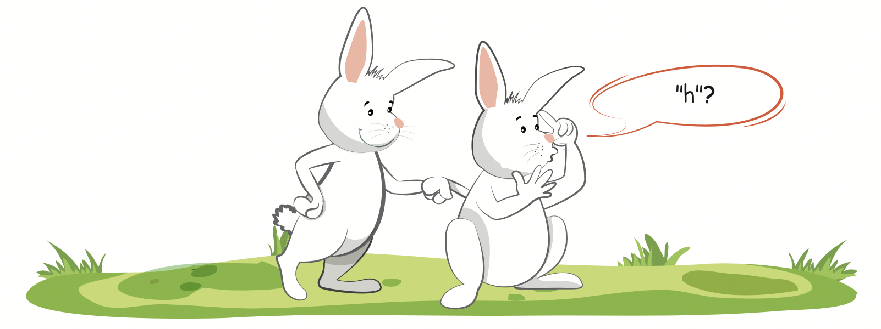

Slide 17

Let’s play!

Slide 18

Let’s Dance Game

Slide 19
How To Play
Students must take turns reading the words in order.
Each time a student can choose to say the words in 1 square, 2 squares or a maximum of 3 squares.
The student who says the red word must dance!

Slide 20

a
b
c
door
e
food
g
h
insect
juice
k
love
m
cap
j

Slide 21


Slide 22
Practice

Slide 23

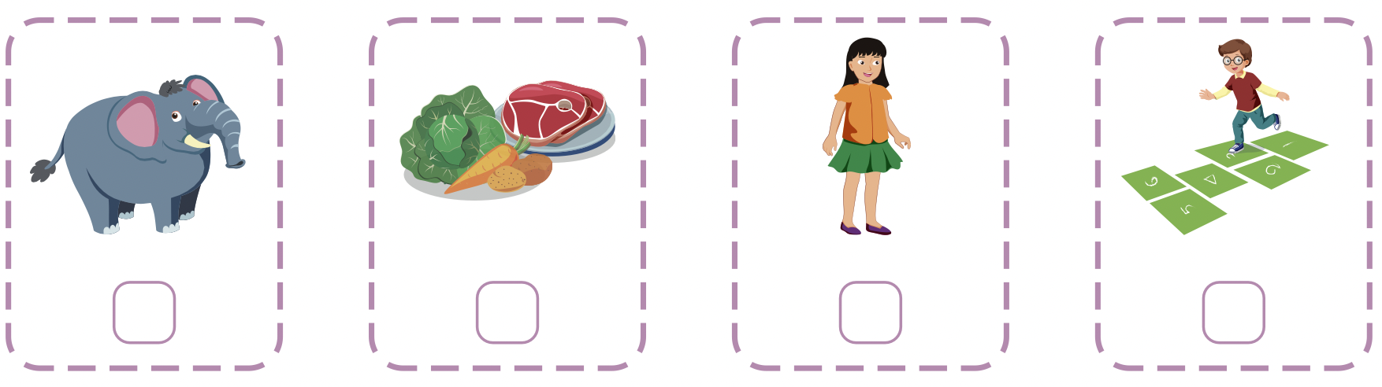
Extra Practice
WB, page 63
Click the icon to hear the sound
4
3
1
2

Slide 24

CONSOLIDATION

Slide 25
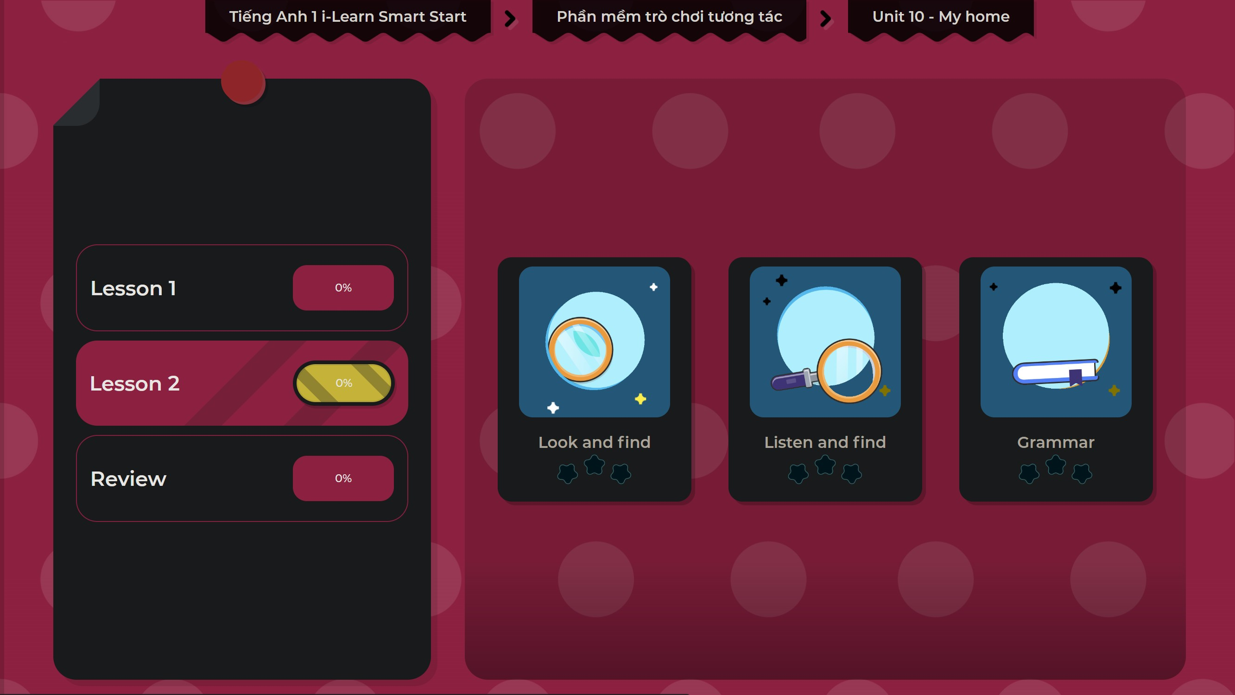
Extra Practice
DHA on Eduhome
LET’S PLAY!
Click on the picture below to play the games.

Slide 26

WRAP-UP

Slide 27
Today’s lesson
Phonics
Review the sounds for letter A to M.

Slide 28
Homework
Practice the vocabulary and structure. Make sentences using them.
Do the exercises in Tiếng Anh 1 i-Learn Smart Start WB (page 63).
Do the exercises in Tiếng Anh 1 i-Learn Smart Start Notebook (page 61).
Prepare for the next lesson (page 66 SB).
Play the consolidation games in Tiếng Anh 1 i-Learn Smart Start DHA App on www.eduhome.com.vn

Slide 29

Enjoy your day!

