Slide 1


Unit 10: My House
Review 10
Page 67

Slide 2
Lesson Outline
Warm-up
Practice
Production
Consolidation
Wrap-up

Slide 3
Objectives
By the end of this lesson, students will review identifying rooms in house.
Vocabulary: kitchen, living room, bedroom
Structures: This is my (living room).

Slide 4

WARM UP

Slide 5
Let’s play!
Tic-Tac-Toe
Divide the class into 2 teams: X and O.
Each team choose a number, read, look and answer.
If the student in X team responds correctly, she takes an X on this number on the tic-tac-toe board. (Then, O team).
Play continues until one team achieves three in a row, a line or a cross.

Slide 6
Tic-Tac-Toe
1
2
3
1
2
3
4
5
6
4
5
6
7
8
9
7
8
9
End

Slide 7
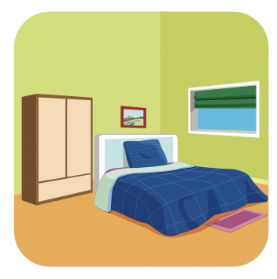

1
bedroom.
This is my…………………
BACK TO GAME

Slide 8
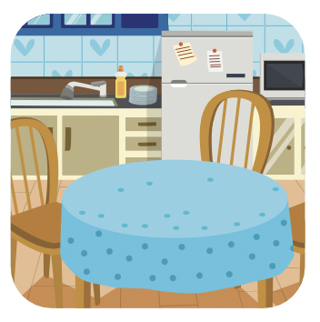
2
kitchen.
This is my…………………
BACK TO GAME

Slide 9
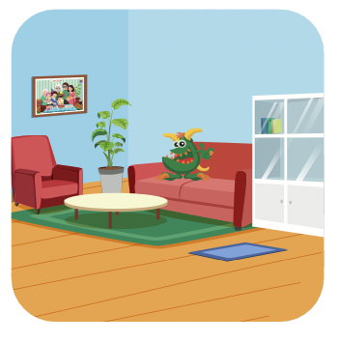
3
living room.
This is my…………………
BACK TO GAME

Slide 10
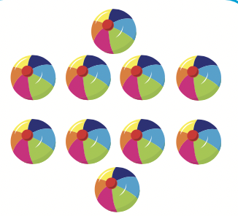
4
How many balls?
Six balls.
BACK TO GAME

Slide 11
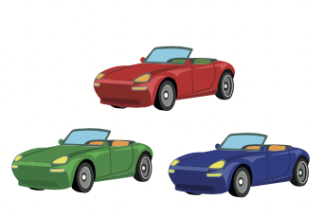
5
How many cars?
Three cars.
BACK TO GAME

Slide 12
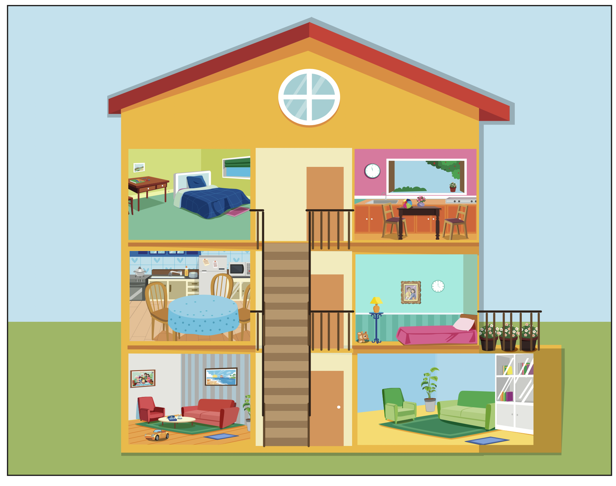
6
house.
This is my…………………
BACK TO GAME

Slide 13

7
a teddy bear.
I have…………………..
BACK TO GAME

Slide 14
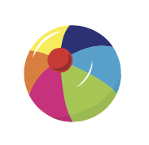
8
a ball.
I have…………………..
BACK TO GAME

Slide 15

9
How many teddy bears?
Six teddy bears.
BACK TO GAME

Slide 16

It’s time to learn …

Slide 17

New words
bedroom,
kitchen,
living room

Slide 18



Click the icon to hear the sound

Slide 19
Notes:
play the video to hear the song again

Slide 20
Structures
This is my (bedroom).

Slide 21

Review

Slide 22
Look and say
This is my……………
living room.

Slide 23
Look and say
This is my kitchen.

Slide 24
Look and say
This is my bedroom.

Slide 25

Listening

Slide 26

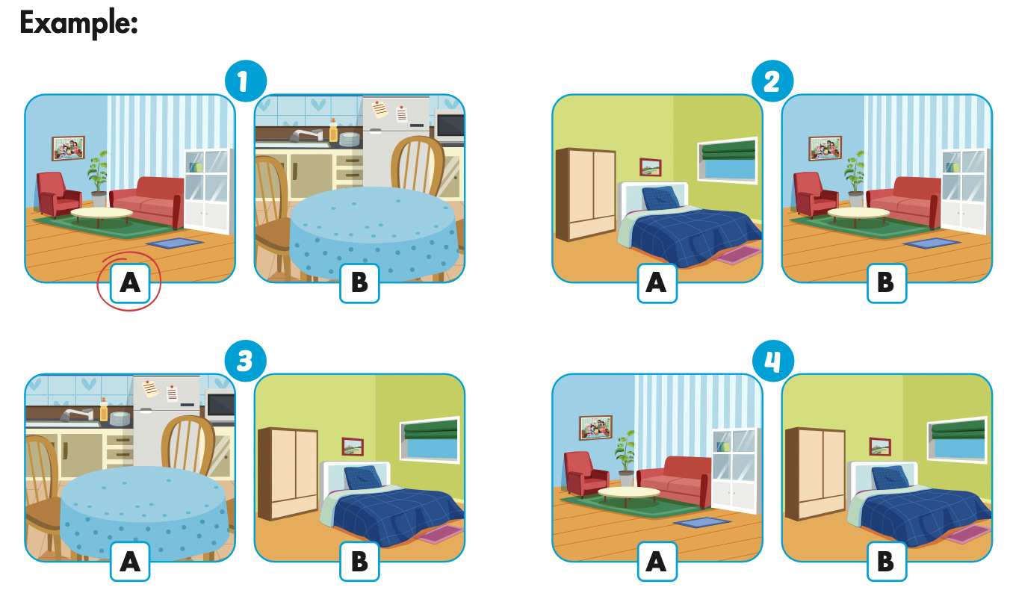
Click the icon to hear the sound.

Slide 27
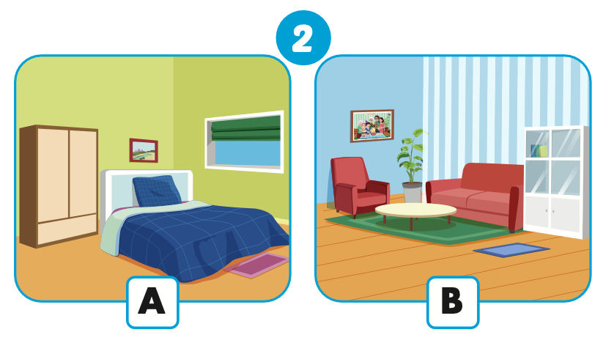
Let’s check!

Slide 28
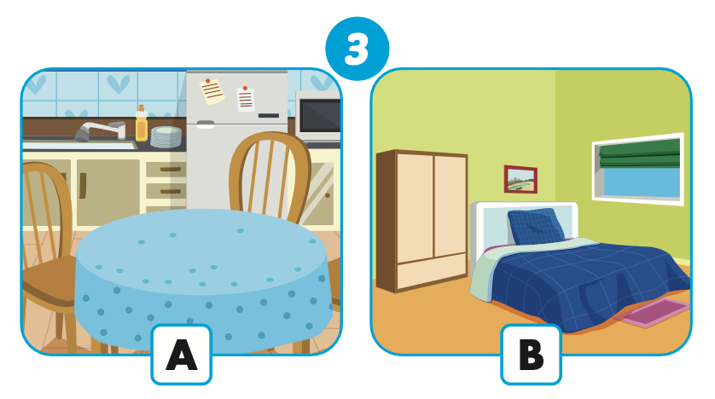
Let’s check!

Slide 29
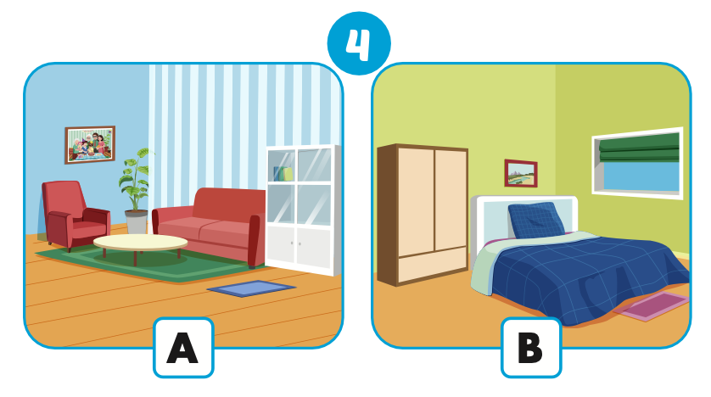
Let’s check!

Slide 30

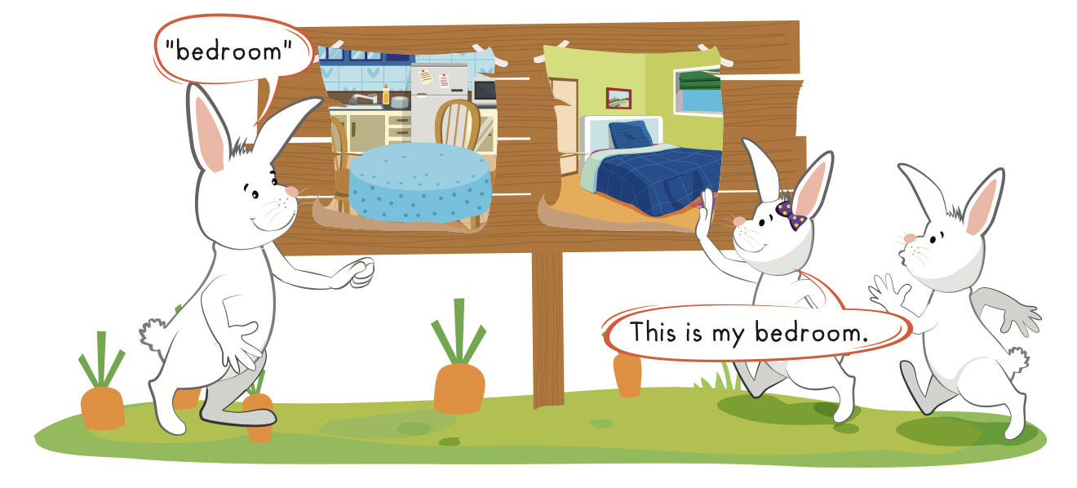

Slide 31

Practice

Slide 32

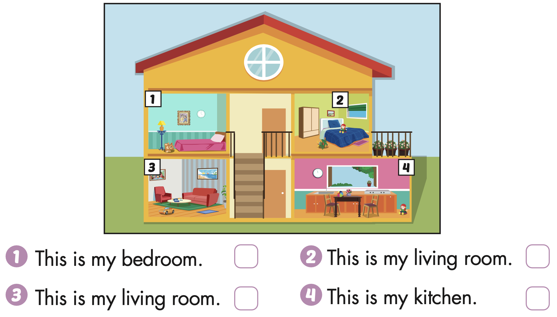


Extra Practice
WB, page 65

Slide 33

CONSOLIDATION

Slide 34
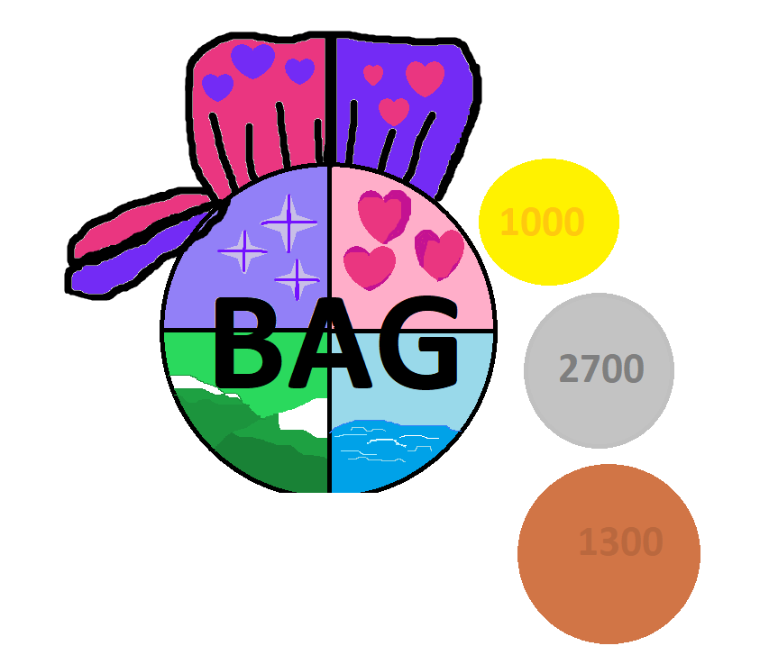
Let’s play!
Beanbag Circle Game
Notes:
Put some flashcards in a bag.
Have students sit in a circle.
They pass the bag around the circle while music plays in the background.
When the music stops, the person holding the “beanbag”, takes out a flashcard in the bag and say the sentence

Slide 35
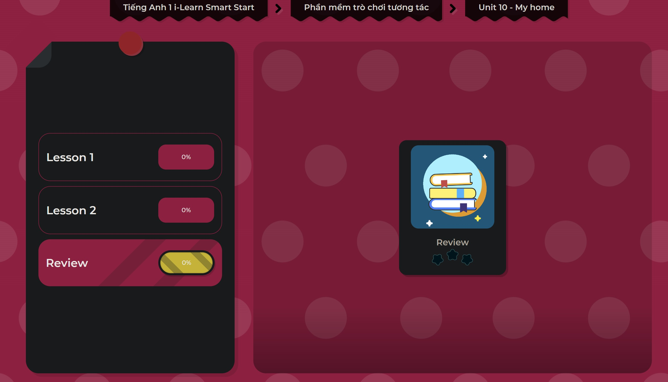
Extra Practice
DHA on Eduhome
LET’S PLAY!
Click on the picture below to play the games.

Slide 36

WRAP-UP

Slide 37
Today’s lesson
Vocabulary
kitchen, living room, bedroom
Structures/ Sentence patterns
This is my (living room).

Slide 38
Homework
Practice the vocabulary and structures. Make sentences using them.
Do the exercises in TA 1 i-Learn Smart Start WB (page 65).
Do Unit 6 – 10 review in TA1 i-Learn Smart Start Notebook (pages 62 – 65).
Practice The Final Test TA1 i-Learn Smart Start Notebook (pages 66 – 69).
Play the consolidation games in Tiếng Anh 1 i-Learn Smart Start DHA App on www.eduhome.com.vn

Slide 39

Enjoy your day!

