Slide 1


Unit 10: My House
Review 9
Page 66

Slide 2
Lesson Outline
Warm-up
Practice
Production
Consolidation
Wrap-up

Slide 3
Objectives
By the end of this lesson, students will review saying what objects they have, asking and answering about numbers of objects.
Vocabulary: teddy bear, car, ball
Structures: I have a (teddy bear ).
How many (cars)?
Two cars.

Slide 4

WARM UP

Slide 5
Matching Game
Let’s play!

Slide 6
How to Play
Divide the class into two teams.
Each team takes turns in choosing TWO squares.
If the two squares are the same word / picture, then the team gets a point.
If the two squares are different, then click on the red circle to hide the picture again.

Slide 7



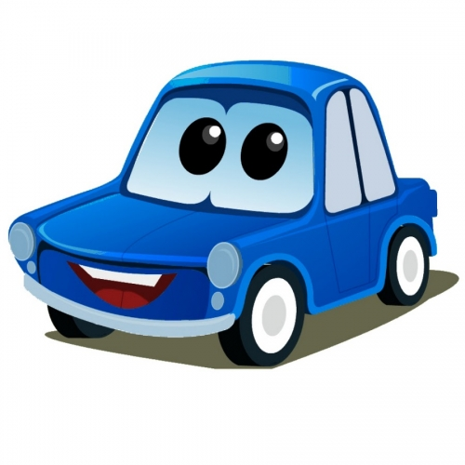

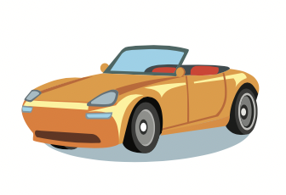
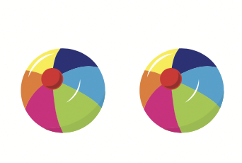
1
2
3
4
5
6
Teddy
bear
balls
six
8
car
Match image / word
14
15
16
17
18
13
ten
10
eight
6

Slide 8

It’s time to learn …

Slide 9

New words
teddy bear,
car,
ball

Slide 10
Structures
How many (cars)?
Two cars.
I have a (teddy bear).

Slide 11

Review

Slide 12
Look, read and answer
What is this?
A teddy bear.
I have a teddy bear.

Slide 13
Look, read and answer
I have a car.

Slide 14
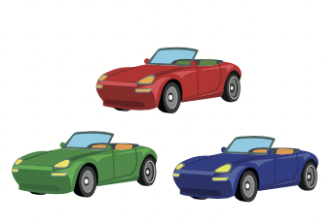
Look, read and answer
How many cars?
Three cars.

Slide 15
Look, read and answer
How many balls?
Two balls.

Slide 16
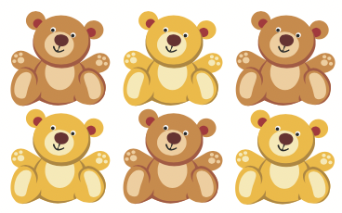
Look, read and answer
How many teddy bears?
Six teddy bears.

Slide 17
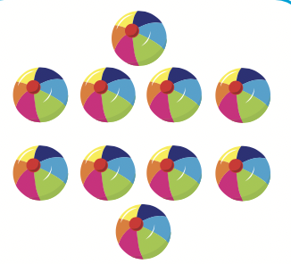
Look, read and answer
How many balls?
Ten balls.

Slide 18
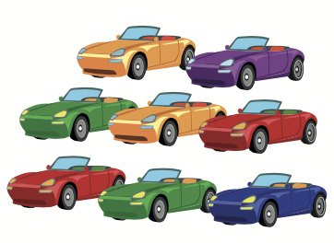
Look, read and answer
How many cars?
Eight cars.

Slide 19

Listening

Slide 20


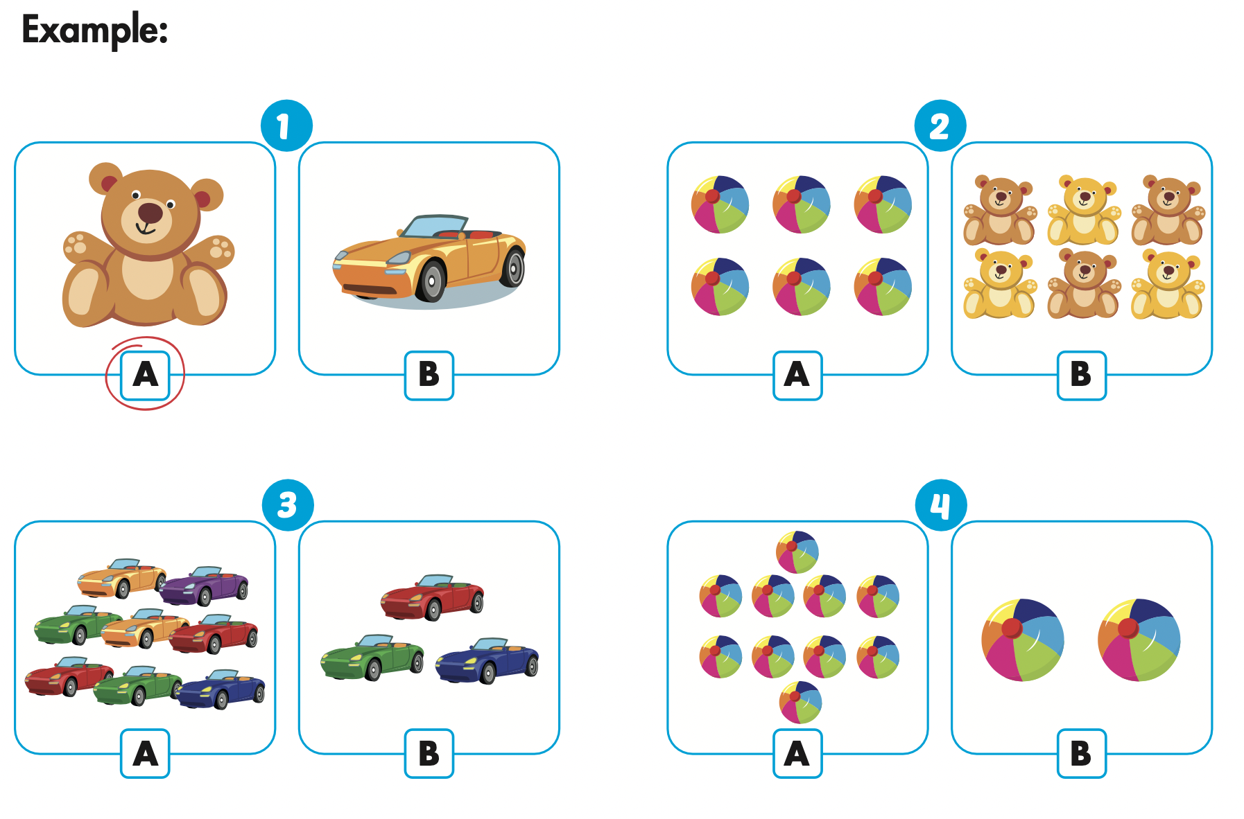
Click the icon to hear the sound

Slide 21
Let’s check!

Slide 22
Let’s check!

Slide 23
Let’s check!

Slide 24

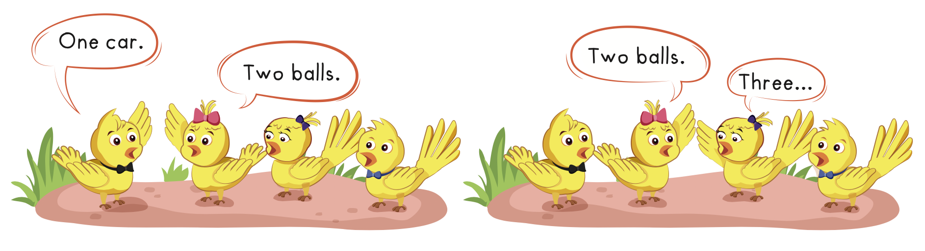

Slide 25

Practice

Slide 26

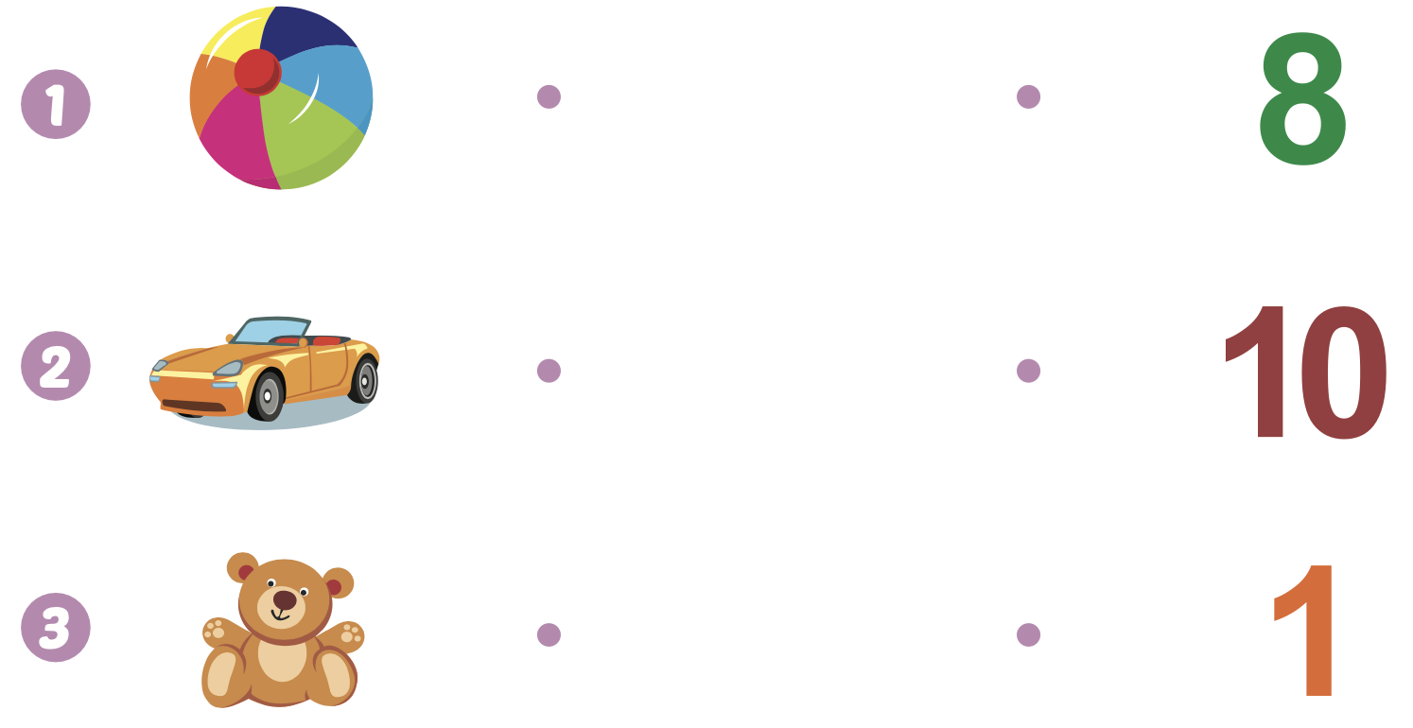
Extra Practice
WB, page 64
Click the icon to hear the sound

Slide 27

CONSOLIDATION

Slide 28

Let’s play!
Guess the word
Notes:
Divide the class into teams.
Write a word on the board with several letters missing.
Have each team take turns calling out a letter.
Add the missing letters to the word if correctly guessed.

Slide 29
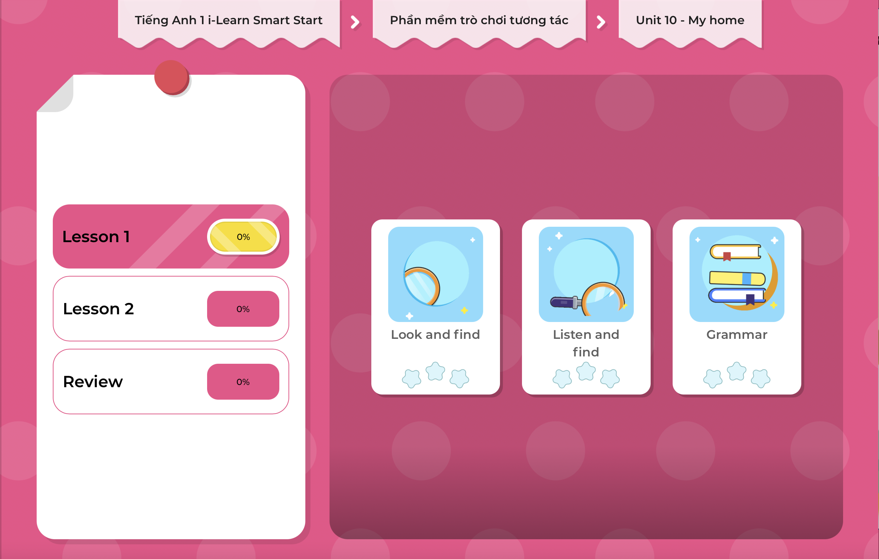
Extra Practice
DHA on Eduhome
LET’S PLAY!
Click on the picture below to play the games.

Slide 30

WRAP-UP

Slide 31
Today’s lesson
Vocabularies
teddy bear, car, ball
Structures/ Sentence patterns
I have a (teddy bear).
How many (cars)?
Two cars.

Slide 32
Homework
Practice the vocabulary and structures. Make sentences using them.
Do the exercises in Tiếng Anh 1 i-Learn Smart Start WB (page 64).
Prepare for the next lesson (page 67 SB).
Play the consolidation games in Tiếng Anh 1 i-Learn Smart Start DHA App on www.eduhome.com.vn

Slide 33
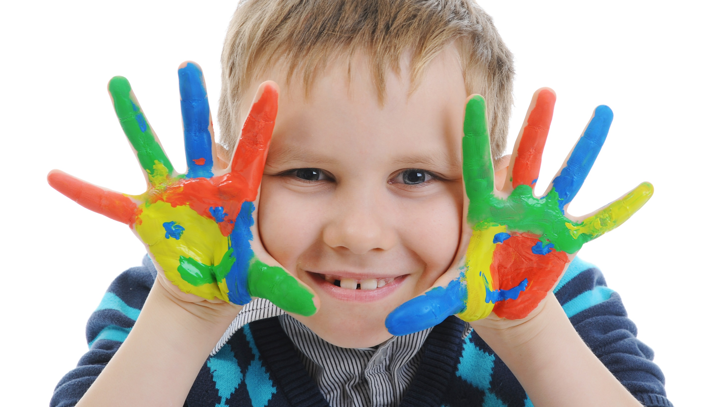
Enjoy your day!

