Slide 1


Unit 2: School
Lesson 1.2
Page 15

Slide 2
Lesson Outline
Warm-up
Practice
Production
Consolidation
Wrap-up

Slide 3
Objectives
By the end of this lesson, students will be able to identify classroom objects and say what school thing it is, using ….
Vocabulary: pencil, book, bag
Structure: It’s a (pencil).

Slide 4

WARM UP

Slide 5
Let’s sing!

Slide 6


Slide 7

It’s time to learn …

Slide 8

New words
Pencil,
Book,
Bag

Slide 9

Review

Slide 10

Let’s play!
Beanbag Circle Game
Notes:
Put some flashcards in a bag.
Have students sit in a circle.
They pass the bag around the circle while music plays in the background.
When the music stops, the person holding the “beanbag”, takes out a flashcard in the bag and say the sentence

Slide 11
Structures
It’s a (pencil).

Slide 12

Speaking

Slide 13

Let’s say!
pencil
It’s a pencil.

Slide 14

Let’s say!
book
It’s a book.

Slide 15

Let’s say!
bag
It’s a bag.

Slide 16

Practice

Slide 17

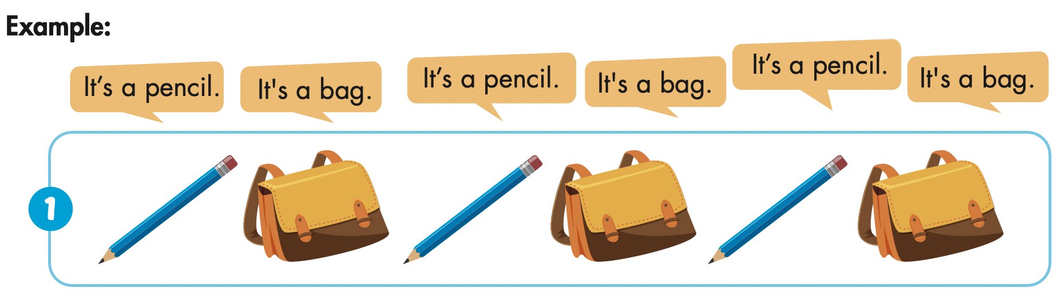

Slide 18


Slide 19


Slide 20


Slide 21

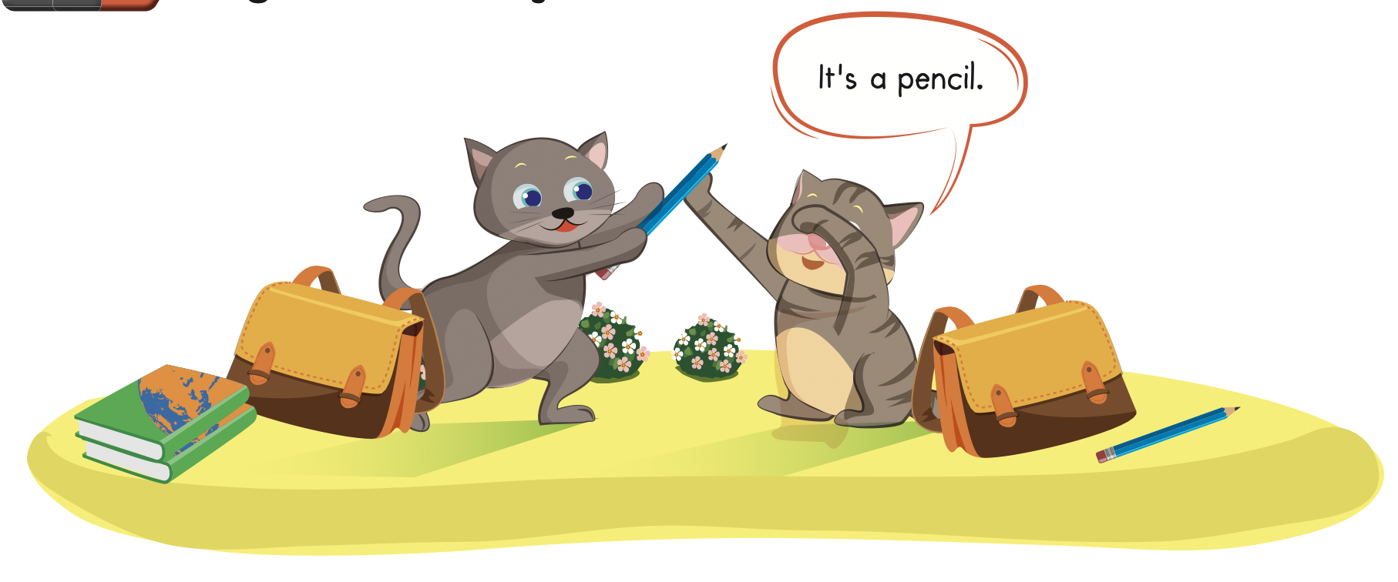

Slide 22

Production

Slide 23
Let’s play!
Read, look and choose

Slide 24

It’s a book.
It’s a bag.
It’s a pencil.

Slide 25
It’s a book.
It’s a bag.
It’s a pencil.

Slide 26
It’s a book.
It’s a pencil.
It’s a bag.

Slide 27
It’s a pencil.

Slide 28

It’s a bag.

Slide 29


Slide 30

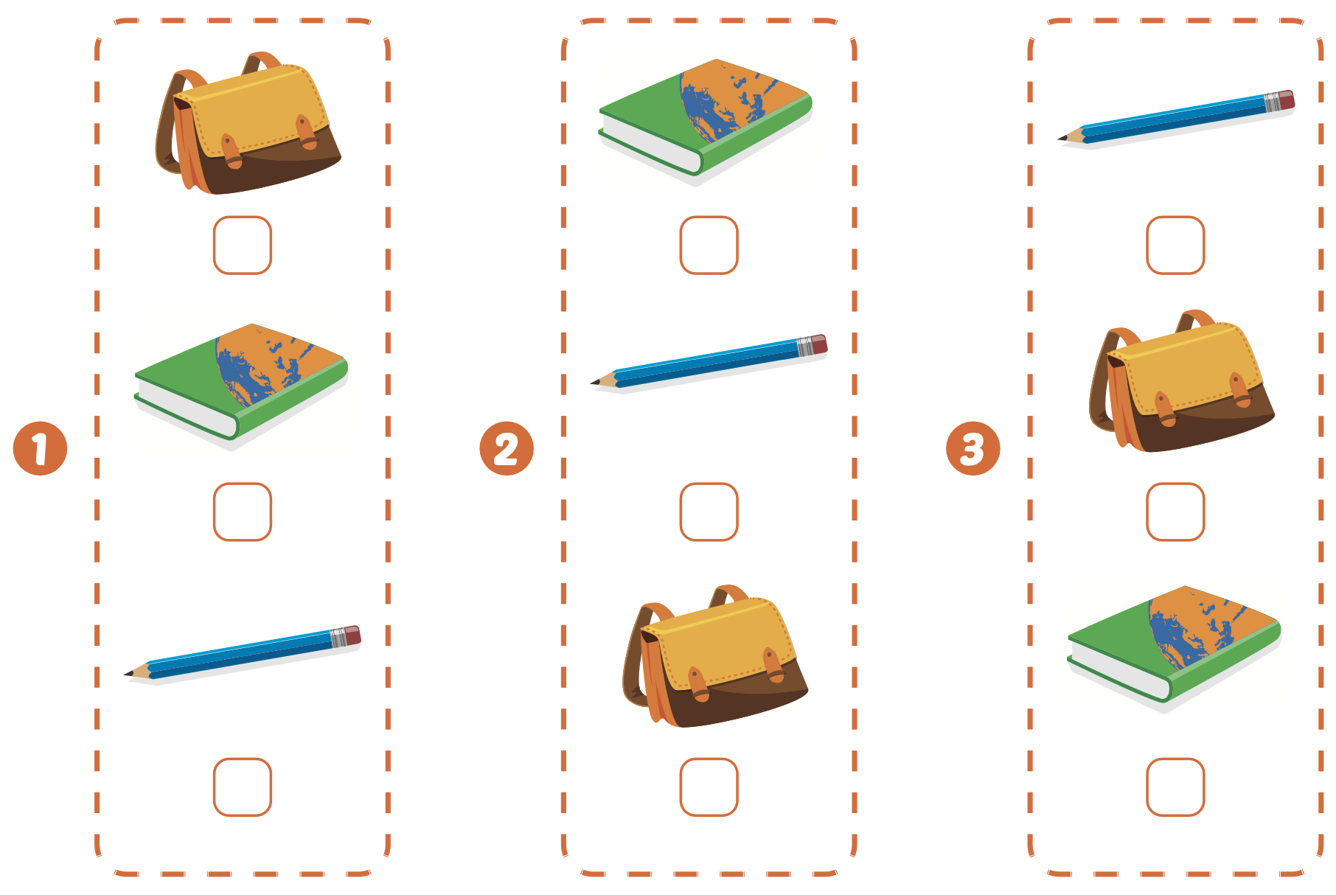

Extra Practice
WB, page 13

Slide 31
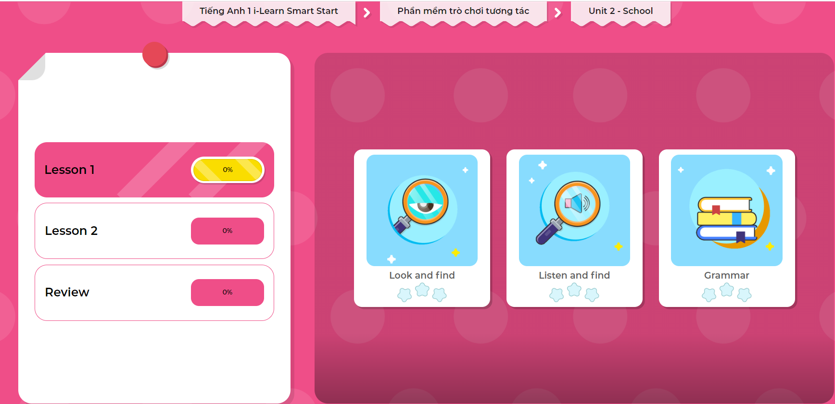
Extra Practice
DHA on Eduhome
LET’S PLAY!
Click on the picture below to play the games.

Slide 32

CONSOLIDATION

Slide 33
Let’s draw!
……………………………..
Notes:
Students draw and write: “It’s a (pencil).

Slide 34

WRAP-UP

Slide 35
Lesson 3
Today’s lesson
Vocabularies
Pencil,
Bag,
Book
Structures/ Sentence patterns
It’s a (pencil).

Slide 36
Lesson 3
Homework
Practice the vocabularies and structure, and make sentences using them.
Do the exercises in Tiếng Anh 1 i-Learn Smart Start WB (page 13).
Do the exercises in Tiếng Anh 1 i-Learn Smart Start Notebook (page 11).
Prepare the next lesson (page 16 SB)
Play the consolidation games in Tiếng Anh 1 i-Learn Smart Start DHA App on www.eduhome.com.vn

Slide 37

Enjoy your day!

Slide 38
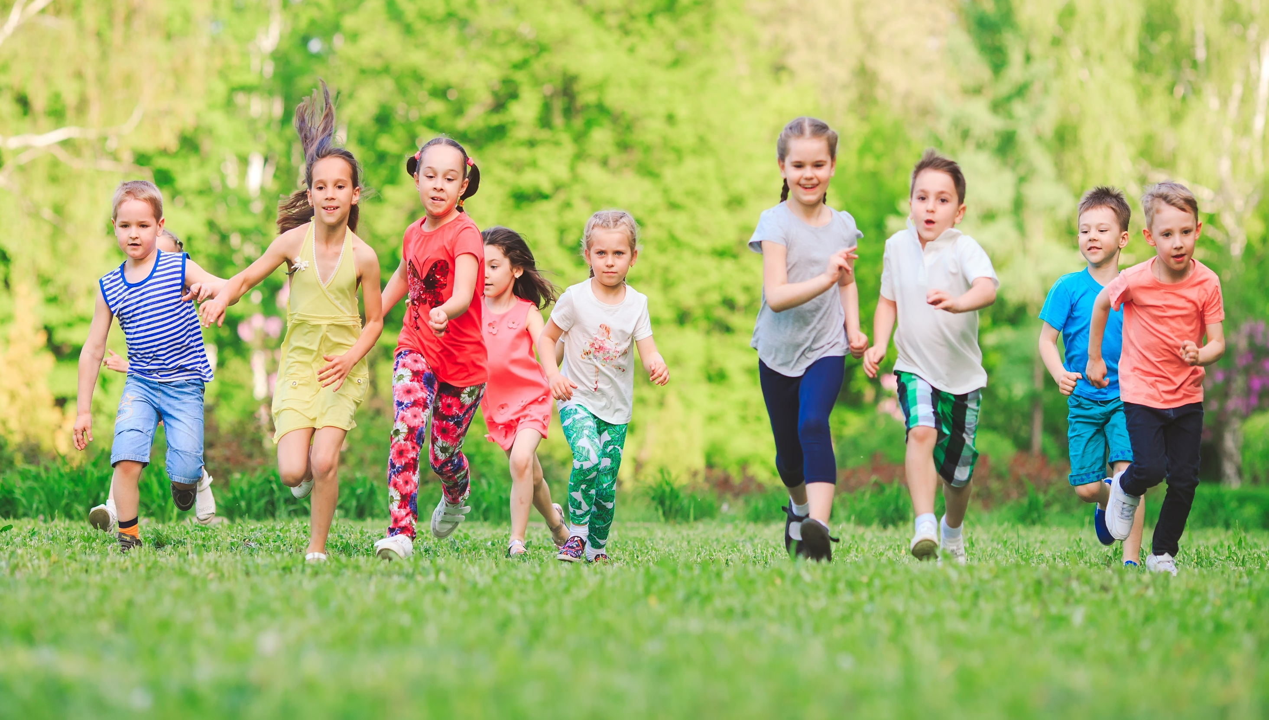
Have a nice day!

