Slide 1


Unit 2: School
Lesson 2.1
Page 16

Slide 2
Lesson Outline
Warm-up
Listening
Consolidation
Wrap-up

Slide 3
Objectives
By the end of this lesson, students will be able to recognize the /k/ sound and pronounce it correctly.
Vocabulary: C, cap
Phonic: /k/

Slide 4

WARM UP

Slide 5
Let’s sing!

Slide 6


Slide 7

It’s time to learn …

Slide 8

Phonics
/k /

Slide 9

Presentation

Slide 10

Click the icon to hear the sound.

Slide 11


Click the icon to hear the sound.
C, c
/ k /

Slide 12
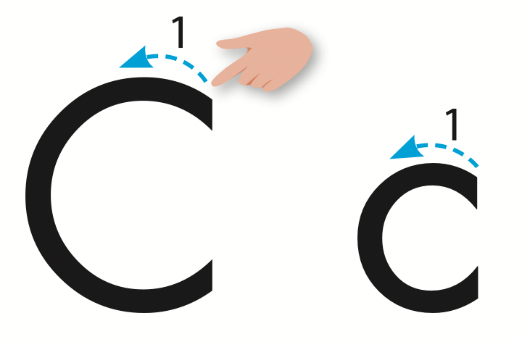
Let’s trace!

Slide 13

Practice

Slide 14

Listening

Slide 15



Click the icon to hear the sound.

Slide 16
Click the picture to hear the sound.
cap
/kæp/
mũ lưỡi trai

Slide 17

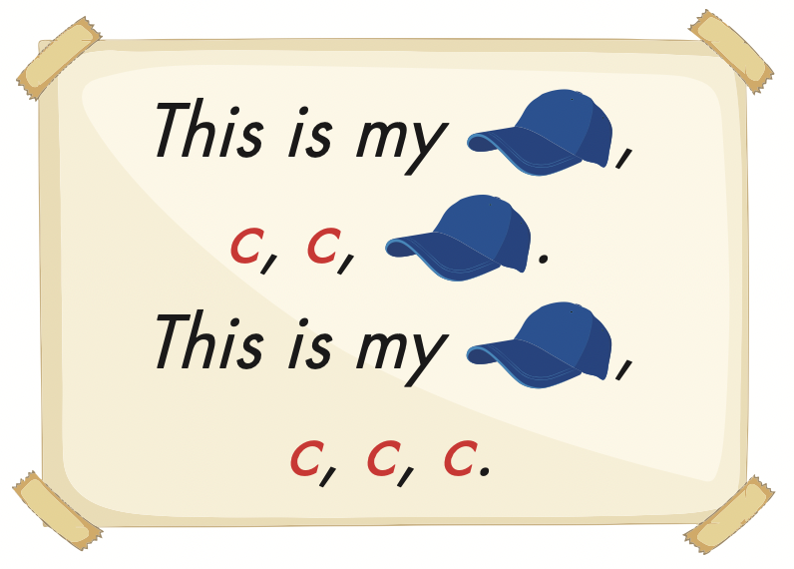
Click the icon to hear the sound.

Slide 18

Production

Slide 19



Slide 20
Let’s play!
Listen and choose

Slide 21


/k/
C
cap

Slide 22
/k/
C
cap

Slide 23
/k/
C
cap

Slide 24


Slide 25

CONSOLIDATION

Slide 26
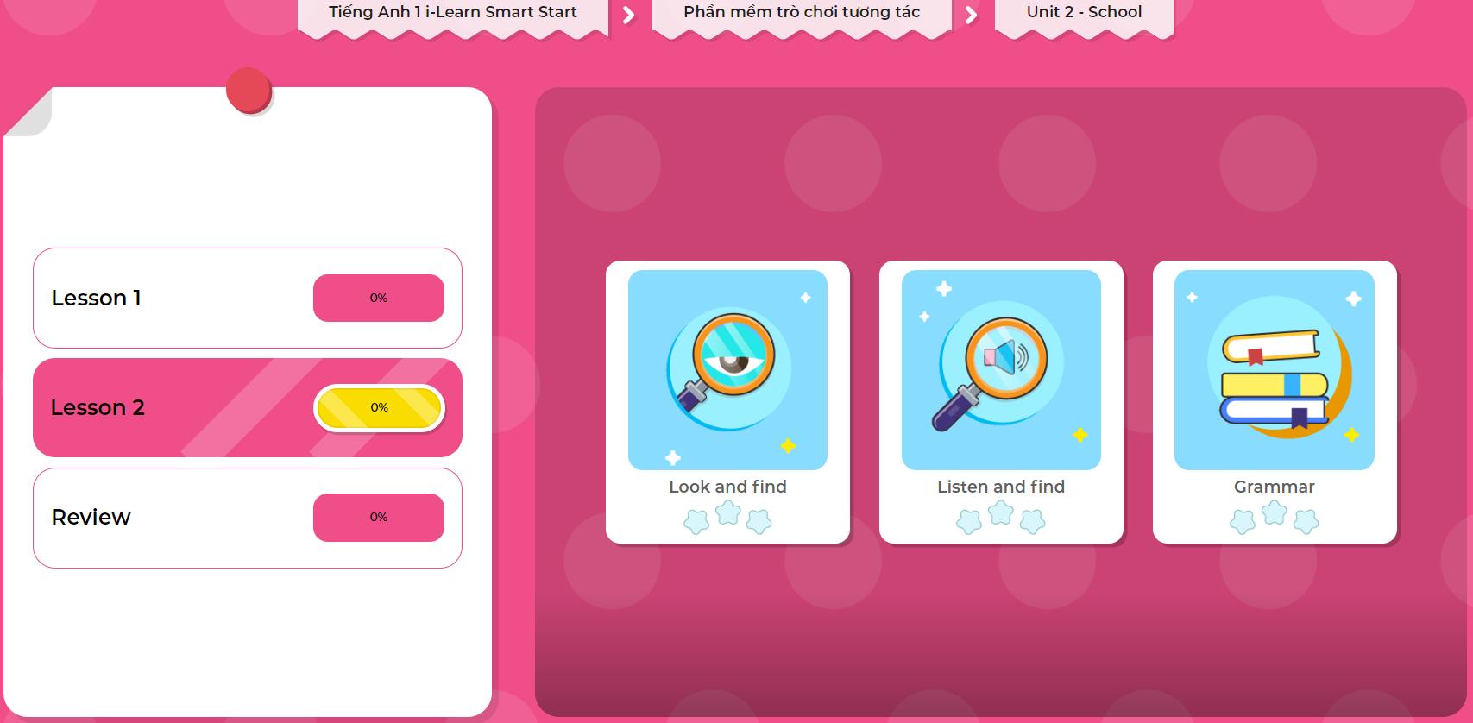
Extra Practice
DHA on Eduhome
LET’S PLAY!
Click on the picture below to play the games.

Slide 27

WRAP-UP

Slide 28
Lesson 3
Today’s lesson
Vocabularies
cap
Phonics
/ k /

Slide 29
Lesson 3
Homework
Practice the /k/ sound.
Do the exercises in Tiếng Anh 1 i-Learn Smart Start Notebook (page 12).
Prepare the next lesson (page 17 SB)
Play the consolidation games in Tiếng Anh 1 i-Learn Smart Start DHA App on www.eduhome.com.vn

Slide 30

Enjoy your day!

Slide 31

Have a nice day!

