Slide 1


Unit 2: School
Lesson 2.2
Page 17

Slide 2
Lesson Outline
Warm-up
Listening
Consolidation
Wrap-up

Slide 3
Objectives
By the end of this lesson, students will be able to recognize the /d / sound and pronounce it correctly.
Vocabulary: door
Phonic: /d /

Slide 4

WARM UP

Slide 5
Let’s sing!

Slide 6


Click the icon to hear the sound.

Slide 7

It’s time to learn …

Slide 8

Phonics
/d/

Slide 9

Presentation

Slide 10

Click the icon to hear the sound.

Slide 11


Click the icon to hear the sound.
D, d
/ d /

Slide 12
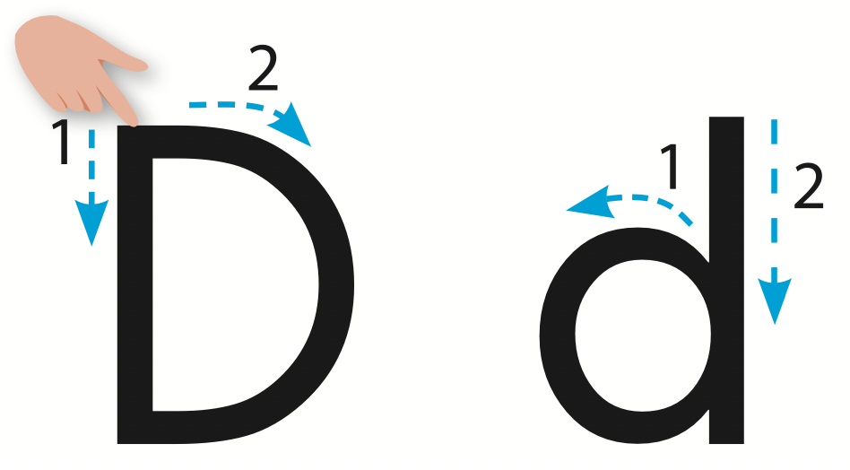
Let’s trace!

Slide 13

Practice

Slide 14

Listening

Slide 15

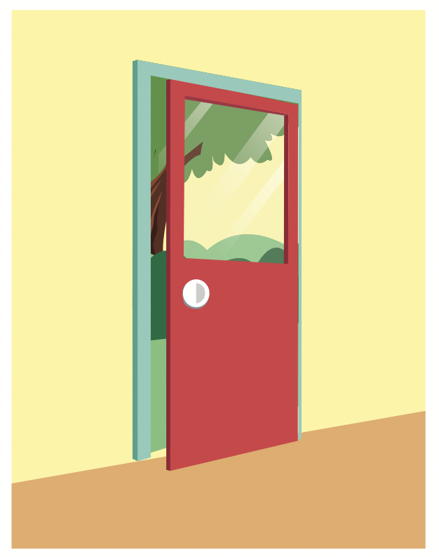

Click the icon to hear the sound.

Slide 16
Click the picture to hear the sound.
door
/dɔːr/
cánh cửa

Slide 17

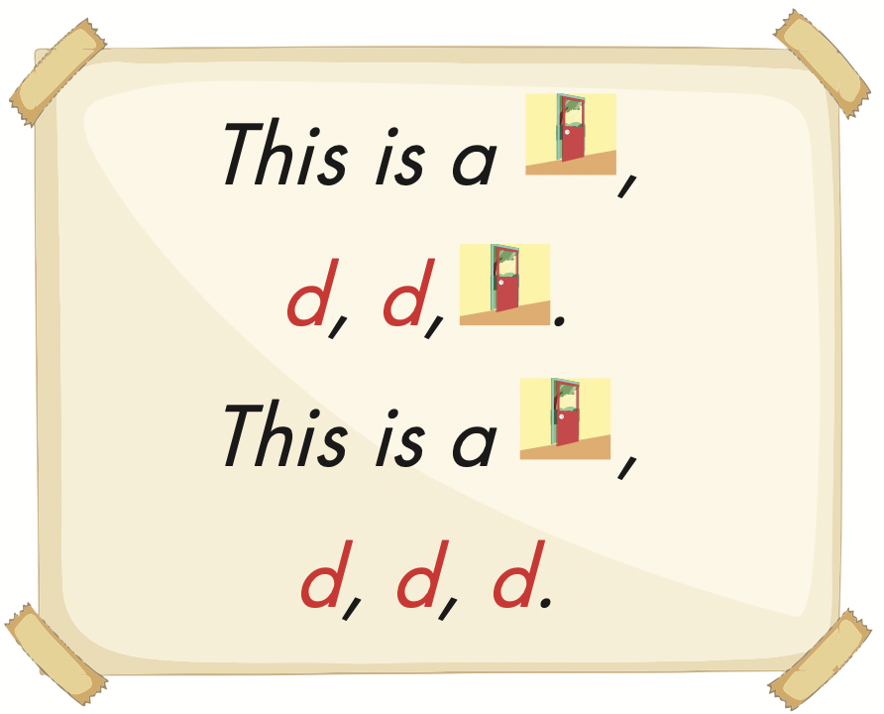
Click the icon to hear the sound.

Slide 18


Click the icon to hear the sound.

Slide 19

Production

Slide 20
Let’s play!
Listen and choose

Slide 21


/k/
/d/
/b/

Slide 22
/d/
/k/
/b/

Slide 23
C
B
D

Slide 24
B
C
D

Slide 25
Bag
Cap
Door

Slide 26

Bag
Cap
Door

Slide 27


Slide 28
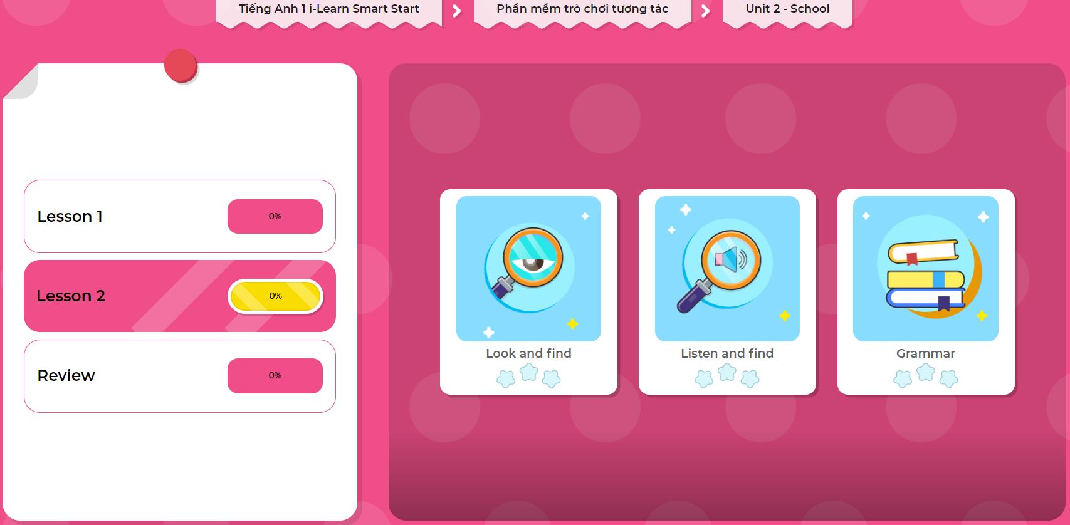
Extra Practice
DHA on Eduhome
LET’S PLAY!
Click on the picture below to play the games.

Slide 29

CONSOLIDATION

Slide 30
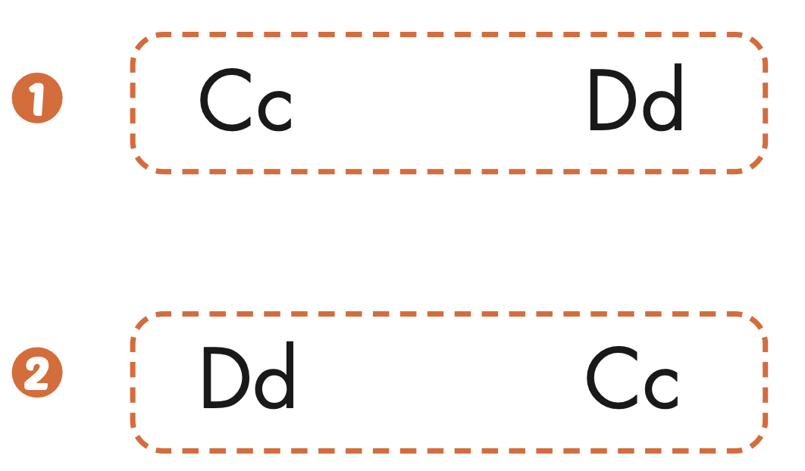
Extra Practice
WB, page 15
Click the icon to hear the sound.

Slide 31

WRAP-UP

Slide 32
Today’s lesson
Vocabularies
door
Phonics
/ d /

Slide 33
Lesson 3
Homework
Practice the /d/ sound.
Do the exercises in Tiếng Anh 1 i-Learn Smart Start WB (pages 14, 15).
Do the exercises in Tiếng Anh 1 i-Learn Smart Start Notebook (page 13).
Prepare the next lesson (page 18 SB)
Play the consolidation games in Tiếng Anh 1 i-Learn Smart Start DHA App on www.eduhome.com.vn

Slide 34

Enjoy your day!

Slide 35

Have a nice day!

