Slide 1


Unit 5: Animals
Lesson 3.2
Page 37

Slide 2
Objectives
By the end of this lesson, students will be able to apologize.
Structure: I’m sorry.
That’s OK.

Slide 3
Lesson Outline
Warm-up
Vocabulary
Structure
Consolidation
Wrap-up

Slide 4

WARM-UP

Slide 5
Let’s play!

Slide 6
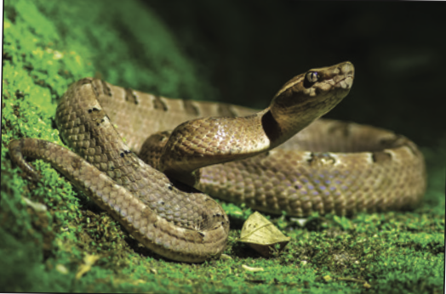
snake
SHOW

Slide 7
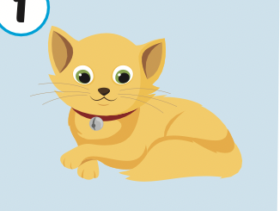
cat
SHOW

Slide 8
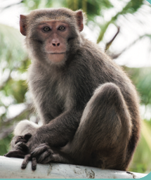
monkey
SHOW

Slide 9
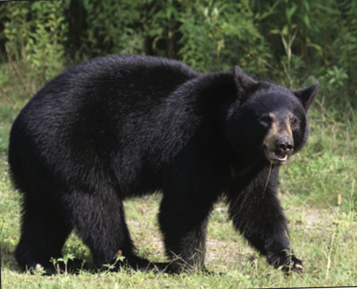
bear
SHOW

Slide 10


Slide 11

It’s time to learn …

Slide 12

Structures
I’m sorry.
That’s OK.

Slide 13

Presentation

Slide 14
Look at the picture and answer these questions.

Slide 15
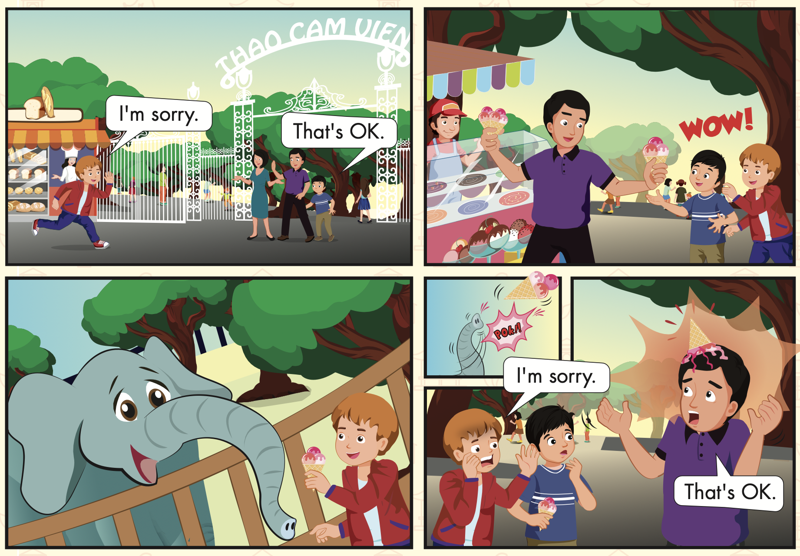
How many people?
Who can you see?
Where are they?

Slide 16

Listening

Slide 17


Slide 18

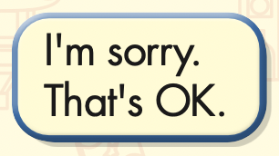

Slide 19

Practice

Slide 20

Speaking

Slide 21
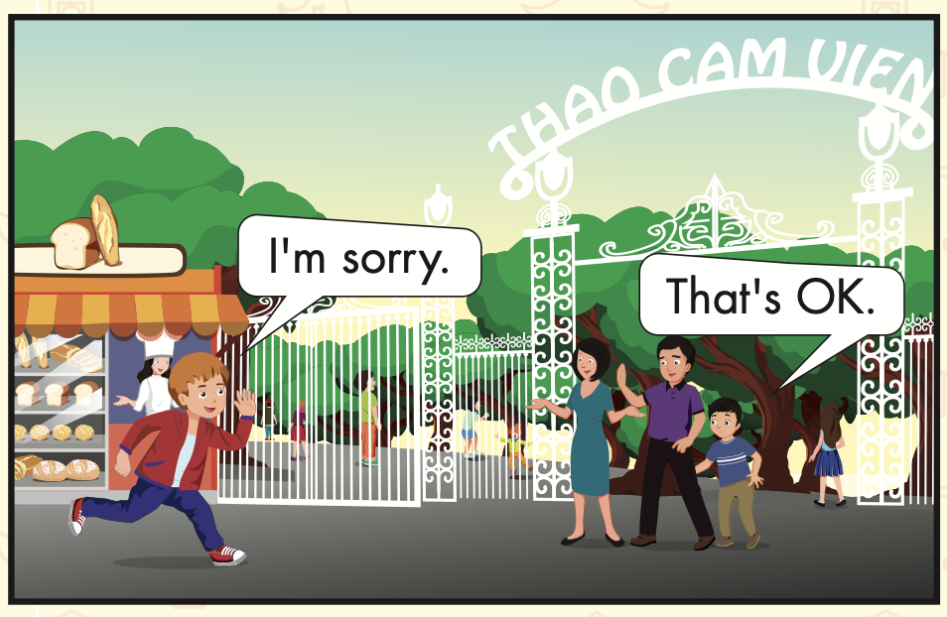
Let’s say!
I’m sorry.
That’s OK.

Slide 22
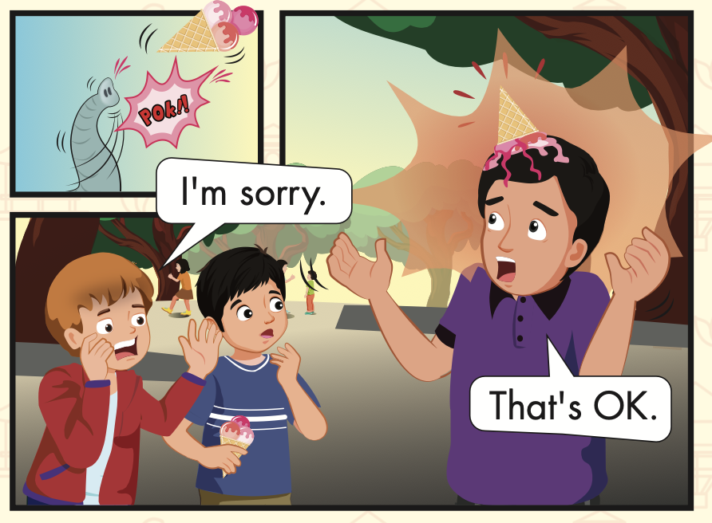
Let’s say!
I’m sorry.
That’s OK.

Slide 23

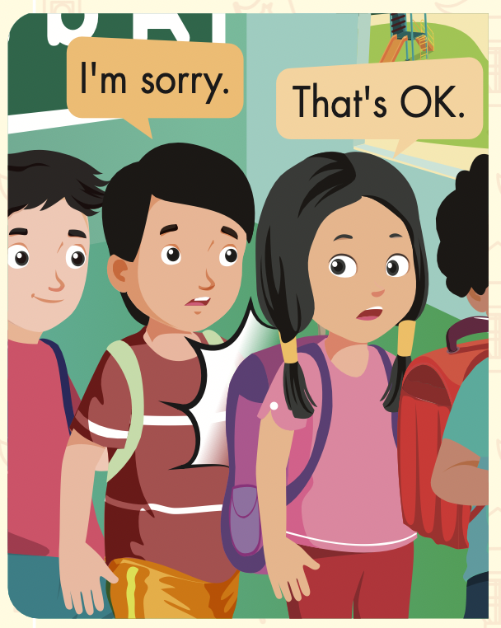

Slide 24
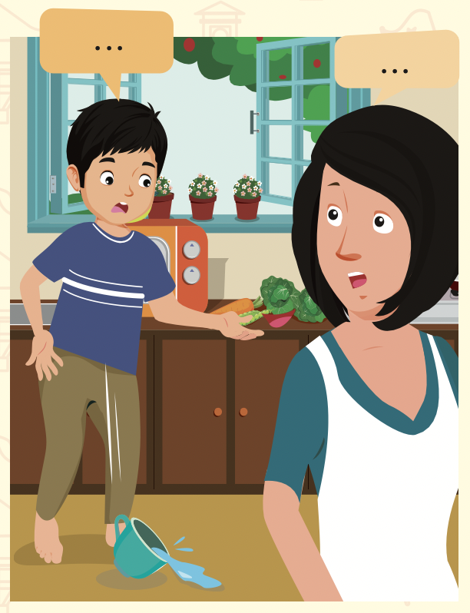
I’m sorry.
That’s OK.

Slide 25
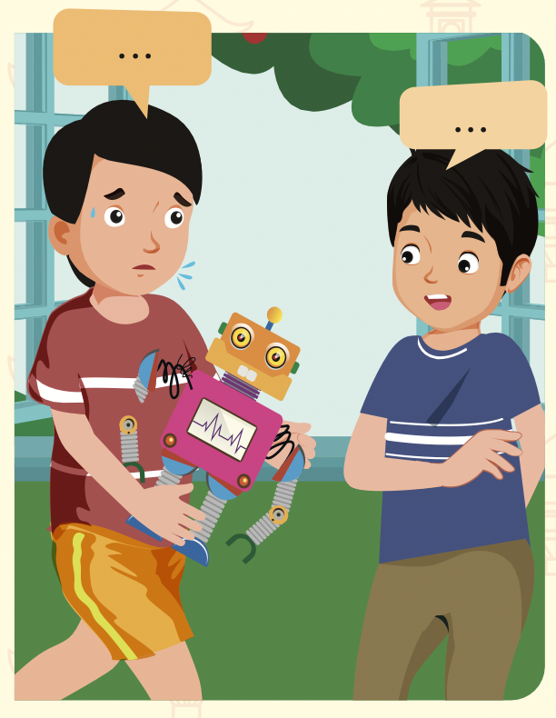
I’m sorry.
That’s OK.

Slide 26

Production

Slide 27
Let’s demonstrate!

Slide 28

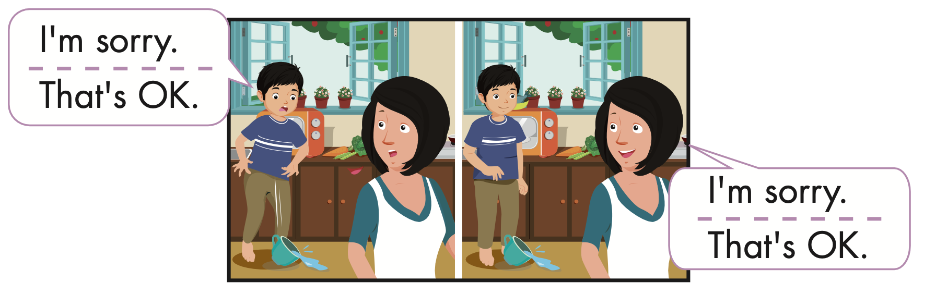
Extra Practice
WB, page 35

Slide 29

CONSOLIDATION

Slide 30
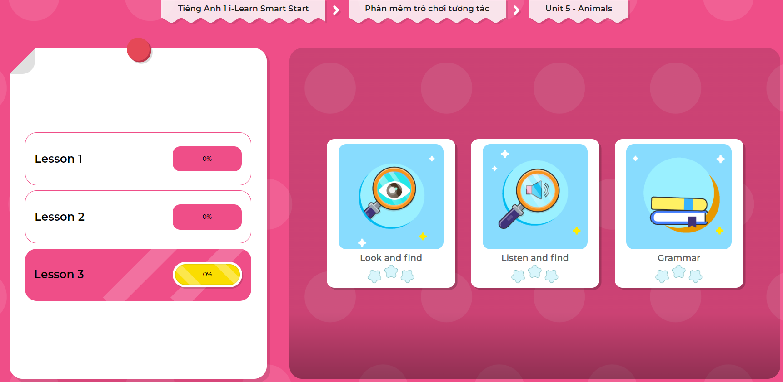
Extra Practice
DHA on Eduhome
LET’S PLAY!
Click on the picture below to play the games.

Slide 31

Let’s play!
Greetings Mingle Game

Slide 32

WRAP-UP

Slide 33
Today’s lesson
Vocabularies
Monkey,
Snake,
Bear.
Structures/ Sentence patterns
I’m sorry.
That’s OK.

Slide 34
Homework
Practice the vocabularies and structure; and make sentences using them.
Do the exercises in Tiếng Anh 1 i-Learn Smart Start WB (page 35).
Do the exercises in Tiếng Anh 1 i-Learn Smart Start Notebook (page 29).
Prepare the next lesson (page 38 SB) Play the consolidation games in Tiếng Anh 1 i-Learn Smart Start DHA App on www.eduhome.com.vn

Slide 35
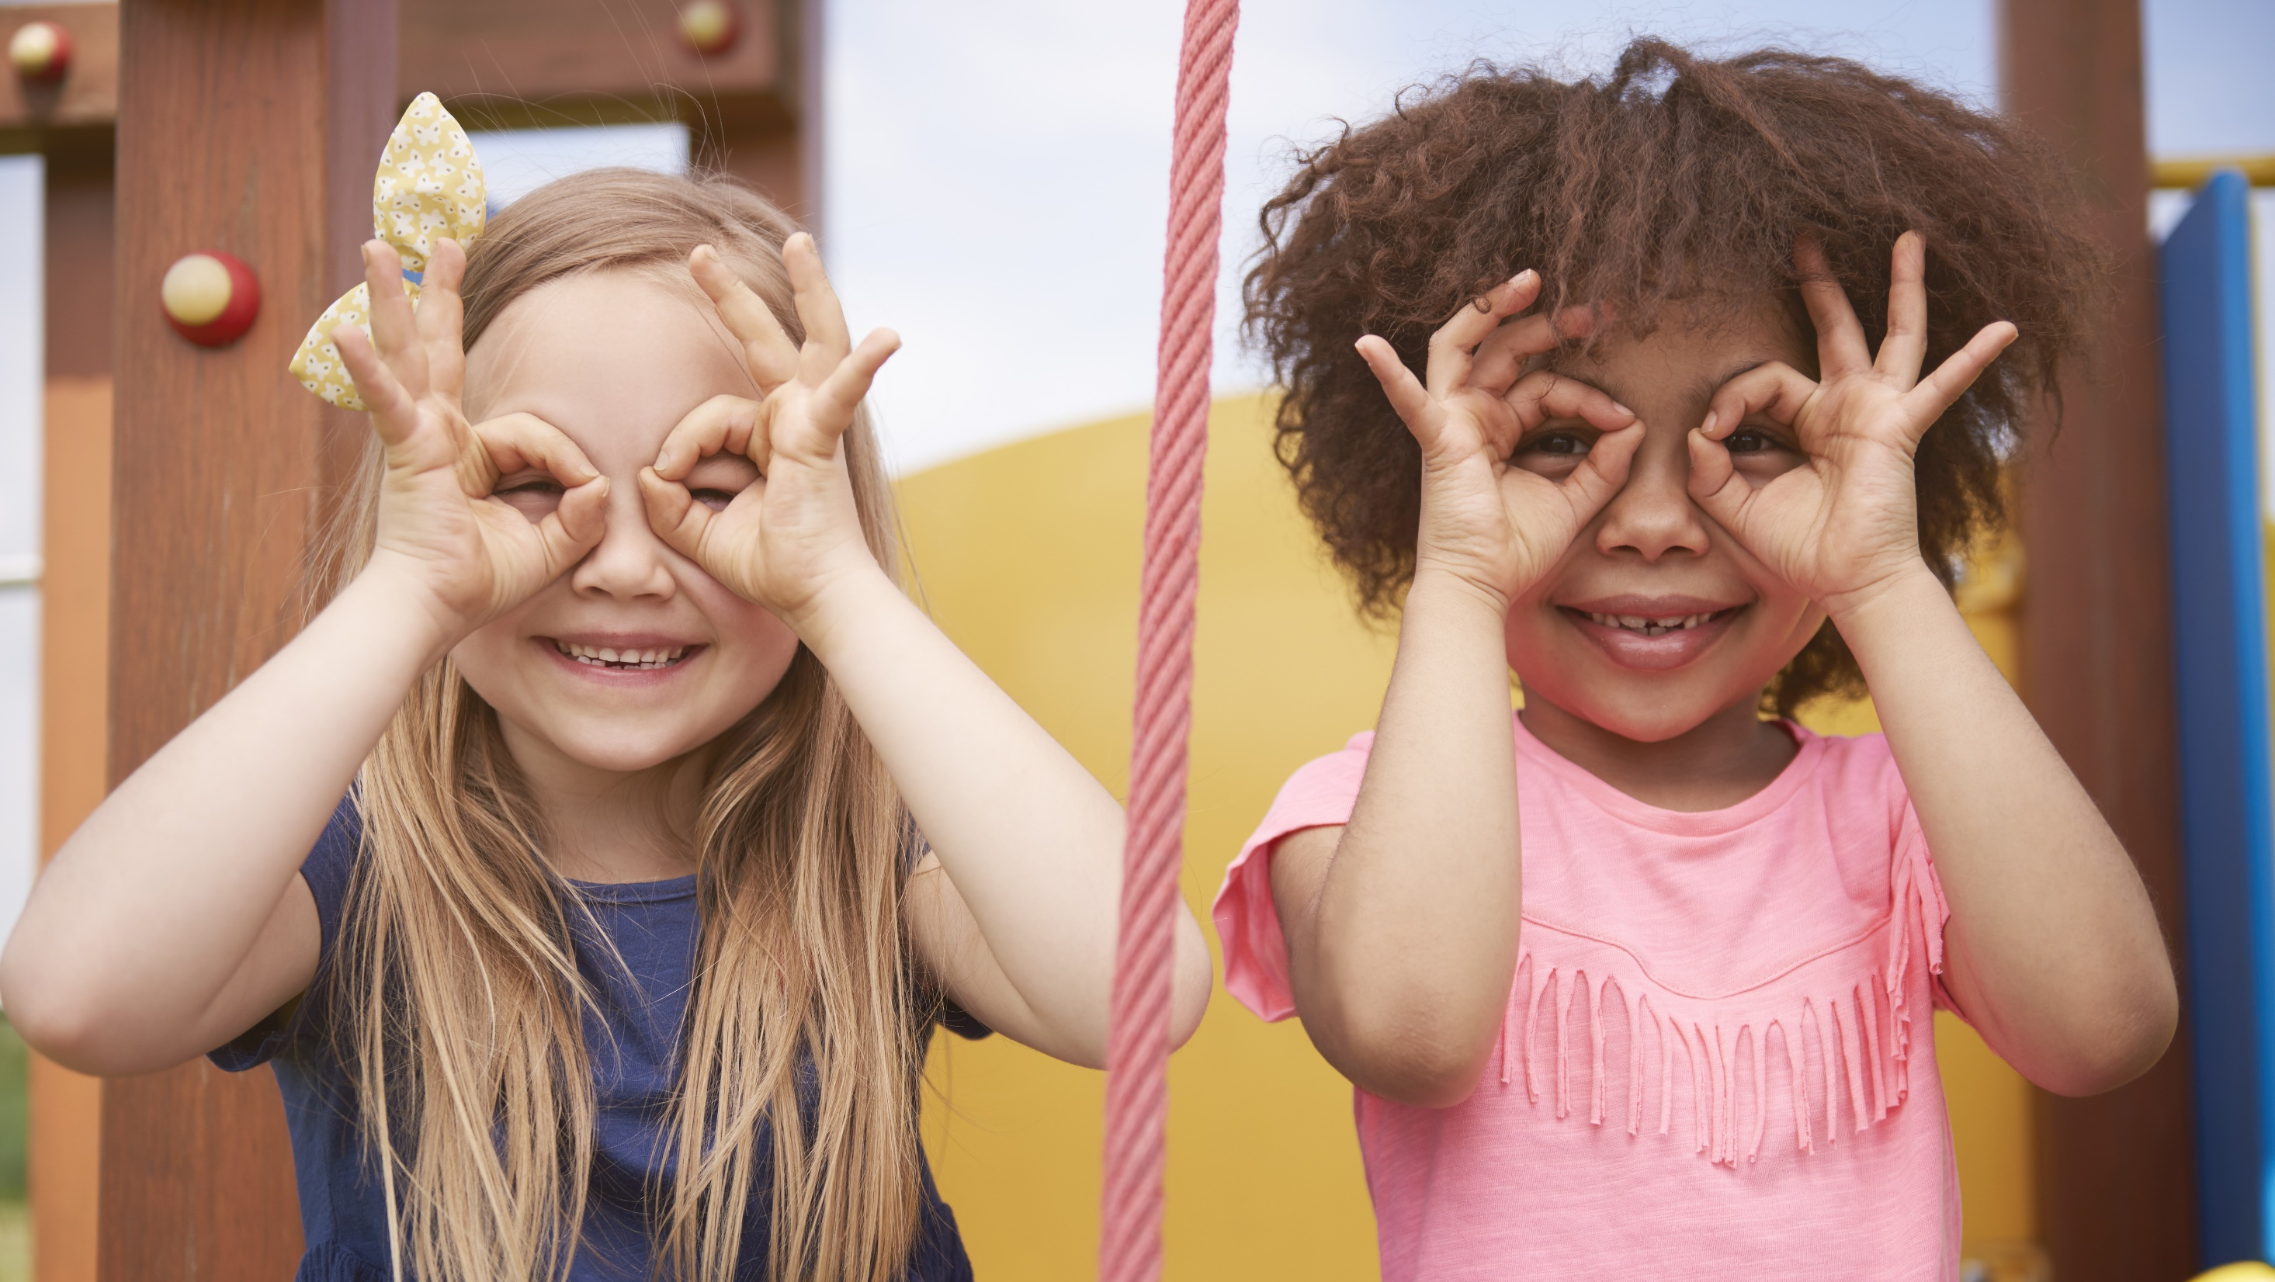
Enjoy your day!

