Slide 1


Unit 6: Activities
Lesson 2.1
Page 40

Slide 2
Objectives
By the end of this lesson, students will review the /e/ and /f/ sounds and pronounce them correctly.
Vocabulary: elephant, food
Phonic: / e /, / f /

Slide 3
Lesson Outline
Warm-up
Listening
Consolidation
Wrap-up

Slide 4

WARM-UP

Slide 5
Let’s sing!

Slide 6


Slide 7

It’s time to learn …

Slide 8


Slide 9

Review

Slide 10

Phonics
/ e /,
/ f /.

Slide 11

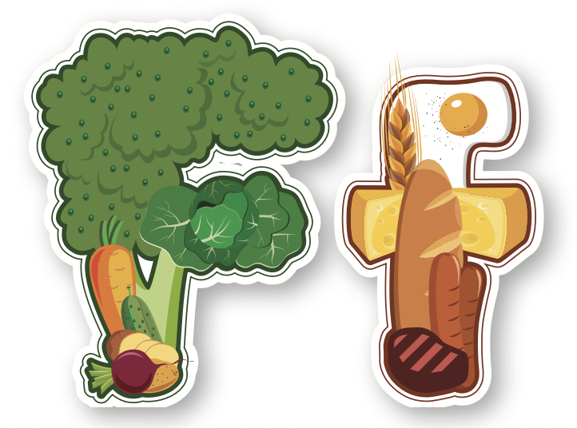

/ e /
/ f /

Slide 12

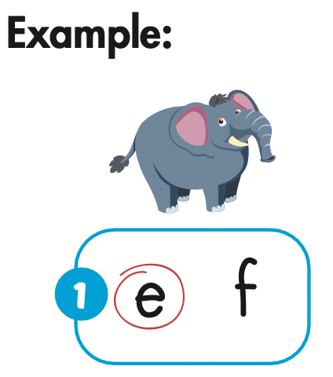
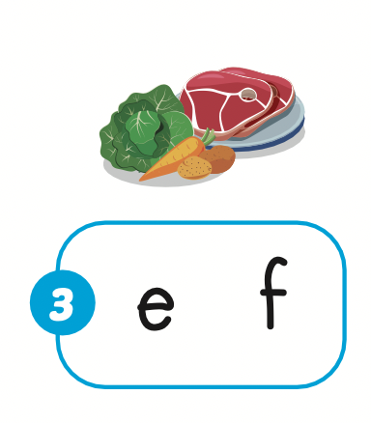
elephant
food
/ˈel.ə.fənt/
/fuːd/

Slide 13

Practice

Slide 14

Listening

Slide 15



Slide 16
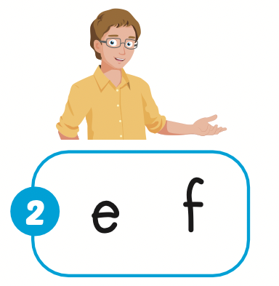

Slide 18
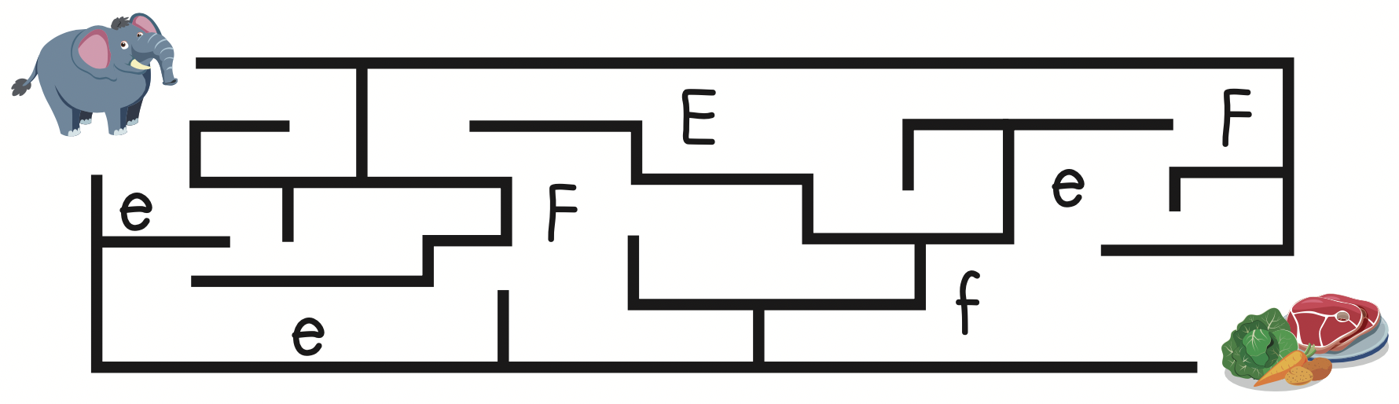

Slide 19

Production

Slide 20
Let’s play!
Listen and choose

Slide 21


food
elephant
father

Slide 22
/ g /
/ e /
/ f /

Slide 23
/ g /
/ e /
/ f /

Slide 24
father
food
elephant

Slide 25


Slide 26
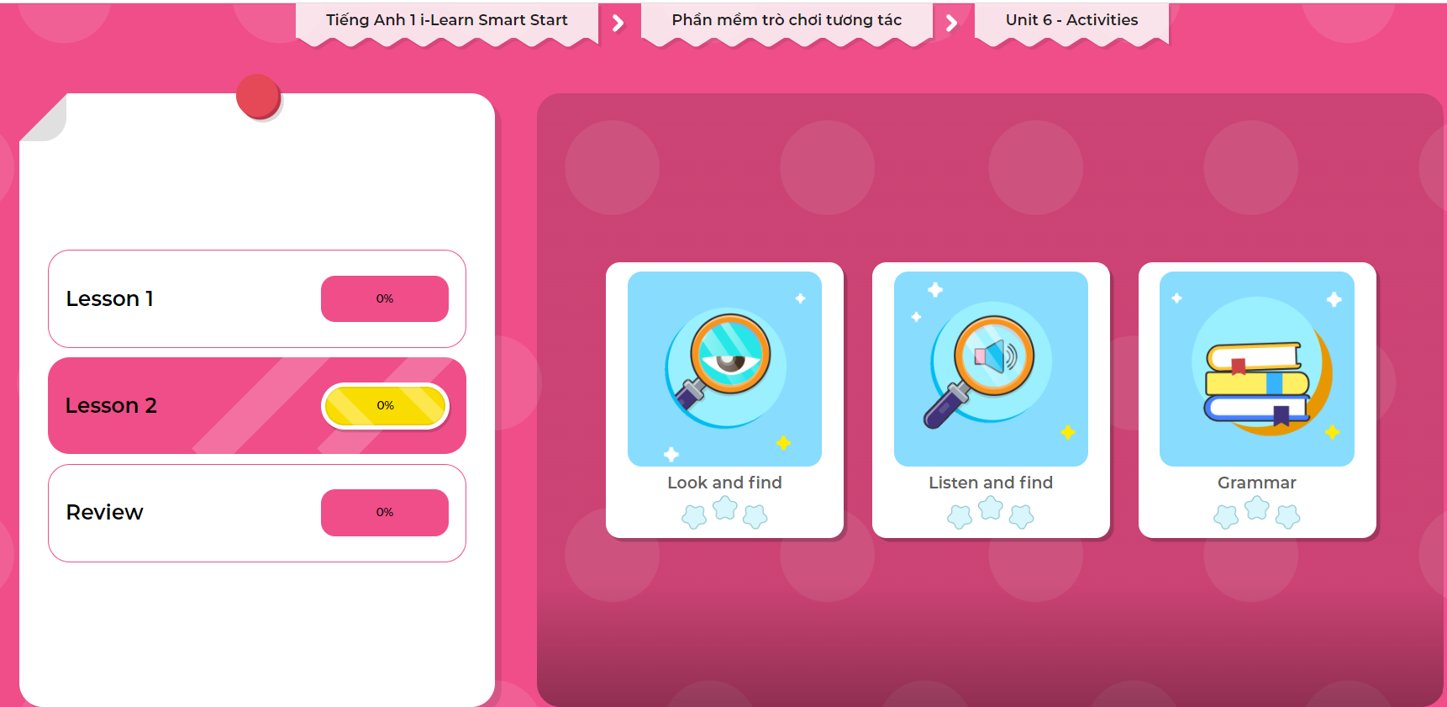
Extra Practice
DHA on Eduhome
Click on the picture below to play the games.
LET’S PLAY!

Slide 27

CONSOLIDATION

Slide 28

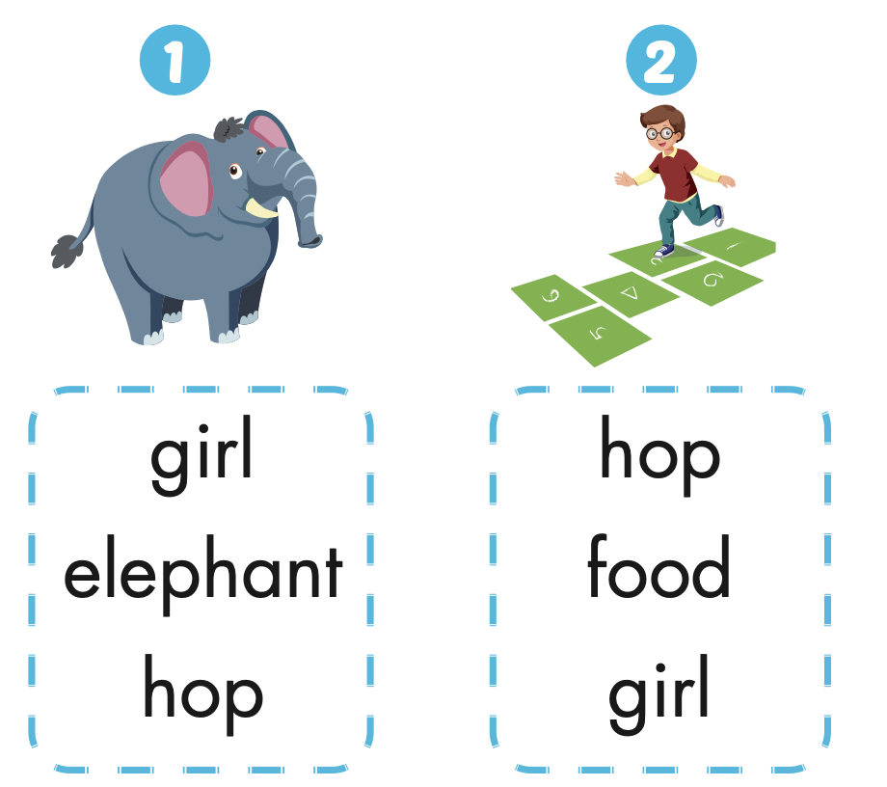
Extra Practice
WB, page 38

Slide 29
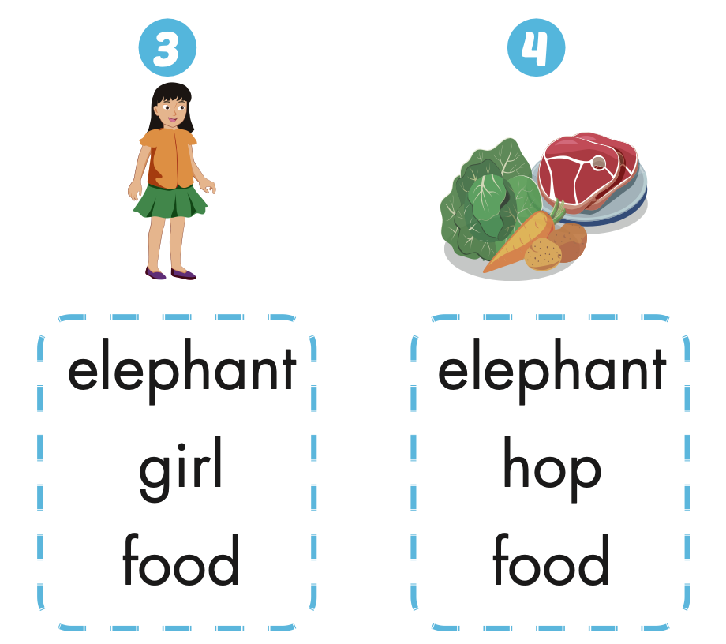

Slide 30

Let’s play!
Read my lips

Slide 31

WRAP-UP

Slide 32
Today’s lesson
Vocabularies
Elephant,
Food.
Phonics
/ e /, / f /

Slide 33
Homework
Practice saying the sounds.
Do the exercises in Tiếng Anh 1 i-Learn Smart Start WB (page 38).
Do the exercises in Tiếng Anh 1 i-Learn Smart Start Notebook (page 40).
Prepare the next lesson (page 41 SB).
Play the consolidation games in Tiếng Anh 1 i-Learn Smart Start DHA App on www.eduhome.com.vn

Slide 34

Enjoy your day!

