Slide 1


Unit 7: Numbers
Lesson 1.1: Vocabulary & Sentence Patterns
Page: 44

Slide 2
Objectives
By the end of this lesson, students will be able to gain the following:
Vocabulary:
one, two, three
Skills:
Identify and use vocabulary about numbers.

Slide 3
Lesson Outline
Warm-up
Vocabulary
Structure
Practice
Consolidation
Wrap-up

Slide 4

WARM-UP

Slide 5

one
two
four
five
next

Slide 6

twelve
three
two
eight
next

Slide 7

two
one
four
three
next

Slide 8

It’s time to learn …

Slide 9

New words
one, two, three

Slide 10

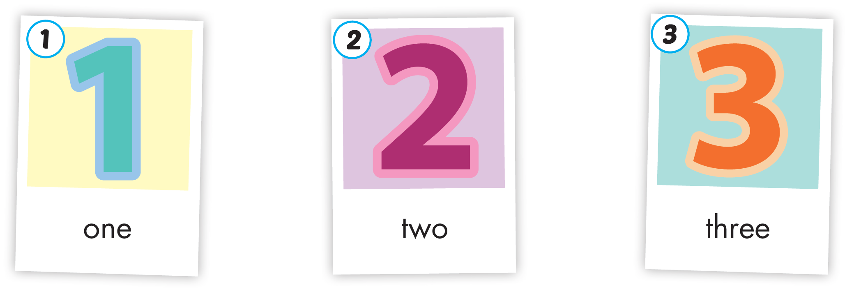

Slide 11







/wʌn/
số một
/tuː/
số hai
/θriː/
số ba

Slide 12

/wʌn/
số một

Slide 13

/tuː/
số hai

Slide 14

/θriː/
số ba

Slide 15

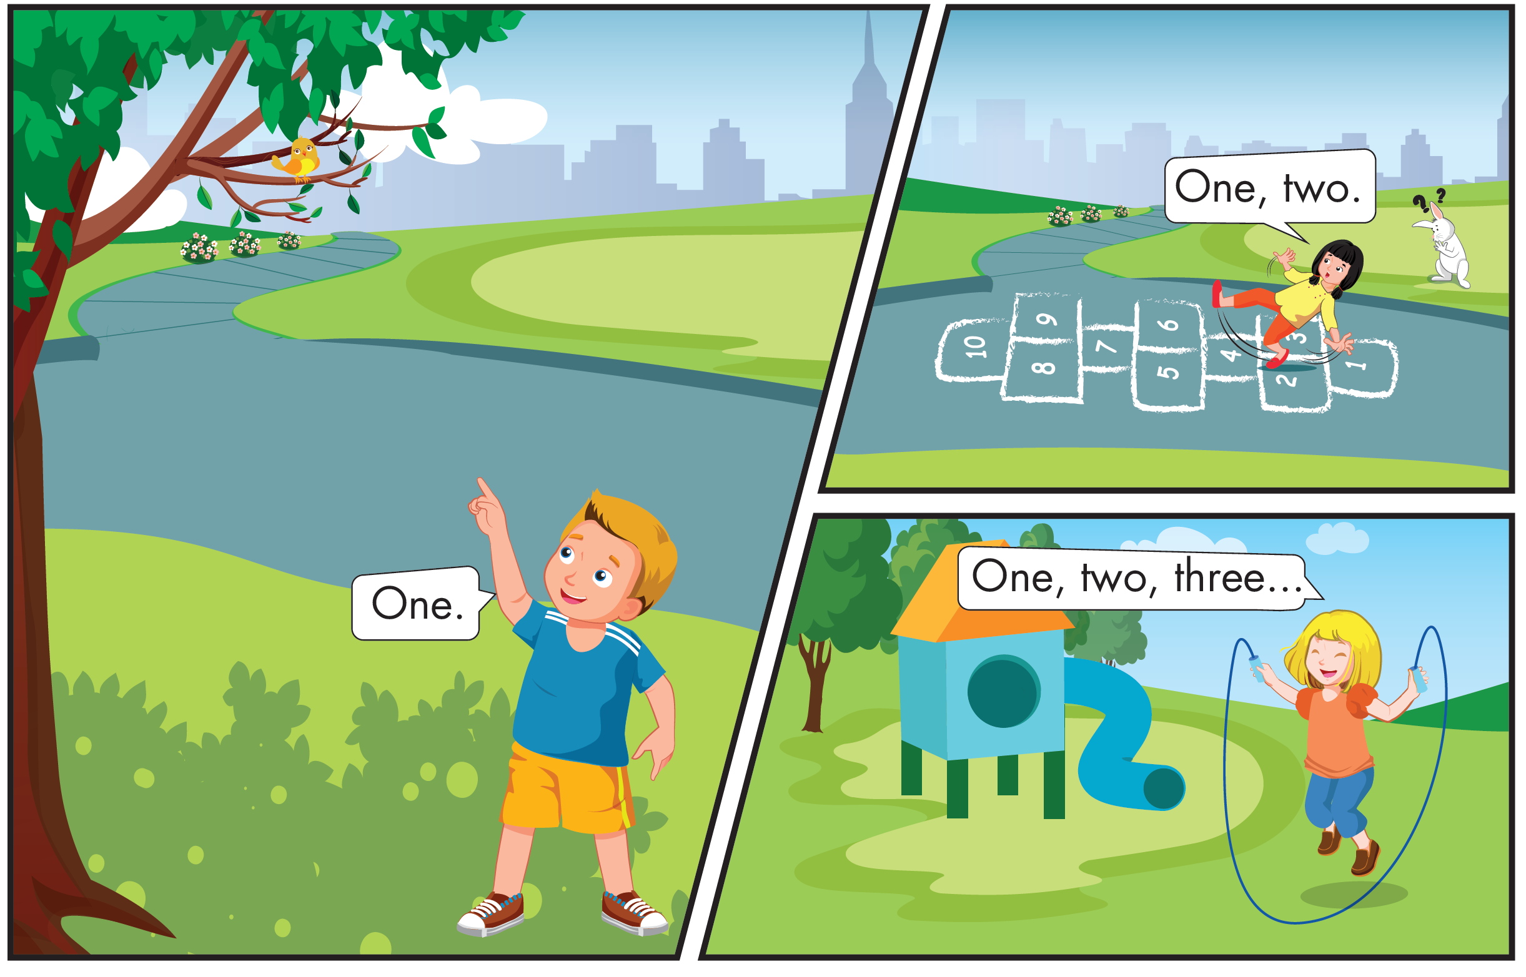
Who are they?

Slide 16
What are they doing?

Slide 18

Practice

Slide 19


One.
One.
One.
One.
One, two.
One, two.
One, two.
One, two.
One, two, three.
One, two, three.
One, two, three.
One, two, three.

Slide 20
It’s time to play …

Slide 21






How many bears?

Slide 22

How many snakes?

Slide 23

How many cats?

Slide 24
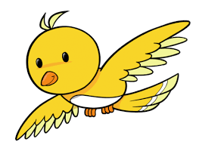
How many birds?

Slide 25

How many monkeys?

Slide 26
How many dogs?

Slide 27

Further Practice

Slide 28

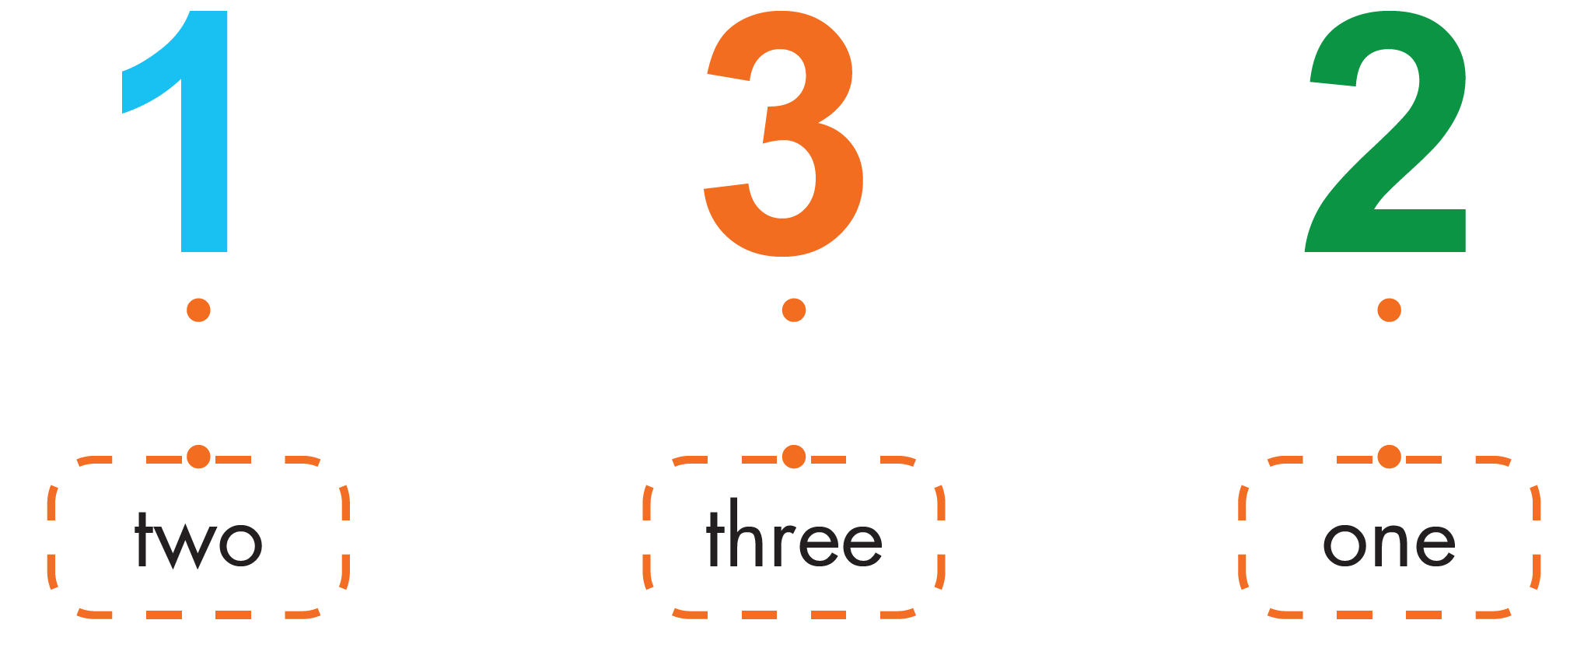

Slide 29

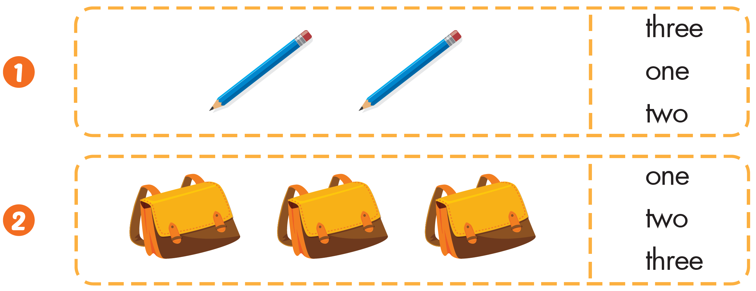


Slide 30
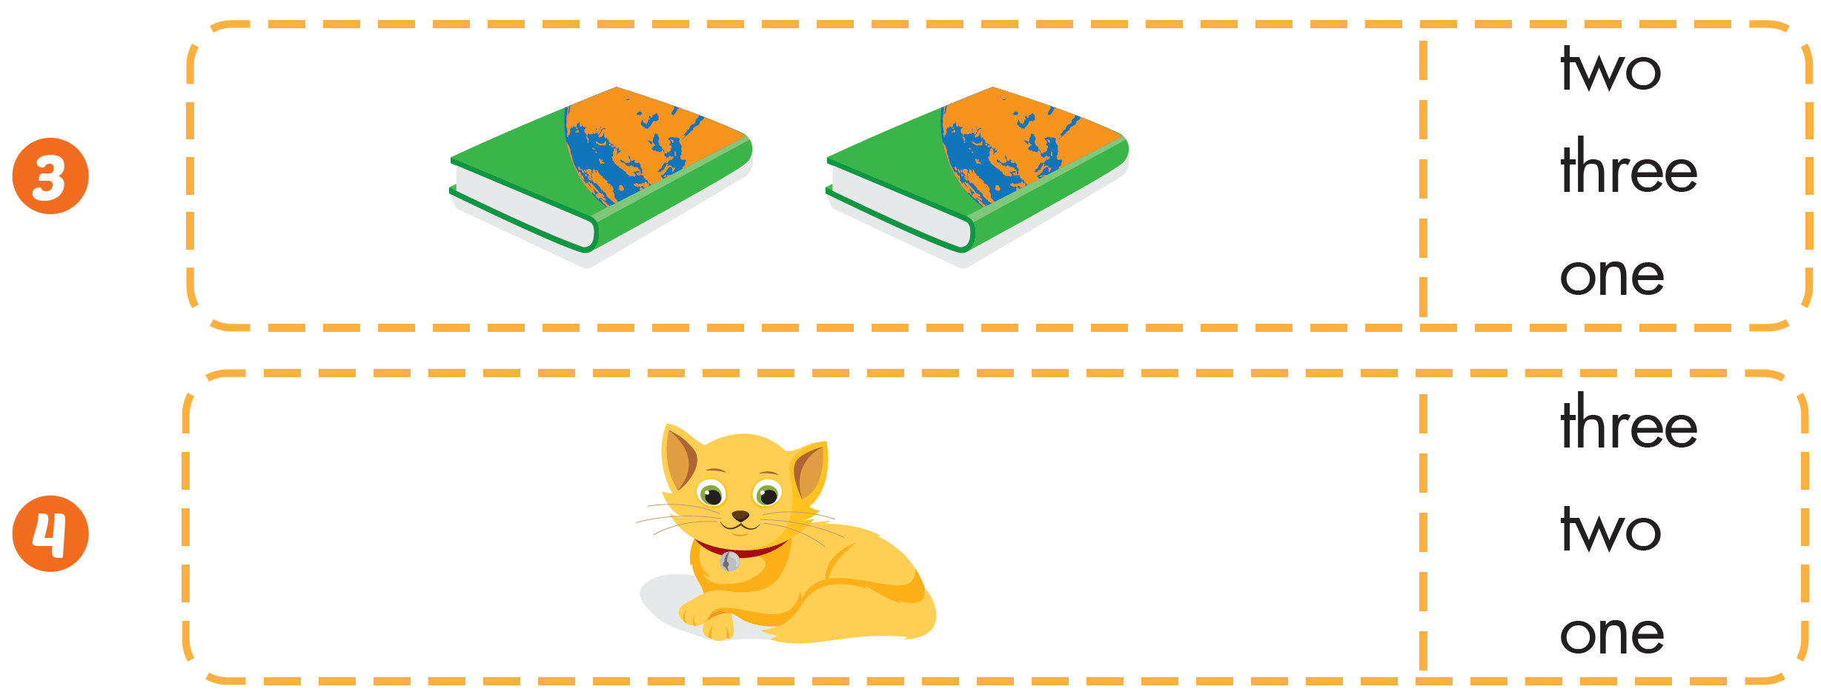

Slide 31

CONSOLIDATION

Slide 32
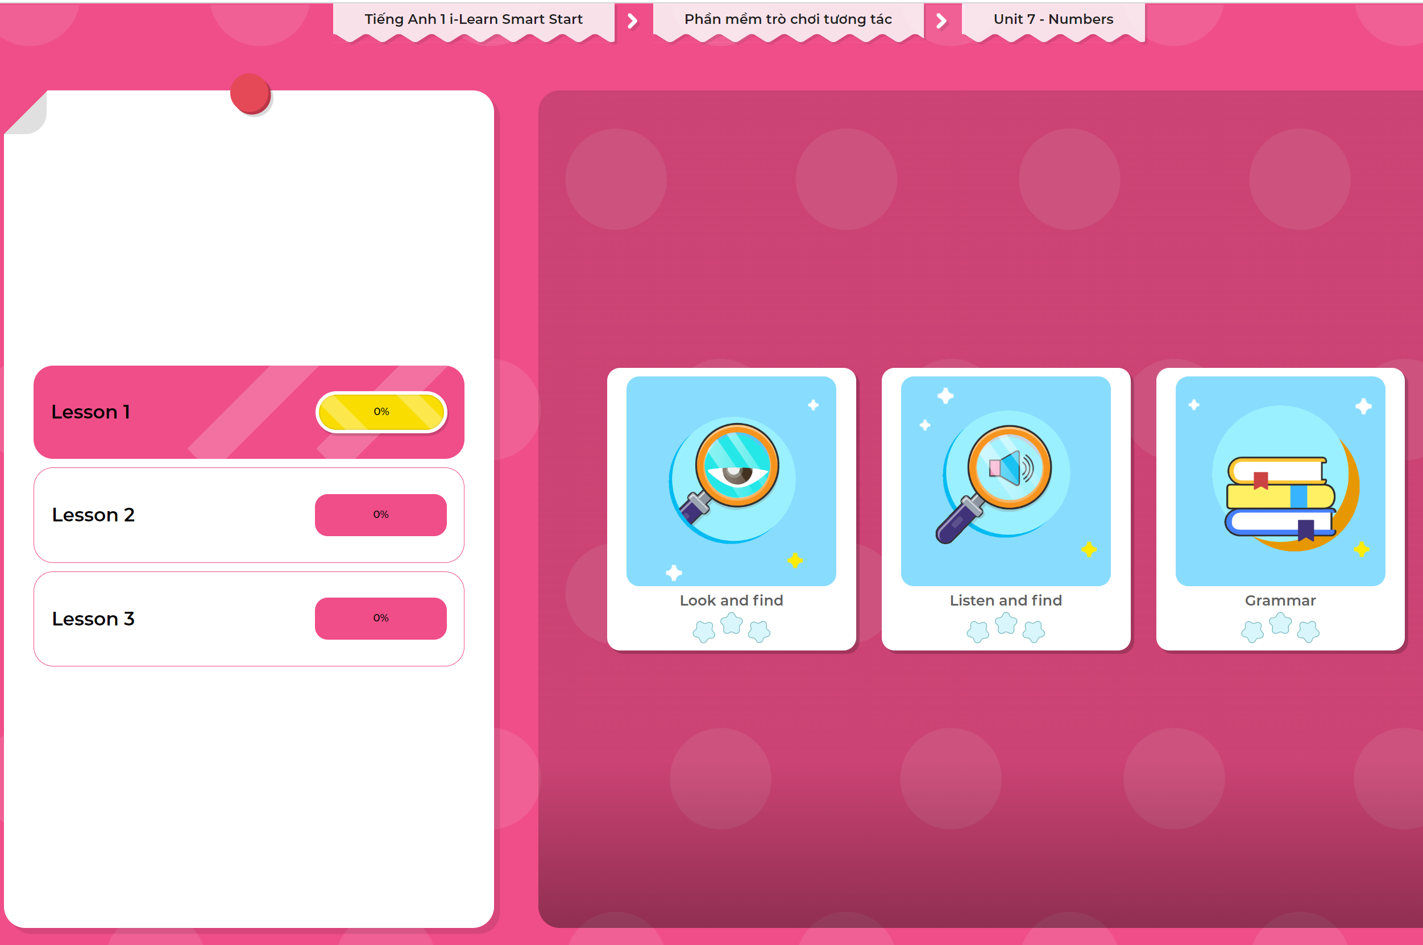
Extra Practice
DHA App
LET’S PLAY!
Click here to play the games

Slide 33

WRAP-UP

Slide 34
Today’s lesson
Skills:
Identify and use vocabulary about numbers.
Vocabulary
one, two, three

Slide 35
Homework
Practice vocabularies and structure. Make sentences using them.
Practice the vocabulary and structure in Tiếng Anh 1 i-Learn Smart Start Notebook (page 42).
Do the exercises in Tiếng Anh 1 i-Learn Smart Start Workbook (page 42).
Play the consolidation games in Tiếng Anh 1 i-Learn Smart Start DHA App on www.eduhome.com.vn
Prepare the next lesson (page 45).

Slide 36

Enjoy your day!

