Slide 1


Unit 7: Numbers
Lesson 1.2: Speaking
Page: 45

Slide 2
Lesson Outline
Warm-up
Speaking
Practice
Consolidation
Wrap-up

Slide 3
Objectives
By the end of this lesson, students will be able to gain the following:
Vocabulary:
one, two, three
Skills:
Say the numbers, using the vocabulary in the lesson.

Slide 4

WARM-UP

Slide 5












two
a b c
a
b
c

Slide 6
three
a b c
a
b
c

Slide 7


one
a b c
a
b
c

Slide 8
tow
twe
two
a b c
a
b
c

Slide 9
owe
one
oen
old
a b c
a
b
c

Slide 10
three
thre
threi
a b c
a
b
c

Slide 11

It’s time to learn …

Slide 12

Speaking

Slide 13


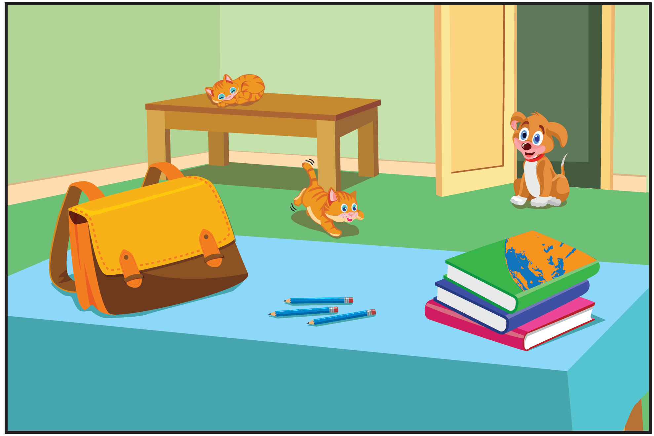

Slide 14
How many cats?
A. one
B. two
C. three

Slide 15
How many books?
A. one
C. two
B. three

Slide 16
How many bags?
B. one
A. two
C. three

Slide 17
How many dogs?
B. one
A. two
C. three

Slide 18
How many pencils?
A. one
C. two
B. three

Slide 19
Point and say

Slide 20

Practice

Slide 21

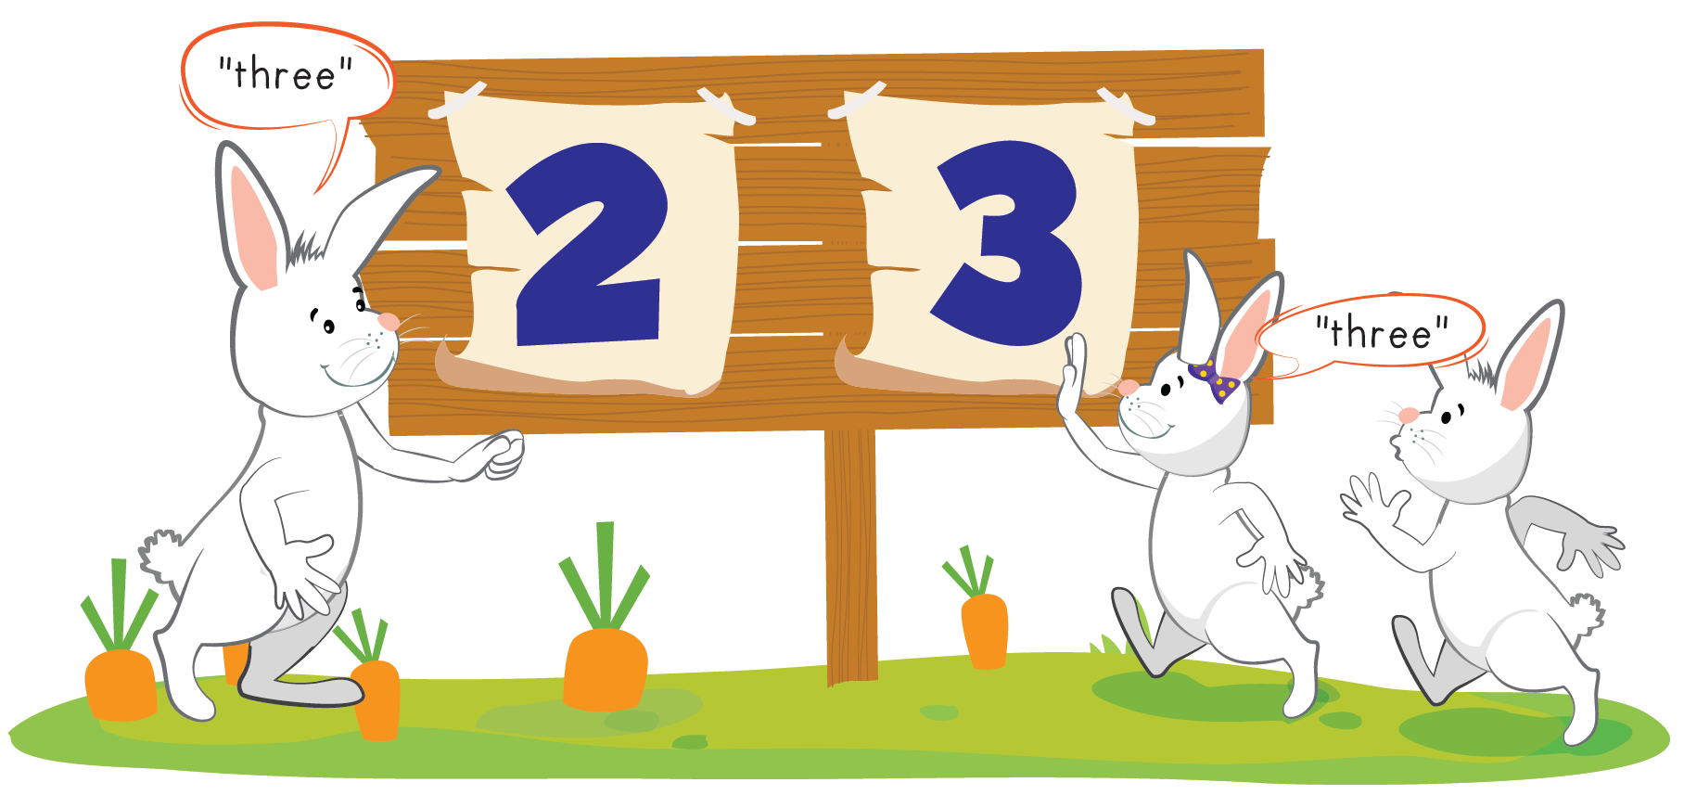

Slide 22
Further Practice

Slide 23









Slide 24

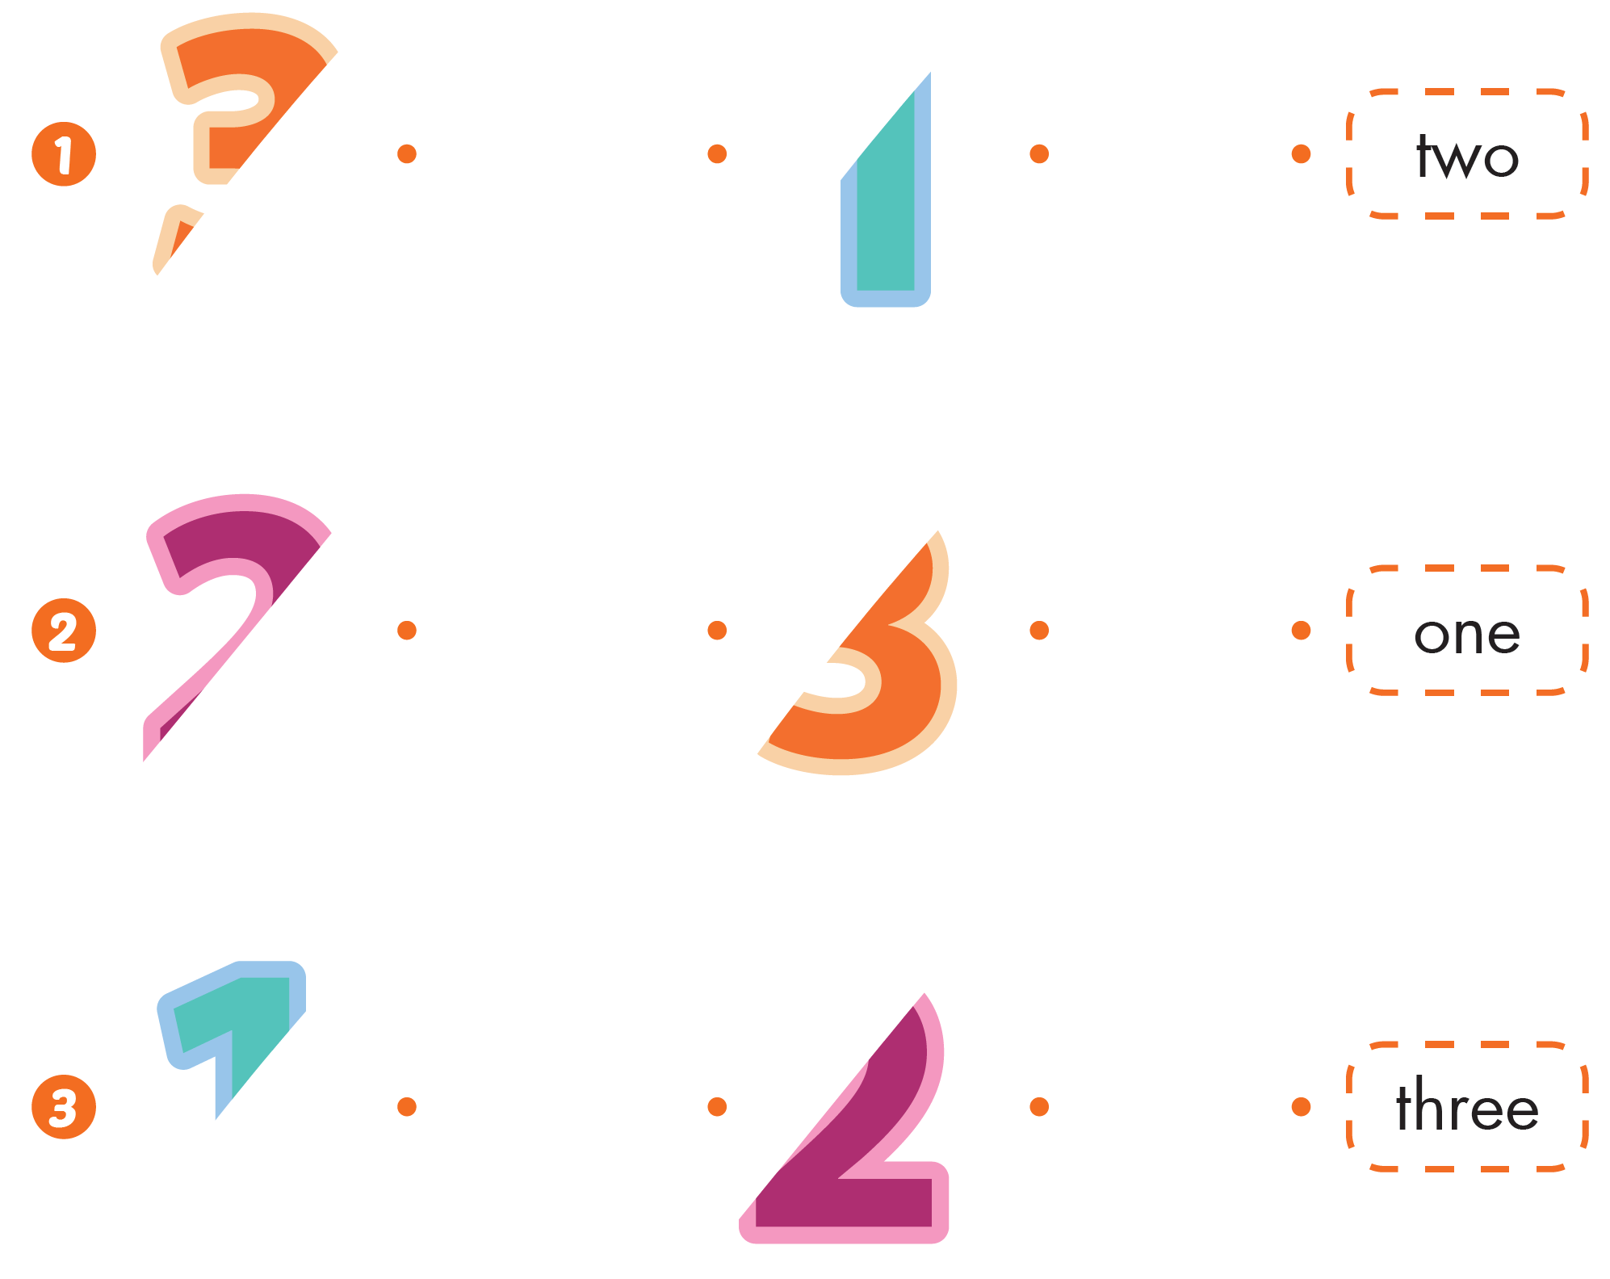

Slide 25
It’s time to play …

Slide 26




Slide 27









Slide 28


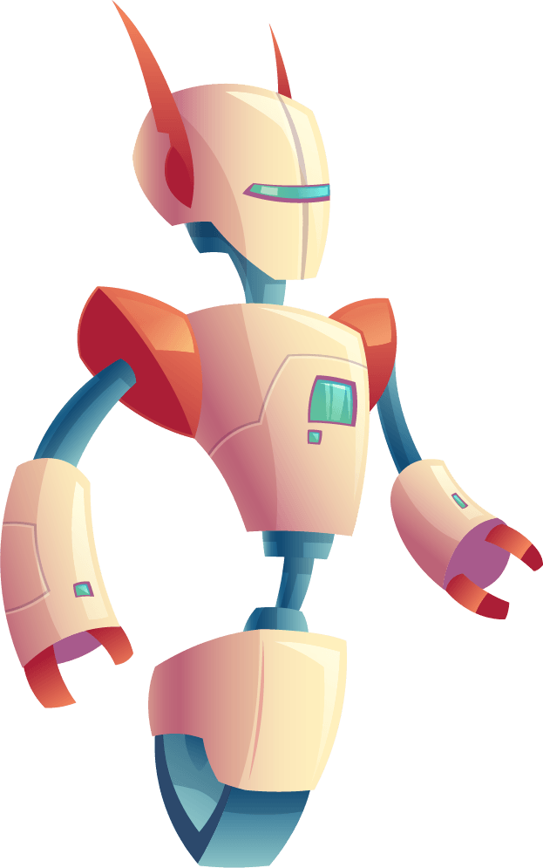





two
three
one

Slide 29

two
one
three

Slide 30

three
two
one

Slide 31

two
three
one

Slide 32

two
three
one

Slide 33

one
two
three

Slide 34



three

Slide 35

one

Slide 36

CONSOLIDATION

Slide 37
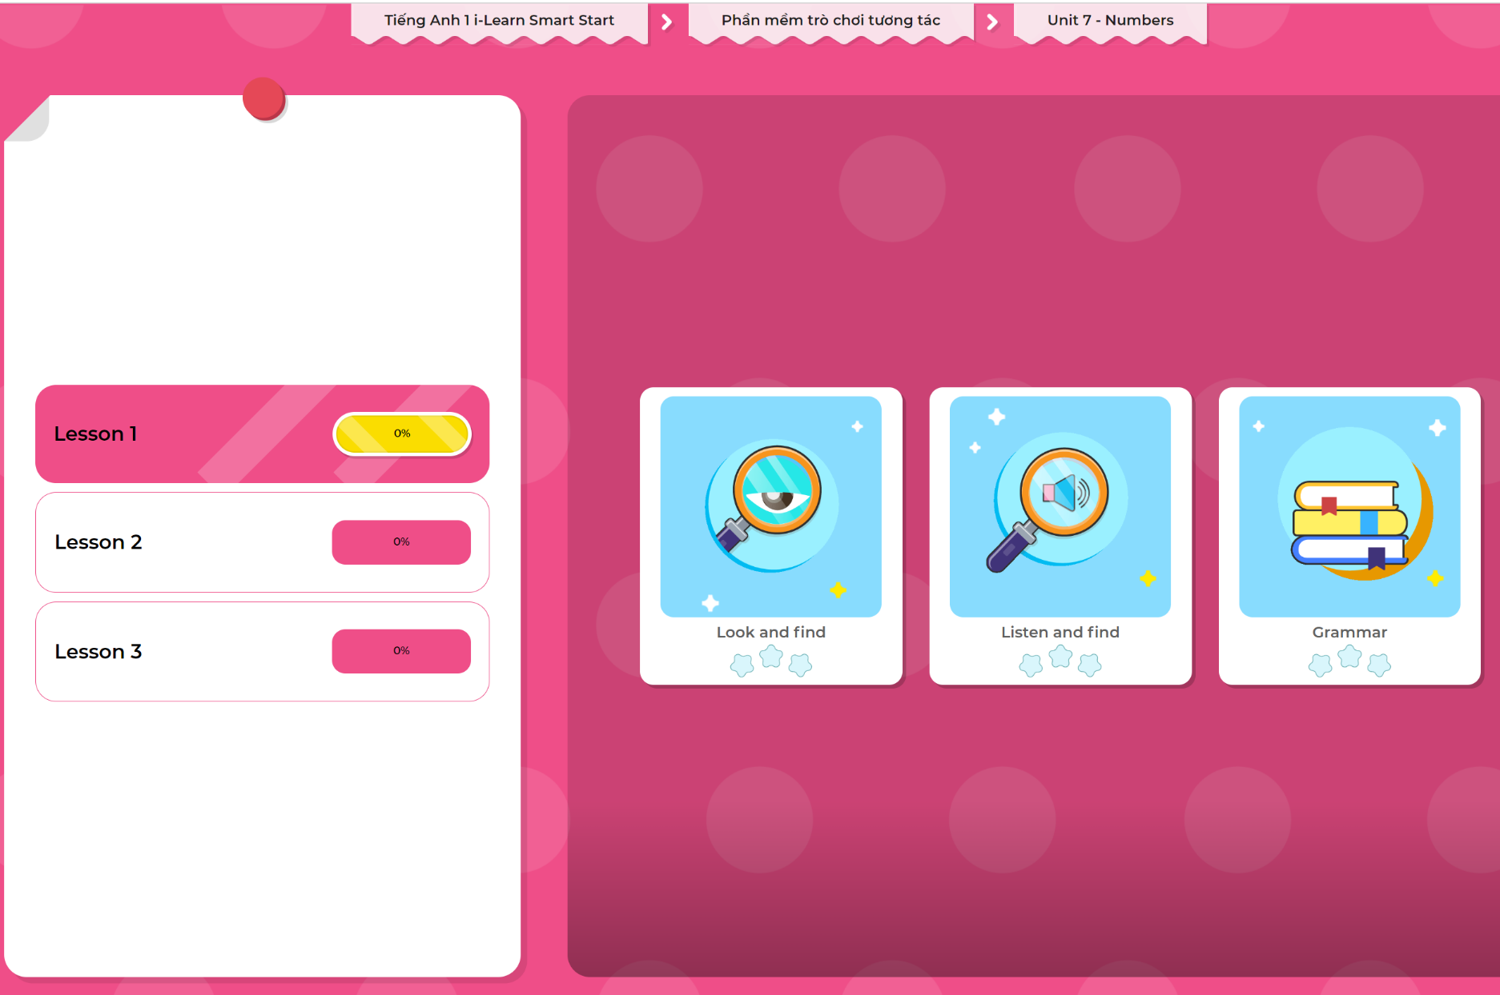
Extra Practice
DHA App
LET’S PLAY!
Click here to play the games

Slide 38

WRAP-UP

Slide 39
Today’s lesson
Skills
Say the numbers, using the vocab in the lesson.
Vocabulary
one, two, three

Slide 40
Homework
Review the vocabularies & structures and make sentences using them.
Practice the vocabulary and structure in Tiếng Anh 1 i-Learn Smart Start Notebook (page 43).
Do the exercises in Tiếng Anh 1 i-Learn Smart Start Workbook (page 43).
Play the consolidation games in Tiếng Anh 1 i-Learn Smart Start DHA App on www.eduhome.com.vn
Prepare the next lesson (page 46).

Slide 41

Enjoy your day!

