Slide 1


Unit 7: Numbers
Lesson 2.1: Vocabulary & Phonics
Page: 46

Slide 2
Lesson Outline
Warm-up
Vocabulary
Phonics
Practice
Consolidation
Wrap-up

Slide 3
Objectives
By the end of this lesson, students will be able to gain the following:
Phonics: /ɪ/
Vocabulary:
insect, ink
Skills:
Recognize the letter I/i and make the /ɪ/ sound.

Slide 4

WARM-UP

Slide 5

It’s one.
YES
NO

Slide 6

It’s two.
YES
NO

Slide 7

It’s three.
YES
NO

Slide 8

It’s time to learn …

Slide 9

Phonics
/ɪ/

Slide 10

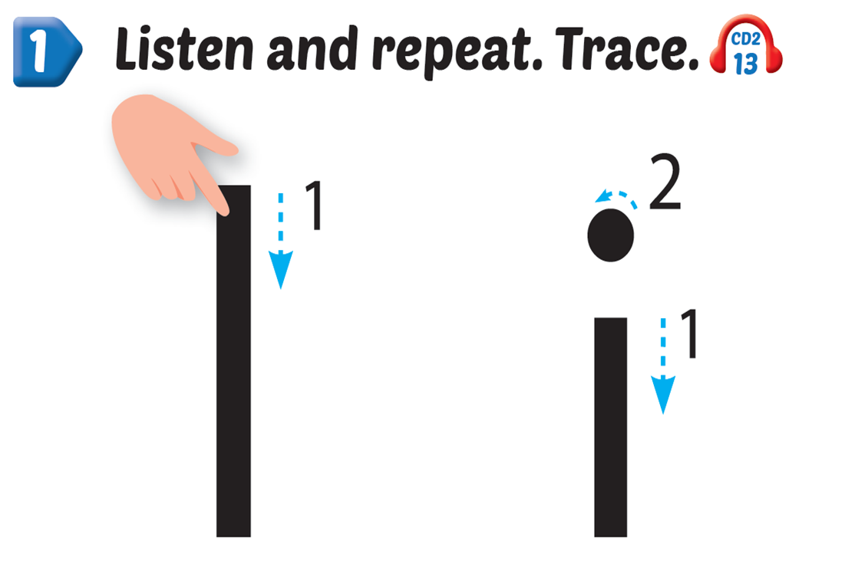
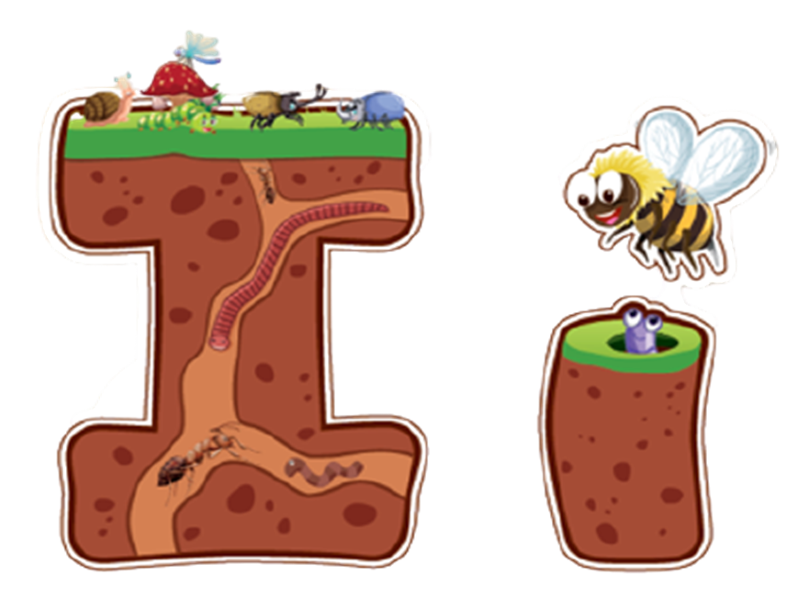

Slide 11

New words
insect, ink.

Slide 12
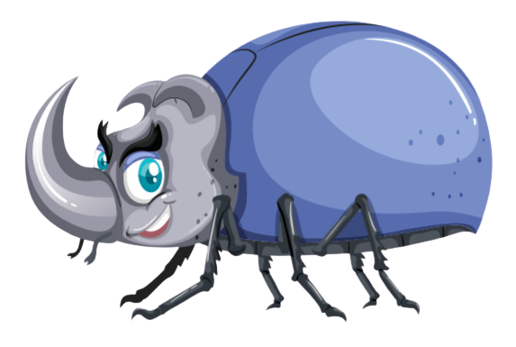
i
i
insect
/ˈɪnsekt/
côn trùng

Slide 13

i
i
ink
/ɪŋk/
mực

Slide 14




Slide 15


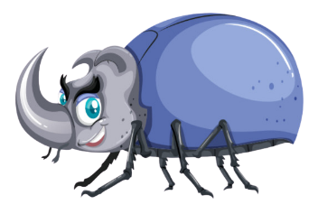
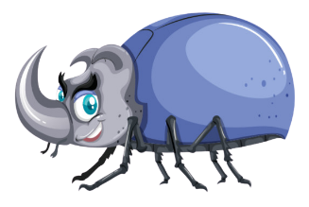

This is an ,
e, e, .
This is an ,
e, e, e.

Slide 16

Practice

Slide 17



Slide 18
It’s time to play …

Slide 19


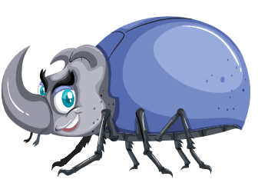
Listen and match
Click on the icon to hear the sound.

Slide 20
Fill the missing letters
i n
i n e c
k
s
t

Slide 21
Read and choose
ink

Slide 22
Read and choose
insect

Slide 23
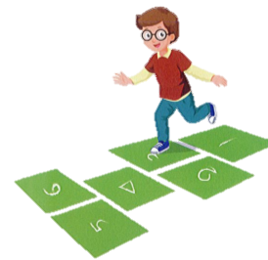
Choose the picture beginning with the sound “i”.

Slide 24
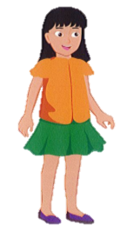
Choose the word beginning with the sound “i”

Slide 25

Further Practice

Slide 26

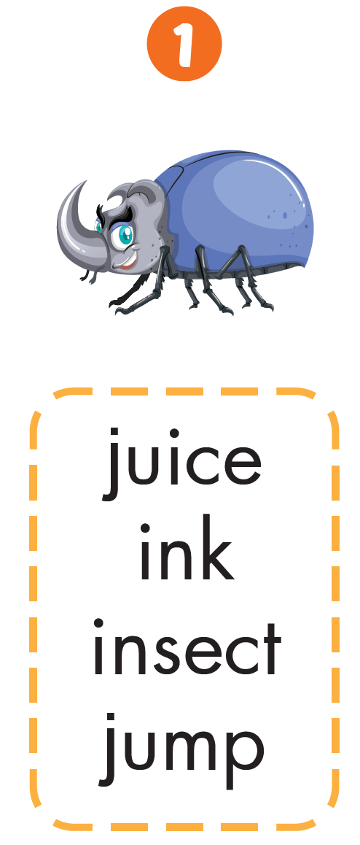



Slide 27

CONSOLIDATION

Slide 28
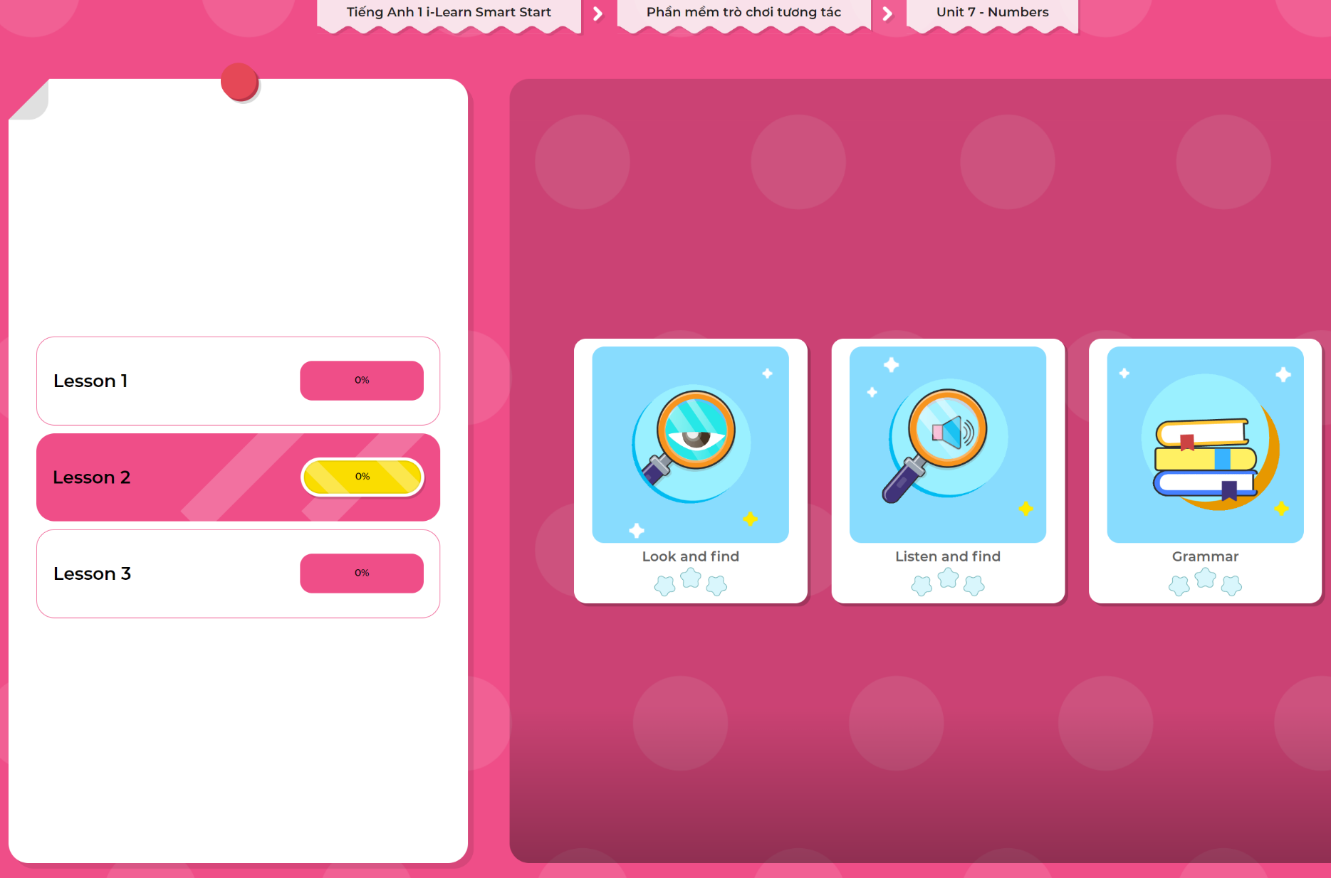
Extra Practice
DHA App
LET’S PLAY!
Click here to play the games

Slide 29

WRAP-UP

Slide 30
Today’s lesson
Phonics
/ɪ/
Vocabulary
insect, ink

Slide 31
Homework
Practice vocabularies and phonics. Make sentences using them.
Practice the vocabulary and phonics in Tiếng Anh 1 i-Learn Smart Start Notebook (page 44).
Do the exercises in Tiếng Anh 1 i-Learn Smart Start Workbook (page 44).
Play the consolidation games in Tiếng Anh 1 i-Learn Smart Start DHA App on www.eduhome.com.vn
Prepare the next lesson (page 47).

Slide 32

Enjoy your day!

