Slide 1

Unit 7: Numbers
Lesson 2.2: Vocabulary & Phonics
Page: 47

Slide 2
Lesson Outline
Warm-up
Vocabulary
Phonics
Practice
Consolidation
Wrap-up

Slide 3
Objectives
By the end of this lesson, students will be able to gain the following:
Phonics: /dʒ/
Sentence pattern: “Everybody, Jump”.
Vocabulary: jump, juice
Skills:
Recognize the letter J/j and the sound /dʒ/ in words and produce them individually.

Slide 4

WARM-UP

Slide 5


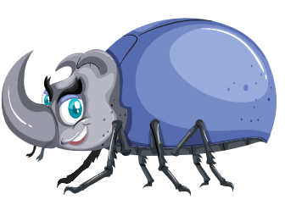
Review: Letter I, i
ink
insect

Slide 6

It’s time to learn …

Slide 7

Phonics
/dʒ/

Slide 8

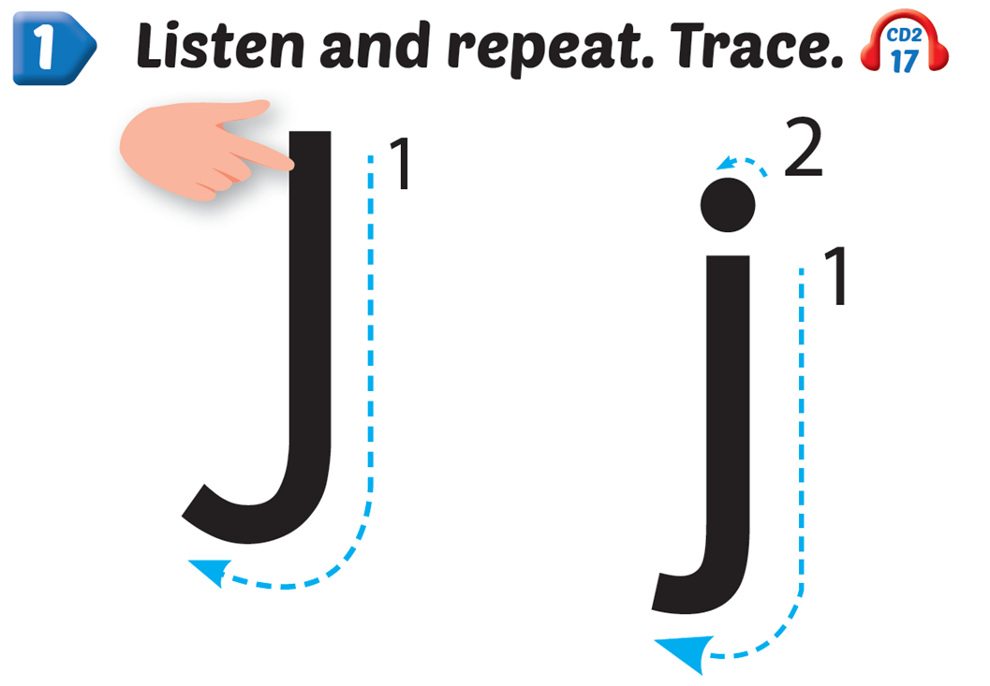
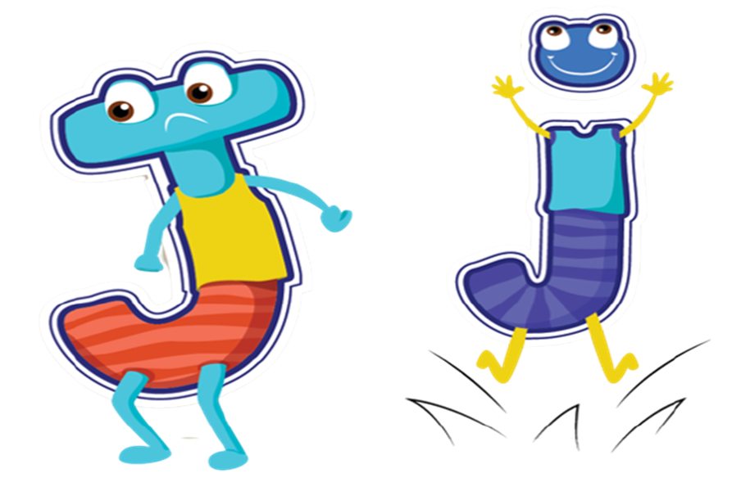

Slide 9

New words
jump, juice

Slide 10

j
j
jump
/dʒʌmp/
nhảy

Slide 11

j
j
juice
/dʒuːs/
nước ép

Slide 12




Slide 13
Structure
Everybody, jump.

Slide 14




Everybody, jump ,
j, j, .
Everybody, jump ,
j, j, j.

Slide 15

Practice

Slide 16



Slide 17
It’s time to play …

Slide 18


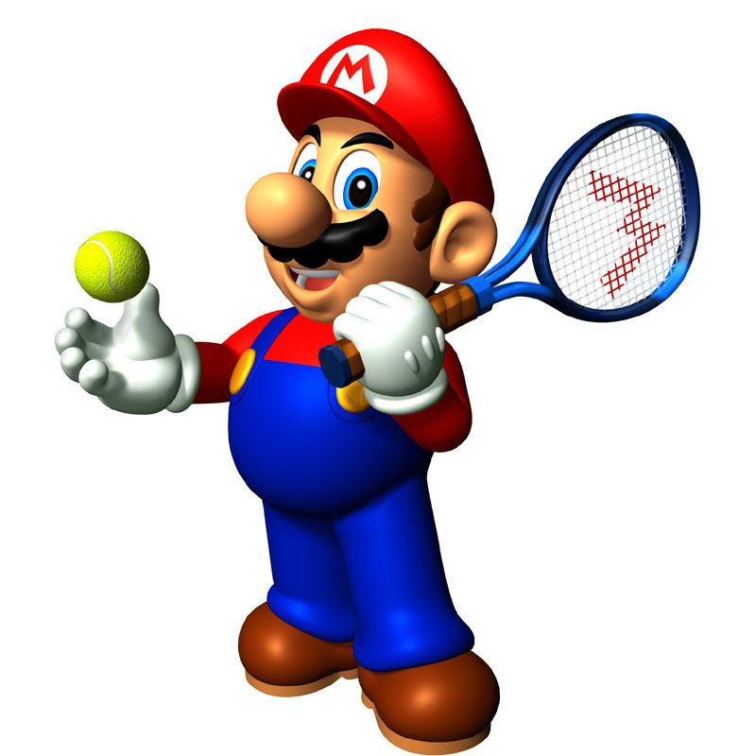





Slide 19
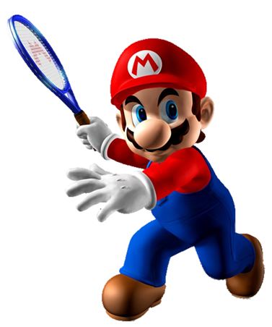

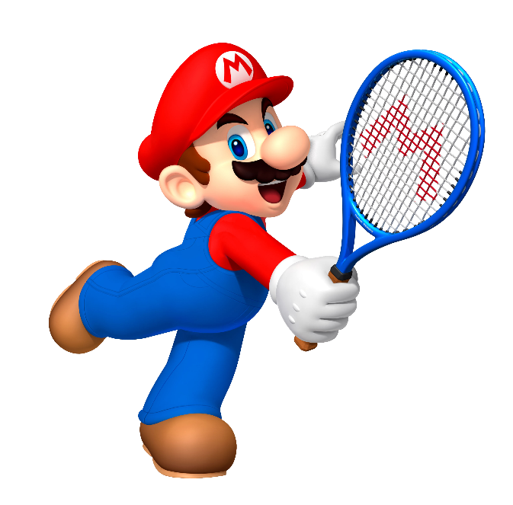

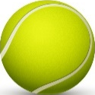
juice
Listen and choose
jump

Slide 20

i
This picture begins with the sound.
j

Slide 21

jupm
Choose the right word for this picture.
jump

Slide 22
jump
Listen and choose
juice

Slide 23
juiec
Choose the right word for this picture.
juice

Slide 24
j
This picture begins with the sound.
i

Slide 25

Further Practice

Slide 26


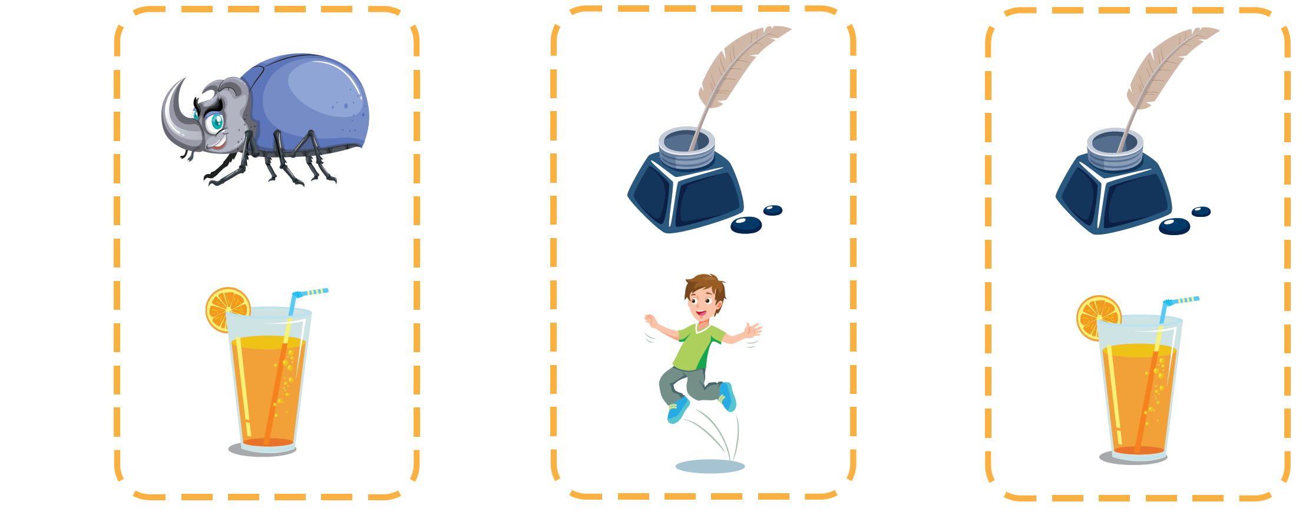




Slide 27




Slide 28

CONSOLIDATION

Slide 29
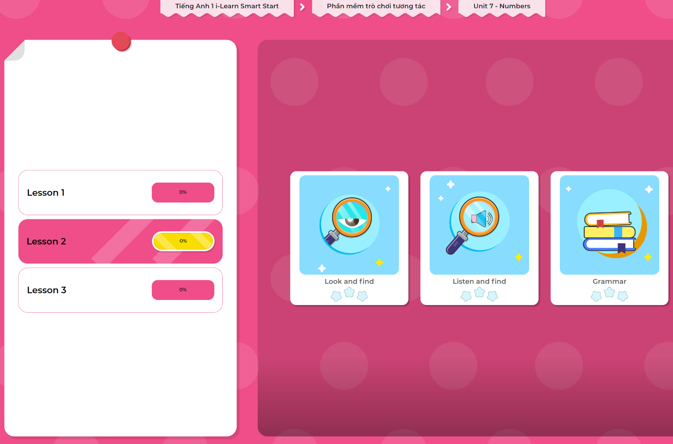
Extra Practice
DHA App
LET’S PLAY!
Click here to play the games

Slide 30

WRAP-UP

Slide 31
Today’s lesson
Vocabulary
jump, juice
Phonics
/dʒ/
Sentence pattern: “Everybody, Jump.”

Slide 32
Homework
Practice vocabularies and phonics. Make sentences using them.
Practice the vocabulary and phonics in Tiếng Anh 1 i-Learn Smart Start Notebook (page 45).
Do the exercises in Tiếng Anh 1 i-Learn Smart Start Workbook (page 45).
Play the consolidation games in Tiếng Anh 1 i-Learn Smart Start DHA App on www.eduhome.com.vn
Prepare the next lesson (page 48).

Slide 33

Enjoy your day!

