Slide 1

Unit 7: Numbers
Lesson 3.1: Vocabulary & Sentence Patterns
Page: 48

Slide 2
Lesson Outline
Warm-up
Vocabulary
Structure
Practice
Consolidation
Wrap-up

Slide 3
Objectives
By the end of this lesson, students will be able to gain the following:
Vocabulary:
four, five, six
Sentence pattern:
(Vinh)’s (six).
Skills:
Tell about someone's age.

Slide 4

WARM-UP

Slide 5


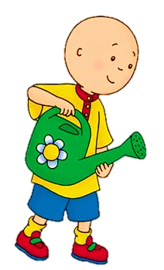



What number is this?
two
one
NEXT

Slide 6

What number is this?
one
three
NEXT

Slide 7

What number is this?
two
three
NEXT

Slide 8
Click on the picture to hear the word.

Slide 9

It’s time to learn …

Slide 10

New words
four, five, six

Slide 11











Slide 12
Click on the picture to hear the sound.
/fɔːr/
số bốn
/faɪv/
số năm
/sɪks/
số sáu

Slide 13

/fɔːr/
số bốn

Slide 14

/faɪv/
số năm

Slide 15

/sɪks/
số sáu

Slide 16

Structures
(Vinh)’s (six).

Slide 17

Practice

Slide 18







Slide 19



Slide 20



Slide 21
It’s time to play …

Slide 22
Play game
“Guess the number”

Slide 23


Guess the number

Slide 24

Guess the number

Slide 25

Guess the number

Slide 26
Guess the number

Slide 27

Guess the number

Slide 28

Guess the number

Slide 29

Further Practice

Slide 30

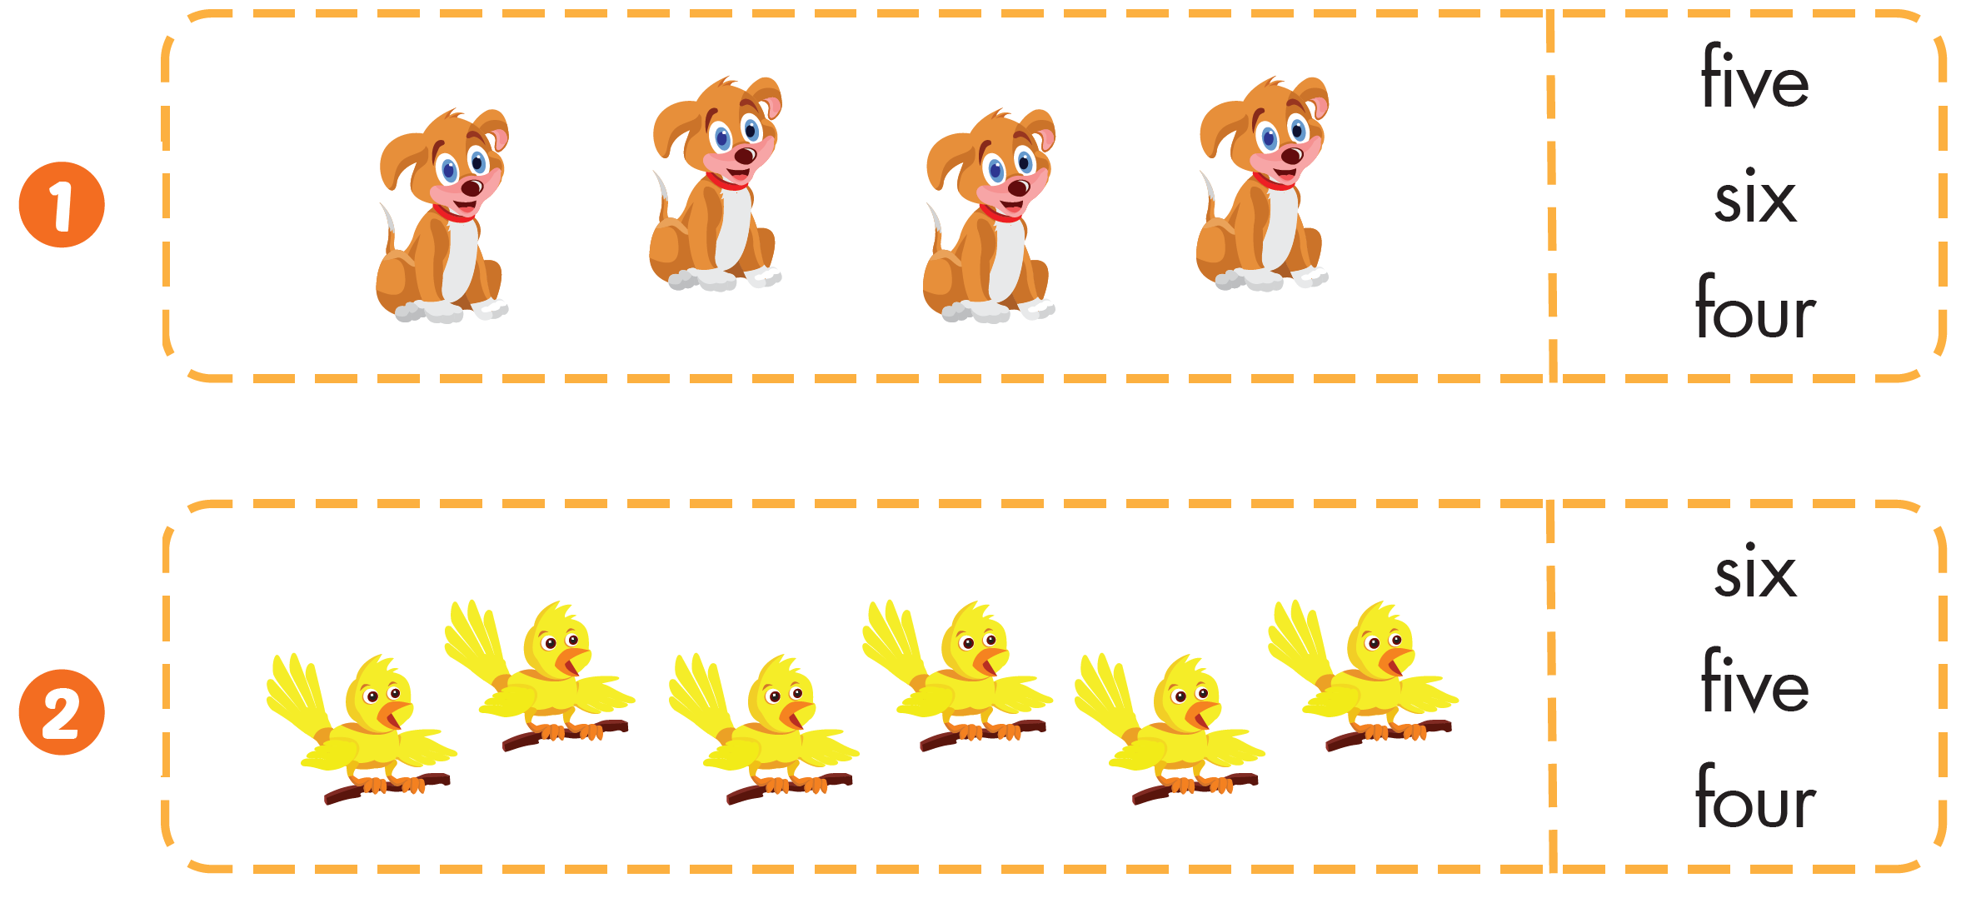


Slide 31
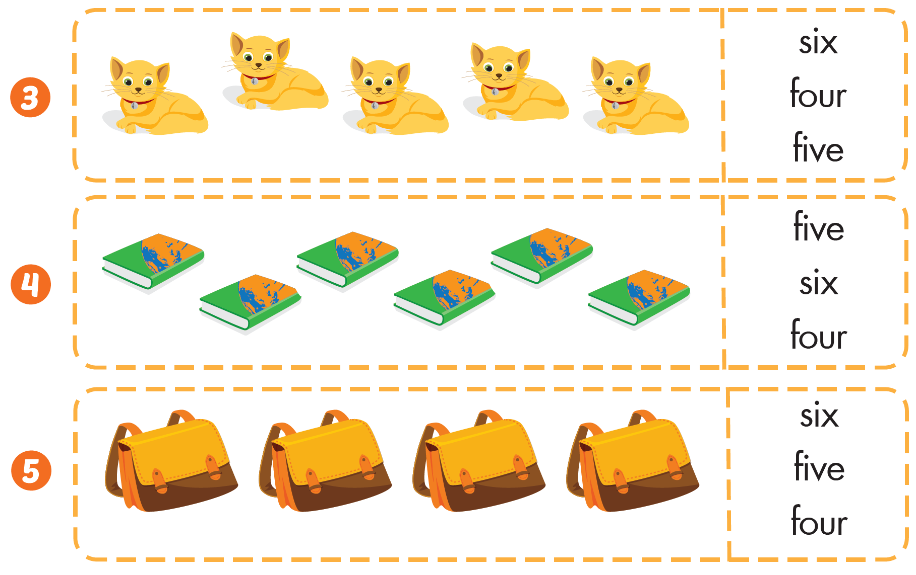

Slide 32

CONSOLIDATION

Slide 33
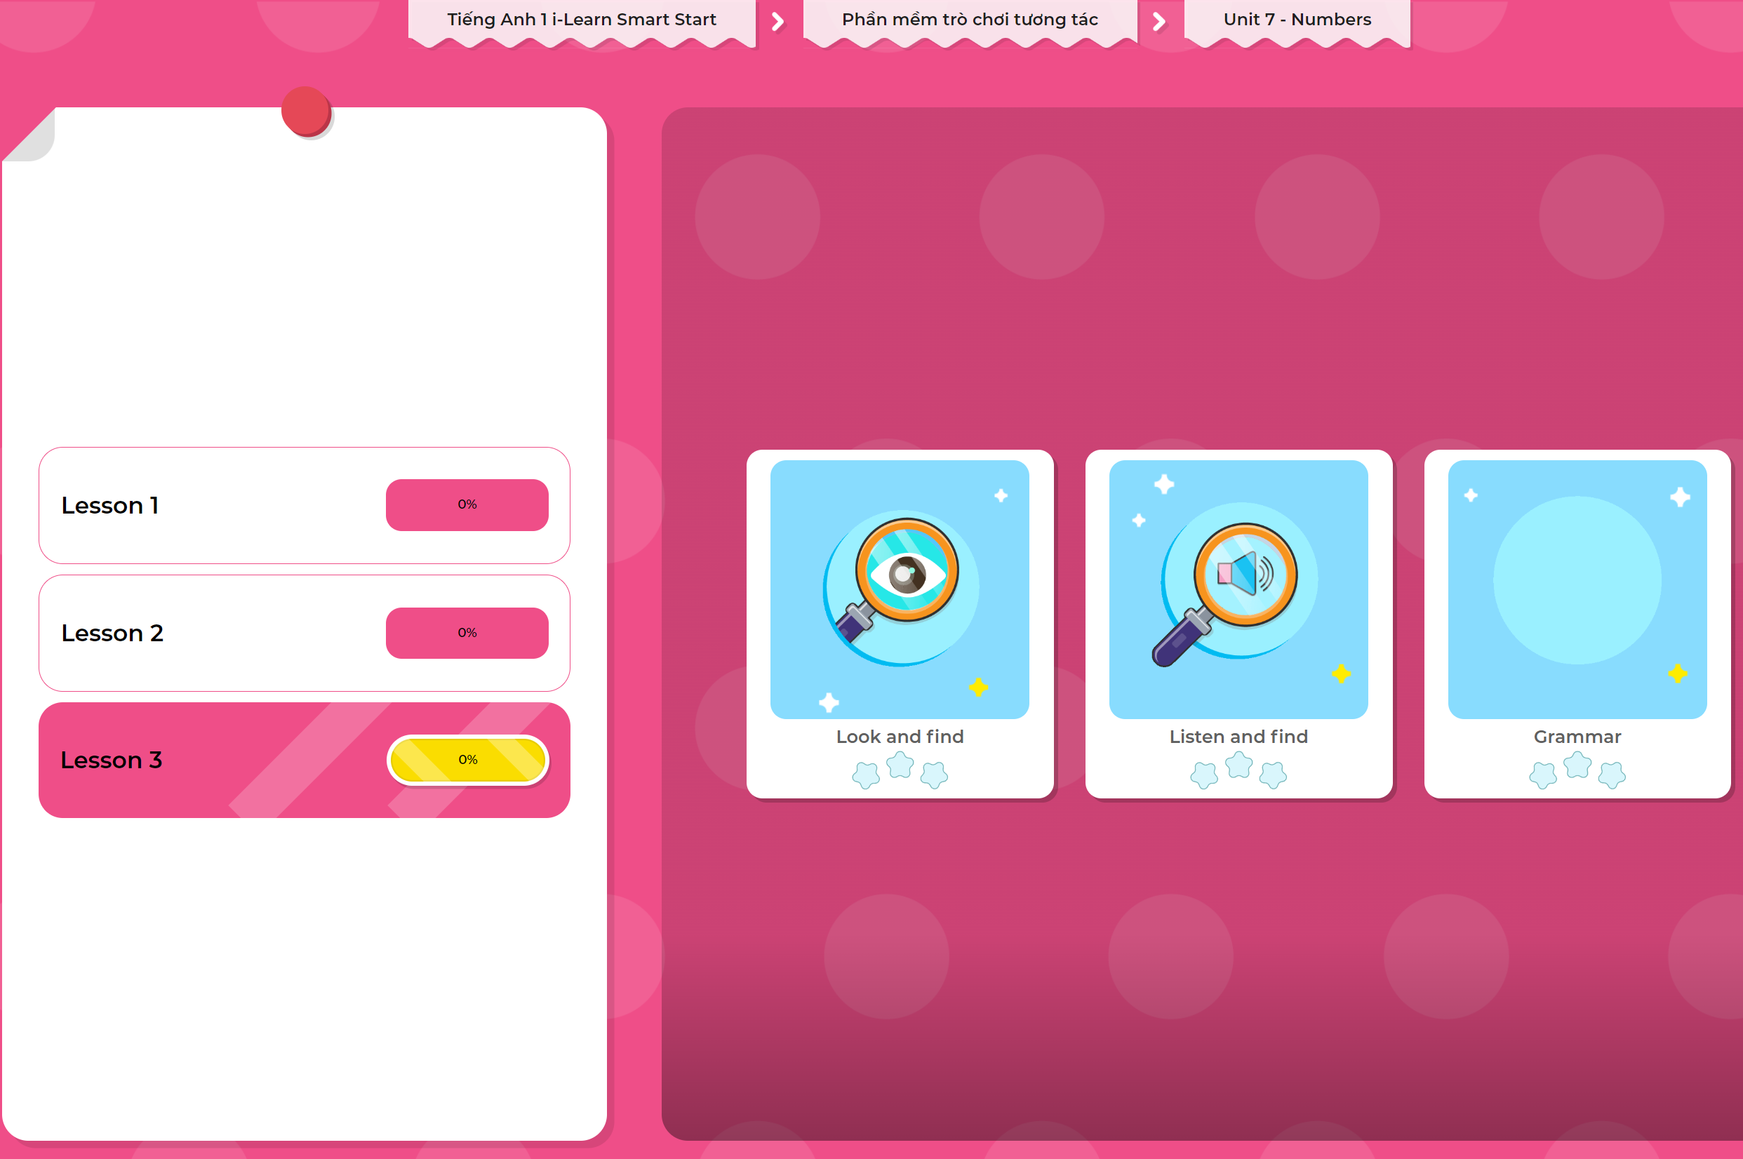
Extra Practice
DHA App
LET’S PLAY!
Click here to play the games

Slide 34

WRAP-UP

Slide 35
Today’s lesson
Structures/ Sentence patterns
(Vinh)’s (six).
Vocabulary
four, five, six

Slide 36
Homework
Practice vocabularies and structure. Make sentences using them.
Practice the vocabulary and structure in Tiếng Anh 1 i-Learn Smart Start Notebook (page 46).
Do the exercises in Tiếng Anh 1 i-Learn Smart Start Workbook (page 46).
Play the consolidation games in Tiếng Anh 1 i-Learn Smart Start DHA App on www.eduhome.com.vn
Prepare the next lesson (page 49).

Slide 37

Enjoy your day!

