Slide 1

Unit 7: Numbers
Lesson 3.2: Sentence Patterns
Page: 49

Slide 2
Lesson Outline
Warm-up
Structure
Practice
Consolidation
Wrap-up

Slide 3
Objectives
By the end of this lesson, students will be able to gain the following:
Sentence pattern:
“How old are you?”
“I’m (six).”
Skills:
Ask and answer question about someone's age.

Slide 4

What number is it?
five
five
five
five
five
five

Slide 5

What number is it?
one
one
one
one
one
one

Slide 6

What number is it?
three
three
three
three
three
three

Slide 7
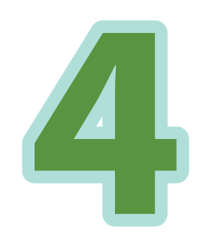
What number is it?
four
four
four
four
four
four

Slide 8
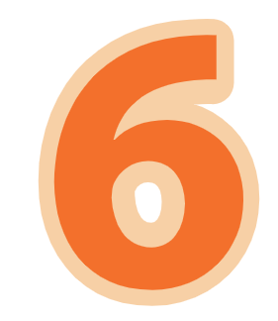
What number is it?
six
six
six
six
six
six

Slide 9

What number is it?
two
two
two
two
two
two

Slide 10

WARM-UP

Slide 11

It’s time to learn …

Slide 12

Structures
How old are you?
I’m (six).

Slide 13



How old are you?
I'm six.

Slide 14



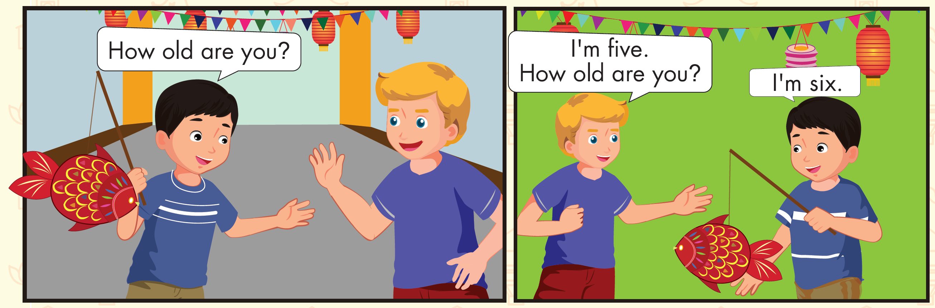

Slide 15

Practice

Slide 16

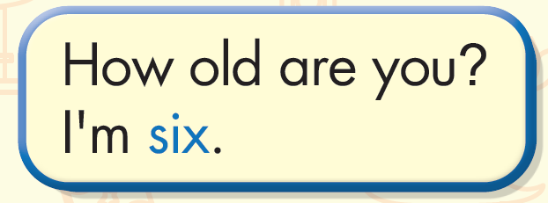

Slide 17

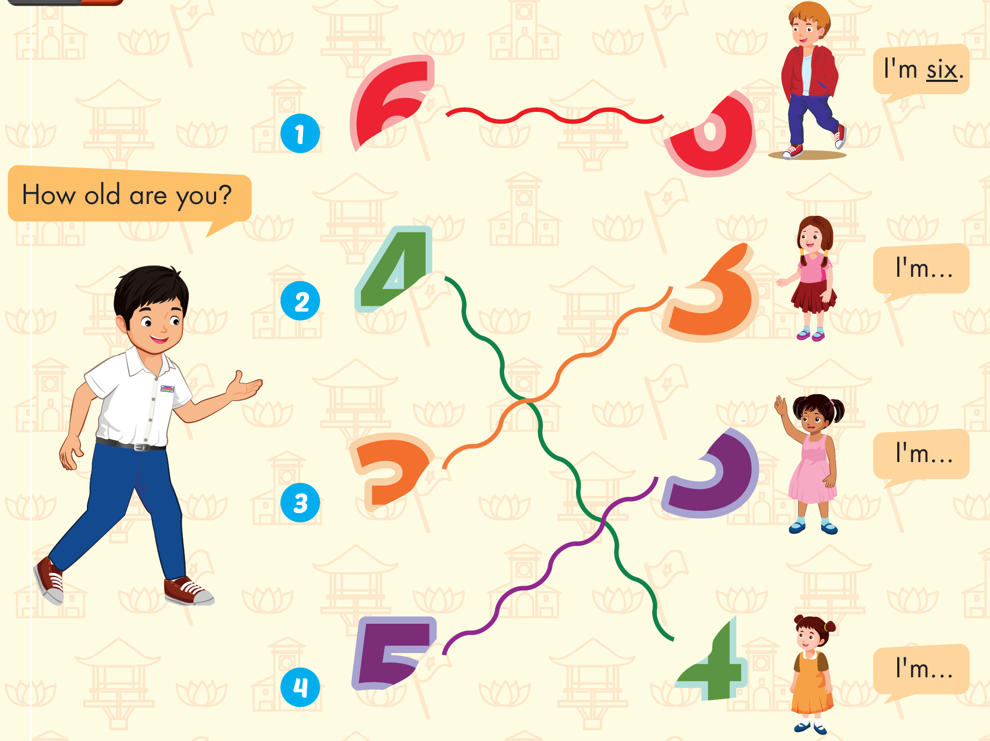

Slide 18
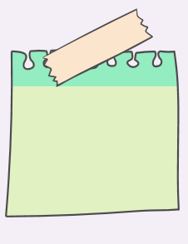

How old are you?
I’m six.

Slide 19
How old are you?
I’m …….

Slide 20
…………..?
I’m …….

Slide 21
…………..?
I’m …….

Slide 22
It’s time to play …

Slide 23
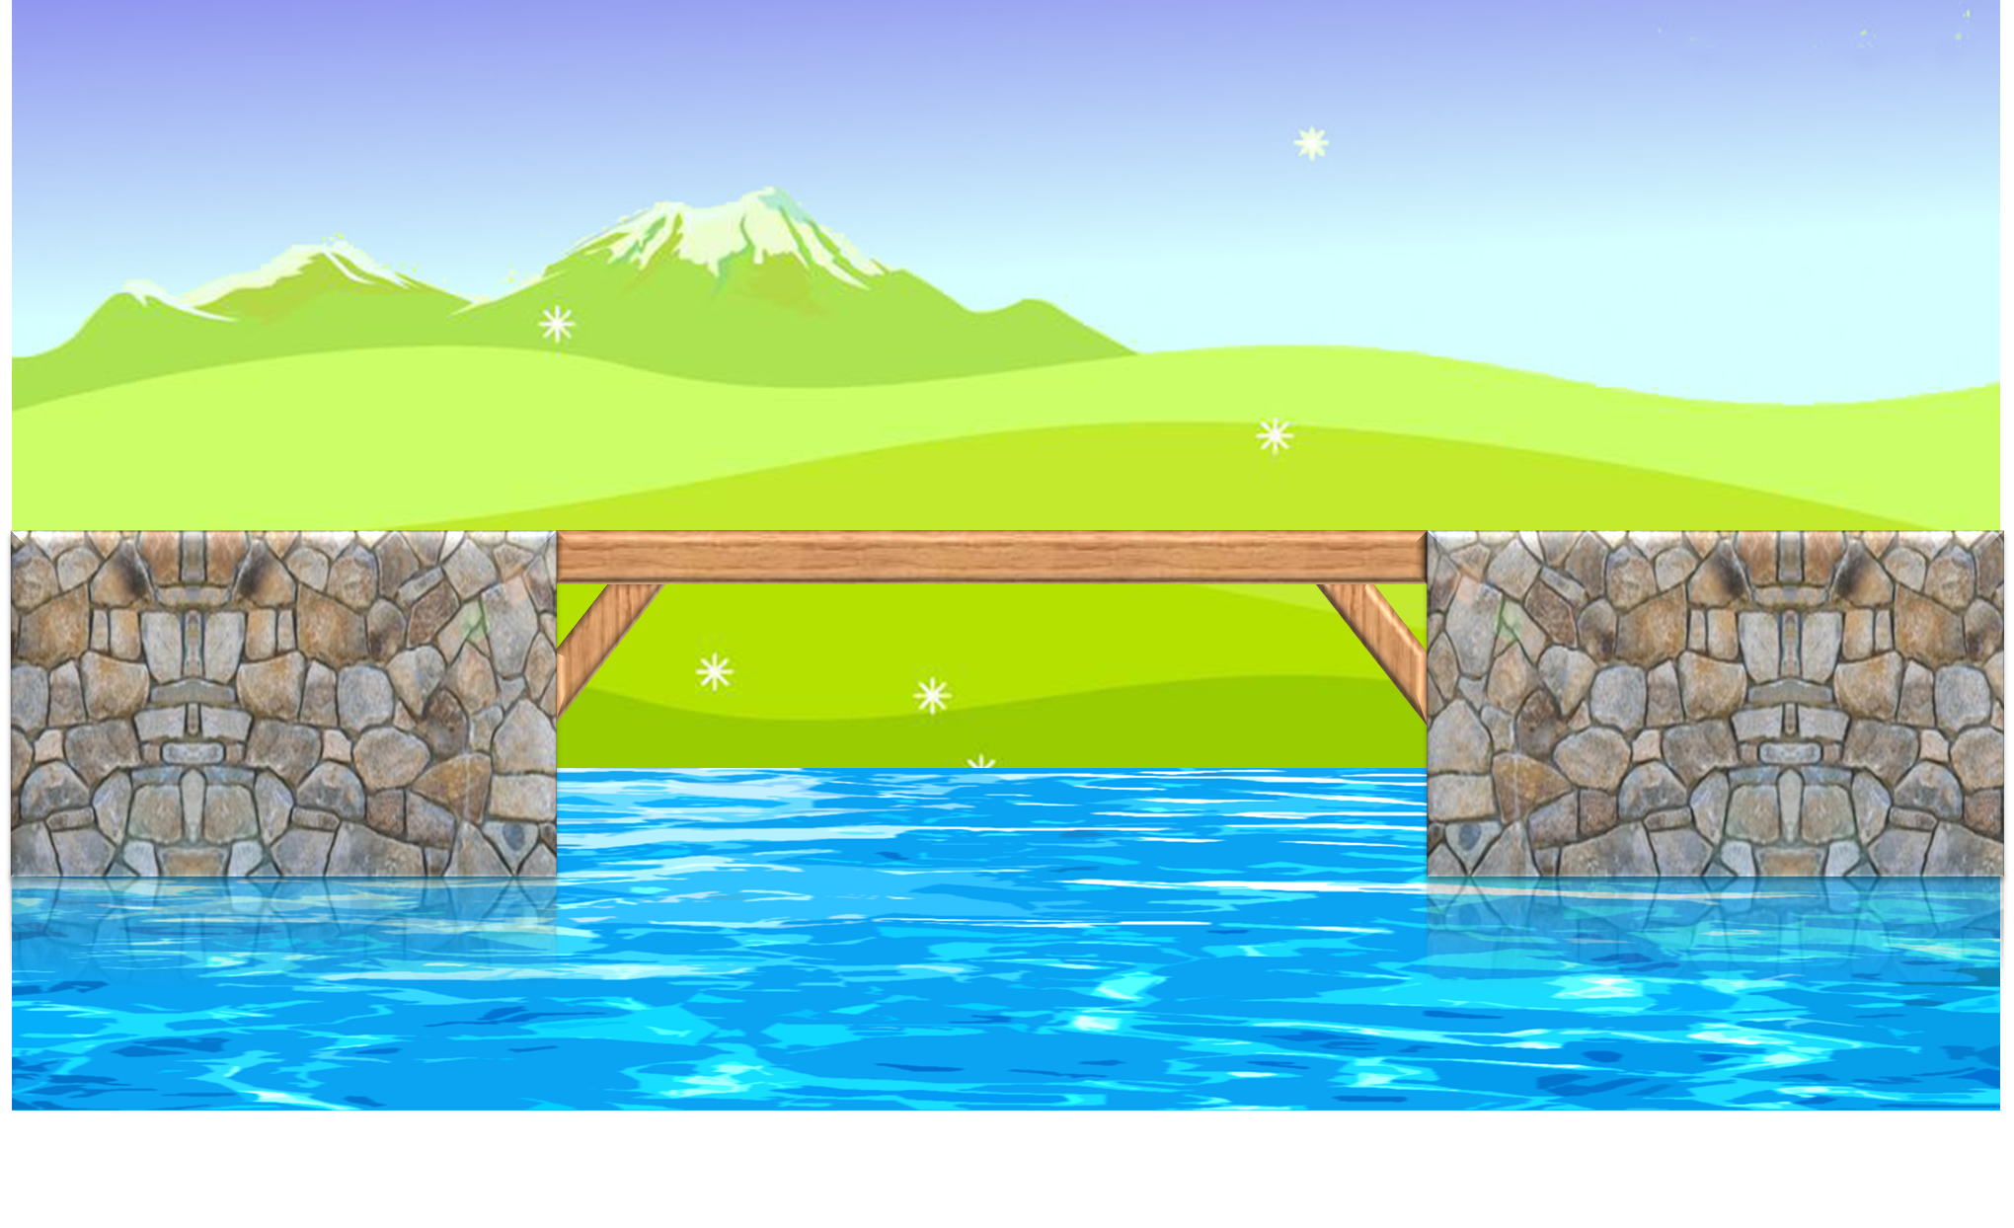
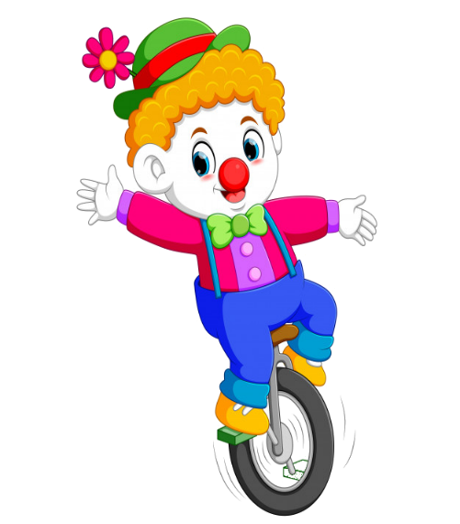



PLAY

Slide 24




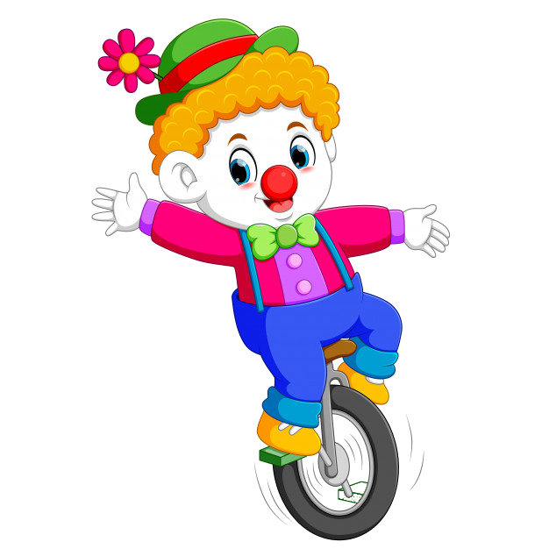
How old are you?
I’m five.
I’m six.
I’m four.
I’m three.

Slide 25
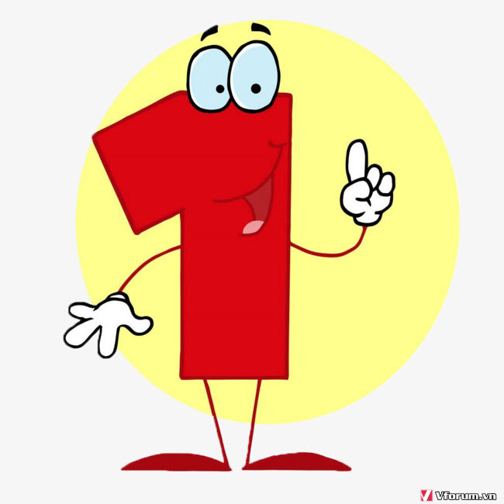
How old are you?
I’m two.
I’m six.
I’m four.
I’m one.

Slide 26

How old are you?
I’m five.
I’m two.
I’m four.
I’m three.

Slide 27

How old are you?
I’m two.
I’m three.
I’m one.
I’m six.

Slide 28
How old are you?
I’m two.
I’m one.
I’m six.
I’m three.

Slide 29
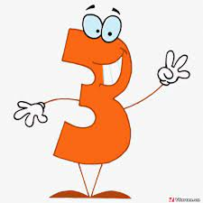
How old are you?
I’m two.
I’m three.
I’m five.
I’m four.

Slide 30

Further Practice

Slide 31

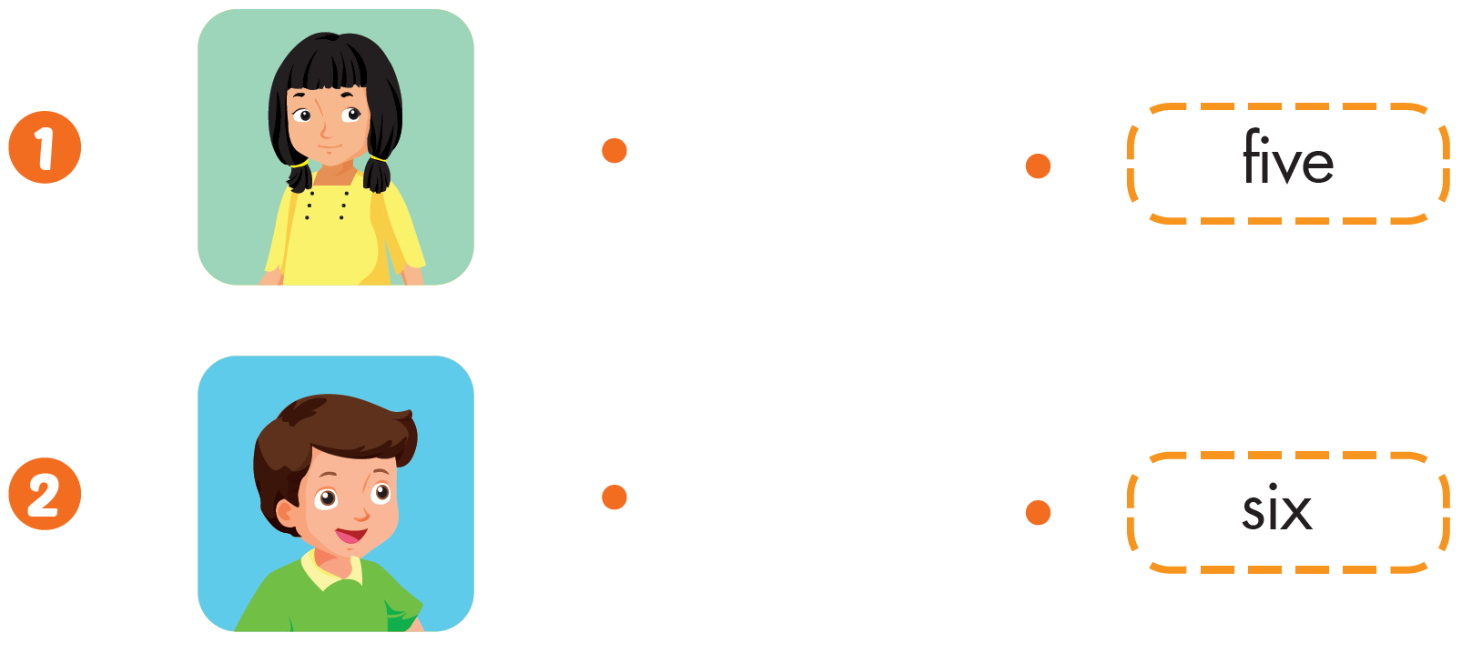



Slide 32

CONSOLIDATION

Slide 33
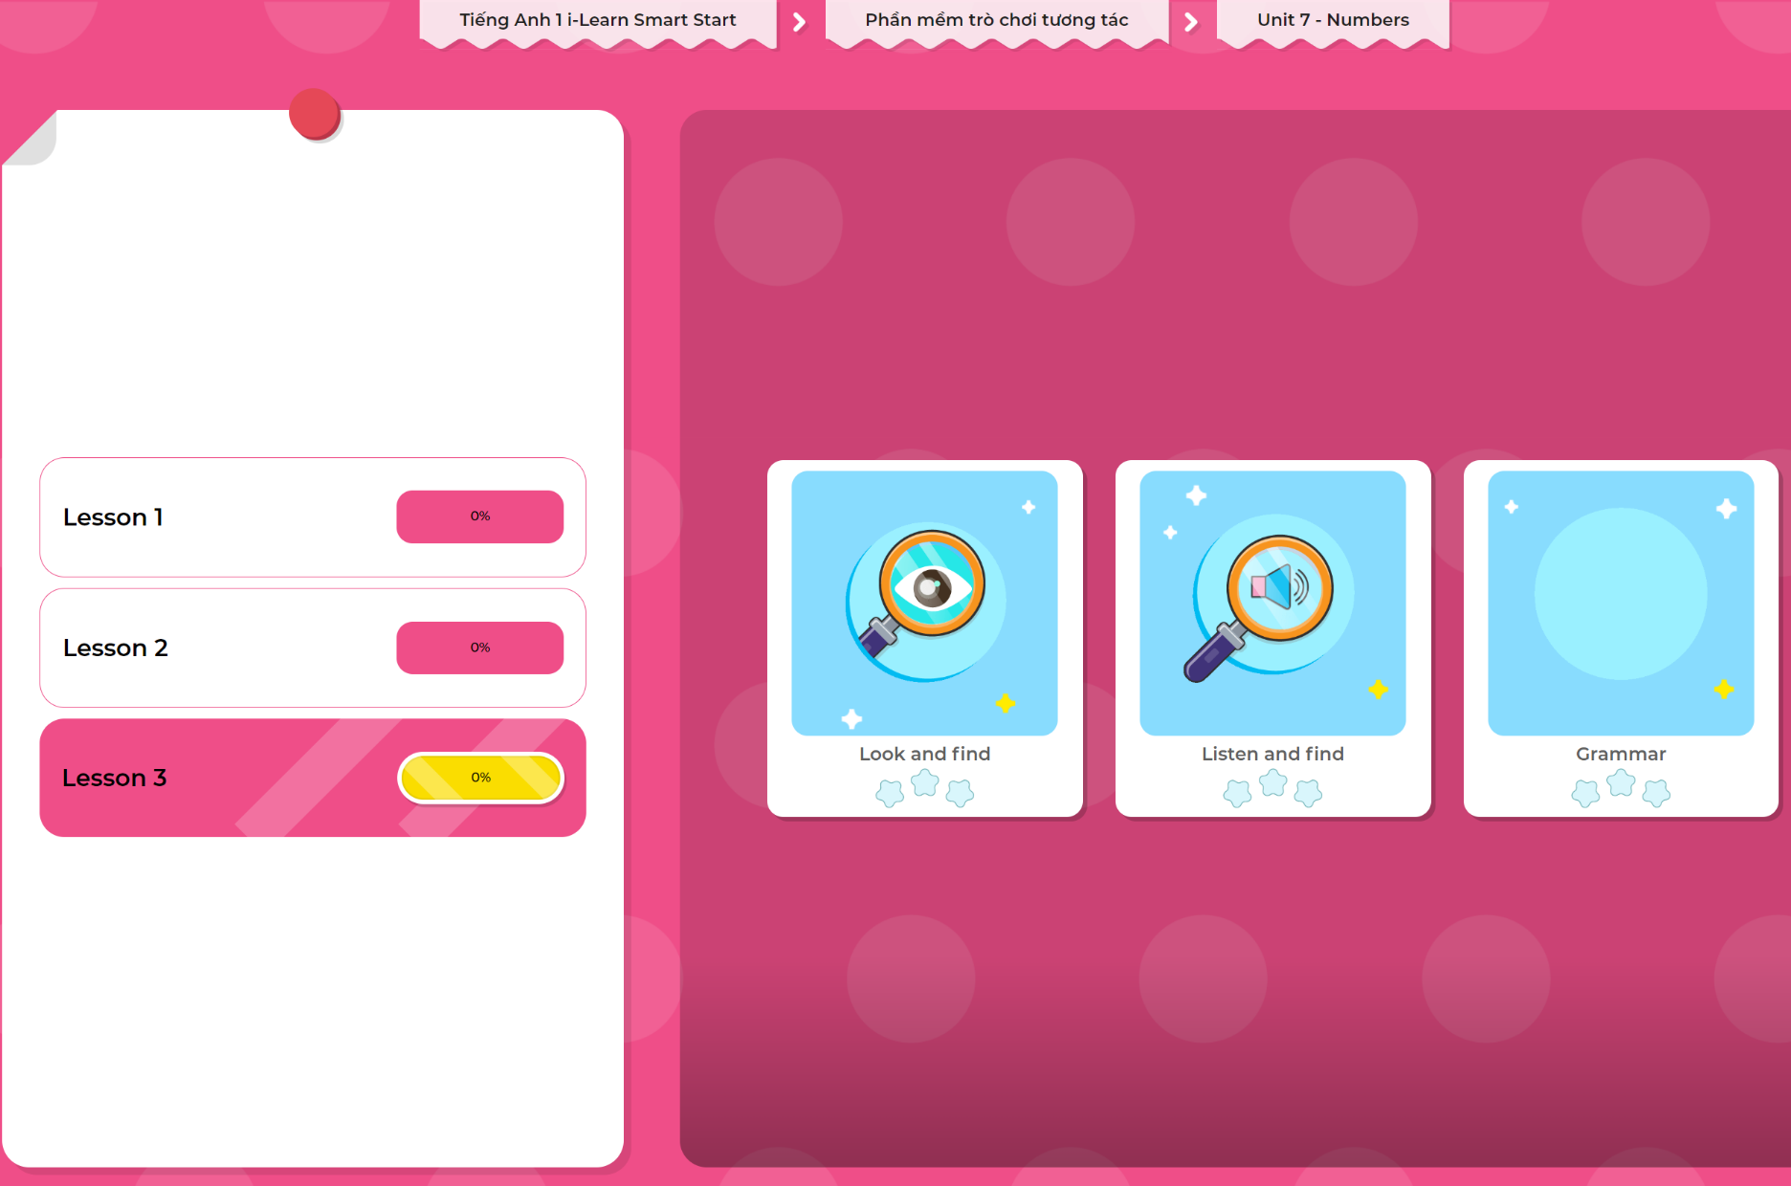
Extra Practice
DHA App
LET’S PLAY!
Click here to play the games

Slide 34

WRAP-UP

Slide 35
Today’s lesson
Structures/ Sentence patterns
“How old are you?”
“I’m (six).”
Vocabulary
Revise

Slide 36
Homework
Practice vocabularies and structure. Make sentences using them.
Practice the vocabulary and structure in Tiếng Anh 1 i-Learn Smart Start Notebook (page 47).
Do the exercises in Tiếng Anh 1 i-Learn Smart Start Workbook (page 47).
Play the consolidation games in Tiếng Anh 1 i-Learn Smart Start DHA App on www.eduhome.com.vn
Prepare the next lesson (page 50).

Slide 37

Enjoy your day!

