Slide 1

Unit 8: Food
Lesson 1.1: Vocabulary & Sentence Patterns
Page: 50

Slide 2
Lesson Outline
Warm-up
Vocabulary
Structure
Practice
Consolidation
Wrap-up

Slide 3
Objectives
By the end of this lesson, students will be able to gain the following:
Vocabulary:
banana, cookie, sandwich
Sentence pattern:
I want a (banana).
Skills:
Talk about food.

Slide 4

WARM UP

Slide 5










Listen and choose
A
B
C

Slide 6
Listen and choose
A
B
C

Slide 7
Listen and choose
A
B
C

Slide 8



Listen and choose
A
B
C

Slide 9



Listen and choose
A
B
C

Slide 10

Listen and choose
A
B
C

Slide 11

It’s time to learn …

Slide 12

New words
banana, cookie, sandwich

Slide 13

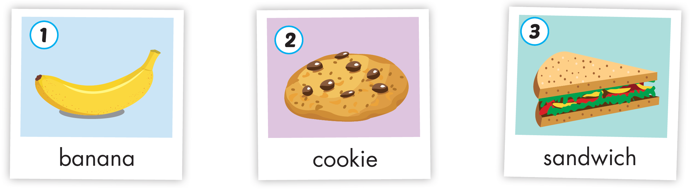
Click the icon to hear the sound
Notes:
Click vào hình A. 1. Listen and point. Repeat để cho cả audio full chạy

Slide 14
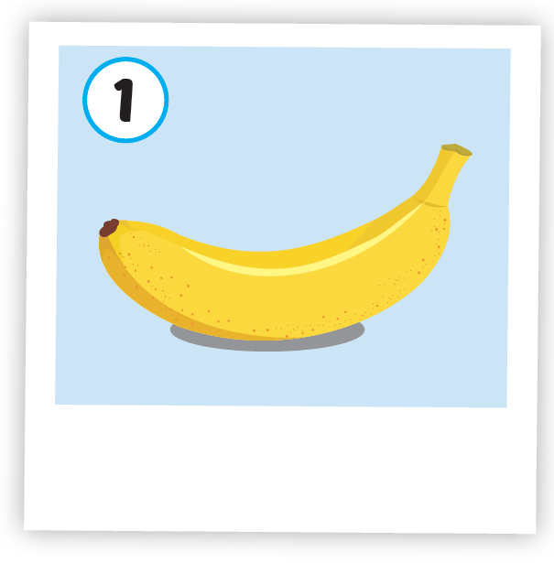
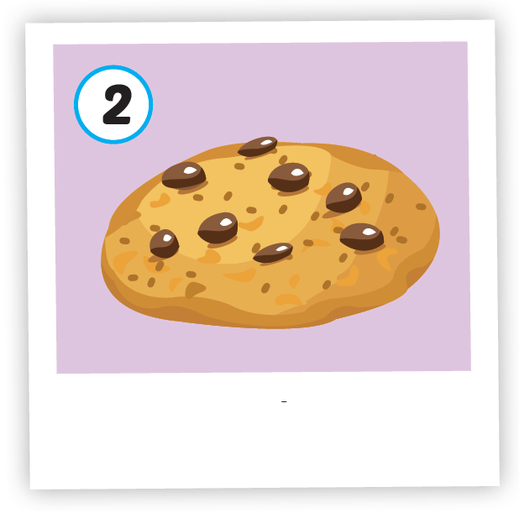
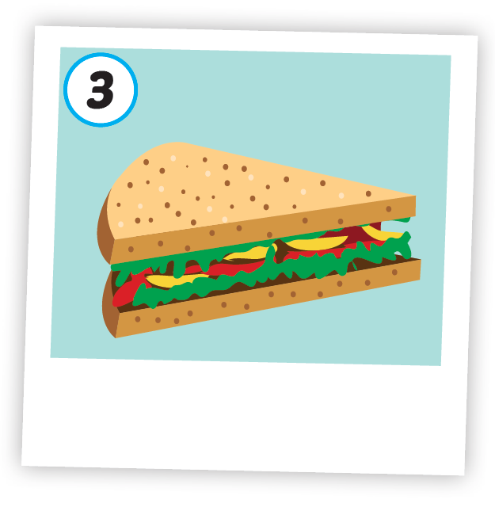



Click each icon to hear the sound
/bəˈnænə/
quả chuối
/ˈkʊki/
bánh quy
/ˈsænwɪtʃ/
bánh mì kẹp

Slide 15

Click the icon to hear the sound
/bəˈnænə/
quả chuối

Slide 16

Click the icon to hear the sound
/ˈkʊki/
bánh quy

Slide 17
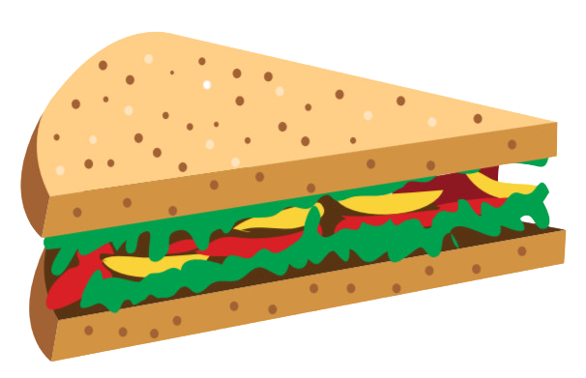
Click the icon to hear the sound
/ˈsænwɪtʃ/
bánh mì kẹp

Slide 18

Structures
I want a banana.

Slide 19

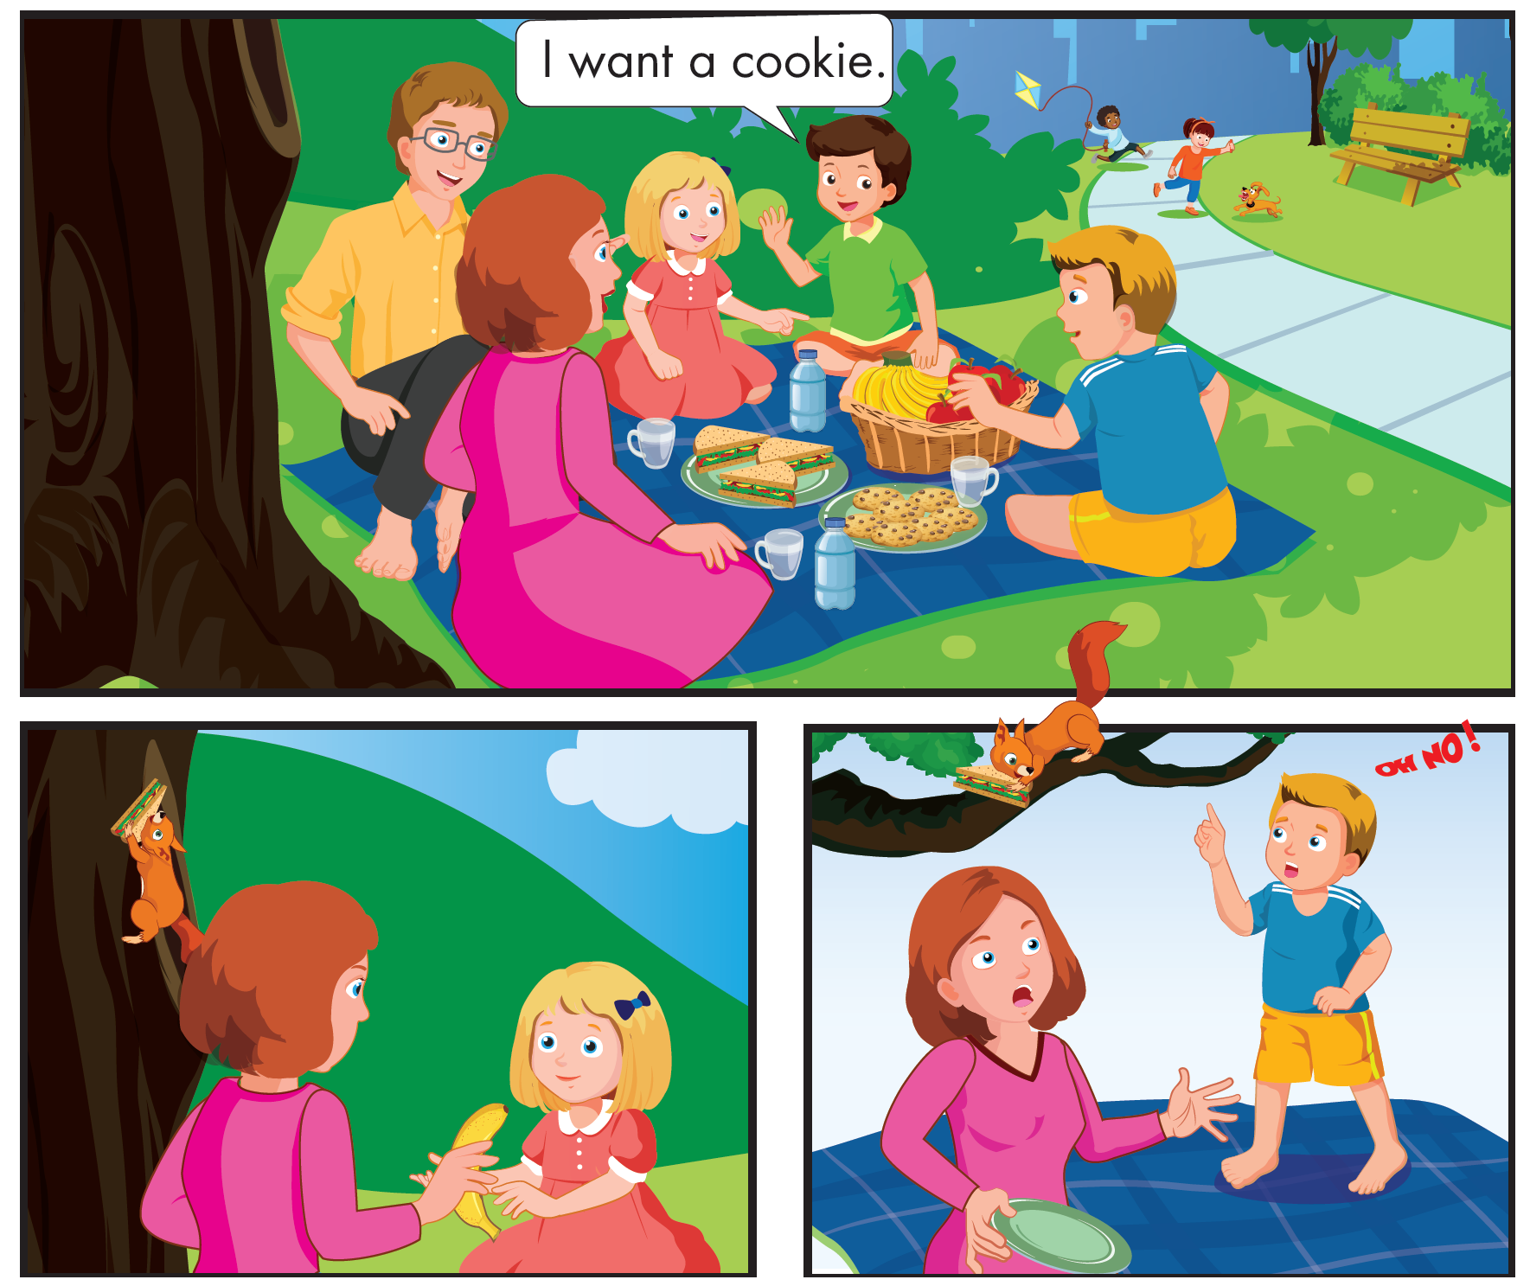
Who are they?
Click the icon to hear the sound

Slide 20
What are they talking about?
Click the icon to hear the sound

Slide 21
Click the icon to hear the sound

Slide 22
It’s time to play …

Slide 23







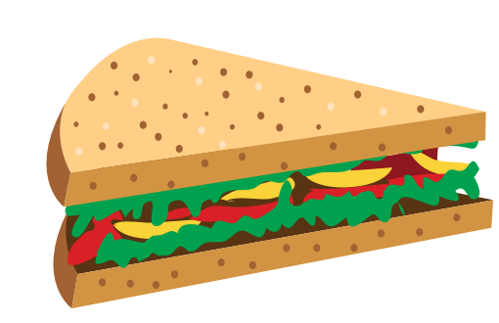


Yeahhh,
That’s right
Huhu,
That is wrong.
Try your best
Look and choose
sanwich
sandwith
sandquich
sandwich

Slide 24


Yeahhh,
That’s right!
Huhu,
That is wrong.
Try your best
Look and choose
banana
bananam
panana
benana

Slide 25


Yeahhh,
That’s right!
Huhu,
That is wrong.
Try your best
.
Look and choose
cooki
cookie
cooky
cookia

Slide 26

Yeahhh,
That’s right
Listen and choose
Huhu,
That is wrong.
Try your best
sandwich
cookie
banana

Slide 27
Yeahhh,
That’s right
Listen and choose
Huhu,
That is wrong.
Try your best
cookie
banana
sandwich

Slide 28

Practice

Slide 29


Click the icon to hear the sound
I want a banana.
I want a banana.
I want a banana.
I want a banana.
I want a cookie.
I want a cookie.
I want a cookie.
I want a cookie.
I want a sandwich.
I want a sandwich.
I want a sandwich.
I want a sandwich.

Slide 30

Further Practice

Slide 31

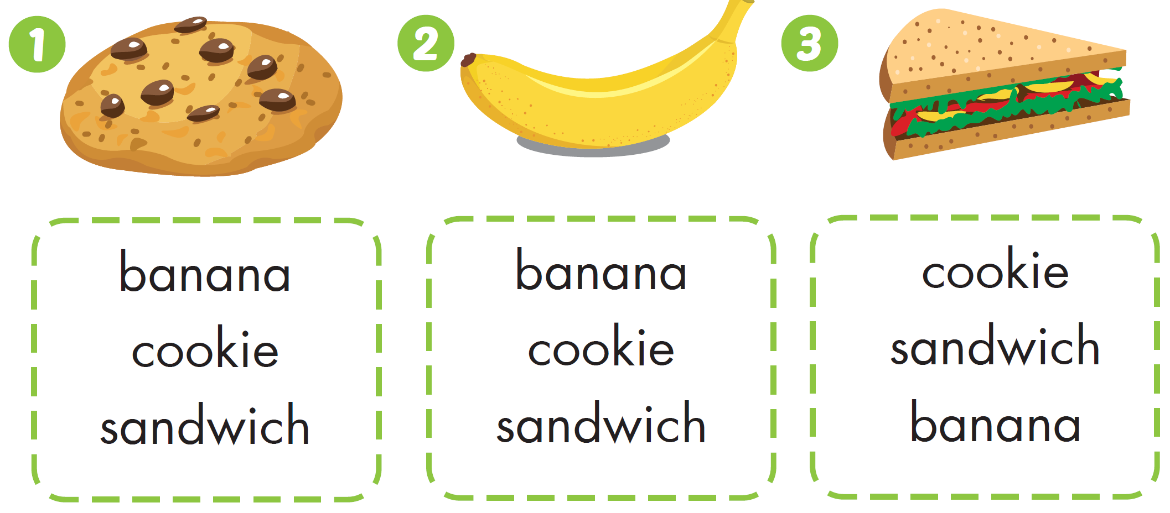

Workbook - Page 48

Slide 32

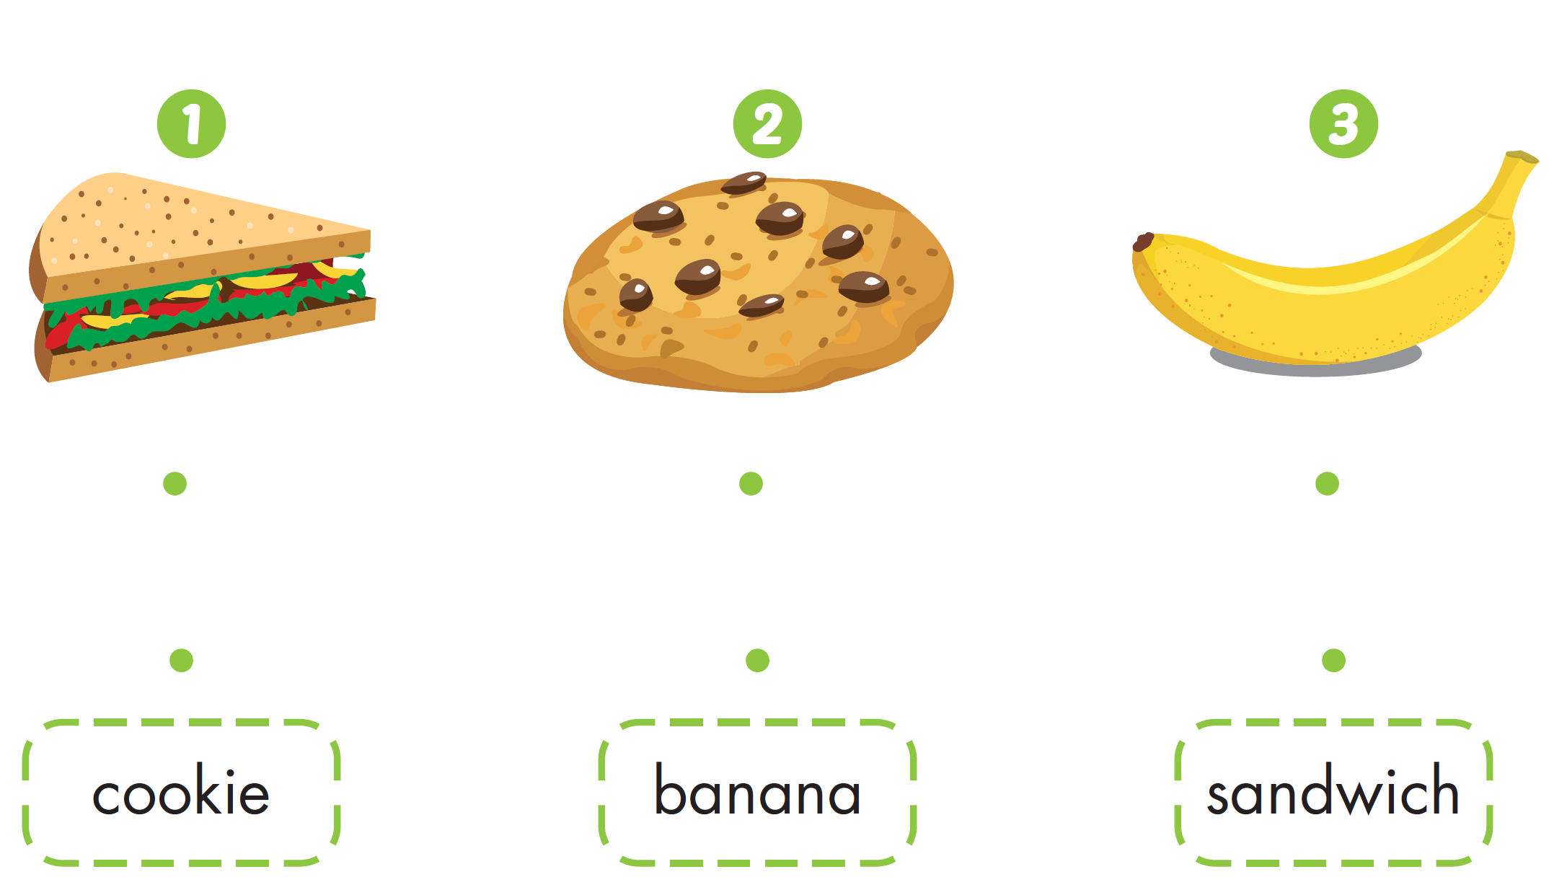
Workbook - Page 48

Slide 33

CONSOLIDATION

Slide 34
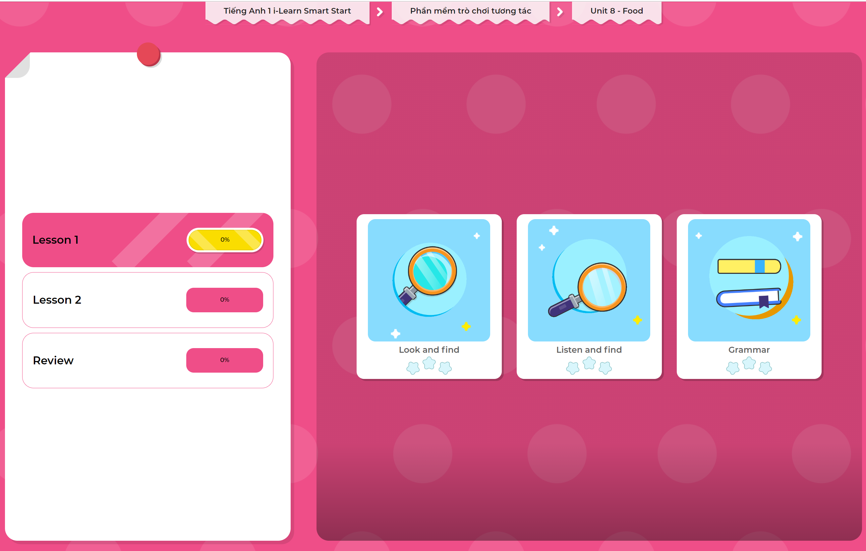
Extra Practice
DHA App
LET’S PLAY!
Click here to play the games

Slide 35

WRAP-UP

Slide 36
Today’s lesson
Structures/ Sentence patterns
I want a (banana).
Vocabulary
banana, cookie, sandwich

Slide 37
Homework
Practice vocabularies and structures. Make sentences using them.
Do the exercises in Tiếng Anh 1 i-Learn Smart Start Notebook (page 48).
Do the exercises in Tiếng Anh 1 i-Learn Smart Start Workbook (page 48).
Play the consolidation games in Tiếng Anh 1 i-Learn Smart Start DHA App on www.eduhome.com.vn
Prepare the next lesson (page 51).

Slide 38

Enjoy your day!

